Slide 1

Welcome to Thermodynamics 2.0!
• Integrate Sciences • Empower Humanity!

Slide 2

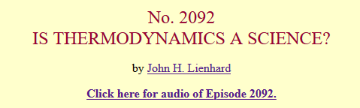

Today, we wonder what makes a science….
https://www.uh.edu/engines/epi2092.htm

Slide 3
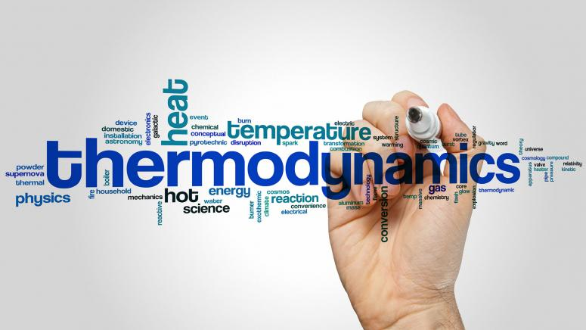
Thermodynamics: if it really is a science?
Source: https://online.stanford.edu/

Slide 4
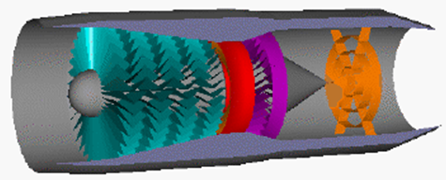
What is Thermodynamics?
Thermodynamics is the study of the effects of work, heat, and energy on a system. Thermodynamics is only concerned with large scale observations.
Zeroth Law: Thermodynamic Equilibrium and Temperature
First Law: Work, Heat, and Energy
Second Law: Entropy
Third Law: Entropy as T → 0 K

Slide 5
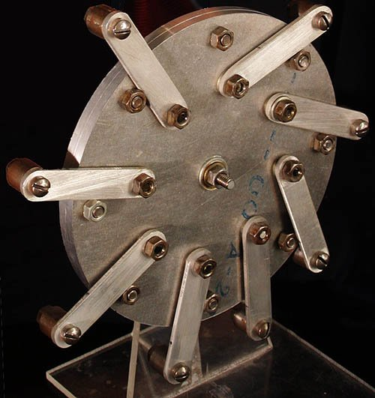
Two primal facts:
Energy is conserved
Everything moves toward more probable (and less orderly) states.

Slide 6
Thermodynamics vs Atomic physics
Maybe thermodynamics is just as basic as atomic physics.
Thermodynamics exists without any reference to atoms.
[Thermodynamics] express general truths that apply to vast aggregates of atoms -- aggregates large enough to be experienced by our human senses.

Slide 7
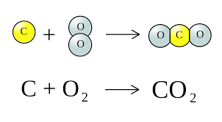
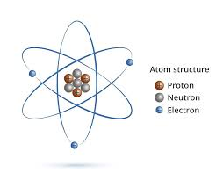
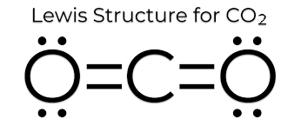
Heating value in terms of atoms

Slide 8


Thermodynamics: An Anthropomorphic Science?
Notes:
https://www.bbc.co.uk/ideas/videos/what-if-everyone-in-the-world-planted-a-tree/p084ttpq

Slide 9
a science of the forest, not just the trees
The sciences of the atomic trees also serve us very well in may arenas, make no mistake.
But they ultimately do so by helping us to better understand the great forest of those things that we can touch and see.

Slide 10
IS THERMODYNAMICS A SCIENCE?
John H. Lienhard
College of Engineering
The University of Houston
we're interested in the way inventive minds work!

Slide 11

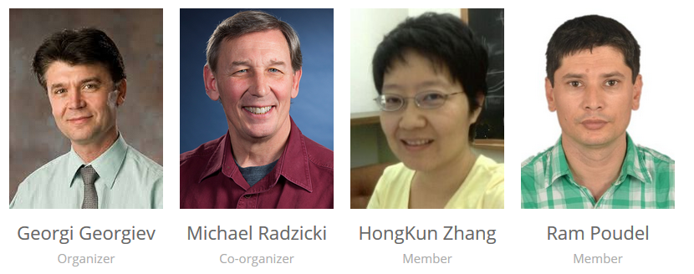
• Integrate Sciences • Empower Humanity!

