Slide 1
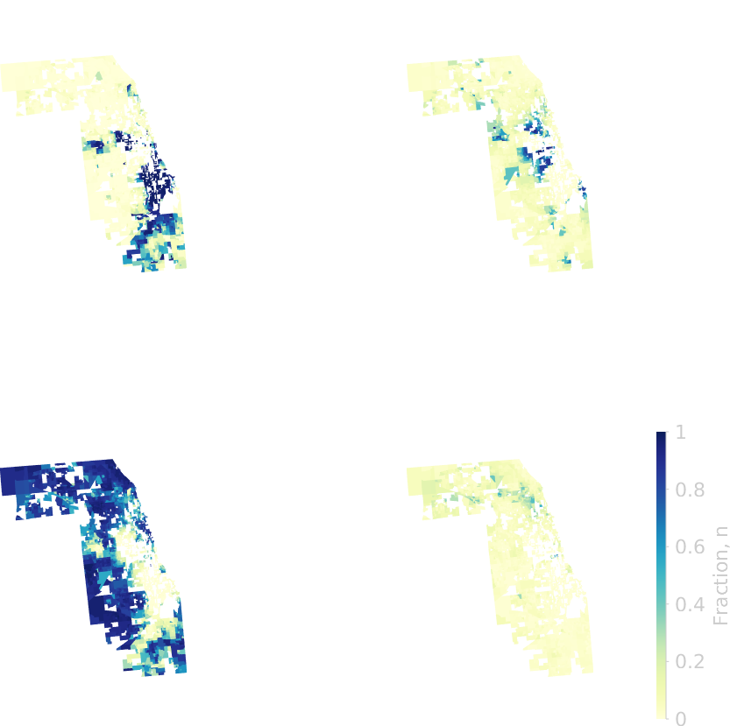
Measuring Segregation and Forecasting Residential Dynamics Using Density Functional Fluctuation Theory
Yunus Kinkhabwala, Matthew Hall, Tomás Arias, Itai Cohen

Slide 2
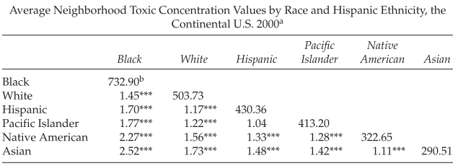
Measuring Segregation and Forecasting Residential Dynamics Using Density Functional Fluctuation Theory
Yunus Kinkhabwala, Matthew Hall, Tomás Arias, Itai Cohen
Pollution
Downey, Liam, and Brian Hawkins. "Race, income, and environmental inequality in the United States." Sociological Perspectives 51, no. 4 (2008): 759-781.

Slide 3
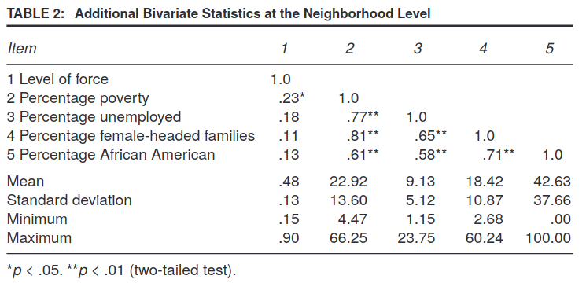
Measuring Segregation and Forecasting Residential Dynamics Using Density Functional Fluctuation Theory
Yunus Kinkhabwala, Matthew Hall, Tomás Arias, Itai Cohen
Use of Police Force
Terrill, William, and Michael D. Reisig. "Neighborhood context and police use of force." Journal of research in crime and delinquency 40, no. 3 (2003): 291-321.

Slide 4
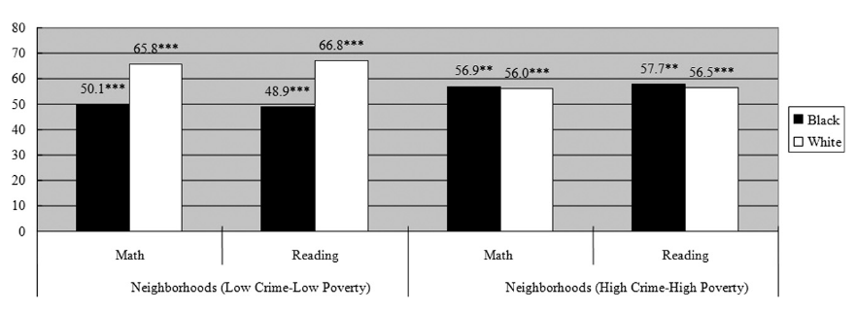
Measuring Segregation and Forecasting Residential Dynamics Using Density Functional Fluctuation Theory
Yunus Kinkhabwala, Matthew Hall, Tomás Arias, Itai Cohen
Education
Lee, Moosung, and Na'im Madyun. "The impact of neighborhood disadvantage on the Black–White achievement gap." Journal of education for students placed at risk 14, no. 2 (2009): 148-169.

Slide 5
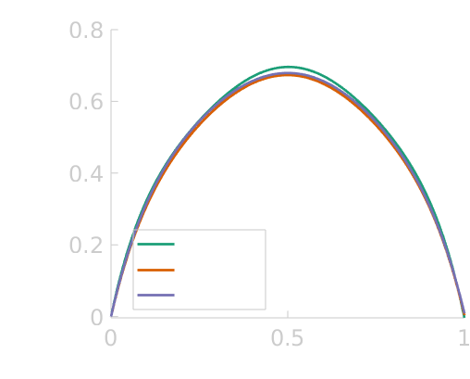
Measuring Segregation and Forecasting Residential Dynamics Using Density Functional Fluctuation Theory
Yunus Kinkhabwala, Matthew Hall, Tomás Arias, Itai Cohen

Slide 6
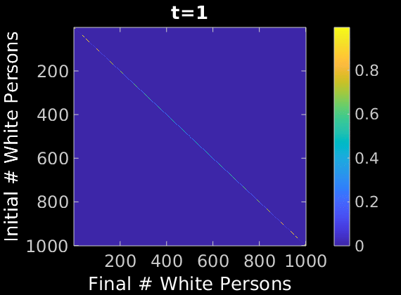
Measuring Segregation and Forecasting Residential Dynamics Using Density Functional Fluctuation Theory
Yunus Kinkhabwala, Matthew Hall, Tomás Arias, Itai Cohen
Probability

Slide 7
Quantifying Segregation

Slide 8
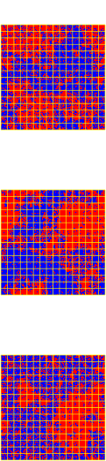
DFFT on simulated data

Slide 9
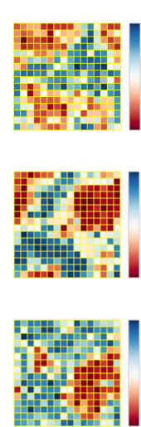
DFFT on simulated data

Slide 10

DFFT on simulated data

Slide 11
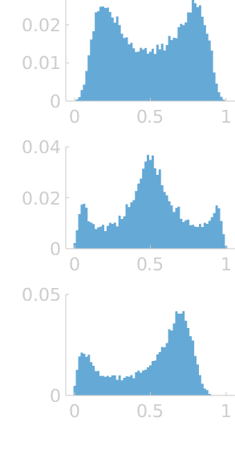
DFFT on simulated data

Slide 12
Desired properties of a functional segregation metric
Sample size invariance
Composition invariance
Interpretable

Slide 13

DFFT Transformation of Probability Distributions
s - > # people in block
H(n) -> Headache function

Slide 14
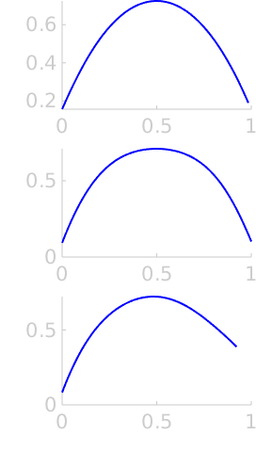
DFFT Transformation of Probability Distributions
s - > # people in block
H(n) -> Headache function

Slide 15
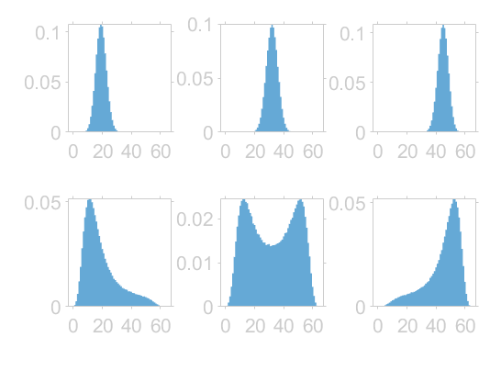
Composition invariance
Random
Segregated

Slide 16
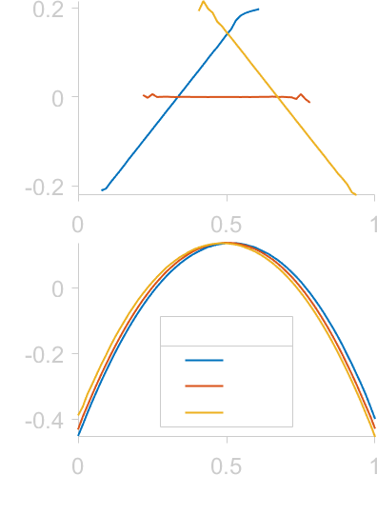
Composition invariance
Random
Segregated

Slide 17
DFFT on simulated data

Slide 18
Analysis of American Census Data

Slide 19

Inferring H function from Census data
Notes:
\color{White}{\underset{H(n)}{\text{max}}\sum_b log(P(n_b|s_b))}\\
\text{where}\:P(n|s)=\binom{s}{ns}e^{-sH(n)}

Slide 20
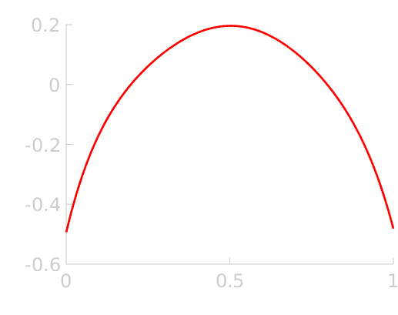
Inferring H function from Census data
Notes:
\color{Black}{\underset{H(n)}{\text{max}}\sum_b log(P(n_b|s_b))}\\
\text{where}\:P(n|s)=\binom{sn}{n}e^{-sH(n)}

Slide 21

Nationwide segregation function:
White/Other, 2000

Slide 22
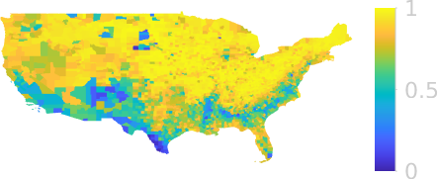

Nationwide segregation function:
White/Other, 2000

Slide 23
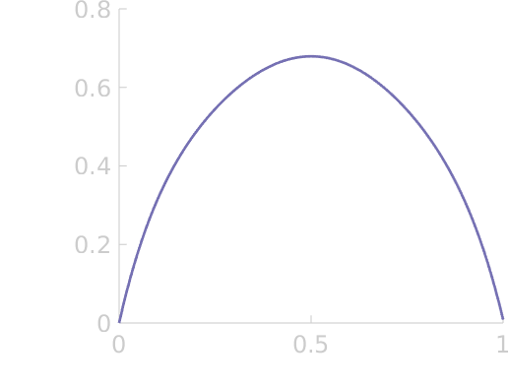
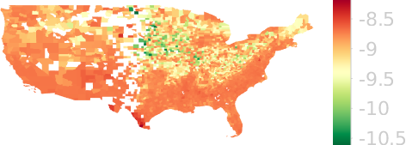

Nationwide segregation function:
White/Other, 2000

Slide 24
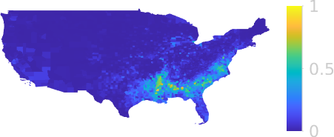
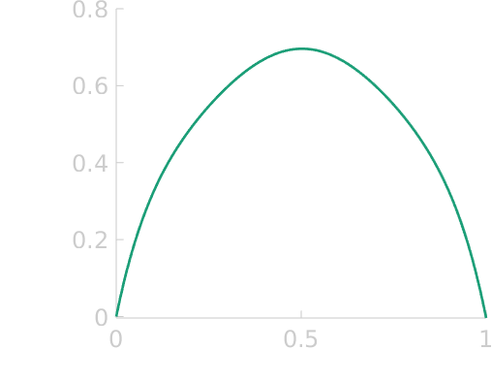
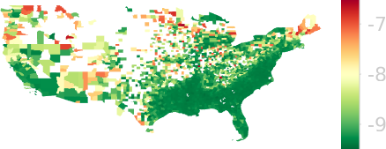
Nationwide segregation function:
Black/Other, 2000

Slide 25
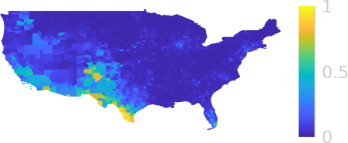
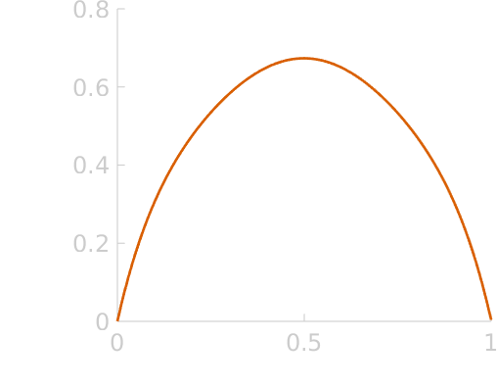
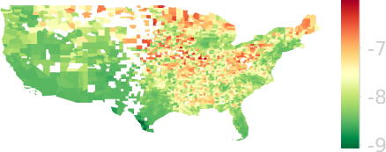
Nationwide segregation function:
Hispanic/Other, 2000

Slide 26
Segregation comparison across races
Degree of Segregation
Hispanic/non-Hispanic
White/non-White
Black/non-Black
Logan, John R. "The persistence of segregation in the 21st century metropolis." City & community 12, no. 2 (2013).

Slide 27
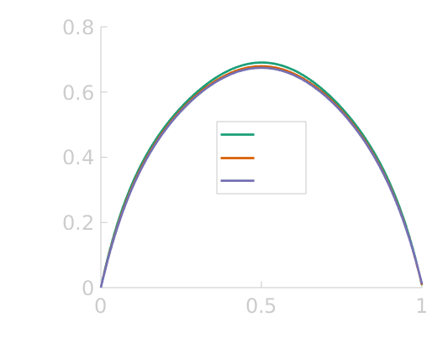
Segregation change from 1990-2010: White
White/non-White segregation has decreased from 1990-2010
Logan, John R. "The persistence of segregation in the 21st century metropolis." City & community 12, no. 2 (2013).

Slide 28
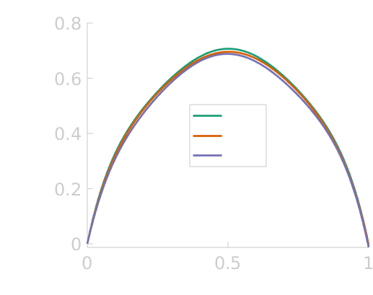
Segregation change from 1990-2010: Black
Black/non-Black segregation has decreased from 1990-2010
Logan, John R. "The persistence of segregation in the 21st century metropolis." City & community 12, no. 2 (2013).

Slide 29
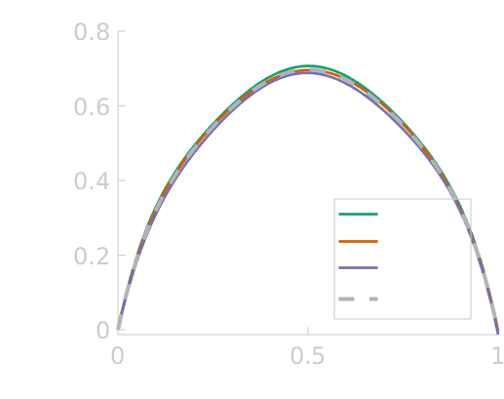
Segregation change from 1990-2010: Black
Black/non-Black segregation has decreased from 1990-2010

Slide 30
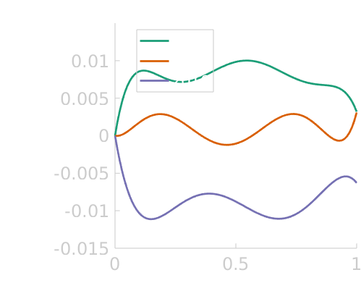
Segregation change from 1990-2010: Black

Slide 31
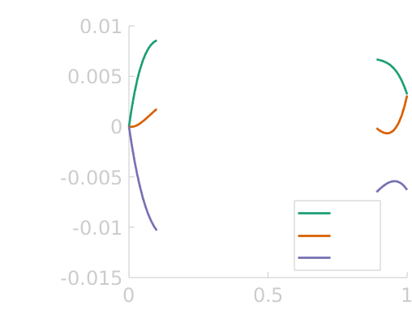
Segregation change from 1990-2010: Black
Black persons became more likely to move into neighborhoods almost entirely occupied by non-Black persons.
Wilson, William Julius. The truly disadvantaged: The inner city, the underclass, and public policy. University of Chicago Press, 2012.

Slide 32
What if we let there be more than one frustration function?
Notes:
\color{White}{\underset{f^i(n),\,V_c,\,\Lambda_c}{\text{max}}\sum_b \delta(i,\Lambda_c)log(P(n_b|c_b,V_c,f^i(n))}

Slide 33

What if we let there be more than one frustration function?
Notes:
\color{White}{\underset{f^i(n),\,V_c,\,\Lambda_c}{\text{max}}\sum_b \delta(i,\Lambda_c)log(P(n_b|c_b,V_c,f^i(n))}

Slide 34
Clustering algorithm
Reassign counties to clusters with greatest likelihood
no
Randomly assign counties to clusters
Each county assigned to cluster with frustration that maximizes likelihood?
Calculate likelihood for counties with each cluster frustration
Calculate cluster-wide frustration
yes
END

Slide 35
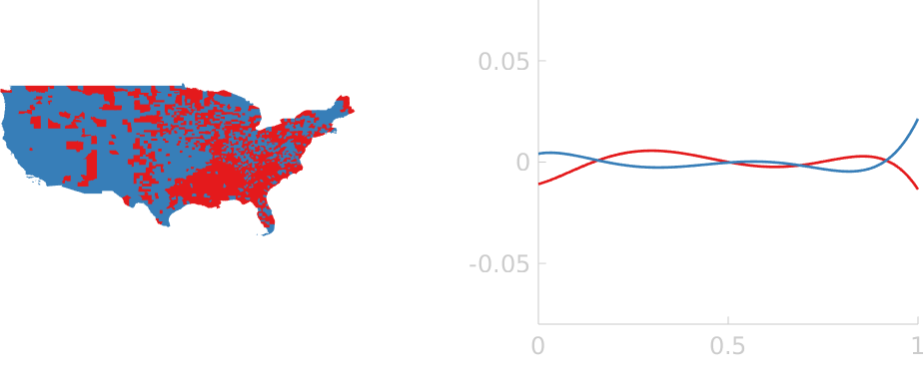
2 Cluster analysis:
White/non-White ‘00

Slide 36
2 Cluster analysis:
White/non-White ‘00
White/non-White segregation is strongest in red counties, mostly due to decreased probability of non-White persons to move into all White neighborhoods.

Slide 37
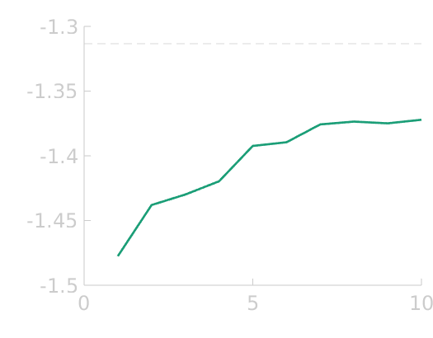
Quality of clustering

Slide 38
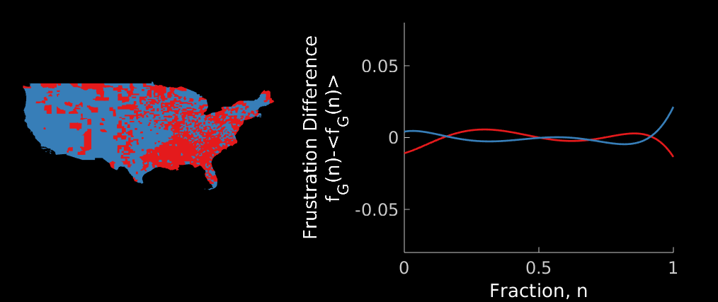
Clustering counties with similar frustrations: White

Slide 39
Forecasting neighborhood scale demographic changes

Slide 40
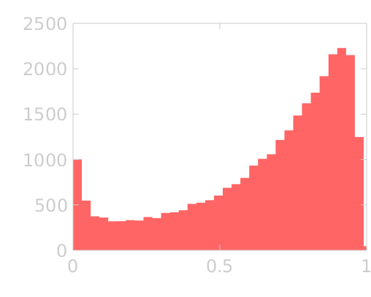
Observed Dynamics on data subset
Data filters
County Fraction:
50%-70% White
Blockgroup size:
700-1300 Total persons

Slide 41
Observed Dynamics on data subset
Data filters
County Fraction:
50%-70% White
Blockgroup size:
700-1300 Total persons

Slide 42
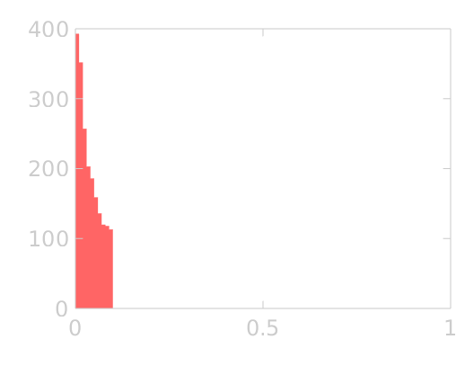
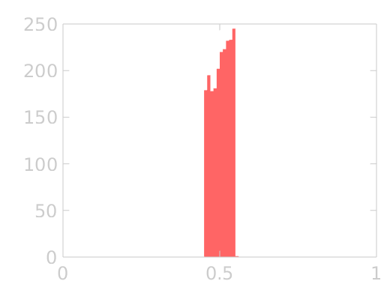
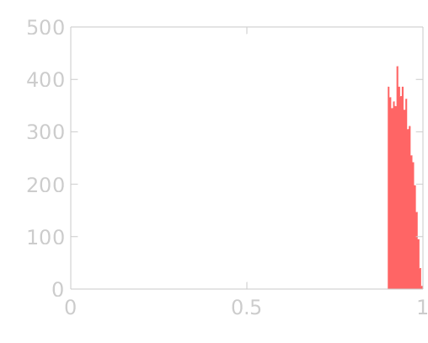
Observed Dynamics on data subset

Slide 43
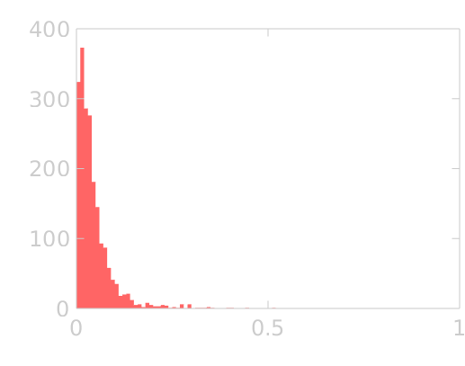
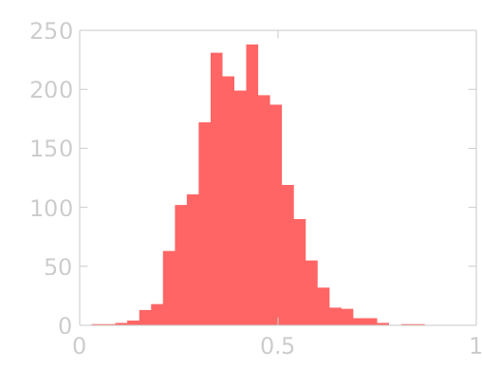
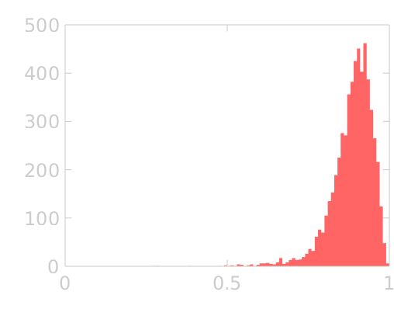
Observed Dynamics on data subset

Slide 44
Simulating dynamics

Slide 45
Simulating dynamics

Slide 46
Simulating dynamics
?

Slide 47

Simulating dynamics
?
Notes:
{\color{White} {P(R\rightarrow B)=\frac{1}{1+e^{H(n_f)-H(n_i)}}}}

Slide 48
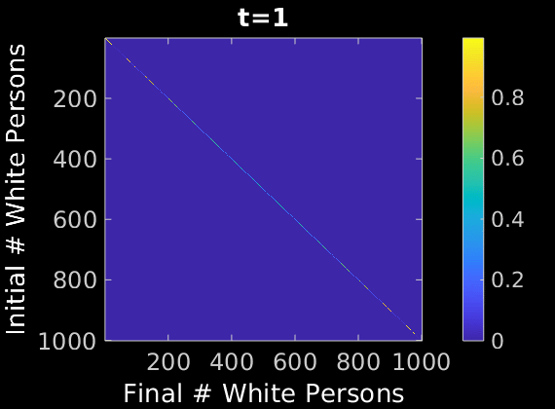
Simulating dynamic approach to steady state distribution
Probability

Slide 49
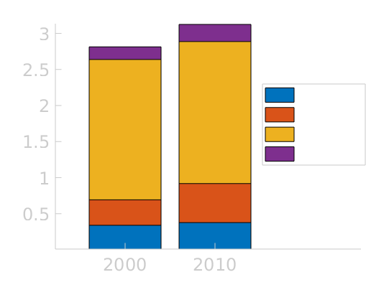
Nationwide demographic change
Hispanic growth
+15 million
Other growth
+12 million
White % Change
-5.4%

Slide 50

Accounting for nationwide change in fraction
Probability
Notes:
{\color{White} {P(R\rightarrow B)=\frac{1}{1+e^{H(n_f)-H(n_i)+\color{Yellow}{\Delta V}}}}}

Slide 51
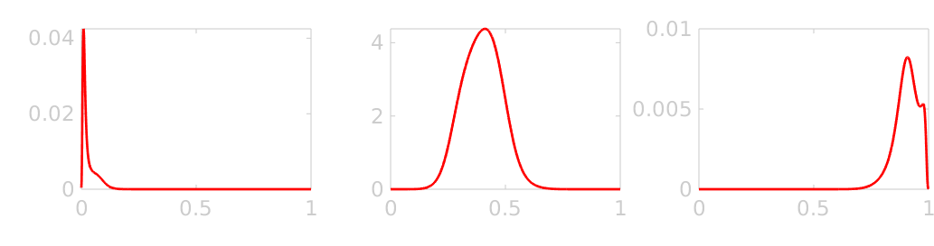
Time scale matching
Observed
Forecasted

Slide 52
Overview

Slide 53
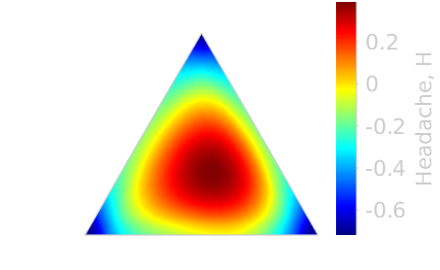
Overview
Multigroup Analysis

