Slide 1
THERMODYNAMICS, ECONOMIC EVOLUTION AND GROWTH OF INFORMATION:
THE PERSPECTIVE OF PEIRCEAN SEMIOTICS
Carsten Herrmann-Pillath
Professor and Permanent Fellow
Max Weber Centre for Advanced Cultural and Social Studies
carsten.herrmann-pillath@uni-erfurt.de
cahepil.net
Presented at:
International Conference on Thermodynamics 2.0
June 22-24, 2020 | Worcester, MA, USA

Slide 2
Core claims
The integration of thermodynamics and economics does not yet include a thermodynamic concept of information (pace Ayres)
Reason: Focus on Shannon information and struggling with semantic information
My proposal I: Building the semantics of information on Peirce’s theory of signs (semiotics) (seminal: Short)
My proposal II: Broadening the scope of physical causes beyond efficient causes (formal and final causality) (seminal: Deacon)
My proposal III: Bridging to thermodynamics via Maximum Entropy, both as a formalism of inference and a physical theory (seminal: Salthe)
Application: Design in technological evolution

Slide 3
Maxwell‘s demon, 2.0
Maxwell’s demon as analytical parable for building the bridge between thermodynamics and economics
Step 1: Taking stock of the long century of debating the demon: No information processing without energy throughputs, validity of Second Law for assemblages of demon, gas and devices for storing information
Step 2: Interpreting measurement as sign: semiotic triad as unit of semantic information
Step 3: Conceiving the demon as ‘autonomous agent’ (Kauffman): Work generated by emerging heat gradient is consumed by the demon
Step 4: Considering a population of demons competing over energy inputs to reproduce by means of economizing over measurement devices

Slide 4
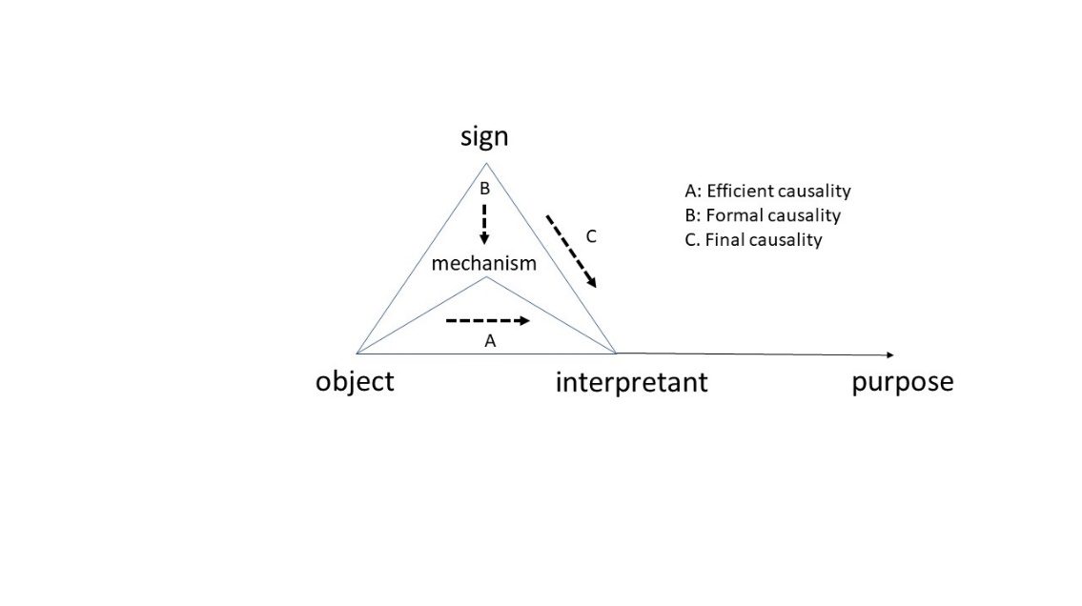
Semiotic triad, basics

Slide 5
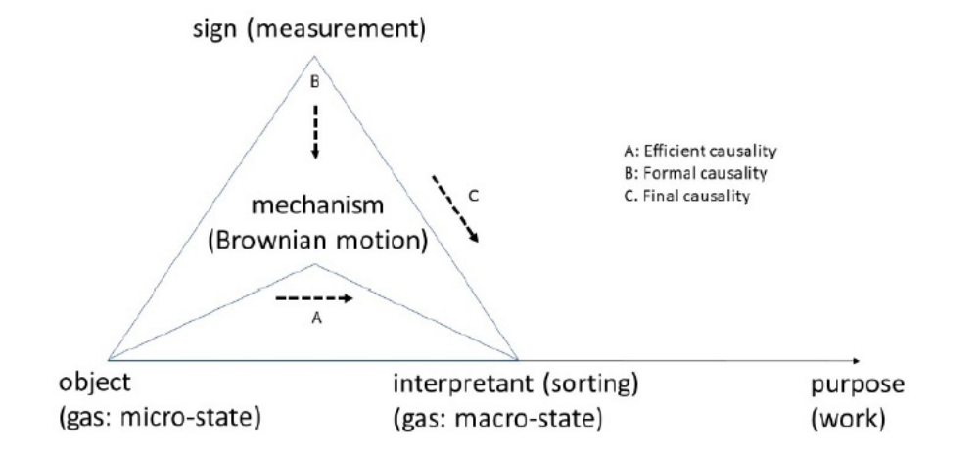
Semiotic triad, demon

Slide 6
Enter Maximum Entropy
The demon as autonomous agent: Designs measurement procedures and separation devices to maximize output of useful work
Thermodynamic cycles of sorting, generation of work and resorting, correspond to cycles of information generation (measurement), information compression (transition to macro-state information) and information loss (obsolescence and erasure)
Consider populations of agents competing over energy feeds to sustain their cycles: Lotka‘s theorem applies (Maximum power production, MPP)
Maximum entropy: Demons will resort to MaxEnt as efficient measurement/inference procedure; via MPP, this results in Maximum Entropy Production (MEP)

Slide 7
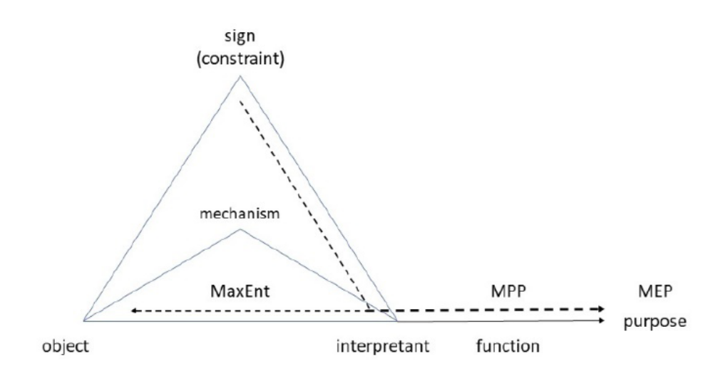
MEPping semiosis

Slide 8
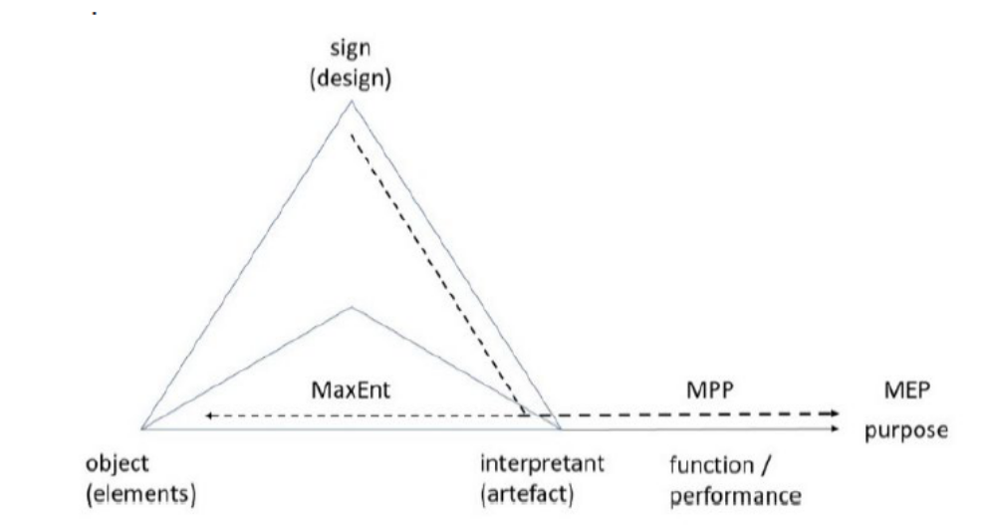
Techno-semiosis
Design mediates object (physical mechanisms) and uses of artefacts that fulfil functional needs
Hypothesis: The evolution of designs follows MPP as function and MEP as ultimate cause (purpose)

Slide 9
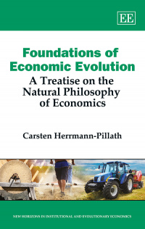
Conclusion
Semiosis aka semiotic triad is the basic unit of semantic information in economic evolution, embodied in design
The evolution of designs obeys to MPP and MEP
Hence, the thermodynamics of growth is NOT about constraints on growth (Georgescu-Roegen and after), but growth realizes MPP and MEP via the growth of information
Important policy implication: No greening of the economy by ICT / AI!

