Slide 1

Torricelli-Style Social Barometer
A Theoretical
To Measure Social Pressure
Libb Thims
Thermodynamics 2.0 Conference
Tue, 11:25 AM (ETD), 23 Jun 2020

Slide 2
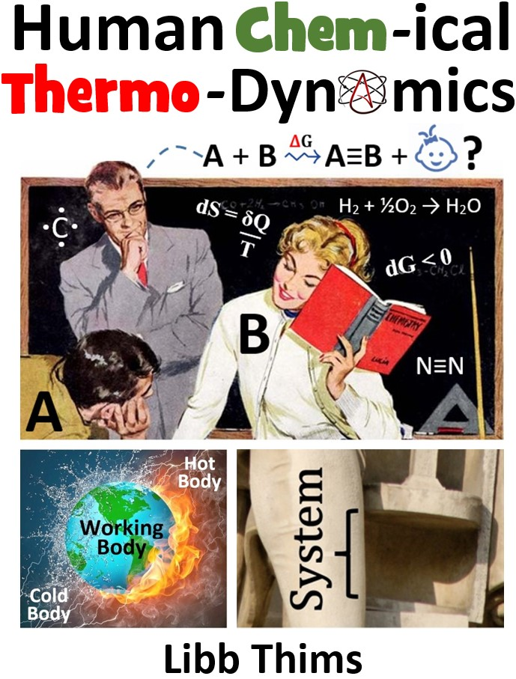
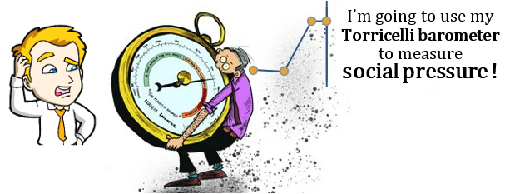
Origin | 2019
The idea of this talk originated in the chapter “Torricelli Vacuum” of 2019 draft version of the author’s Human Chemical Thermodynamics.

Slide 3

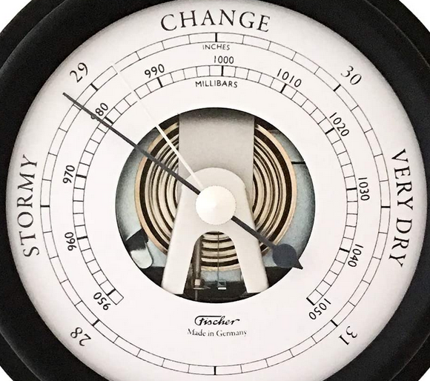


Barometer
(Fischer, $109 USD, Amz)

Slide 4
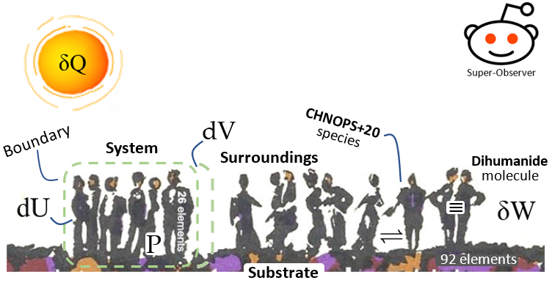
Social System

Slide 5
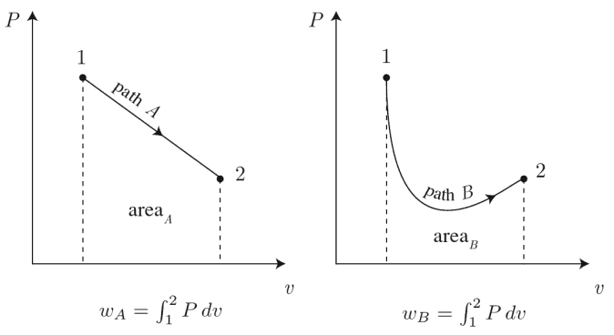
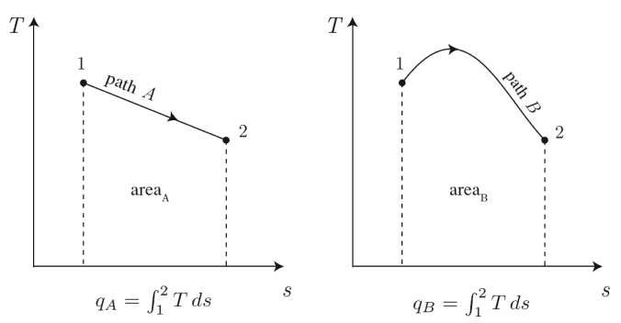
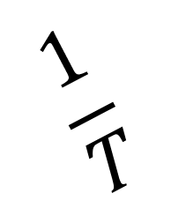
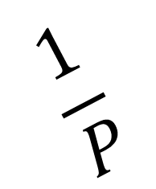
Work
δW = PdV
Heat
δQ = TdS
$$\frac{1}{P}$$
$$\frac{1}{T}$$
Integrating
factor
Integrating
factor
(Clapeyron, 1834)
(Clausius/Thomson, 1854)

Slide 6

Chemical Thermodynamics | Origin
Horstmann | Oct 1873
August Horstmann declares “maximum entropy”, aka the maximum value of N or the “equivalence value of all uncompensated transformation”, to be the condition of equilibrium, for the problem of chemical dissociation, such as shown below:

Slide 7
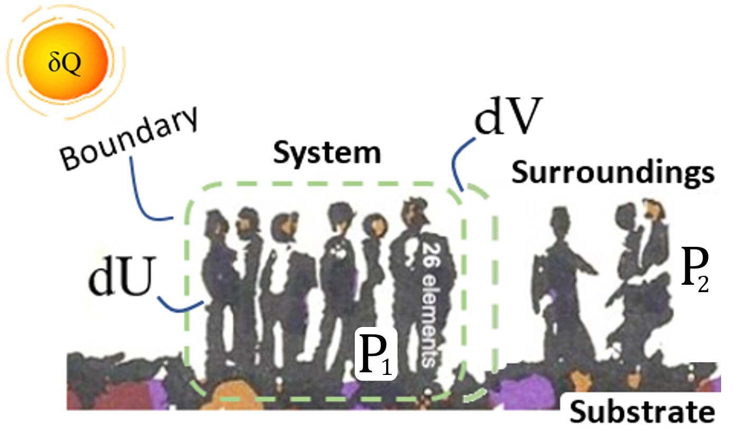

Slide 8
“The deeper the liquid is, the more it will compress the deeper parts; for they are compressed both by the upper parts [vertical pressure] and by those next to them [lateral pressure].”
— Niccolo Tartaglia (c.1545), JordanuS

Slide 9
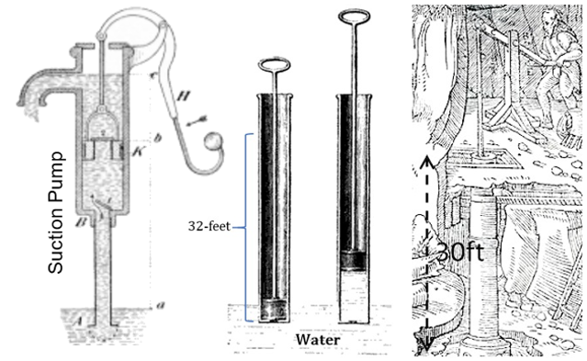
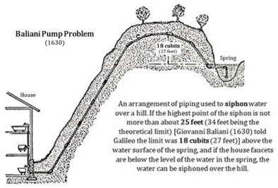
Pump Problem
In 1630, Giovanni Baliani, a physicist and experimenter, queried Galileo why syphon pumps stopped working at a pumping height of 30ft?

Slide 10
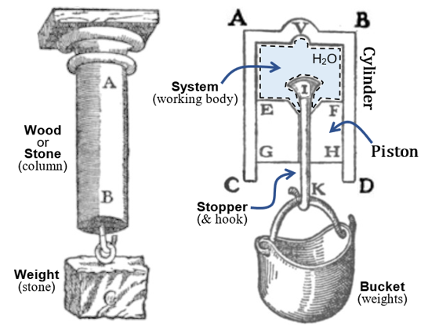
Vacuum Measuring Device
In 1632, Galileo, in his Dialogue Concerning the Two New Sciences, posited that we could use the following theoretical device to measure the vacuum?

Slide 11
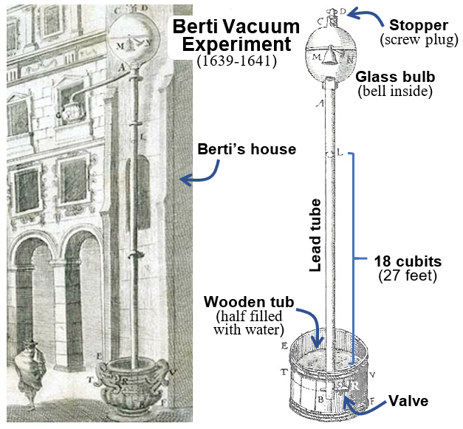
Berti Water Column Experiment
In 1639, Gasparo Berti, having read Galileo’s Dialogue Concerning the Two New Sciences, decided to build a device to test Galileo’s water column rope breaking model?

Slide 12
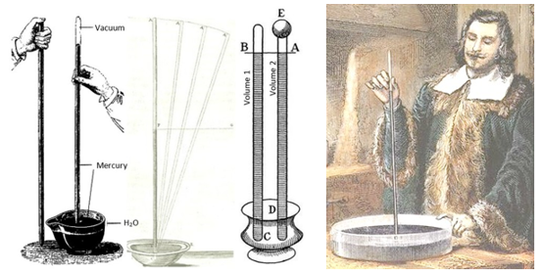
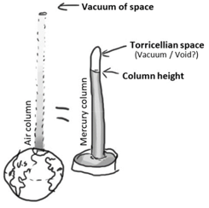
Torricelli Mercury Column Experiment
In 1643, Evangelista Torricelli, working with Vincenzo Viviani, both students of Galileo, repeated the Berti experiment using mercury instead of water?

Slide 13
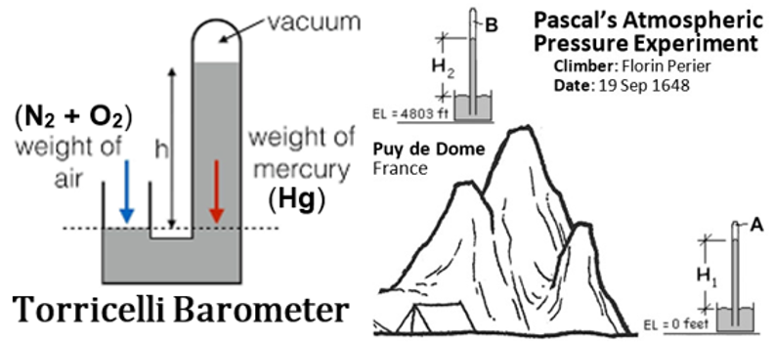
Pascal | Atmospheric Pressure Experiment
In 1648, Blaise Pascal had his brother-in-law carry a mercury barometer to the top of Puy de Dome, recording the changes in mercury column height along the way, finding that the column height fell during the ascent:

Slide 14
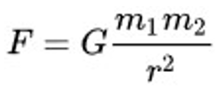
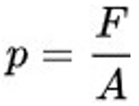
Newton | Force
Bernoulli | Pressure
In 1686, Isaac Newton established the gravitational force of attraction between two bodies, varies as the product of their masses and the inverse radius of separation squared:
In 1738, Daniel Bernoulli established that pressure is force per unit area, measured at the surface of interaction:
wherein m₁ one is the mass of the earth, and m₂ is the mass of either the gas molecule (N₂ or O₂) or mercury molecule (Hg).

Slide 15
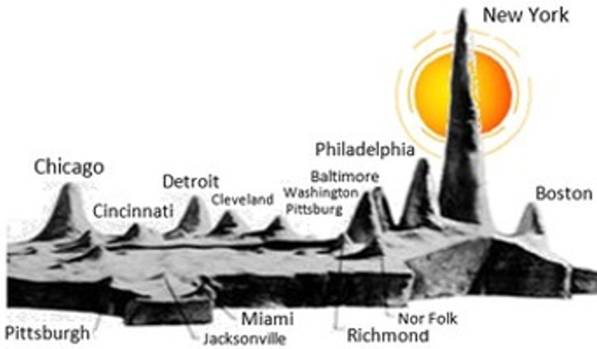
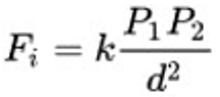
Warntz | Social Force
In 1950s, William Warntz, of the Princeton social physics school, established that the force F_{i} of attraction between two social bodies, varies as the product of their masses and the inverse distance d of separation squared:
wherein P₁ and P₂ are populations of given cities, e.g. New York and Chicago, and k is a social gravitation constant.

Slide 16
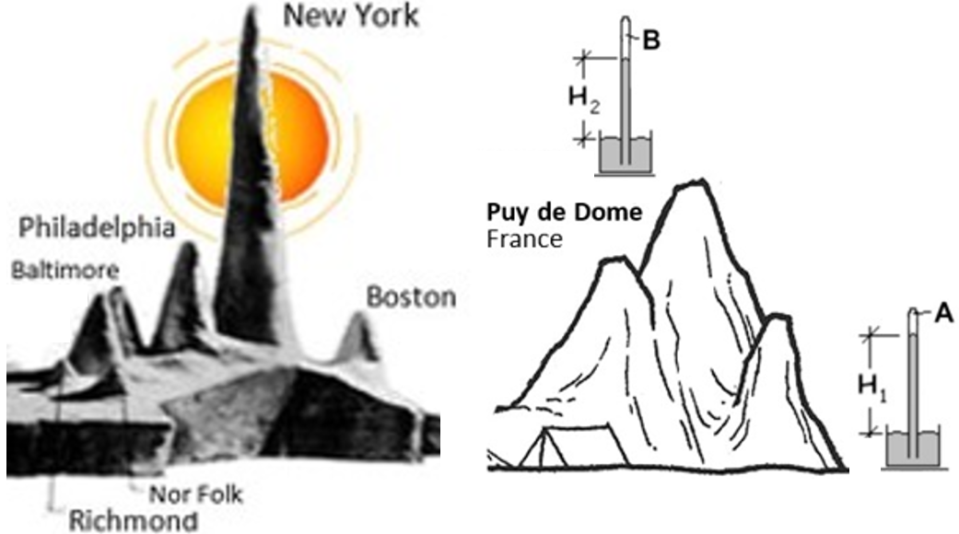
Thims | Social Pressure Experiment
In 2019, the author gleaned the thought experiment that if one could make a ‘social barometer’, that could be moved into or out of Warntz-conceptualized social mountains,
the ‘social mountain’ of New York, considered as the base of Puy de Dome, and an outlying city, e.g. Richmond, thought of as the top of Puy de Dome, then social pressure could be quantified.

Slide 17

Thims | Social Barometer Experiment
With the following in mind, left showing a backed double-decker bus, in Hong Kong (or India), as compared to an empty double decker-bus:

Slide 18
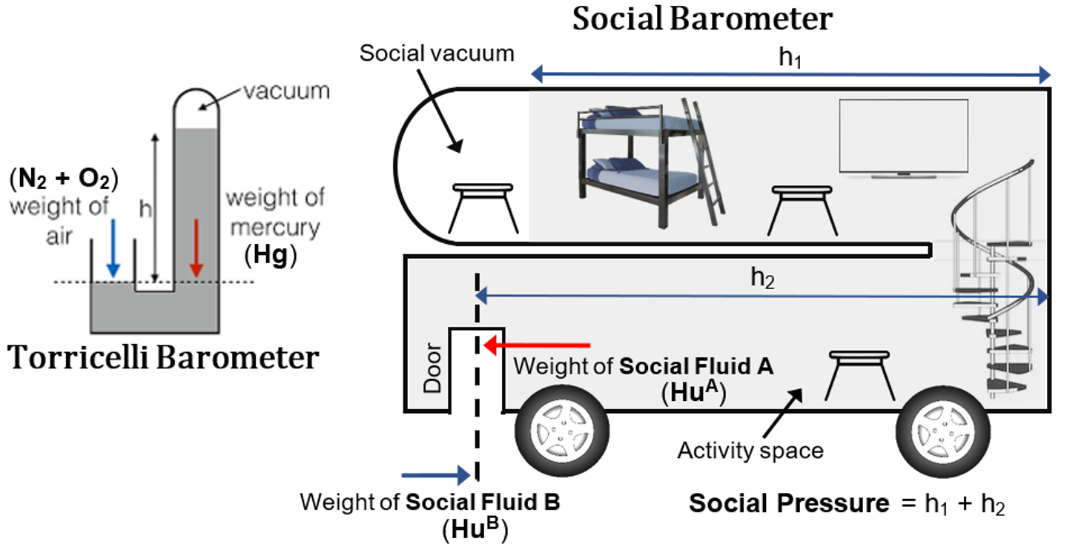
Social Barometer | Experiment

Slide 19
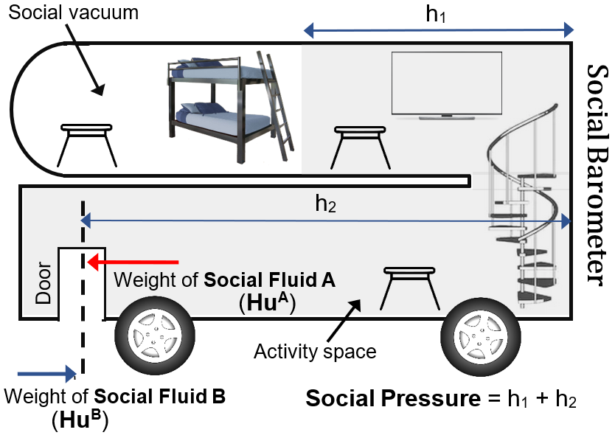

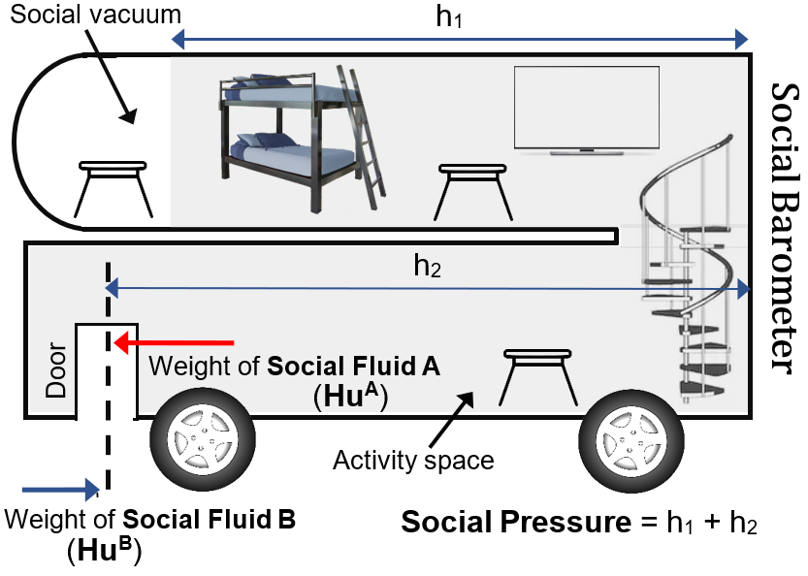
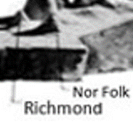
Social Barometer | Prediction
Prediction: in Big Cities, the social vacuum, or ‘Torricelli’ space, should be smaller (social mercury height more); in Small Cities, the social vacuum should be larger (social mercury height less).
Big Cities
Small Cities

Slide 20
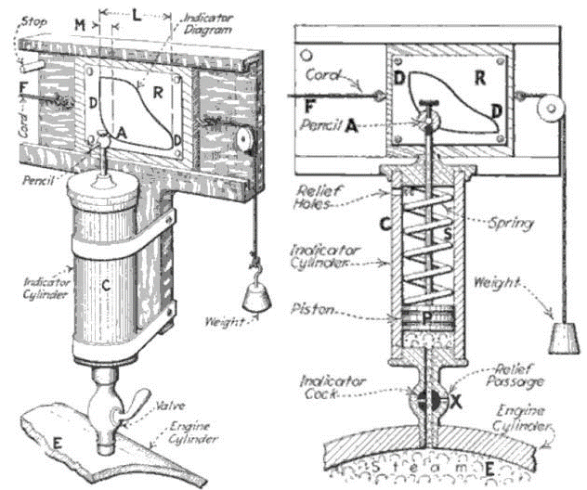
Social Barometer | High Pressures
Note: when we get to higher social pressures, e.g. during civil war, or other similar explosive situations, the inquisitive thinker will have to invent new instruments, akin to the Watt spring loaded steam pressure gauge, shown on the Watt-Southern indicator diagram, which is the origin of the PV-diagram of thermodynamics.

