Slide 1
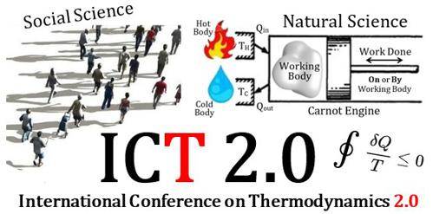
Historical Attempts to Bridge the Two cultures: Natural Sciences + Social Sciences
Libb Thims
22-24 Jun 2020

Slide 2

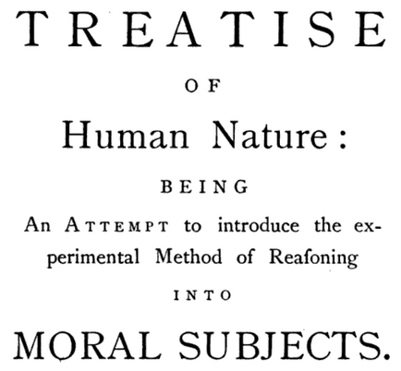
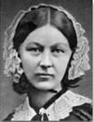

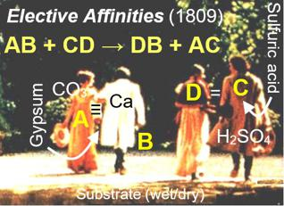
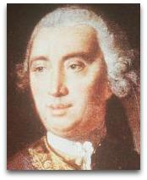

TWO CULTURES T I M E L I N E
Florence Nightingale proposes a Chair of Social Physics to be established at Oxford University, based on the ‘social physics’ of Quetelet
Goethe pens Elective Affinities, introducing ‘human chemical theory’ of social interaction
Adolphe Quetelet
Human Physics
1822
1882
1739
1809
1835
1874-1891
David Hume
Science of Man
Helmholtz proves that ‘free energy’ G is the measure of chemical affinity A.
Auguste Comte
Social Physics

Slide 3
Oxford Social Physics | Applications
● The effects of schooling, secondary, night schools, and other state-funded schools?
● The results of legal punishments in actually deterring crime?
● Does education decrease crime?
● The effects of charity and workhouses?
— Florence Nightingale (1876), discussion with Benjamin Jowett

Slide 4
Oxford Social Physics | Outcome
“Quetelet’s ‘social physics’ should become a course at Oxford, upon which alone social and political philosophy, administrative, legislative, theodike, and all the government can be founded.”
  — Florence Nightingale (1874), “Memoriam on the passing of Quetelet”, Feb 21
“I’ll leave money in my will for the chair, and it should be named after your father.”
— Benjamin Jowett (1876)
“The government ought to do it.”
  Alfred Marshall (1891)
End: Nightingale (1891), in her discussions with Galton, offered to give £2,000 pounds [100,000 USD / modern]. Galton, however, was only prepared to use the money on a few essays, and Nightingale withdrew her offer. The project stalled out after this point.

Slide 5

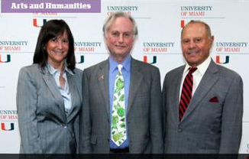
Modern University Chair| Price?
2.2M USD donation, by Louis Appignani (2016), above right, established a Chair in Atheism, Humanism, and Secular Ethics at Miami University.

Slide 6
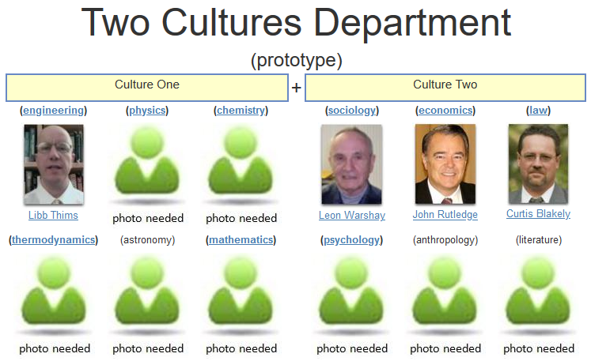



Physico-chemical Humanities Chair
(2013 Prototype)

Slide 7
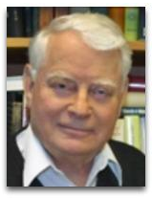
Physico-chemical Humanities Chair
“Your idea for a department for teaching two cultures would NOT be appreciated at Berkeley.
In the social sciences and in some humanities, thermodynamics may be useful as an analogy, as a suggestion for looking at a problem (e.g. information theory) but beyond that, I see little use of thermodynamics outside [physical] science.”
— Reply (2013) to Thims’ two cultures query
John Prausnitz
● Chemical thermodynamics historian
● UC Berkeley Chemical Engineering Professor
● NAS member

Slide 8
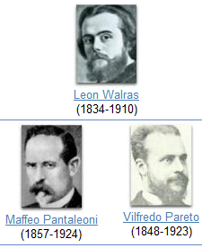
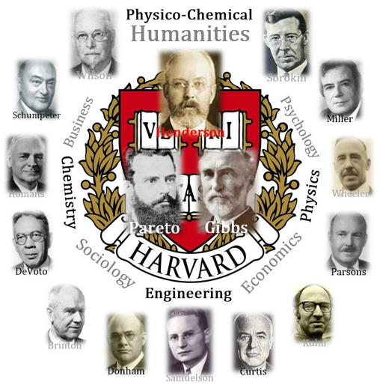
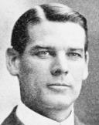

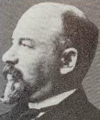

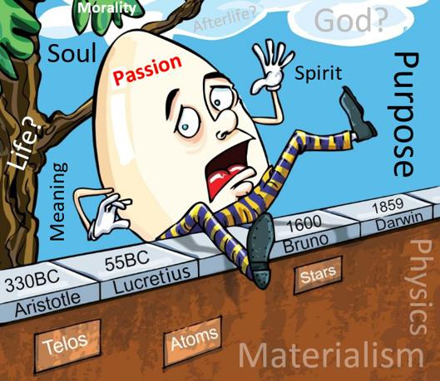

TWO CULTURES T I M E L I N E
Leon Winiarski
Taught pure and applied political economics and social mechanics at the University of Geneva, based on the Clausius inequality.
Judson Herrick
Gives his ‘Humpty Dumpty’ speech at the dedication of University of Chicago’s new Social Science Research building.
1854-1946
1902
1932-1942
1894-1900
1930
Lawrence Henderson
Unifies Darwin, Gibbs, and Pareto, to initiate the ‘Harvard Pareto Circle’ and teach Gibbs-based ‘Sociology 23’ course at Harvard.
Auguste Walrus
“To create a scientific theory of economics one would need to use differential calculus to derive a ‘science of economic forces, analogous to the science of astronomical forces’.”
Ernest Solvay
Founds Institute of Sociology, aimed at research on ‘social energy’, whose members include: John Dewey, Vilfredo Pareto, Joseph Schumpeter.

Slide 9

Winiarski | Summary
“The energy of social transformation is submitted to the same laws as the energy of the universe. These are the laws of thermodynamics. We can thus represent a primitive horde, as a material system in movement, the driving forces that cause the movement, being hunger and love or attraction.
There is transformation of the energy of the mass social movement in internal energies, psychologies, but there is no gain or loss of energy.
Just as any movement of any mass of the universe is accompanied by production of heat, so to are the masses of biology and society transformed into mental phenomena of different kinds.”
  — Leon Winiarski (1898), “Essay on Social Mechanics: Social Energy and its Measurements”

Slide 10
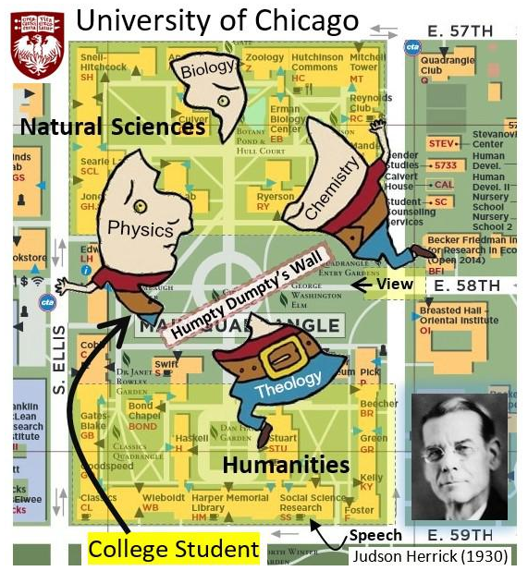
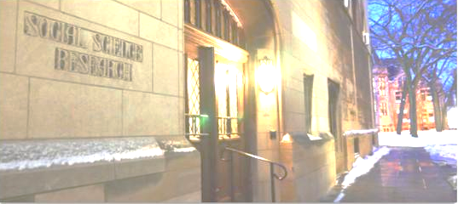
Herrick Humpty Dumpty Speech (1930)
“Humpty Dumpty and His Great Wall: The Scientific Study of Man and the Humanities”
“The Great Wall stands today on [all] our campuses as a barrier between the natural sciences, whose domain is the world of objects, and the humanities, whose domain is the world of [spiritual] values.”

Slide 11
Herrick Humpty Dumpty Speech (1930)
“If these new ‘social sciences’ are to be alive, they must the study of social forces, according to the natural sciences, so to explain, e.g., the motivating forces behind why a child would ‘want to go to school’?”

Slide 12
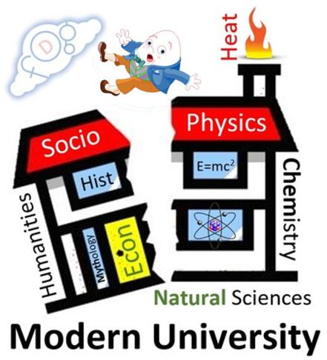
Herrick Humpty Dumpty Speech (1930)
“If the great underlying social forces, are outside the realm of natural law and therefore inaccessible with the technique of natural science, then I affirm that these new ‘social sciences’ are misnamed.
They are pseudosciences, and the whole movement is a stupendous bluff.”

Slide 13
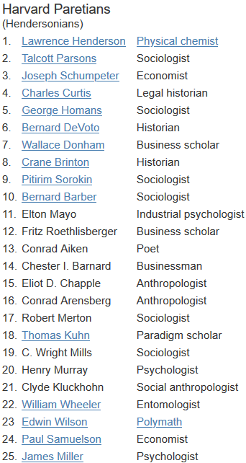
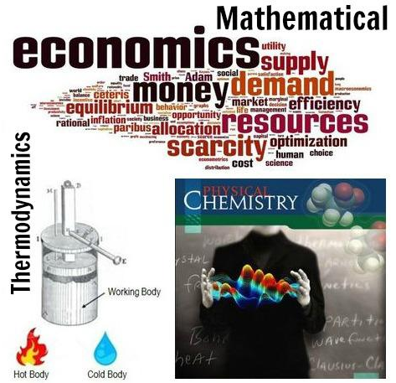
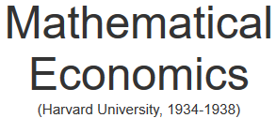

Henderson’s Harvard Pareto Circle

Slide 14
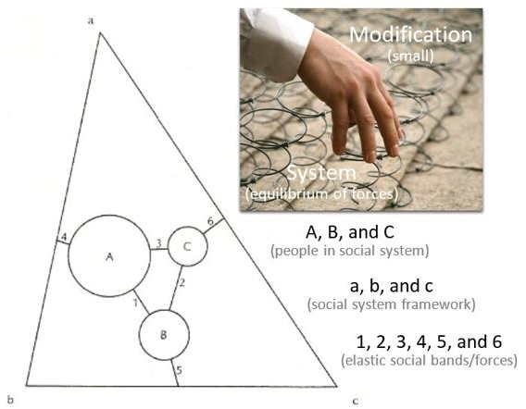
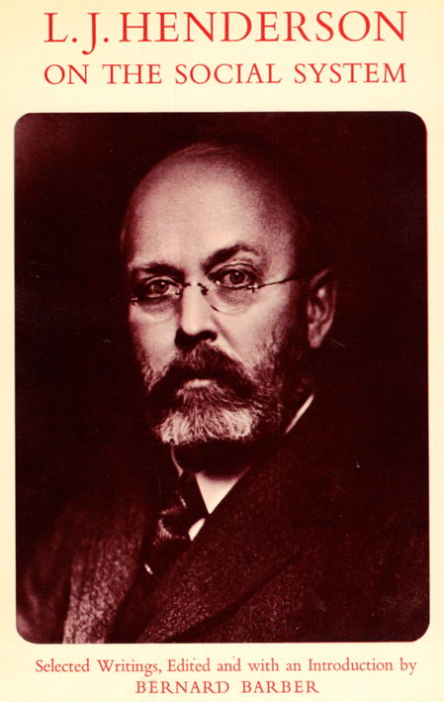
Henderson’s Sociology 23 (1938-1942)
● The Fitness of the Environment (1913)
● The Order of Nature (1917)
→ Henderson / Hospitalized (1926)
→ William Wheeler gives Henderson a copy
of Pareto’s Treatise on Sociology (1912)
● Pareto’s General Sociology (1935)
Sociology 23
(1938-1942)

Slide 15
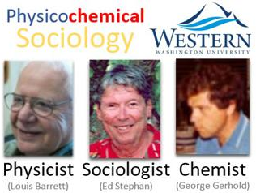
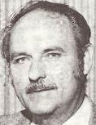
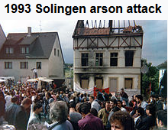

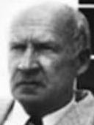
TWO CULTURES T I M E L I N E
George Scott
Attempts to establish a Snow-style two-cultures department at the University of South Dakota
Ed Stephen | Sociologist
Louis Barrett | Physicist
George Gerhold | Chemist
Team up at Western Washington University, to apply chemical potential to human populations
1939-1955
1970
1992-2013
1959-1973
1977-1995
Jurgen Mimkes| Physicist
Amid the 1992-1993 Solingen arson attacks, wherein Turkish immigrants were killed and burned by Nazi youth, initiated the Paderborn University Department of Physico-Chemical Socio-Economics
Ralph Burhoe | Theologian & meteorologist Aharon Katchalsky | Chemical Thermodynamicist
Bruce Lindsay | Physicist
Mihaly Csikszentmihalyi | Psychologist
Host an AAAS Symposium on Science and Human Values: in the context of thermodynamics
John Q. Stewart
Initiates the Princeton Social Physics Project, with funding from the Rockefeller Foundation

Slide 16
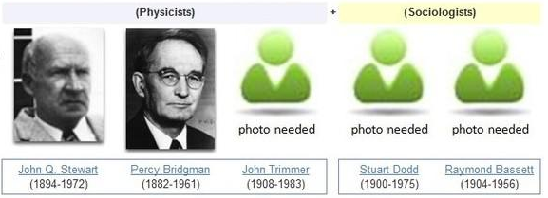
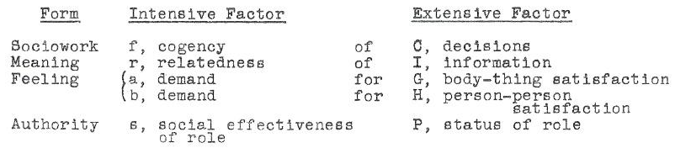
Princeton Social Physics | summary
— John Stewart (1953), “Remarks on the Current State of Social Physics”

Slide 17
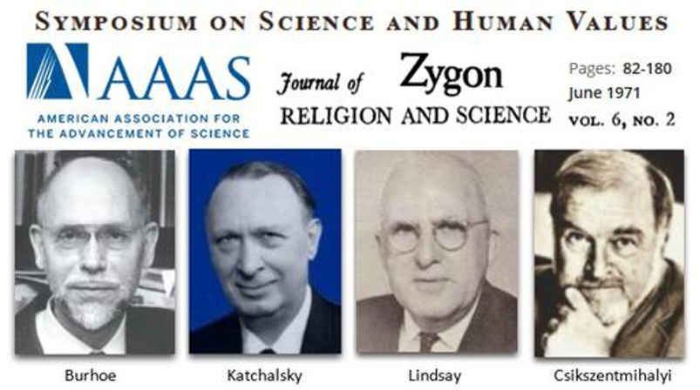
values based on thermodynamics (1970)
Katchalsky talked about Prigogine's dissipative structures theory, mixed with other related melting pot theories, e.g. Zhabotinsky reaction, Alan Turing's chemical morphogenesis, his own work on clay substrate theory origin of life, etc..
Lindsay mostly rambled on to conclude with a restatement of how his version of the thermodynamic imperative should be the new golden rule.

Slide 18
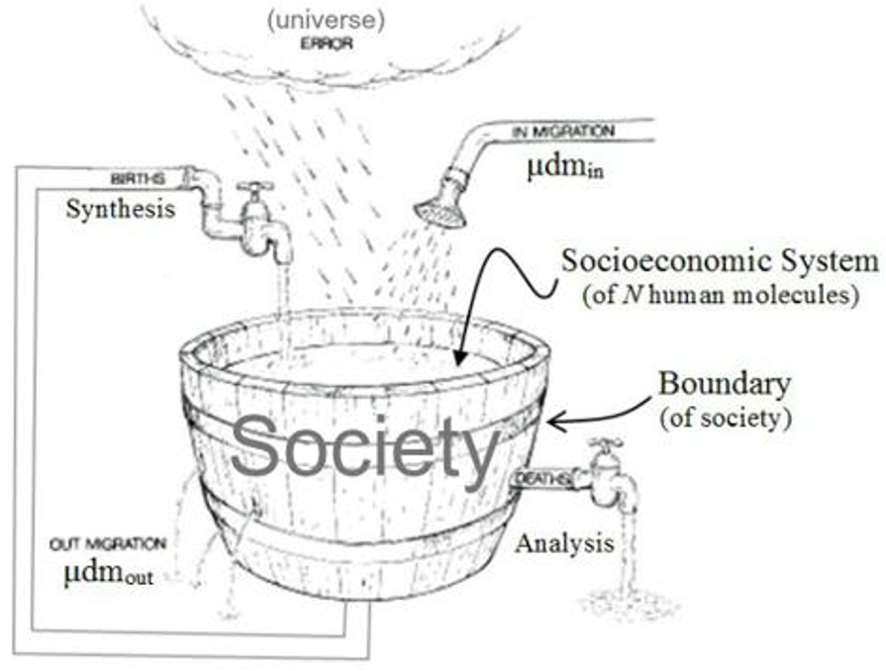
WWU Physico-Chemical Sociology (1977-1995)
● Do humans have something like chemical potential, some sort of (bonding) potential?
● At the level of particles, ‘temperature’ is just velocity of movement.
In social systems, is temperature the equivalent of the movement of technology of transportation and communication?

Slide 19
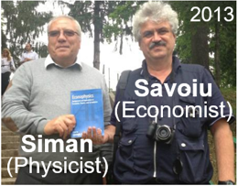




TWO CULTURES TIMELINE
Gheorghe Savoiu | Economist
Ion Siman | Physicist
Team up at University of Pitesti to found Econophysics, Sociophysics, and Multidisciplinary Sciences Journal + annual Conference
Korea University
Offered a 3-credit graduate course on Social Thermodynamics
2002
2005-present
2016
2005-2018
2008-2013
BioPhysical Economics Conference
Held at University of District of Columbia
German Physical Society launches a socio-economic physics division
Libb Thims | Engineer
Initiated the Journal of Human Thermodynamics (2005-2015); university lectures (2010-); two-cultures department initiatives (2013-)

Slide 20
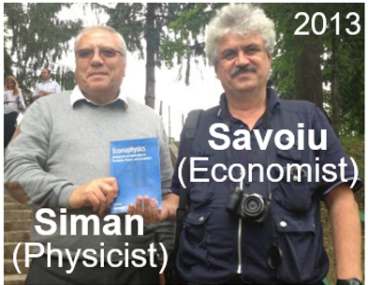
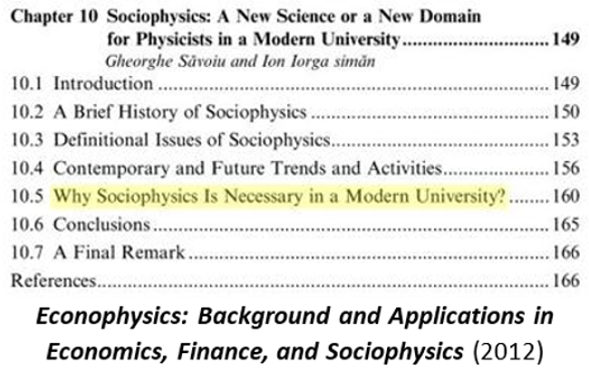
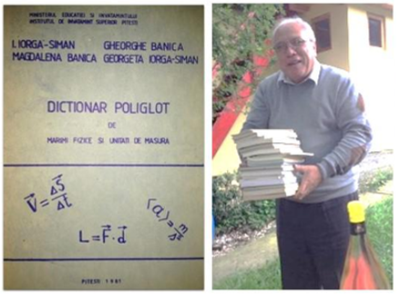
Pitesti University socio-Econo-physics
1P
1S

Slide 21
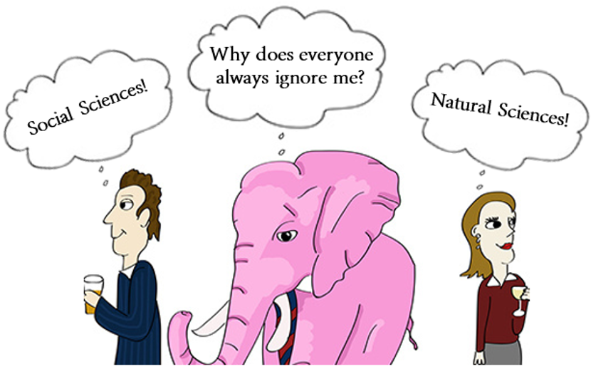
Two cultures | Elephant in the Room
1P
1S

Slide 22
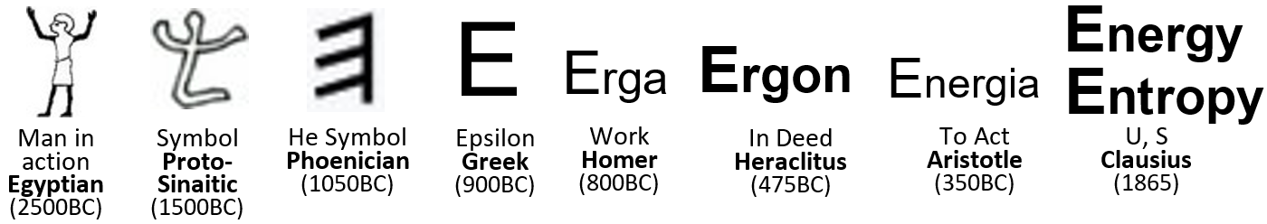
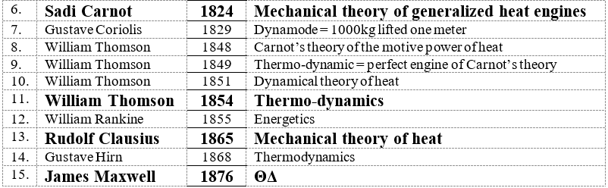
Two cultures | Elephant in the Room
1P
1S

Slide 23
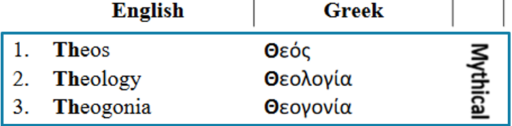
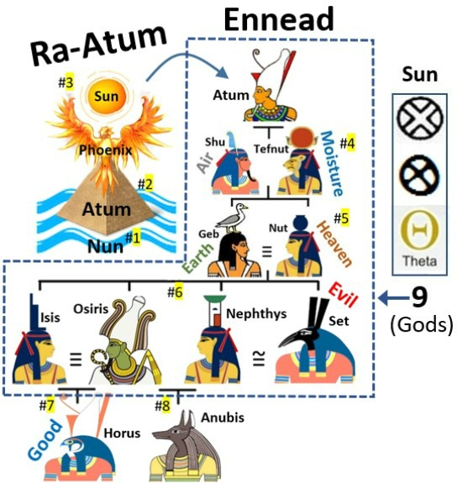
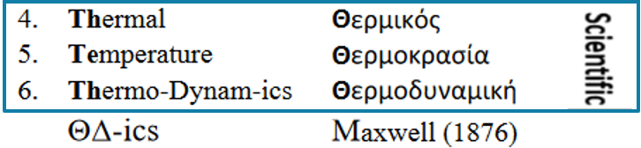
Two cultures | Elephant in the Room
1P
Think / Thought
1S

Slide 24

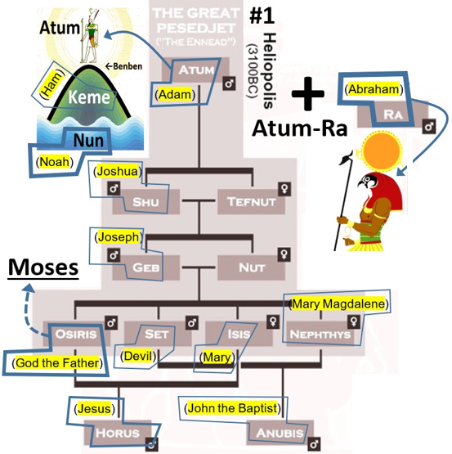
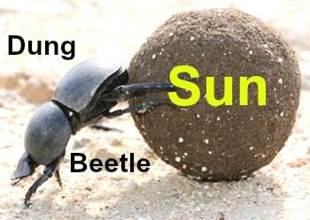
Two cultures | Elephant in the Room
Θ = Sun
Θ = Th-
Θ = 9
1S

Slide 25
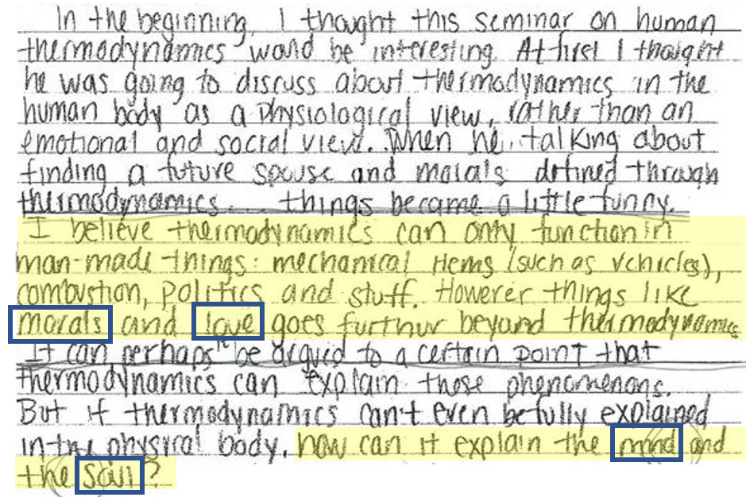
Two cultures | Elephant in the Room
— Anon (2012), bioengineering thermodynamics student; review of Libb Thims’ University of Illinois, Chicago, human thermodynamics lecture
1P
1S

Slide 26
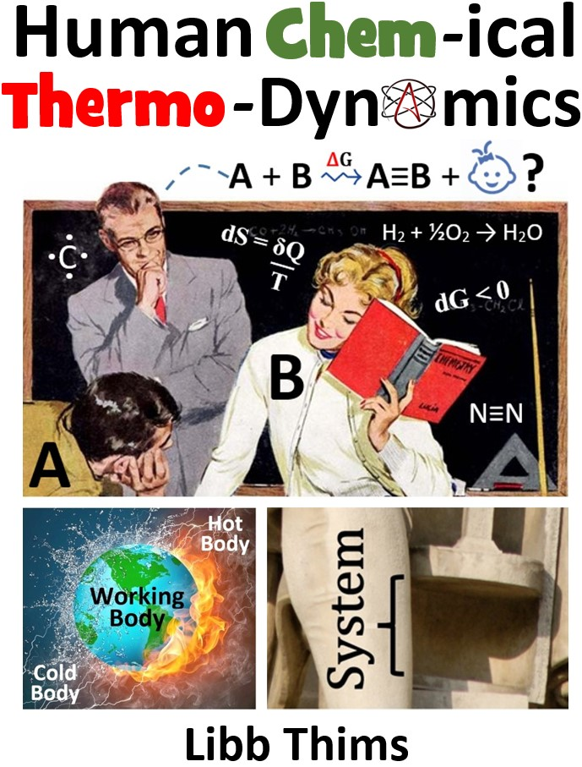
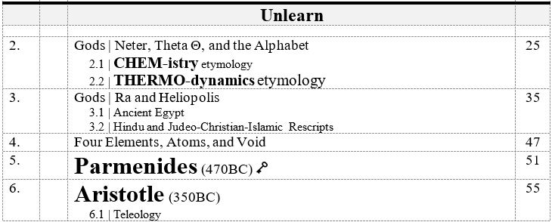
Two cultures | Elephant in the Room
1P
1S

Slide 27

Doctrinaire departmentalism
“Doctrinaire departmentalism has blinded the universities to the spectacular possibilities of adapting the successful methods of physics in the lagging social field.”
— John Q. Stewart (1951), “The New Discipline of Social Physics Examines Instances of Free Competition”
1S

Slide 28
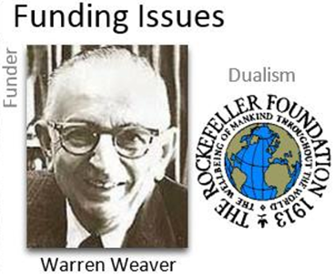
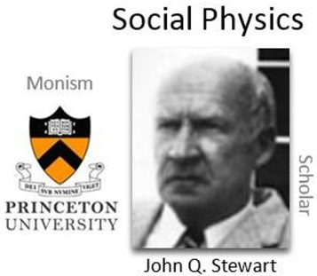
Two cultures | Bias & Funding Issues
“We are attempting isomorphisms between thermal, electromagnetic, and chemical energy and, respectively, human meaning, feeling, and authority, as well as an isomorphism between mechanical work (kinetic, elastic, and gravitational energy) and decision-making.”
— John Q. Stewart (1953), AAAS remarks on Princeton social physics, Dec
“It is hard for me to sense how one can usefully assign [physics-based] quantitative measures to any significantly wide range of “values” in the social field. And when you link together such things as meaning, feeling, authority, and decision-making, this sounds to me like a very heterogeneous mixture.”
— Warren Weaver (1953), Letter to Stewart on Rockefeller $150,000 funding cancellation
1S

Slide 29
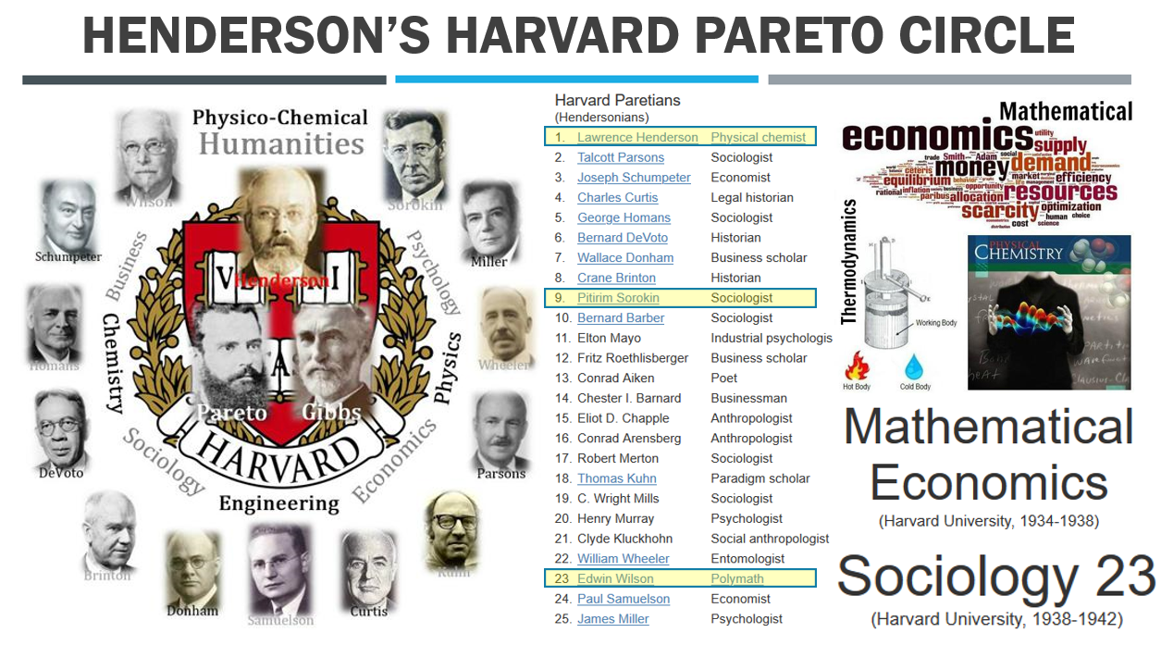
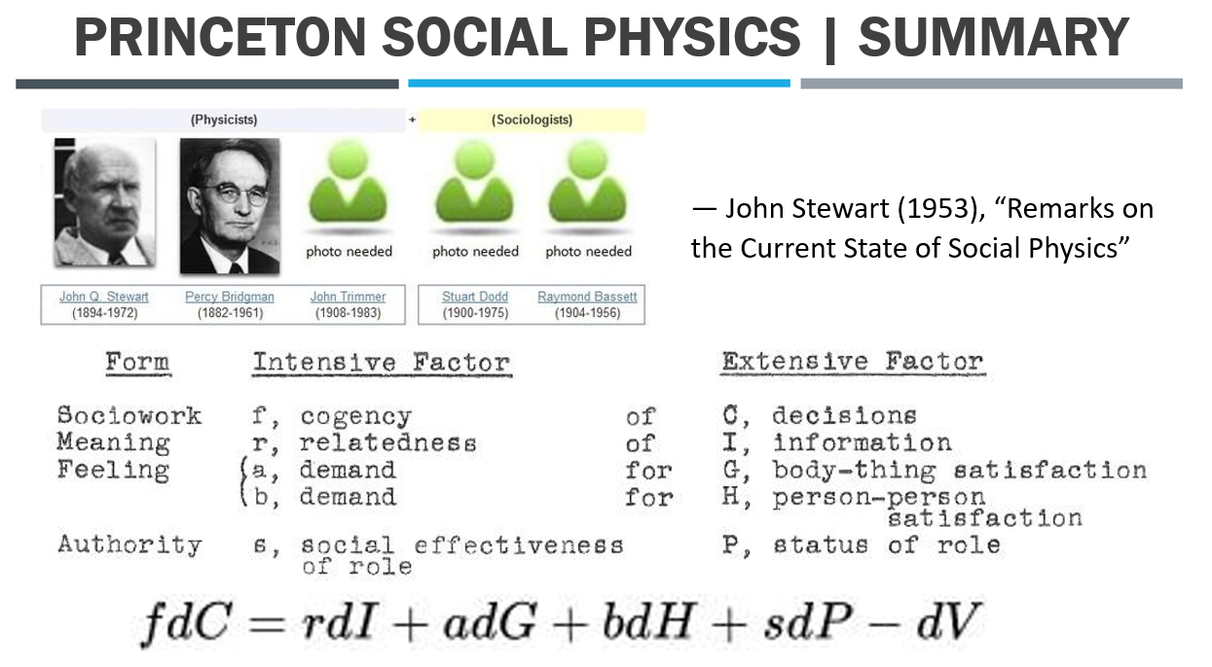
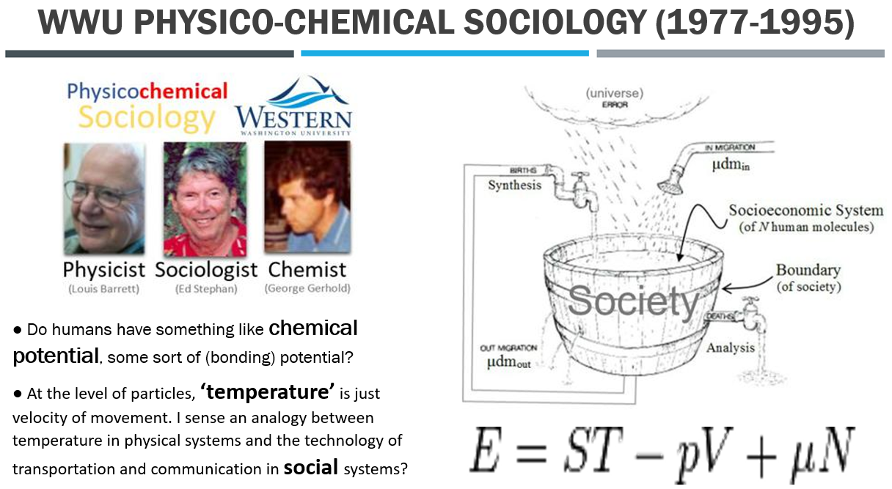
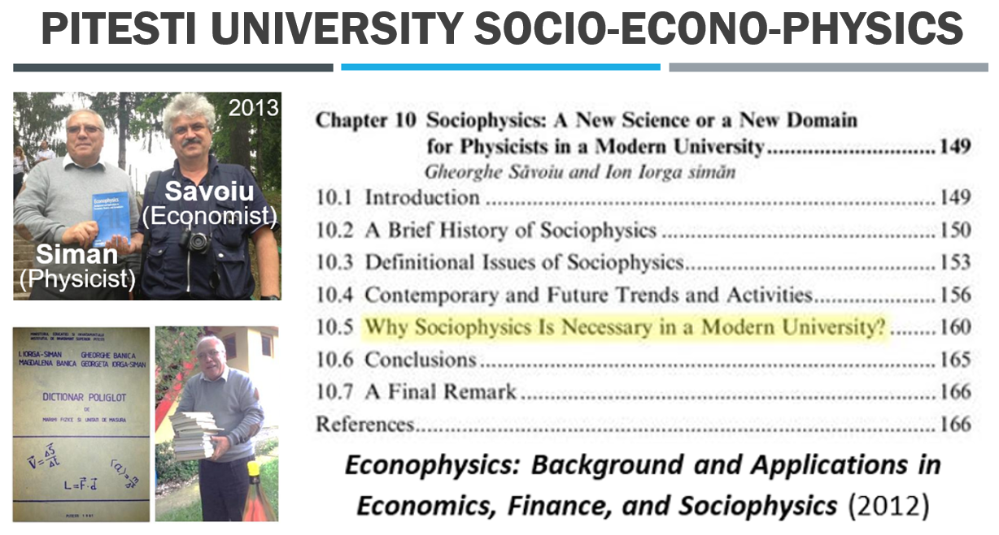
Natural + Social sciences| Summary
1P
1S

Slide 30


Professor-Student Cybernetic Loop
1P
1S
Professor-Student
Feedback Mechanism
One Student (1S) has to become the new Two Cultures Professor (1P)

