Slide 1
Thermodynamics 2.0. International Conference
June 2020, Worcester, Massachusetts, USA
A Physical Basis of Economics
Mieczysław Dobija
Professor of Economics and Accounting
Cracow University of Economics. Poland

Slide 2
Thermodynamics of Integration
The capital model, even the simplest as the compound interest formula C_{t} = C₀e^{pt}, has a theoretical basis in the first and second law of thermodynamics. The percentage of p depends on uncertainty and risk.
Uncertainty is a consequence of the second law of thermodynamics when the risk applies to our projects.
The principle of double entry in accounting forces that capital cannot arise out of nothing. That is why we can measure economic profit.
The spontaneous dispersion of human capital sets a fair minimum wage.

Slide 3
Prehistoric economic systems driven by labor
In the history of economic thought, disputes about the emergence of early economic systems are well known.
Professor Karl Polanyi’s and others studies are a good example. (Trade and Market in the Early Empires, 1957)
I put attention to an important fact indicating the existence of an economic system sooner than previously imagined.
It is related to the particular token representing „labor unit”.

Slide 4
Discoveries of tokens
Professor Denise Schmandt-Besserat recognized that ‘tokens’ (small clay counters) constitute an accounting system, widely used in the Near East from about 8,000 BC to 3,000 BC, that existed for five millennia. She also drew parallels between the shapes of the tokens and those of the first signs of writing, establishing accounting as the prerequisite and impetus to writing and abstract counting.
R. Mattessich (2012). The Beginnings of Accounting and Accounting Thought, Routledge, New York

Slide 5
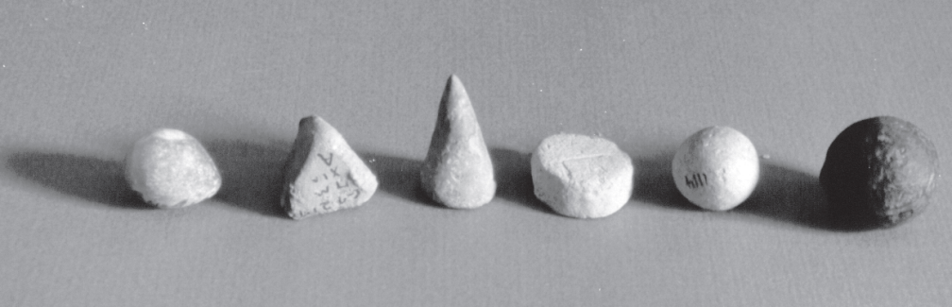
Photo 1. Different clay tokens. The cone, spheres and disk represented various measures of grain; the tetrahedron stood for a unit of labor.
Labor unit 8000 years ago? Fascinating!
Source: Courtesy Denise Schmandt-Besserat, University of Texas at Austin. Schmandt-Besserat D., (2007, p. 3), When Writing Met Art. From Symbol to Story, University of Texas Press.

Slide 6
Clay tablets and economic texts
Struve W., (1969), Some New Data on the Organization of Labor and on Social Structure in Sumer During the Reign of the III rd Dynasty of Ur, In: Diakonoff, I.M. Ancient Mesopotamia. Socio-Economic History. Nauka, Moskwa, 127-172
„ …The time assigned for the performance of each labor operation is sometimes estimated in days, and sometimes in months; but in the majority of cases it is given as one day (. . .) In addition to the unit of labor force, the scribes distinguished such quantities as 5/6, 2/3, ½ etc. of a unit of labor force. The laborer whose productivity of labor was estimated at 5/6, 2/3, 1/2 etc. of a unit of labor force, received grain ratios proportionately reduced. ….”

Slide 7
Question and conclusion
Are we not seeing here the natural measurement of work as the product of the power and the time of work?
Tokens representing products and various units of work are the part of an prehistoric economic system.
Value of labor = Worker Productivity × Time of labor.

Slide 8
Tokens are not only the beginning of writing and counting, but also a proof of the existence of a coherent economic system driven by labor
The natural interpretation indicates that the laborer performing the work on the instructions of the managers received tokens representing the value of the work done, i.e. the tokens represented amounts due for work. To obtain the necessary livelihoods, tokens were exchanged for products such as: barley, olive oil, etc.
In the present system it is similar; we work, in return we receive a record of the amount due for work on the bank account, and then we exchange our receivables for the necessary products. So the work creates our money and this is the basic physical fact in economics.

Slide 9
                Curiosity. Tokens appears in Urantia Book,
                Paper 66
The commission on industry and trade. This council was employed in fostering industry within the tribes and in promoting trade between the various peace groups. Its leader was Nod (…) It was among these enlightened groups that the first commercial credit was practiced. From a central exchange of credits they secured tokens which were accepted in lieu of the actual objects of barter. The world did not improve upon these business methods for hundreds of thousands of years.

Slide 10
Let us move to the present times

Slide 11
Capital and labor are the complementary notions.
Labor is self financing!
Capital
Work
Money
The abstract and potential ability of an object to perform work.
Transfer of capital from the initial location and concentrating it in manufactured objects. The work produce the work receivables.
The work receivables are economic and legal category specifying the unconditional right to receive the value equivalent.

Slide 12
An organization of bank system in the money-goods economy driven by labor
Payer of salaries for public sector.
Central Bank?
The Central Bank transfers payment for work to the accounts of the public sector employees’
House-
holds
Set of the Commer- cial banks
Private sector
Public sector

Slide 13
The Equation of Exchange
The essence of the money-goods economy is the exchange of amounts due for work (work receivables) for products and services.
If you doubt, think about buying bread!
The labor launches two streams: products and money. These streams are constantly confronted.

Slide 14
Market Exchange
GDP – M = 0
GDP = aW +
(1-a)W × k + ΔS
M –Total of Money
(1-a)Wk
+ ΔS
GDP
PMF
P = W × Q
Q – labor productivity
Credit
Creation Function
(1-a)W × k
Saving Level
S
aW
(1-a)W
Assets
A
W = r H
W = r H
Human capital of employees H
W – cost of labor

Slide 15
The Pay Equation of Exchange
GDP = GDPR(1 + i) = a×W + (1 - a)×W×k + d×W
If it's assumed i = 0, then:
GDP = GDPR = a × W + (1- a) × W × k + d × W
Q = Q_{r} = a + (1 – a) × k + d
k = (Q_{r} – a - d)/(1 – a) and
Total credit = W × (Q_{r} - a - d).
This amount of credit must be granted!

Slide 16
Work productivity index Q as the fundamental control factor
Q = GDP / W
where W – total compensations
Poland: Q = 2.07, USA: Q = 3.67
Q does not decrease, so inflation does not increase
Q is a function of important economic indicators, such as: pays, technical equipment of work, assets profitability, and operational efficiency.

Slide 17
Ending notes
Labor is self financing. Labor creates money!
Deflation in developed economies is caused by the financing of public sector work with taxes;
The contemporary Central Bank can do nothing for good of economy but it has tools to destroy it;
The future Central Bank will be a payer of compensations for the public sector under control of labor productivity (index Q);
Scientific economics is consistent with the concepts of physics and is self regulating.

Slide 18

Thank you for your attention

