Slide 1
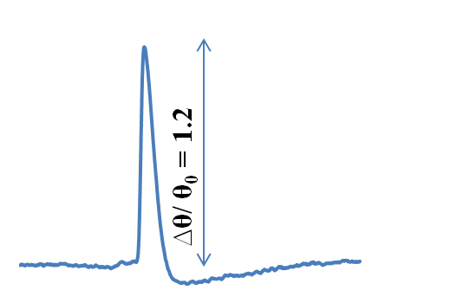
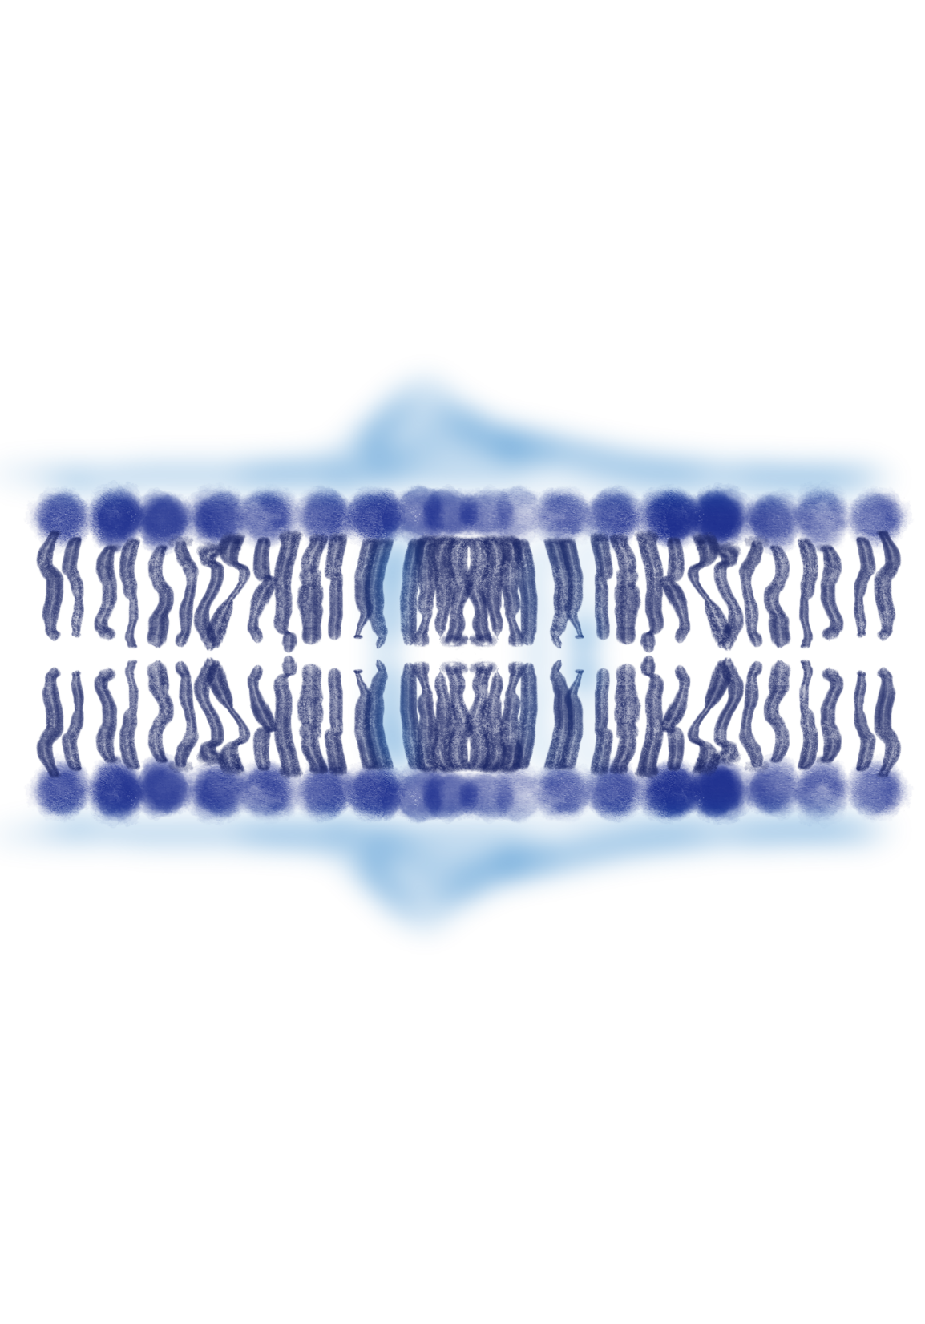
Thermodynamics of spiking based computing on self assembled lipid monolayers
Thermodynamics 2.0 Meeting
Massachusetts, June 2020, USA
AIR
LIPIDS
WATER
Shamit Shrivastava
Department of Engineering Science, University of Oxford, Oxford, UK

Slide 2
Motivation: Brain-like Computing Efficiency
Advanced in Deep learning and AI are putting tremendous demand on the computation power of conventional hardware
Energy efficiency of the brain inspiring new hardware paradigm known as neuromorphic computing
Latest chip from Intel (Pohoiki Springs) claims 100 million neurons at 500 W! Still, off by 3 orders
How are neurons so energy efficient?

Slide 3
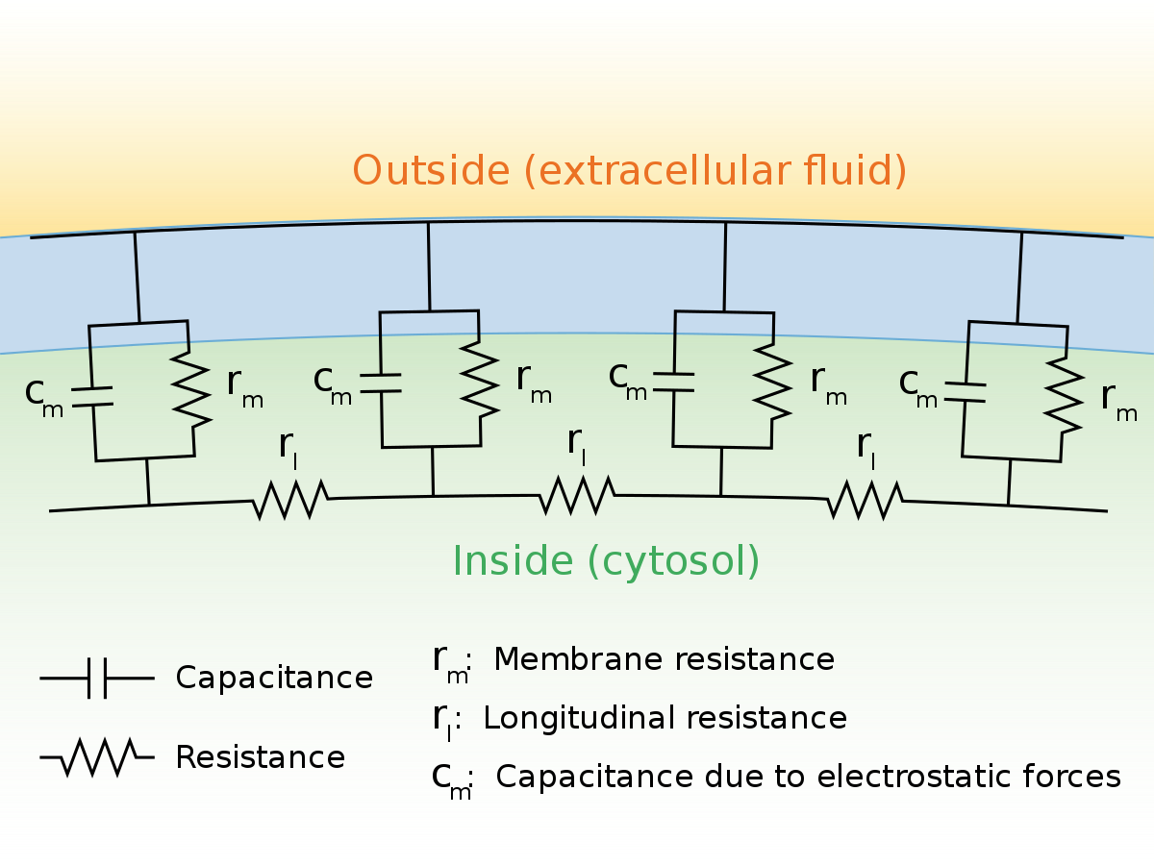
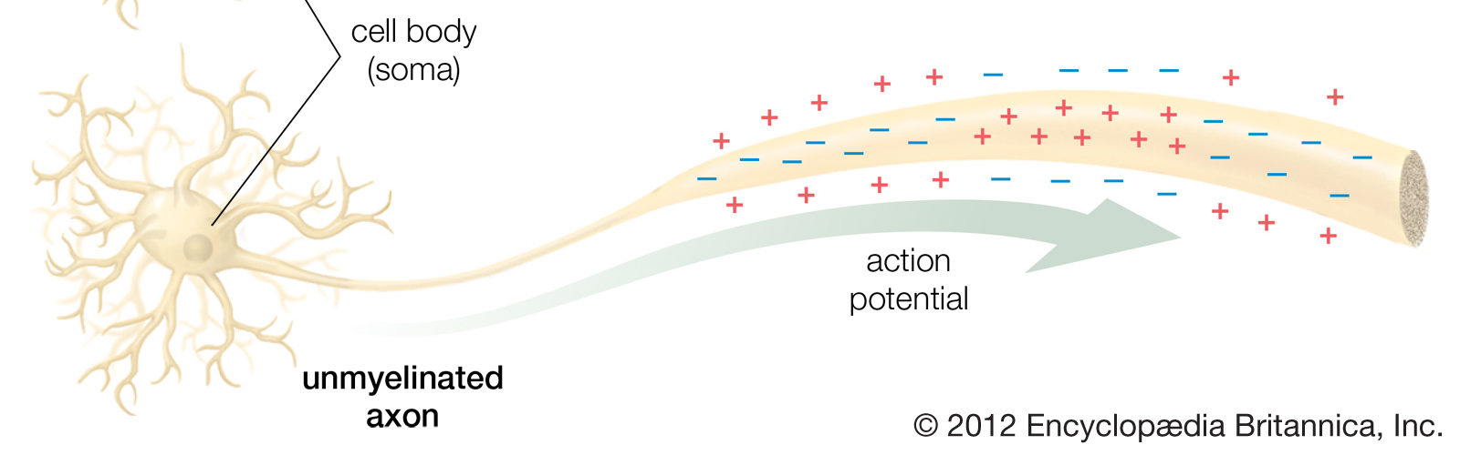
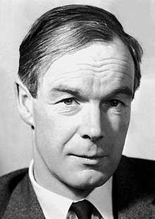
Background: Signal Propagation in a Neuron
“The invariance of the action potential arises because the energy used in propagation does not come from stimulus but is released by the nerve fibre along its length. In this respect nervous conduction resembles the burning of a fuse of gunpowder and is unlike current in an electrical cable” A. Hodgkin 1964

Slide 4
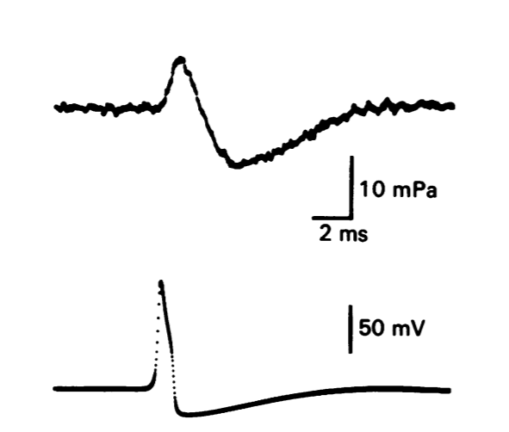
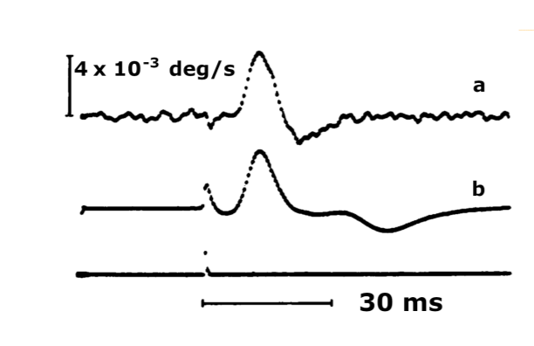
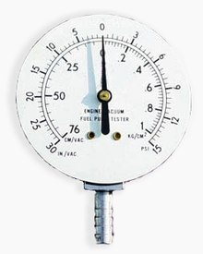
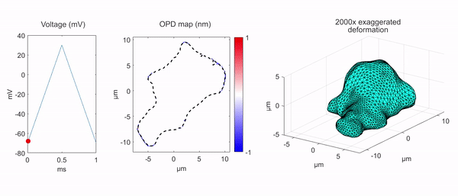
Physical Manifestations of a Nerve impulse
D
P
T
V
V
V
I. Tasaki Science, 1980
Voltage
V
Displacement
Pressure
Temperature
NI are also electrical and not only electrical

Slide 5
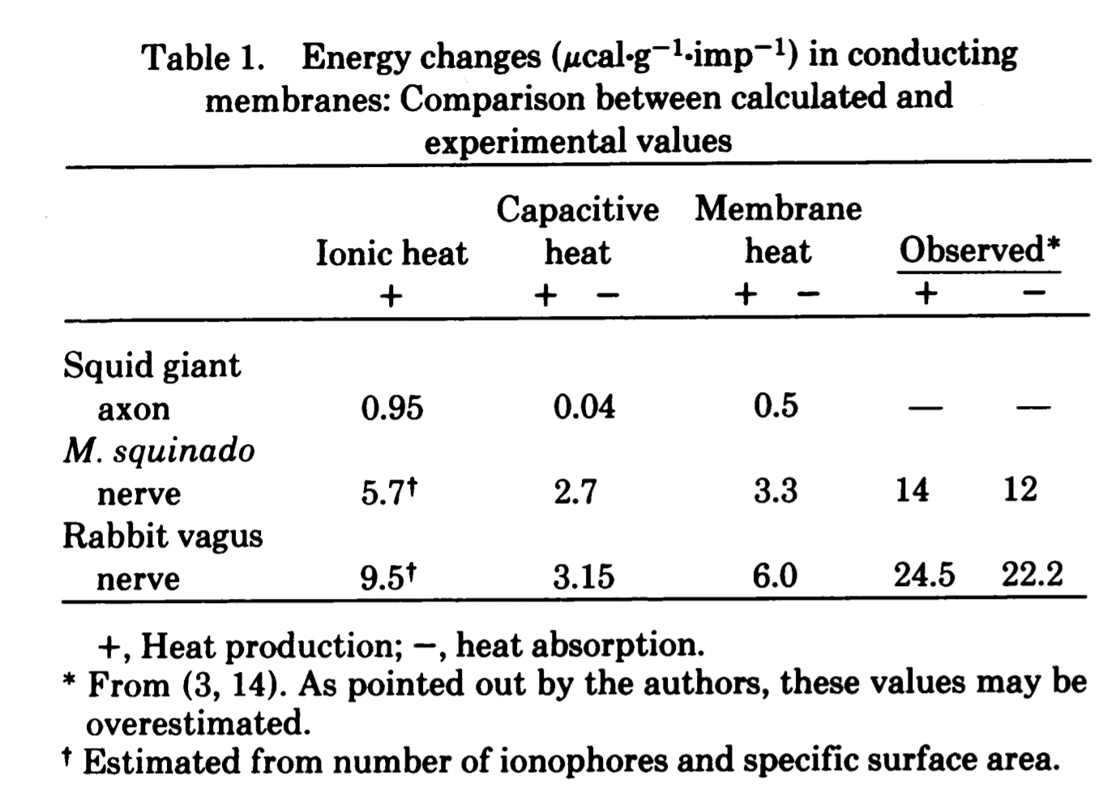
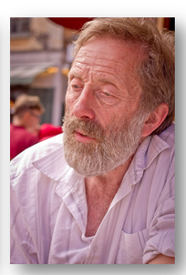
Nerve impulses are substantially reversible
NI as Sound Waves in the Interface?
Medium 1
Interface
Medium 2
Kaufmann 1989
Can such sound waves have the following properties?
Solitary (No dispersion)
All – or – none (Threshold for Excitation)
Conduction velocity 1 to 100m/s
Annihilation upon head – on collision
Temperature, pressure, pH dependence
Regulation of ion - channels
From: Molecular events and energy changes during the action potential PNAS 1977
Observed irreversible/reversible ratio is ~10%
Calculated irreversible/reversible ratio is ~100%

Slide 6
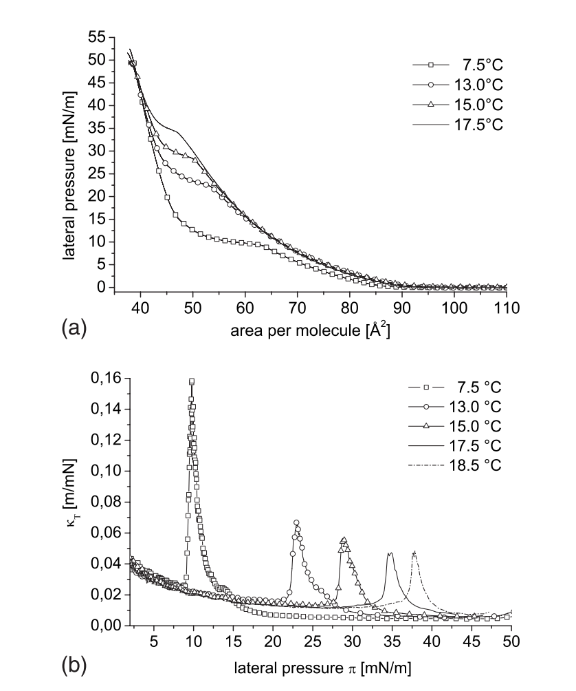
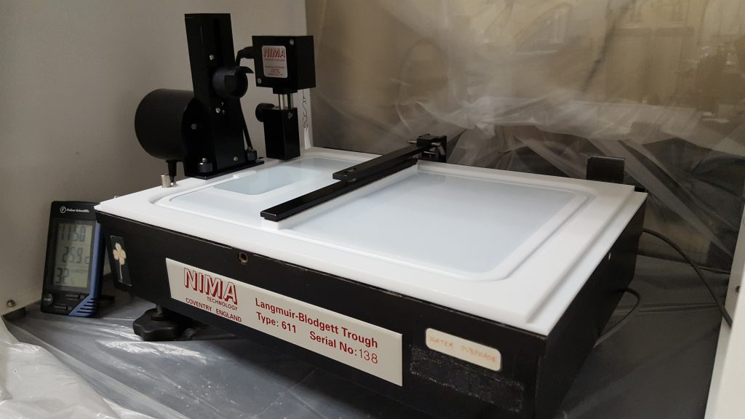
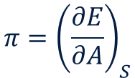
Model System: Lipid Monolayer
AIR
$$π={\left(\frac{∂E}{∂A}\right)}_{S}$$
Langmuir Trough
Image: Kuhl Group UC Davis
The quasi-static electro-mechano-optical coupling of a lipid monolayer can be characterised on a Langmuir Trough
Shrivastava et.al. J.R. Soc. Interface 2014

Slide 7
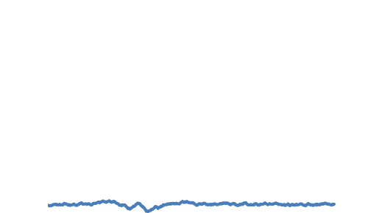
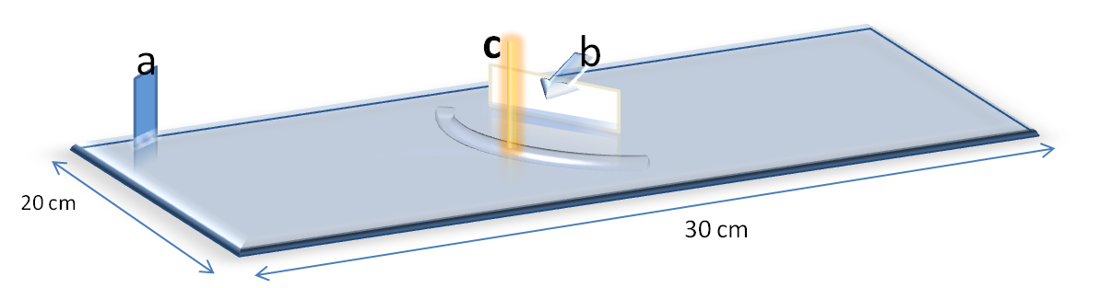
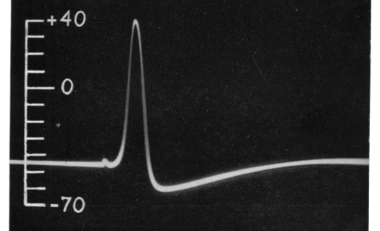
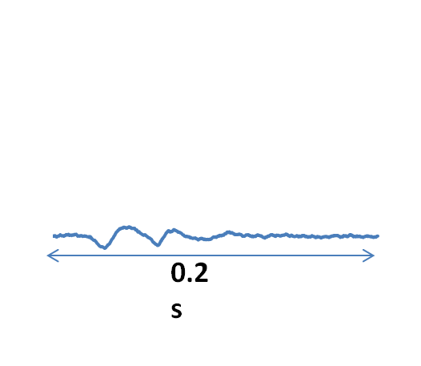

Results: Spike propagation at phase transition
Optical $∆RP/RP$
i
ii
Langmuir Trough
Action Potential Squid Axon (1945)
Mean Pressure
Piezo Excitation
Optical (FRET) detection
ii
i
iii
iii
200 ms
Local agitation of the monolayer propagates as an electro-mechano-optical pulse.
The pulse is nonlinearly amplified near a phase transition in the monolayer.
Shrivastava et.al. J.R. Soc. Interface 2014

Slide 8
Results: All-or-none propagation
Near a phase transition in the monolayer there is a threshold for excitation of the pulses.
The amplitude is amplified by 2-3 orders of magnitude.
The electrical component is expected to be 50-100mV.
Amplification is followed by complete saturation.
100%
20%

Slide 9
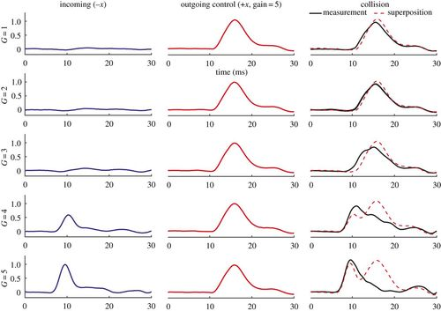
Results: Spikes annihilate upon collision
Increasing Excitation Strength
Time (ms)
Two full amplitude pulses annihilate each other upon head on collision
Nonlinear interactions are critical for computation

Slide 10
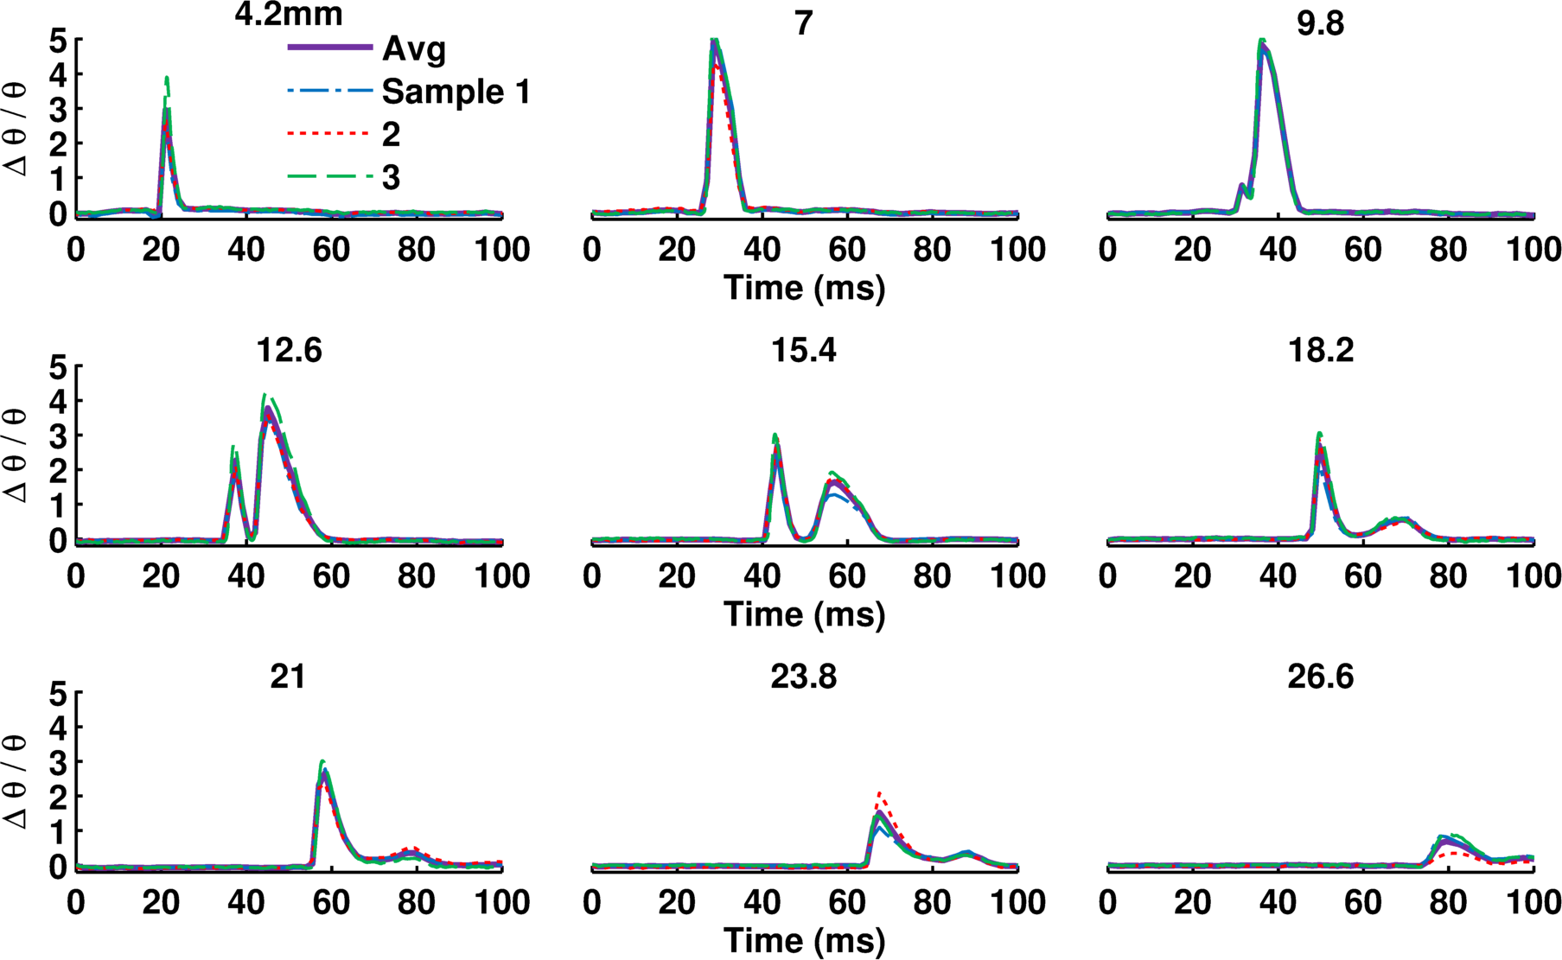
Mechanism: Insights from an Instability
Evolution over distance
mm
mm
mm
mm
mm
mm
mm
mm
Observing pulse propagation over long distance shows internal heat transfer.
This provides a mechanism for exciting and sustaining these waves using an external source of energy

Slide 11
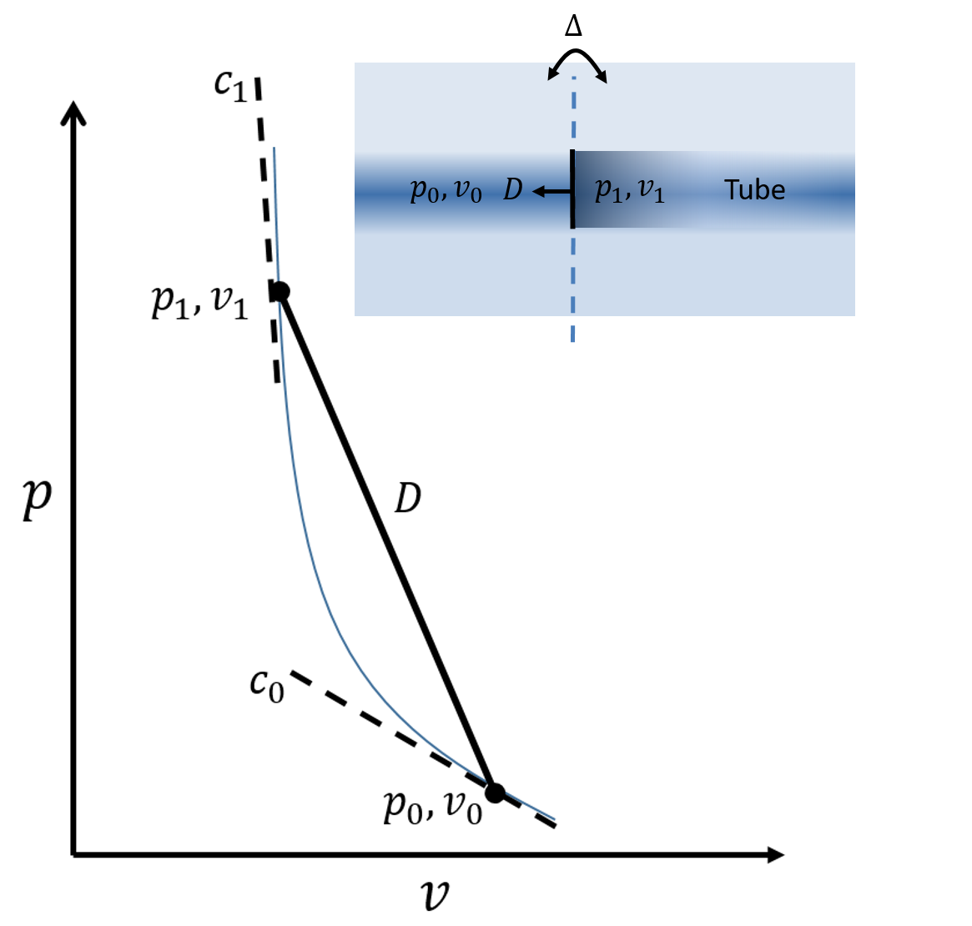
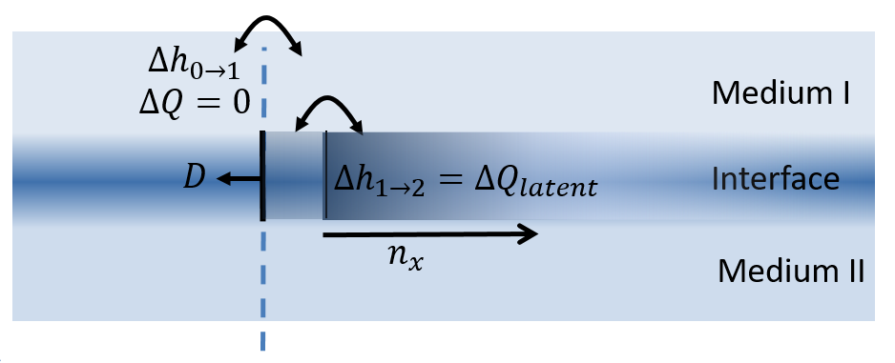


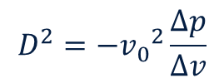
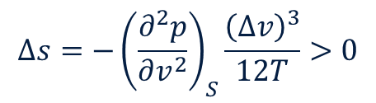

Mechanisms: Shock physics at an Interface
Conservation of Mass and Momentum
$$D^{2}=−{v_{0}}^{2}\frac{∆p}{∆v}$$
Conservation of Energy: Hugoniots
2
$$π$$
$$∆h−∆π\left(a_{0}+a\right)=0$$
1
0
Second Law of Thermodynamics
Isotherm
$$∆s=−{\left(\frac{∂^{2}p}{∂v^{2}}\right)}_{S}\frac{{\left(∆v\right)}^{3}}{12T}>0$$
$$a$$
Reference: Preprint “Shock Physics at an Interface and
the Mechanism of Annihilation of Colliding Action Potentials”

Slide 12
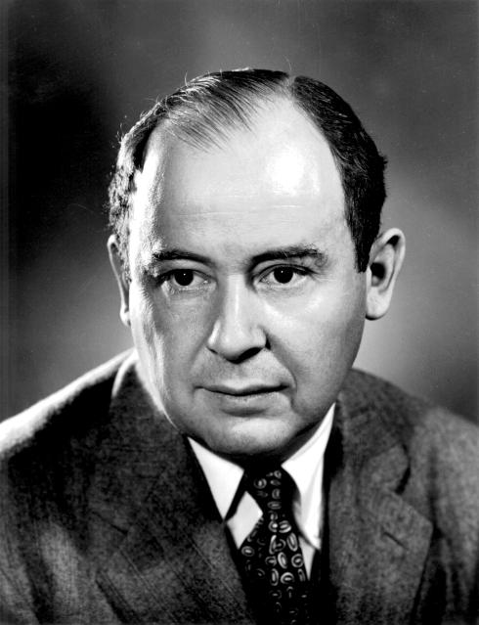
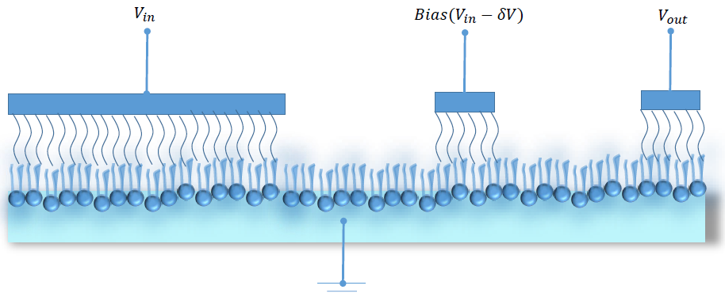

Conclusion and Outlook
“The invariance of the action potential arises because the energy used in propagation does not come from stimulus but is released by the nerve fibre along its length. In this respect nervous conduction resembles the burning of a fuse of gunpowder and is unlike current in an electrical cable” A. Hodgkin 1964
On detonation, von Neumann (1942):“We are thus disregarding the possibility that the detonation is propagated by special kinds of particles (ions,. etc.) moving ahead of the wave head. Indeed, if the views which we propose are found to be correct, no such special particles will be needed to explain the detonation wave.”
$$I_{b}$$
Lipid monolayers as a platform for Neuromorphic Computing
Regeneration and sustenance

