Slide 1
Generalizing Statistical Mechanics
Applications in Economics
Cal Abel
Signal Power and Light, Inc.

Slide 2
“Microeconomics cannot be aggregated into macroeconomics.” –General Sentiment

Slide 3
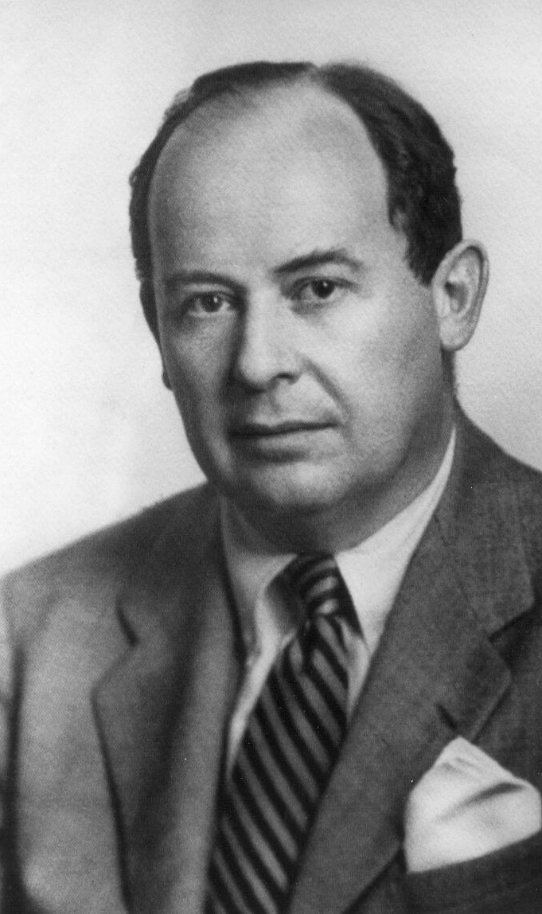
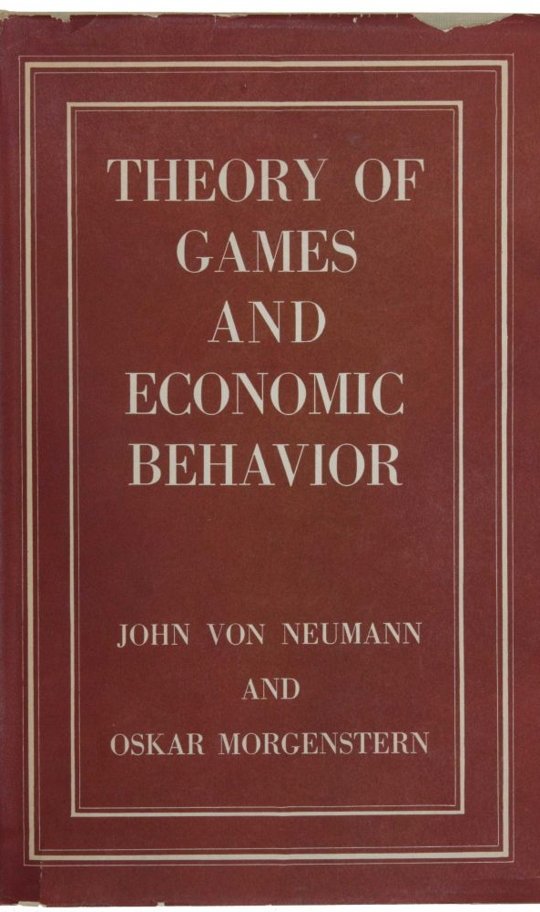
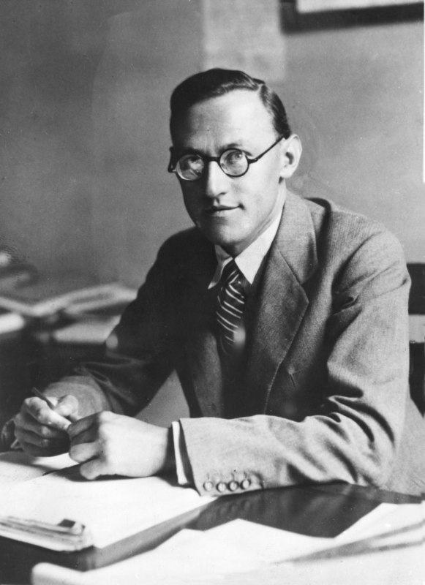

Slide 4
Theory of Measurement
(1968)
J. Pfanzagl generalized vNM expected utility into subjective probability

Slide 5

This is great for the individual

Slide 6

But still doesn’t describe the group

Slide 7
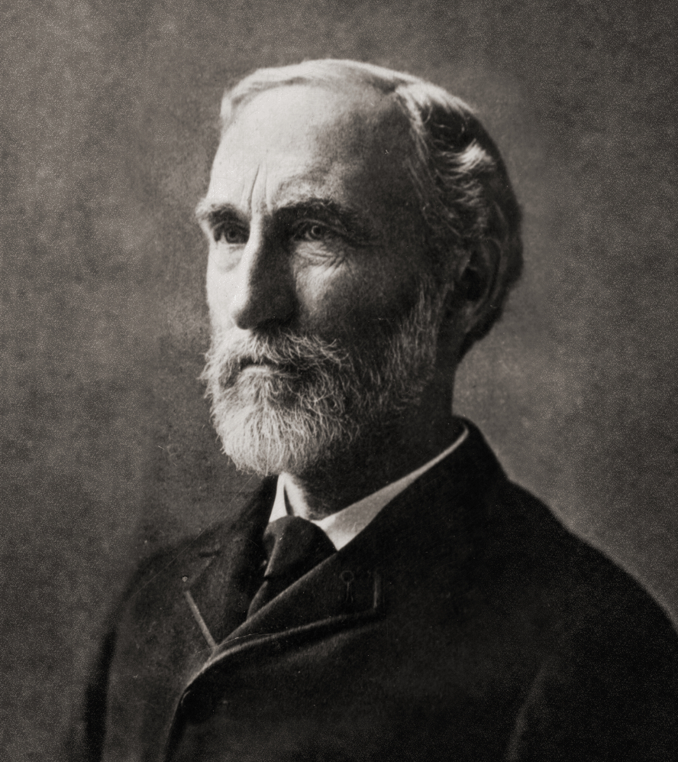
Elementary Principals in Statistical Mechanics
(1902)
J. W. Gibbs

Slide 8
Starts with the Hamiltonian for each individual particle

Slide 9
Expresses knowledge of the state of the system, probability, in terms of each component’s possible position and momentum.

Slide 10
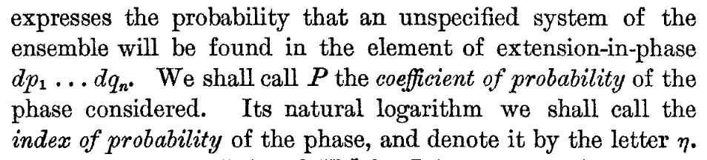

Uses Shannon’s uncertainty, $ln⁡(P)$

Slide 11
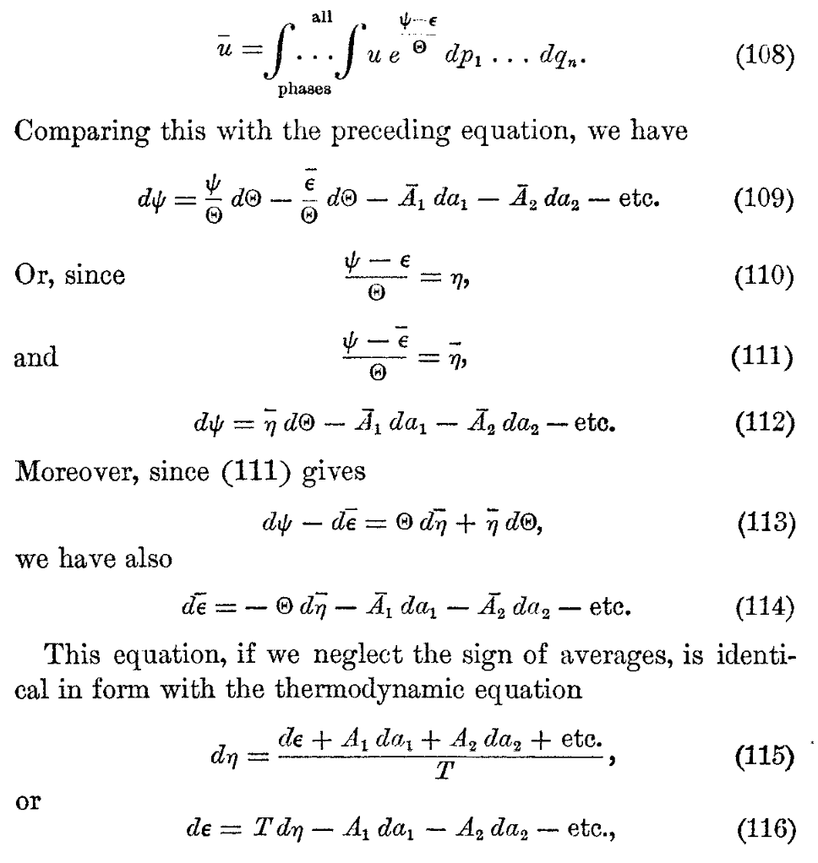
To derive the fundamental equation of thermodynamics.

Slide 12

Where the entropy, $\overline{η}$, is not Boltzmann’s $S$ it is Shannon’s $H$
50-years before Shannon developed Information Theory

Slide 13
Gibbs aggregated laws that described individual particles into entire systems showing the entropy of statistical mechanics is the entropy of Information Theory

Slide 14
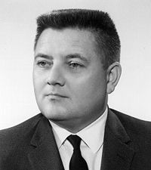
Jaynes understood Gibbs from Information Theory

Slide 15
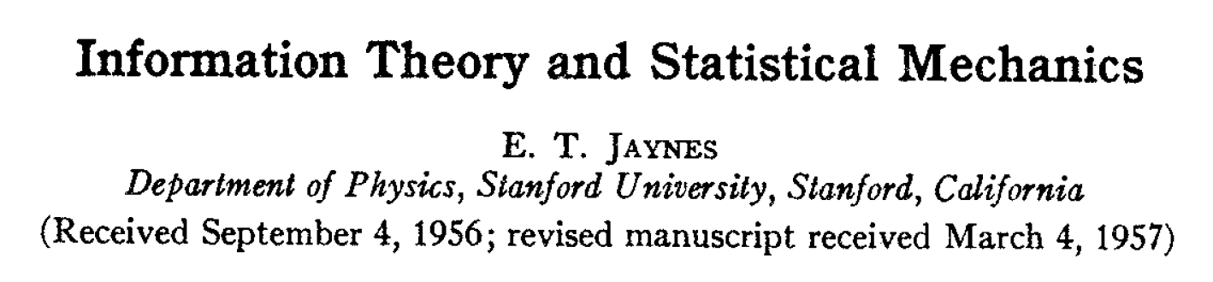
Jaynes generalized Gibbs approach into subjective probability theory, removing Gibbs dependence on the Newtonian/quantum Hamiltonian

Slide 16
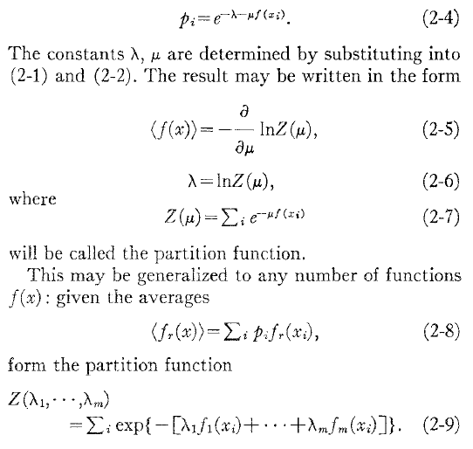
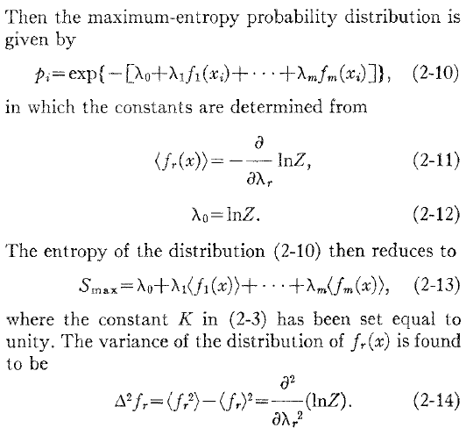
Jaynes’ Generalization

Slide 17
Jaynes work is not without critique. Particularly the use of subjective probability theory

Slide 18
Epistemological Break

Slide 19
Two Modes of Reasoning

Slide 20
“Although the theories of subjective and objective probability theory are mathematically identical, the concepts themselves refuse to be united. In the various statistical problems presented in physics, both viewpoints are required.”
-E. T. Jaynes

Slide 21

The hemispheres are specialized into two modes of reasoning:
Right – Subjective
Left – Objective

Slide 22
Both modes needed for survival.

Slide 23
Both modes are valid within their domains.

Slide 24
Subjective is propositionally weaker and more general

Slide 25
Objective is propositionally stronger and more limited

Slide 26
Experience

Slide 27
Experience
Subjective

Slide 28
Experience
Subjective
Objective

Slide 29
Jaynes observation is much more fundamental and is tied to the physical structure of our brains

Slide 30
Which emerged out of evolutionary pressures in all complex organisms

Slide 31
In response to the physical reality around them over the last billion years

Slide 32
Which is more real, more correct?

Slide 33
Neither and both

Slide 34
It depends…

Slide 35

What we can control – Order
What we can observe – Chaos

Slide 36
“You enter the forest at the darkest point, where there is no path.” – Joseph Campbell

Slide 37
1. Start with Pfanzagl’s definition of measure space of utility and represent our knowledge of it with a probability.
2. Then use Jaynes’ generalization of Gibbs to determine the individual’s utility function.
3. Finally, aggregate the individual into the group using the properties of Shannon’s entropy.

Slide 38
Limitations

Slide 39
This derivation is embedded entirely in subjective principles. As such, it is not about what we can control but simply what we have observed

Slide 40

Express our knowledge of the individual’s utility function as a density function:
$$f\left(x\right)=e^{−\sum_{i}{λ_{i}}φ_{i}\left(x\right)}$$ where $φ_{i}\left(x\right)$ is the $i$^{th} moment of $f\left(x\right)$ constrained by
$$𝔼\left[φ_{i}\left(x\right)\right]=\int{dxφ_{i}\left(x\right)f\left(x\right)}=a_{i}$$

Slide 41

Defining the 0th moment is $φ_{0}\left(x\right)=1$ and its constraint is $a_{0}=1$
This is Gibbs’ conservation of the extension in phase and directly results in the partition function
$Z\left(λ\right)=e^{λ_{0}}=\int{dxe^{−\sum_{i=1}^{m}{{λ_{i}φ}_{i}\left(x\right)}}}$

Slide 42

The maximum entropy distribution is obtained by maximizing
$$s_{max}=\sum_{i=0}{λ_{i}𝔼\left[φ_{i}\left(x\right)\right]}$$ by setting:
$$−\frac{∂}{∂λ_{i}}\ln\left(Z\left(λ\right)\right)=−\frac{∂λ_{0}}{∂λ_{i}}=𝔼\left[φ_{i}\left(x\right)\right]$$

Slide 43

$$𝔼\left[φ_{i}\left(x\right)\right]=−\frac{∂λ_{0}}{∂λ_{i}}=a_{i} \\ s=\sum_{i=0}{λ_{i}a_{i}}$$
Taking the total differential results in the fundamental equation of thermodynamics
$$ds=\sum_{i=1}{λ_{i}da_{i}}$$

Slide 44

Recalling entropy as being additive, the entropy of the individual,
$$s_{i,j}=\sum_{i=0}{λ_{i,j}a_{i,j}}$$ becomes for the group
$$S=\sum_{j=1}{\sum_{i=0}{λ_{i,j}a_{i,j}}}$$
Assuming Rawls’ veil of ignorance results in:
$$S=N\sum_{i=0}{λ_{i}a_{i}}=\sum_{i=0}{λ_{i}A_{i}}$$

Slide 45
Statistical mechanics and the laws of thermodynamics are not consequences of the nature of matter but are derived properties of the statistics we use to describe our phenomenological observations.

Slide 46
Under special circumstances as a result of significant work , e.g. quantum statistical mechanics, we can begin to make more accurate predictions.

Slide 47
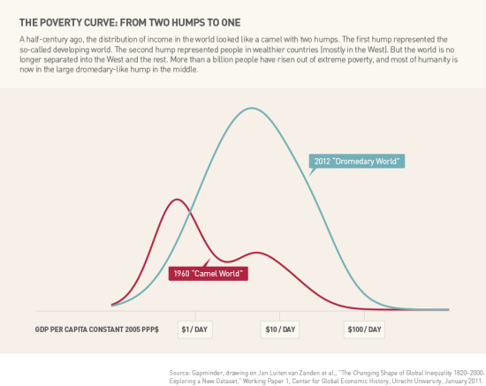
Income distribution measures relative value of economic contribution (utility) of individuals as judged by the entire population

Slide 48
This corresponds directly to their ability to interact with the world

Slide 49
The income distribution is lognormal

Slide 50

$$φ\left(u\right)=\left[\begin{matrix}1 \\ ln(u) \\ {(\ln\left(u\right))}^{2}\end{matrix}\right]$$
The constraints are:
$$λ_{0}=\frac{1}{2}\ln\left(\frac{π}{λ_{2}}\right)+\frac{{\left(λ_{1}−1\right)}^{2}}{4λ_{2}}$$ and,
$$𝔼\left[φ\left(u\right)\right]=\left[\begin{matrix}1 \\ μ \\ {μ^{2}+σ}^{2}\end{matrix}\right]$$

Slide 51

$${−∇λ}_{0}=\left[\begin{matrix}1 \\ \frac{1−λ_{1}}{{2λ}_{2}} \\ \frac{{\left(λ_{1}−1\right)}^{2}}{4λ_{2}^{2}}+\frac{1}{{2λ}_{2}}\end{matrix}\right]=\left[\begin{matrix}1 \\ μ \\ {μ^{2}+σ}^{2}\end{matrix}\right]$$

Slide 52

Solving for the constraints results in:
$$λ=\left[\begin{matrix}\frac{1}{2}ln(2πσ^{2}) \\ 1−\frac{μ}{σ^{2}} \\ 1/{2σ^{2}}\end{matrix}\right]$$

Slide 53

Recalling,
$$〈u〉=e^{μ+\frac{σ^{2}}{2}}$$
The entropy becomes,
$$s=\frac{1}{2}\ln\left(2πeσ^{2}e^{−σ^{2}}\right)+α ln(〈u〉)$$
Where $α$ is determined through the law of fluctuations by,
$$−\frac{∂^{2}s}{{∂〈u〉}^{2}}=\frac{α}{{〈u〉}^{2}}=\frac{1}{Var(u)}$$

Slide 54

Looking at the extrema,
$$\lim_{σ^{2}→∞}{s}=−∞,\lim_{σ^{2}→0}{s}=−∞$$
The first derivative shows a maxima at $σ^{2}=1$ for a given $〈u〉$
$$\frac{∂s}{∂σ^{2}}=e^{−σ^{2}}\left(1−σ^{2}\right)=0$$

Slide 55
What does this mean?

Slide 56

The entropy of the income distribution is maximized when $σ^{2}=1$. When the income distribution is flat $Gini=0$ the entropy is $−∞$

Slide 57
What is entropy?

Slide 58
If entropy always increases globally, what is its nature?

Slide 59
Is it disorder?
Is it missing information?
Is it the invisible hand? or
Is it complexity?

Slide 60
“As it is the power of exchanging that gives occasion to the division of labour, so the extent of the division must always be limited by the extent of that power… [–] by the extent of the market.” – Adam Smith

Slide 61
We need to answer a teleological question, How do we use entropy in economics? Is it a good or bad?

Slide 62
If the nature of the universe is to maximize entropy, who are we to say that that is bad? If the nature of being is good then entropy maximization is aligned with that good.

Slide 63
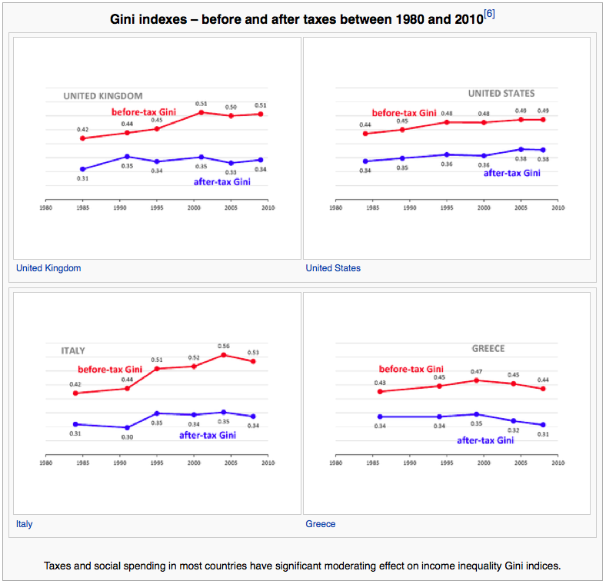

Gini is 0.531 when $σ^{2}=1$

Slide 64
Redistributive taxes reduce the economy’s complexity

Slide 65

The multivariate lognormal is:
$$f\left(X\right)=\frac{1}{\sqrt{{\left(2π\right)}^{k}\left|Σ\right|}\prod_{i}{x_{i}}}e^{−\frac{1}{2}{\left(\ln\left(X\right)−μ\right)}^{T}Σ^{−1}\left(\ln\left(X\right)−μ\right)}$$
Following the same methodology of the univariate case, the entropy of the system is:

Slide 66

$$s=\frac{1}{2}ln\left[{\left(2πe\right)}^{k}\left|Σ\right|e^{−Tr\left(Σ\right)}\right]+\sum_{i}^{k}{α_{i}ln\left(〈x_{i}〉\right)}$$

Slide 67
$$s=\frac{1}{2}ln\left[{\left(2πe\right)}^{k}\left|Σ\right|e^{−Tr\left(Σ\right)}\right]+\sum_{i}^{k}{α_{i}ln\left(〈x_{i}〉\right)}$$
This is the same form of a Cobb-Douglas Production Function for constant entropy.
This is the same form of an ideal gas equation of state.

Slide 68

This is for the individual, to aggregate to the group is straight forward
$$s_{0}=\frac{1}{2}ln\left[{\left(2πe\right)}^{k}\left|Σ\right|e^{−Tr\left(Σ\right)}\right], N_{0}=1$$
$$Ns−{Ns}_{0}=\sum_{i}^{k}{Nα_{i}ln\left(\frac{〈X_{i}〉}{〈X_{i0}〉}\right)}−\sum_{i}^{k}{Nα_{i}ln\left(N\right)}$$

Slide 69

Focus on the bivariate case where $U$ is the total income and $M$ is the money supply.
$$e^{s−s_{0}}={\left(\frac{U}{U_{0}}\right)}^{c}{\left(\frac{M}{M_{0}}\right)}^{R}{\left(\frac{N}{N_{0}}\right)}^{−\left(c+R\right)}$$

Slide 70

$$\frac{U}{U_{0}}=e^{\frac{s−s_{0}}{c}}{\left(\frac{M}{M_{0}}\right)}^{−R/c}{\left(\frac{N}{N_{0}}\right)}^{\left(1+R/c\right)}$$

Slide 71

When $U$is measured in nominal currency, it needs to by multiplied by the marginal utility of money to convert it to absolute terms.
$$\frac{U}{U_{0}}=e^{\frac{s−s_{0}}{c}}{\left(\frac{M}{M_{0}}\right)}^{−R/c}{\left(\frac{N}{N_{0}}\right)}^{\left(1+R/c\right)}$$

Slide 72
Money is the space in which the economy acts. When we exchange money, we are exchanging fractions of economic space.

Slide 73

With Bitcoin, each satoshi is like a deed of land that is exchanged from the possession of one entity to another. The record of title is the blockchain.

Slide 74
Economics is about people doing stuff

Slide 75
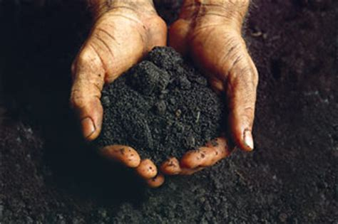


Use the units of doing stuff

Slide 76
The natural unit of economic utility is energy.

Slide 77
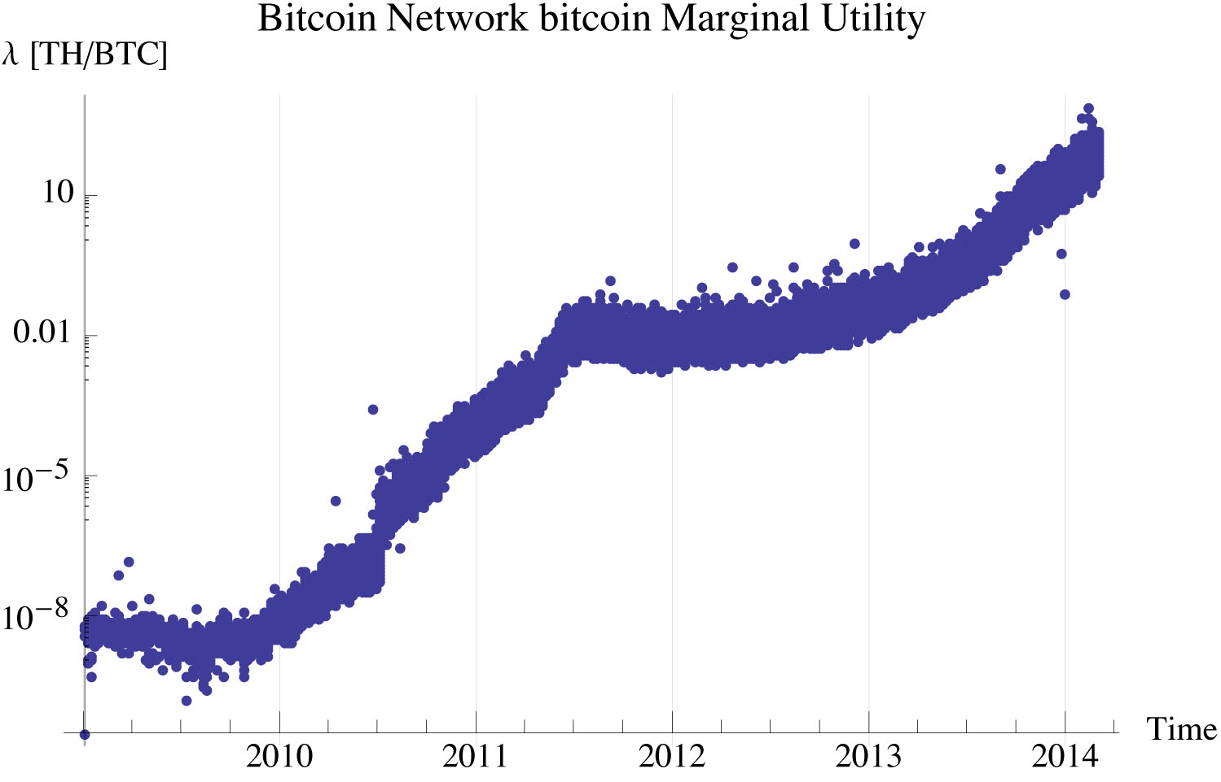

Slide 78
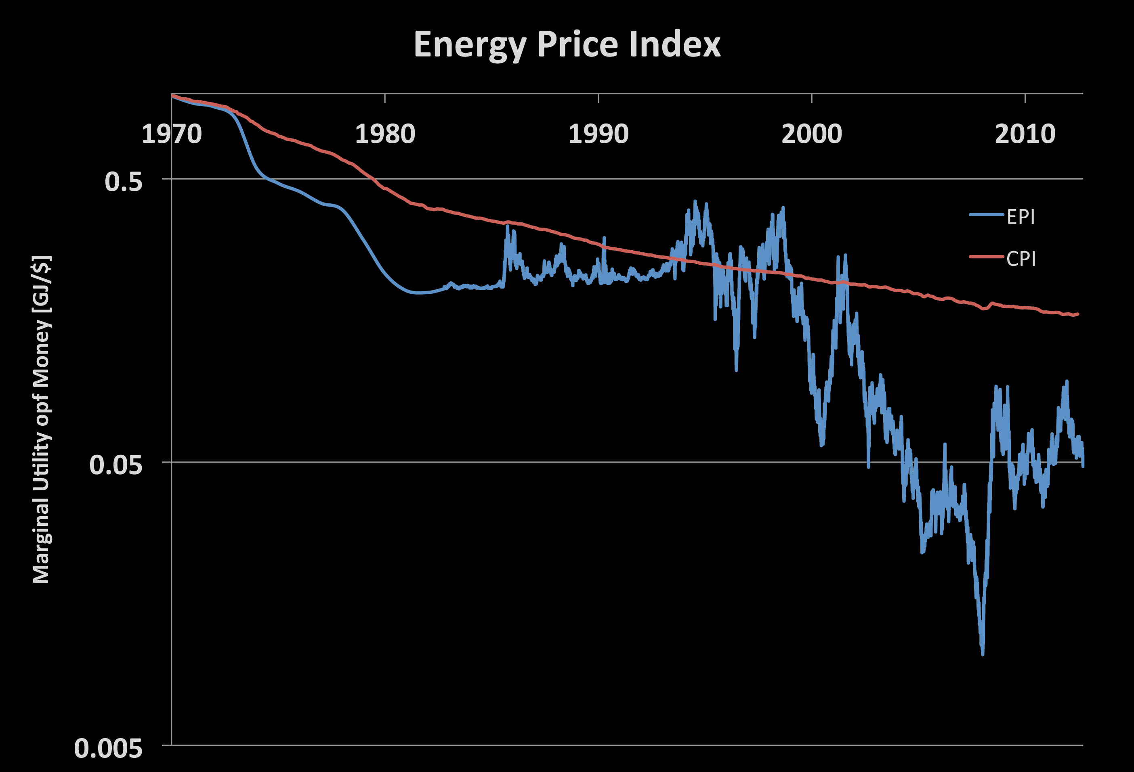

Slide 79
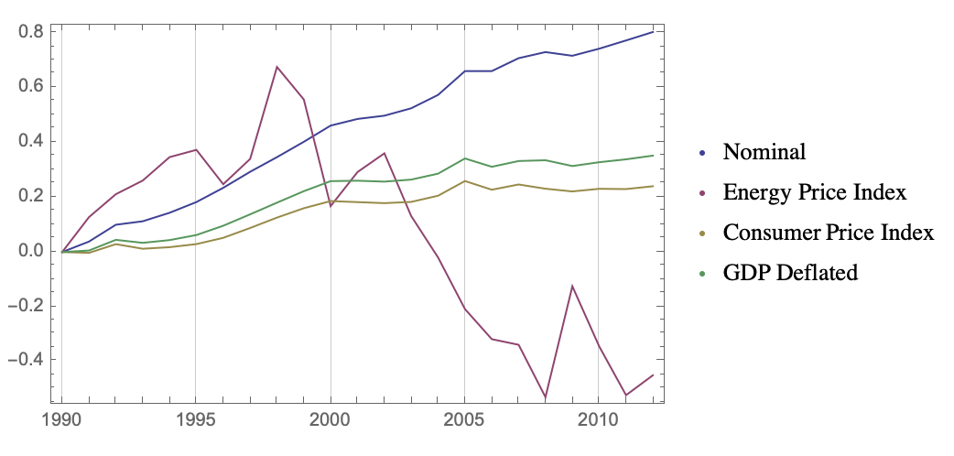
US Income Distribution Specific Entropy

Slide 80
$$\frac{U}{U_{0}}=e^{\frac{s−s_{0}}{c}}{\left(\frac{M}{M_{0}}\right)}^{−R/c}{\left(\frac{N}{N_{0}}\right)}^{\left(1+R/c\right)}$$

Slide 81

$$\frac{∂U}{∂S}=\frac{U}{Nc}=T \\ U=NcT \\ u=cT$$
$$\frac{∂U}{∂M}=−\frac{R}{c}\frac{U}{M}=−\frac{R}{c}\frac{u}{m}=−λ$$
$$λ=\frac{RT}{m} \\ λm=RT \\ λM=NRT$$

Slide 82
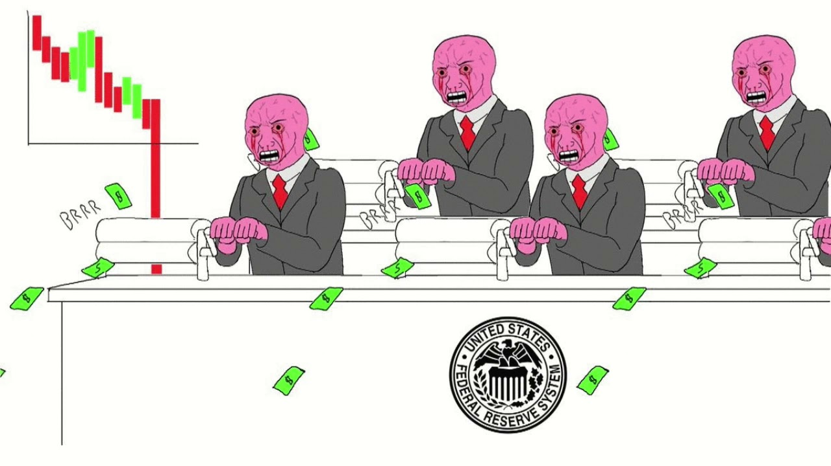

Keynesian Economics and
Modern Monetary Theory
“Money printer go brrrr”
Quantitative Easing lowers economic temperature. It is not stimulative, it is extractive
$$λM=NRT \\ {\left.λM^{γ}\right|}_{s}=λM^{\frac{c+R}{c}}=const$$

Slide 83
This derivation is embedded entirely in subjective principles. As such, it is not about what we can control but simply what we have observed

Slide 84
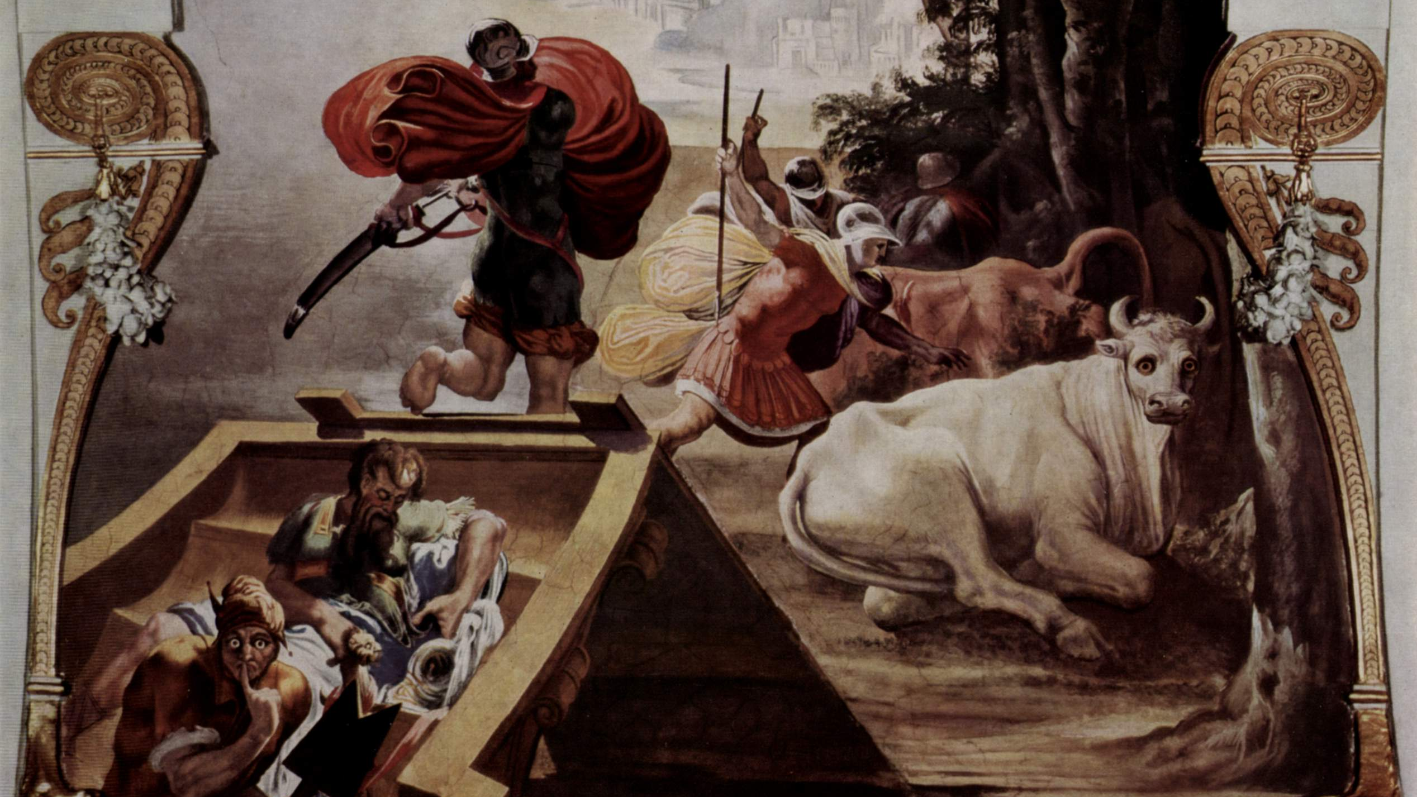
The End crabel@signalpowerandlight.com

