Slide 1
­Unified Mechanics Theory
Prof. Cemal Basaran
University at Buffalo,
The State University of New York
International Conference on Thermodynamics 2.0
June 22-24, 2020

Slide 2
Presentation Outline
I- Objective
II- Introduction
III- Literature
IV- Theory & mathematical & experimental proof
V- Recent work in the literature by others
VI- Conclusions

Slide 3
Objective
Establishing laws of nature governing, behavior of inorganic and organic materials/structures during their lifetime, without the need for phenomenological empirical models based on test data.

Slide 4
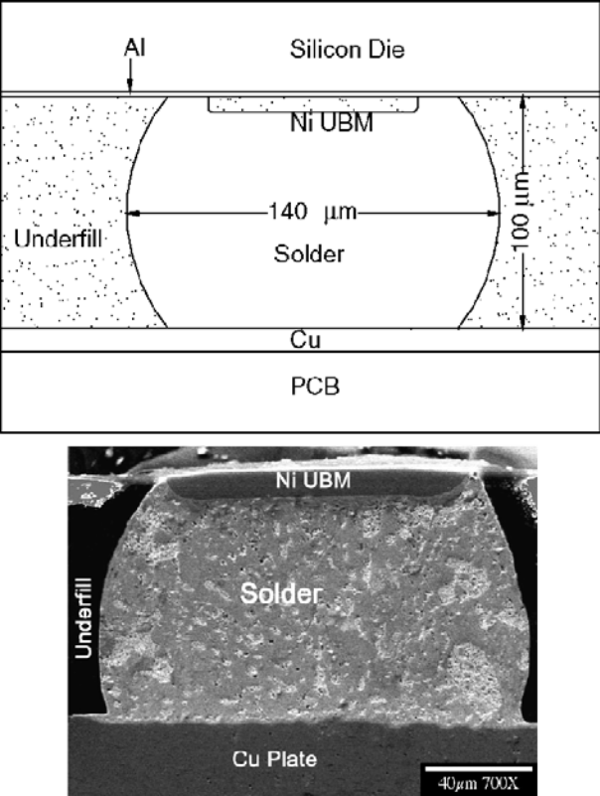
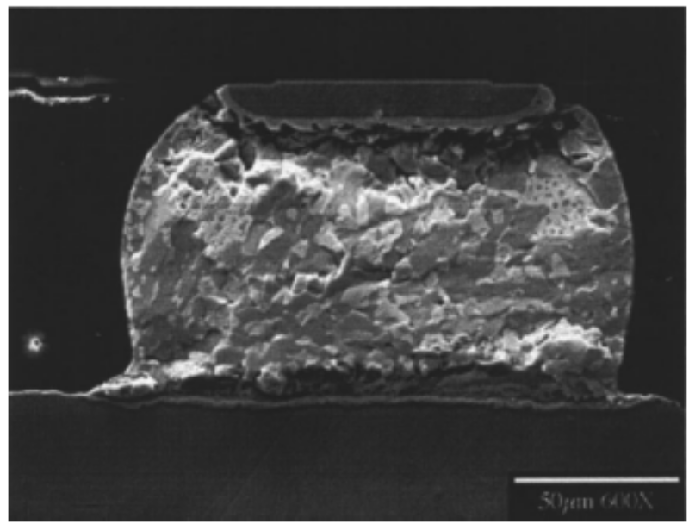
Introduction
Degradation & Failure in a Microelectronics Solder Joint under therm0-mechanical-electrical loads

Slide 5
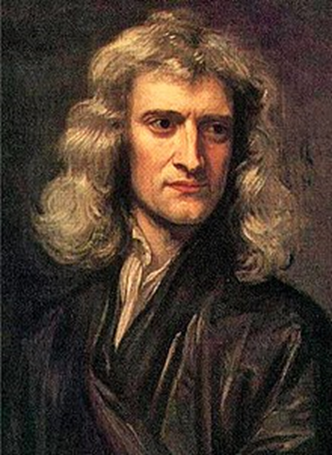
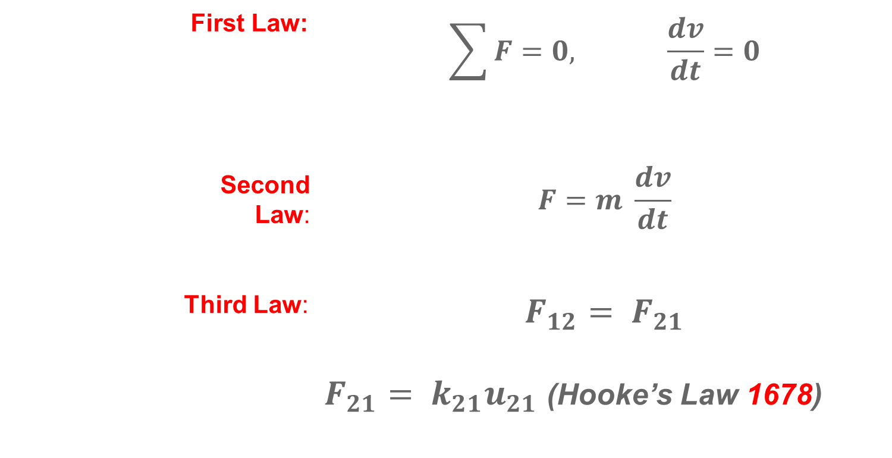
Newtonian Mechanics
Sir Isaac Newton’s work in “The Principia,” 1687
First Law: | $$\sum{F=0, \frac{dv}{dt}=0}$$
Second Law: | $$F=m \frac{dv}{dt}$$
Third Law: | $$F_{12}= F_{21}$$ $F_{21}= k_{21}u_{21}$ (Hooke’s Law 1678)

Slide 6

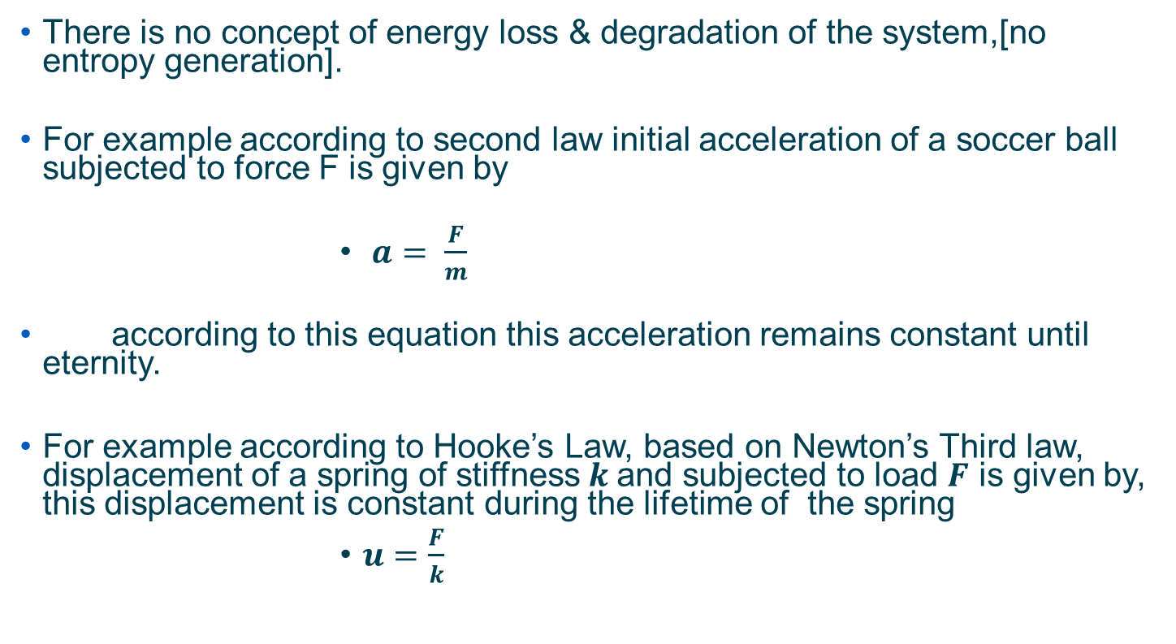
Shortcomings of Newton’s Laws
There is no concept of energy loss & degradation of the system,[no entropy generation].
For example according to second law initial acceleration of a soccer ball subjected to force F is given by
              $a= \frac{F}{m}$
according to this equation this acceleration remains constant until eternity.
For example according to Hooke’s Law, based on Newton’s Third law, displacement of a spring of stiffness $k$and subjected to load $F$ is given by, this displacement is constant during the lifetime of the spring
              $u=\frac{F}{k}$

Slide 7
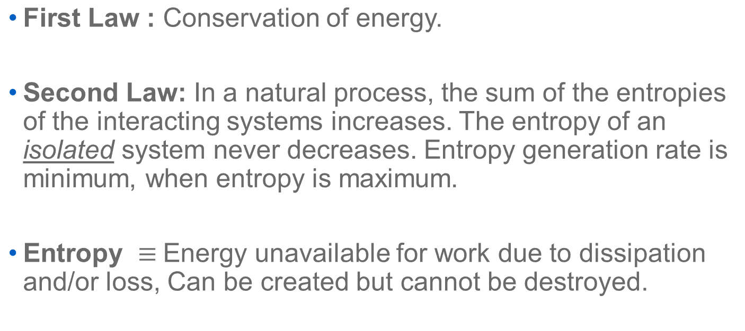
Laws of Thermodynamics
1850 Rudolf Clausius and William Thompson (Lord Kelvin) formulated both the First and Second Laws of Thermodynamics
First Law : Conservation of energy.
Second Law: In a natural process, the sum of the entropies of the interacting systems increases. The entropy of an isolated system never decreases. Entropy generation rate is minimum, when entropy is maximum.
Entropy $≡$Energy unavailable for work due to dissipation and/or loss, Can be created but cannot be destroyed.

Slide 8

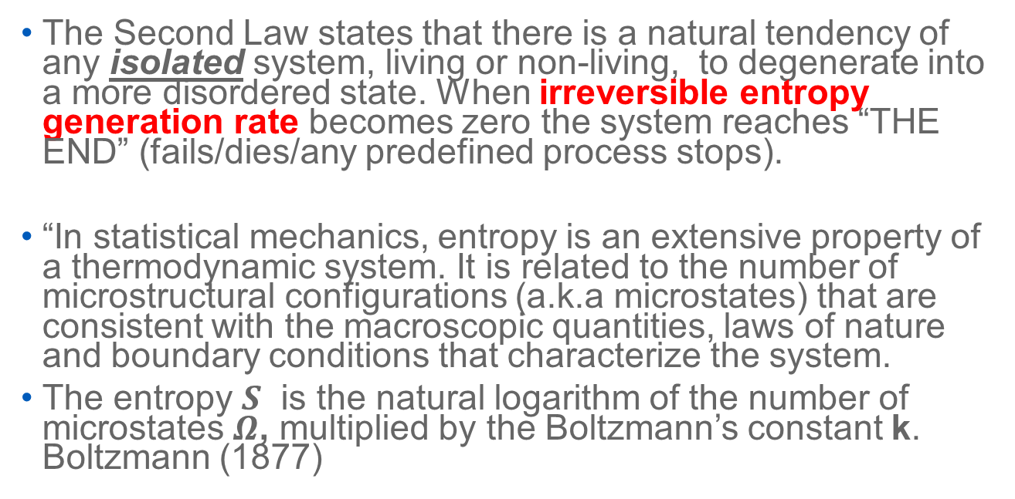
2nd Law of Thermodynamics – Entropy Law
The Second Law states that there is a natural tendency of any isolated system, living or non-living, to degenerate into a more disordered state. When irreversible entropy generation rate becomes zero the system reaches “THE END” (fails/dies/any predefined process stops).
“In statistical mechanics, entropy is an extensive property of a thermodynamic system. It is related to the number of microstructural configurations (a.k.a microstates) that are consistent with the macroscopic quantities, laws of nature and boundary conditions that characterize the system.
The entropy $S$ is the natural logarithm of the number of microstates $Ω$, multiplied by the Boltzmann’s constant k. Boltzmann (1877)
$$s=k \ln{Ω}$$
.

Slide 9
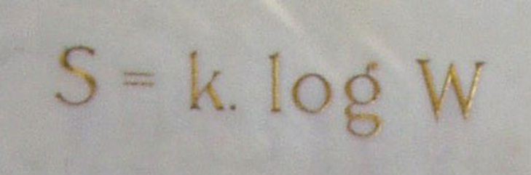
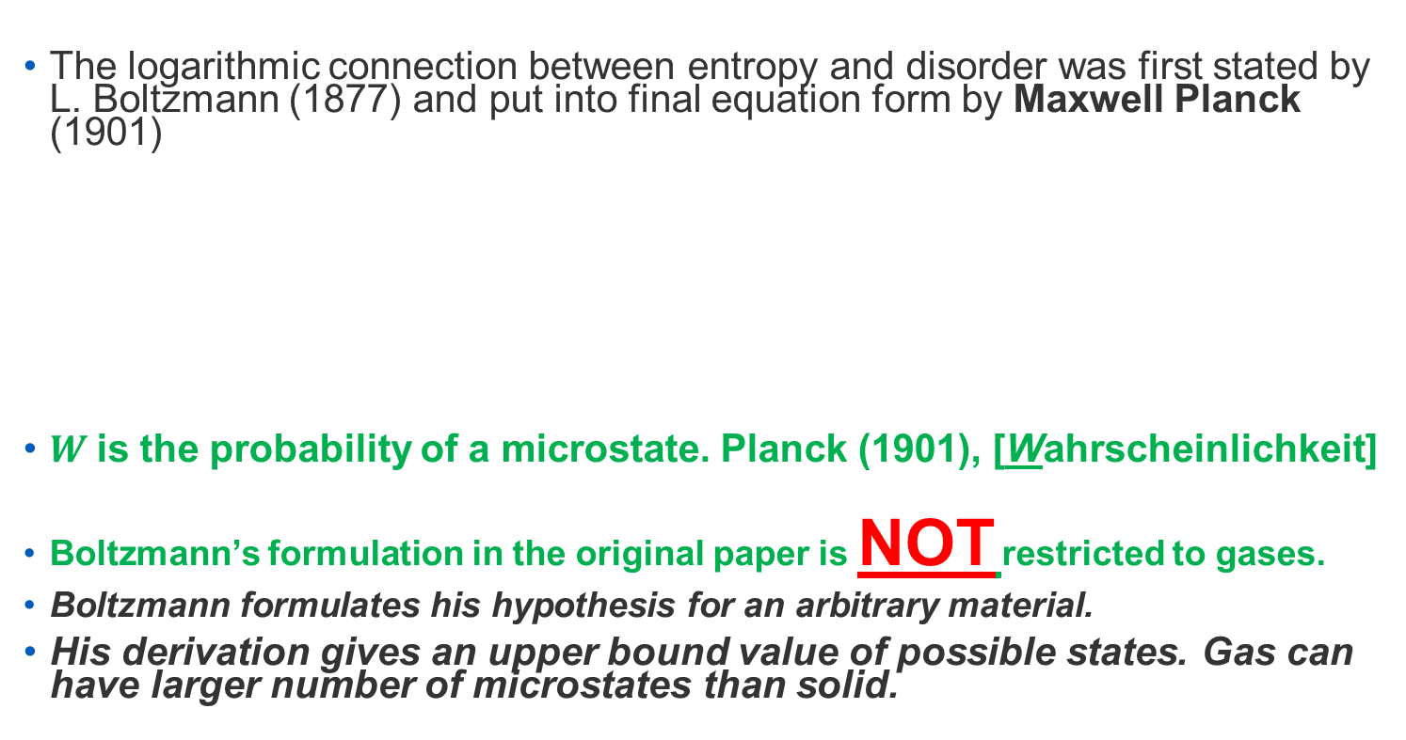
Relation Between Entropy and Disorder
The logarithmic connection between entropy and disorder was first stated by L. Boltzmann (1877) and put into final equation form by Maxwell Planck (1901)
$W$is the probability of a microstate. Planck (1901), [Wahrscheinlichkeit]
Boltzmann’s formulation in the original paper is NOT restricted to gases.
Boltzmann formulates his hypothesis for an arbitrary material.
His derivation gives an upper bound value of possible states. Gas can have larger number of microstates than solid.

Slide 10
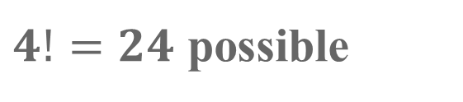
What is Entropy in Boltzmann’ formulation?
A
B
C
D
A
B
D
C
$4!=24$ possible
Description of
(a) order (reference state) (b) disorder
If two atoms are connected like a in solid, the number of microstates will be less than 24.

Slide 11
Reference
Kim Sharp and Franz Matschinsky, “Translation of Ludwig Boltzmann’s Paper “On the Relationship between the Second Fundamental Theorem of the Mechanical Theory of Heat and Probability Calculations Regarding the Conditions for Thermal Equilibrium” Sitzungberichte der Kaiserlichen Akademie der Wissenschaften. Mathematisch-Naturwissen Classe. Abt. II, LXXVI 1877, pp 373-435 (Wien. Ber. 1877, 76:373-435). Reprinted in Wiss. Abhandlungen, Vol. II, reprint 42, p. 164-223, Barth, Leipzig,1909” Entropy, 2015, 17, 1971-2009.

Slide 12
Newtonian Mechanics vs. Thermodynamics
Laws of Newtonian Mechanics provides the response to external disturbance in space-time coordinate system, but it does not take into account changes happening in the system or energy loss.
Terminology: The term “Newtonian Mechanics” is used here to define all it’s derivatives, such as Hamiltonian Mechanics and Lagrangian Mechanics and others
Laws of Thermodynamics, provides information about the changes and energy loss happening over time.

Slide 13
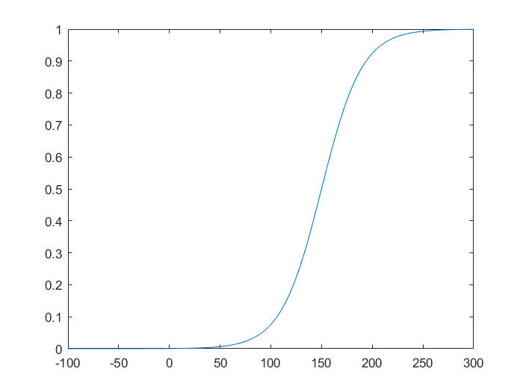
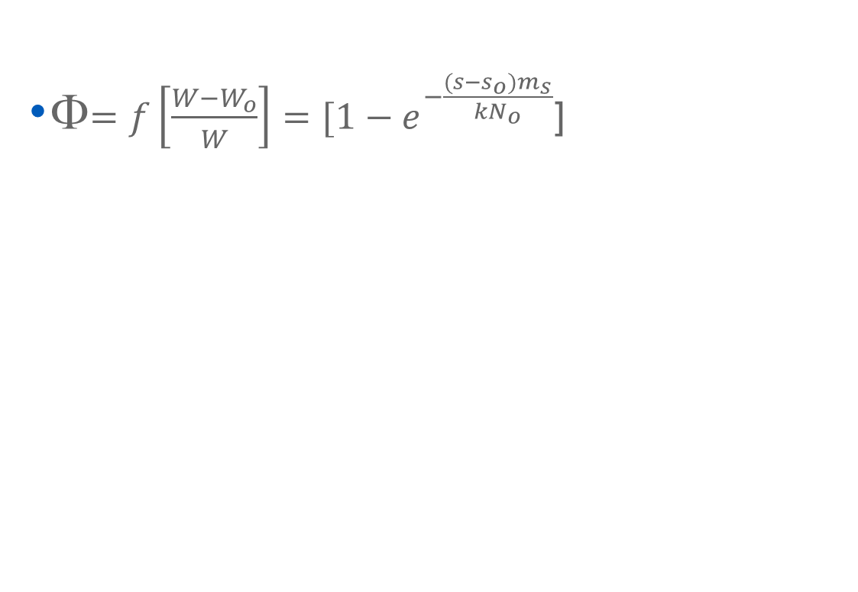
2nd Law of Thermodynamics is a “Universal Degradation Evolution Function”
Thermodynamic State Index (TSI): Φ
Φ$=f\left[\frac{W−W_{o}}{W}\right]=[1−e^{−\frac{(s−s_{o})m_{s}}{kN_{o}}}$]
TSI is normalized form of the second law of thermodynamics, from Boltzmann’s equation.

Slide 14
Thermodynamic State Index (TSI), Φ
In order to relate entropy and “damage/degradation/change/disorder”, consider a point in ground state Φ= 0 with a total entropy of S_{o} and an associated disorder parameter of W_{o} .
In an alternative disordered state, S is total entropy of the same point with an associated parameter of W and a TSI of Φ.
Change in microstructural configuration is difference in disorder from the initial reference state.
Φ= f(W, W_{o})

Slide 15
Irreversible Damage and Disorder
Externally applied energy will lead to permanent changes in microstructure described as a positive entropy production.
In solids “degradation” happens due to irreversible internal entropy production.
Since a disordered state is formed from an “ordered reference” state through irreversible entropy production, the change in TSI and entropy (the measure of disorder) are naturally related
James Rice, J. Mech. Phys. Solids, 1971, 19, 433-455. (Harvard University)
“ At any given temperature and pattern of internal rearrangement within the material, the rate at which any specific structural arrangement occurs is fully determined by the thermodynamic forces”
.

Slide 16
P₁, V₁, N₁, T₁, C₁, …
①
movable adiabatic separation wall
P₂, V₂, N₂, T₂, C₂, …
②
the basic problem of thermodynamics is the determination of the equilibrium state that eventually results after the removal of internal constraints in a closed composite system” Callen (1985.)
This basic problem can be solved if the entropy of the system is known as a function of the intrinsic parameters of the system.
The relation that gives the entropy as a function of the system parameters is known as a fundamental relation. It therefore follows that if the fundamental relation of a particular system is known, all conceivable thermodynamic information about the system can be obtained from it. Essentially if the fundamental relation of a system is known every thermodynamic attribute is completely and precisely determined”. H.B. Callen (1985) Thermodynamics and Introduction to Thermostatistics

Slide 17
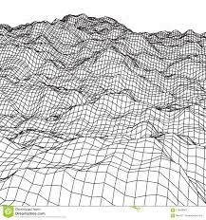
Definition of Thermodynamic State Index
Energy Topology
TSI =0
TSI =1
All organic and inorganic systems exist on a energy topology.

Slide 18
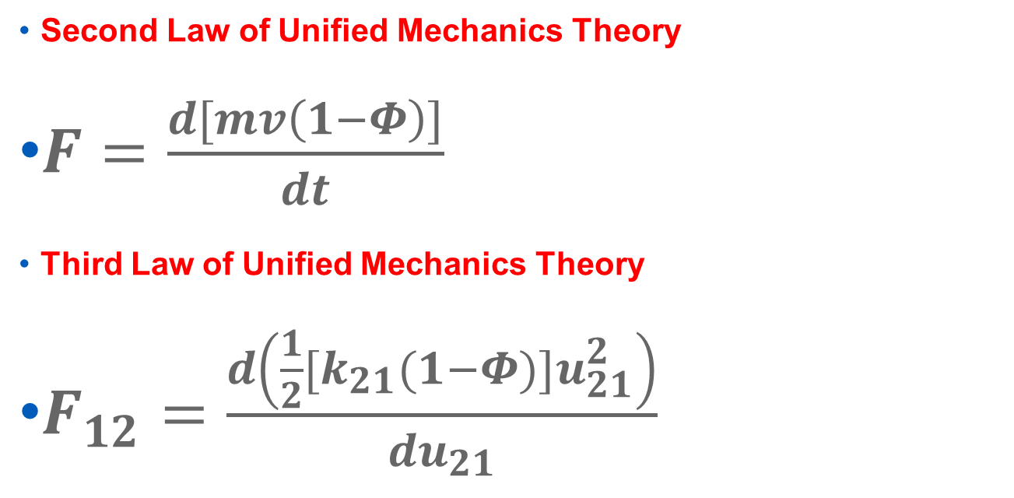
Laws of Unified Mechanics Theory are obtained by combining Newton’s and Thermodynamics Laws in single equations
Second Law of Unified Mechanics Theory
$F=\frac{d[mv\left(1−Φ\right)]}{dt}$
Third Law of Unified Mechanics Theory
$F_{12}=\frac{d\left({\frac{1}{2}[k}_{21}(1−Φ)]u_{21}^{2}\right)}{{du}_{21}}$

Slide 19
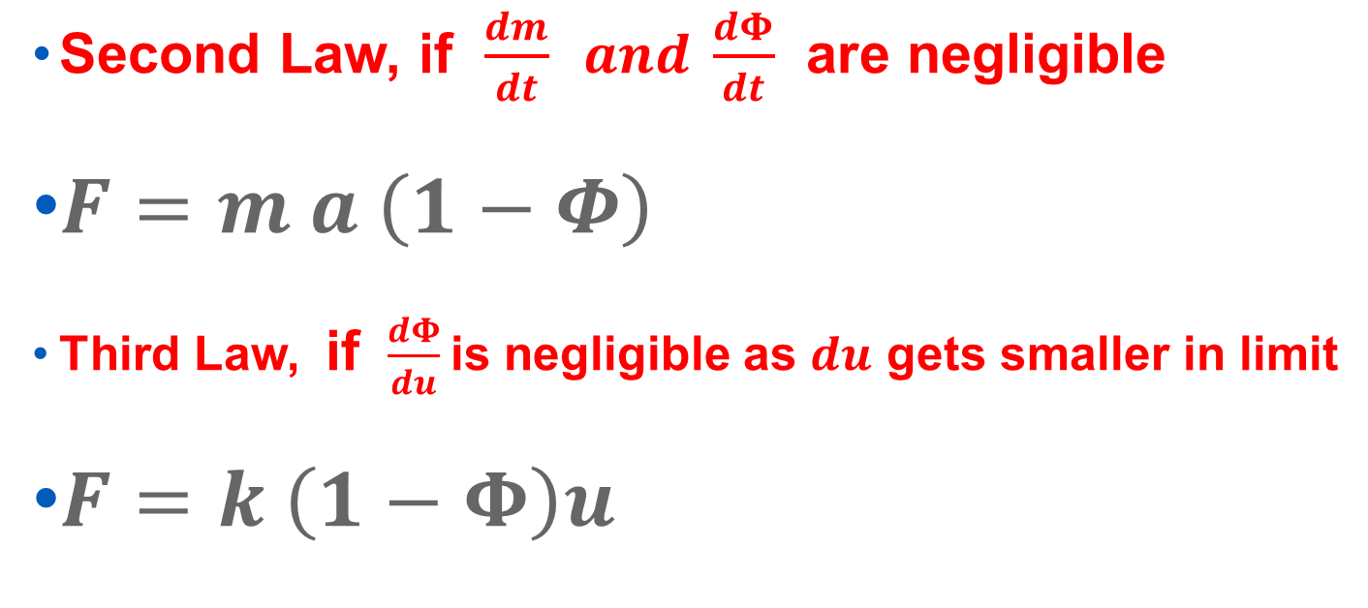
Unified Mechanics Theory Laws
Second Law, if $\frac{dm}{dt} and \frac{dΦ}{dt}$ are negligible
$F=m a \left(1−Φ\right)$
Third Law, if $\frac{dΦ}{du}$is negligible as $du$ gets smaller in limit
$F=k \left(1−Φ\right)u$

Slide 20

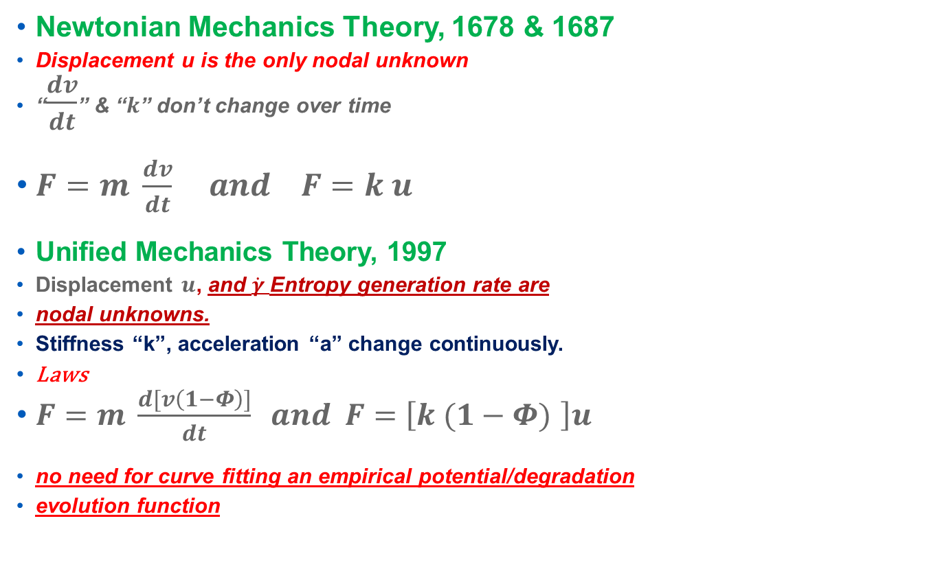

Laws of Unified Mechanics vs. Newtonian Mechanics
Newtonian Mechanics Theory, 1678 & 1687
Displacement u is the only nodal unknown
“$\frac{dv}{dt}$” & “$k$” don’t change over time
$F=m \frac{dv}{dt} and F=k u$
Unified Mechanics Theory, 1997
Displacement $u$, and $\dot{γ}$Entropy generation rate are
nodal unknowns.
Stiffness “k”, acceleration “a” change continuously.
Laws
$F=m \frac{d[v\left(1−Φ\right)]}{dt} and F=\left[k (1−Φ) \right]u$
no need for curve fitting an empirical potential/degradation
evolution function
U, $\dot{γ}$
P

Slide 21



Coordinates in Unified Mechanics Theory
Y
Thermodynamic State Index (TSI)
0.99
=
5 year old
Stage4 cancer
100 year old
0
5 year old
X
100 year old
Z
Time

Slide 22
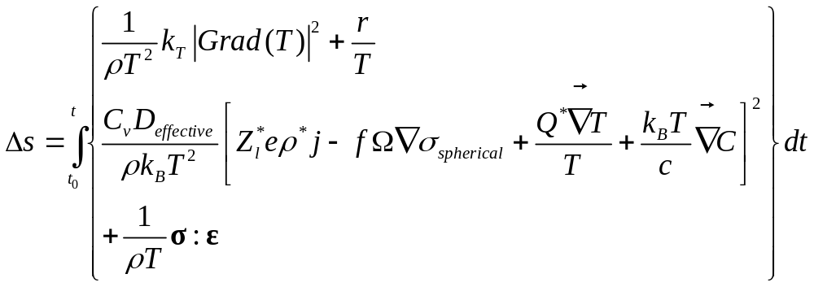
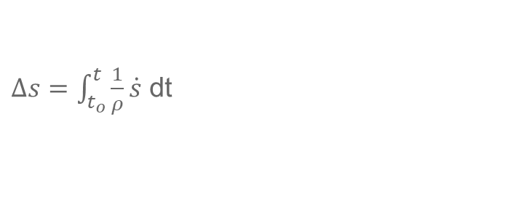
fundamental equation entropy generation as a function of the system parameters in a microelectronics solder joint under high current density
$Δs=\int_{t_{o}}^{t}{\frac{1}{ρ}\dot{s}}$ dt
Irreversible Entropy Production due to
1- Internal heat generation
2- Diffusion mechanisms (Electromigration, stress gradient, thermomigration, and vacancy (chemical) concentration gradient
3- Internal mechanical work

Slide 23
The first publication of this theory and mathematical framework
Basaran, C. and Yan, C. Y., “A Thermodynamic Framework for Damage Mechanics of Solder Joints”, Trans. ASME J. of Electronic Packaging, 120, 379-384,1998.
Basaran, C. and Nie, S., “An Irreversible Thermodynamics Theory for Damage Mechanics of Solids” International Journal of Damage Mechanics, Vol. 13, 3, 205-224, July 2004
Additional Mathematical Basis
Sosnovskiy, L.A. and Sherbakov, S.S. “Mechanothermodynamic Entropy and Analysis of Damage State of Complex Systems”, Entropy (2016), 18, 268;

Slide 24
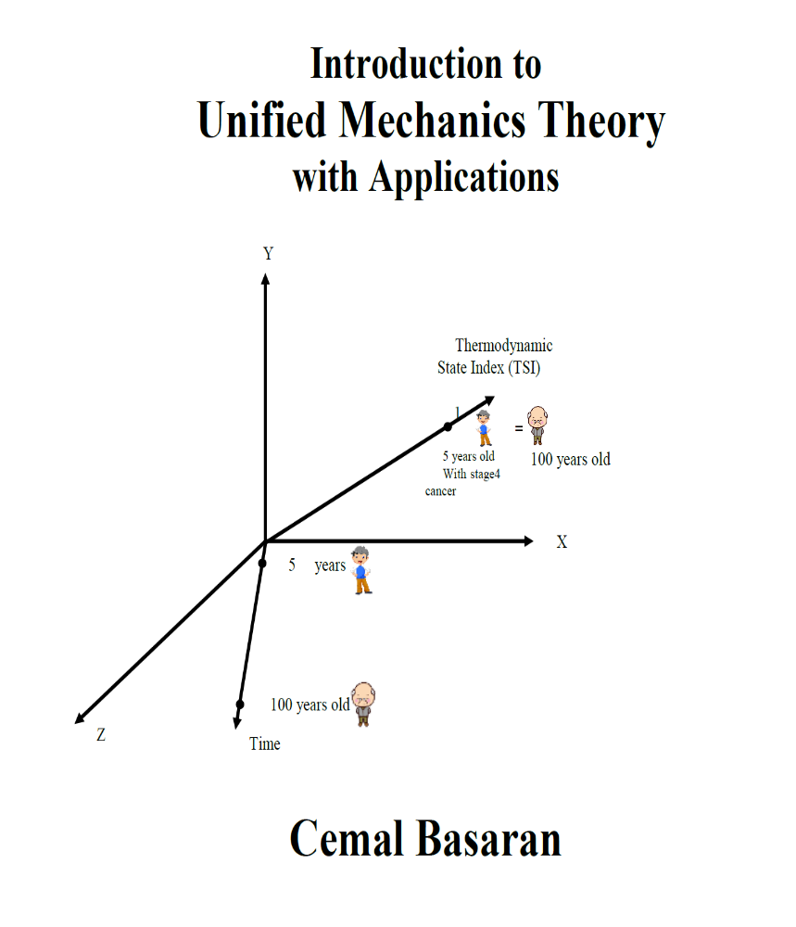
Will be on the market August 2020

Slide 25

Special Issue: "Entropy Based Fatigue, Fracture, Failure Prediction and Structural Health Monitoring"
Impact Factor
Current Impact Factor: 2.419
5-year Impact Factor: 2.505
Special Issue Editor: Cemal Basaran
https://www.mdpi.com/journal/entropy/special_issues/fatigue
June 2020.

Slide 26
Experimental Verifications

Slide 27
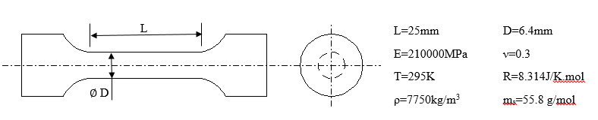
Fatigue Loading on A-36 Steel

Slide 28
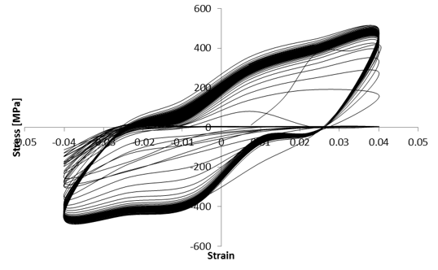
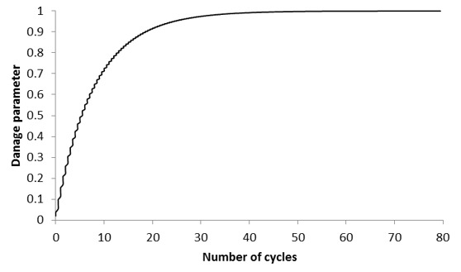
Fatigue Loading –TSI (F)– Calculated from Experiment

Slide 29
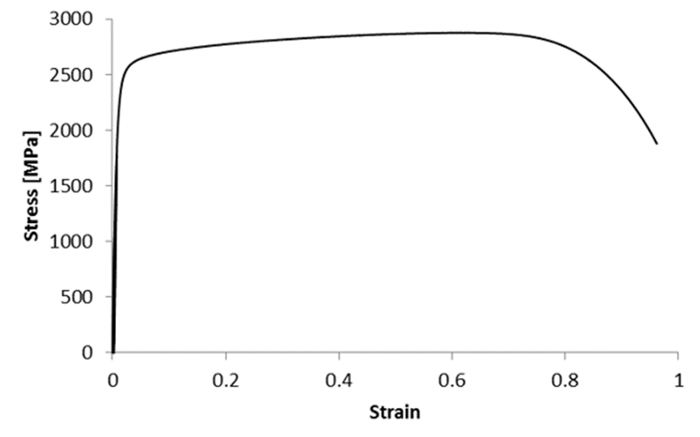
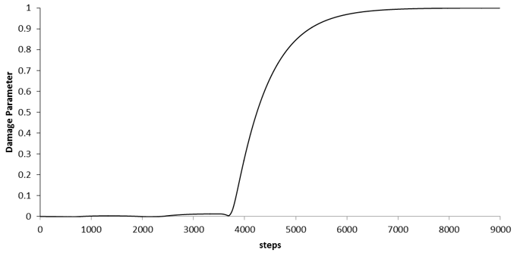

Monotonic Loading Test
$$\%$$
TSI (Φ) Evolution - Calculated from Experiments

Slide 30

Thank you for listening
QUESTIONS

Slide 31
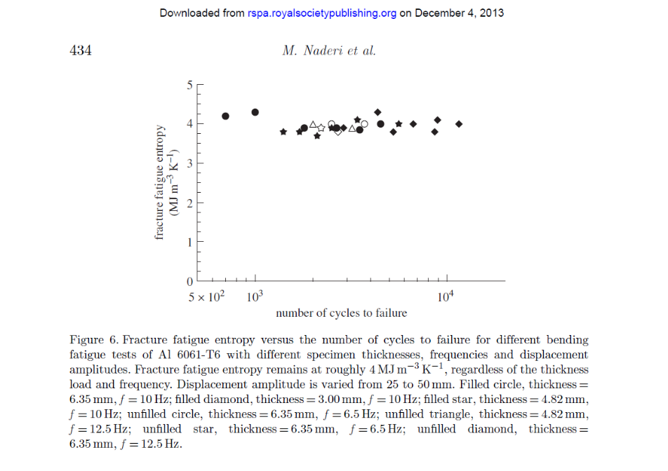
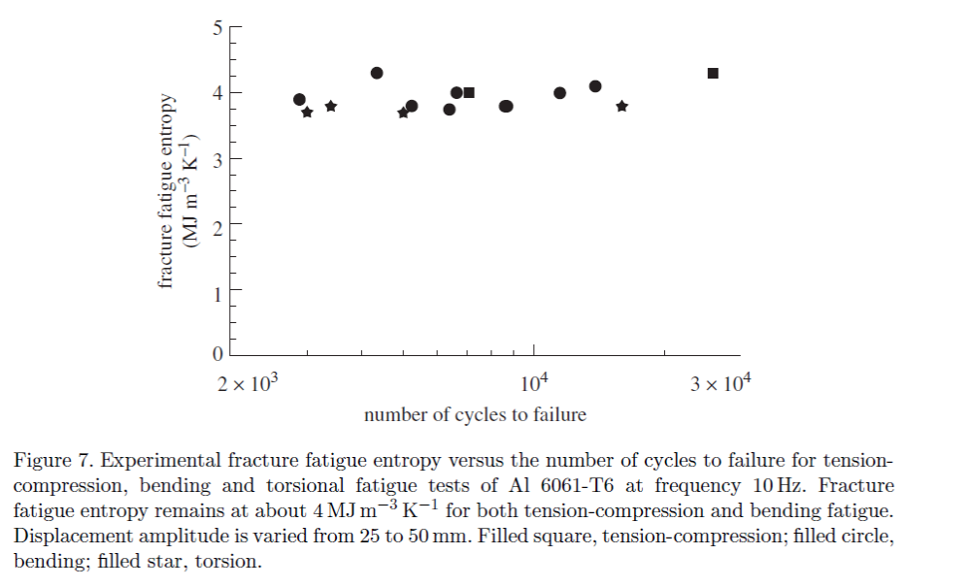
M. Naderi, M. Amiri and M. M. Khonsari , «On the thermodynamic entropy of fatigue fracture” Proceedings of the Royal Society A (2010) 466,423–438
“A thermodynamic approach for the characterization of material degradation, which uses the entropy generated during the entire life of the specimens undergoing fatigue tests is used. Results show that the cumulative entropy generation is constant at the time of failure and is independent of geometry, load level and load frequency.”

Slide 32
K. N. Tu, and A. M. Gusak “A unified model of mean-time-to-failure for electromigration, thermomigration, and stress-migration based on entropy production”, Journal of Applied Physics 126, 075109 (2019)
“On the basis of entropy production, we provide a unified model of MTTF for thermomigration and stress-migration.
In general, the input from all sources of entropy production should be taken into account simultaneously
We use accumulated entropy as a parameter of failure of the [3-D IC] device, and in turn as the link between MTTF and threshold entropy.”

Slide 33
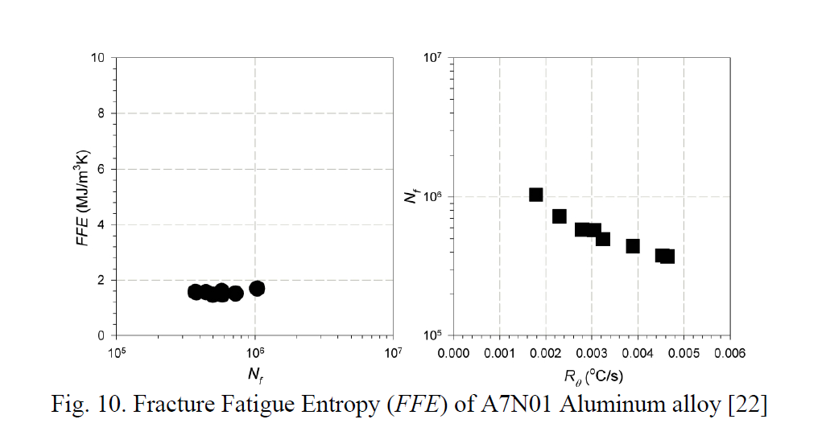

J.Y. Yang and M.M. Khonsari ‘On the Evaluation of Fracture Fatigue Entropy” Theoretical and Applied Fracture Mechanics, 96 (2018), 351-361
Results show that the Fracture Fatigue Entropy remains
constant and the fatigue failure prediction using the
entropy is independent of the loading condition, loading
frequency, and the sample geometry.

Slide 34
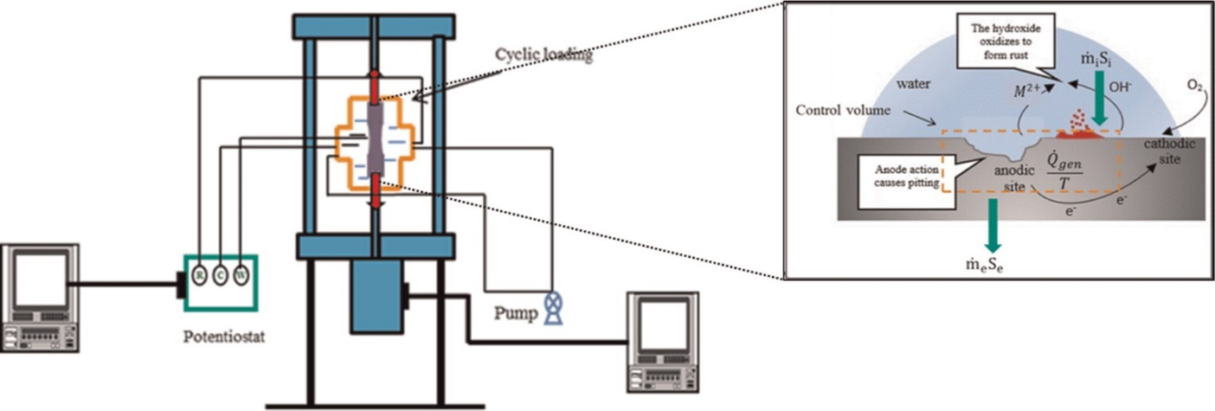
Imanian, A., Modarres, M., “A Thermodynamic Entropy-Based Damage Assessment with Applications to Prognosis and Health Management”, Structural Health Monitoring, (2018) Vol. 17(2) 240–254
“We therefore conclude that entropy generation can be used to assess the degree of damage, the amount of the life of materials expended and the extent of the life remaining”.
Figure Entropy flow in the control volume under corrosion-fatigue

Slide 35
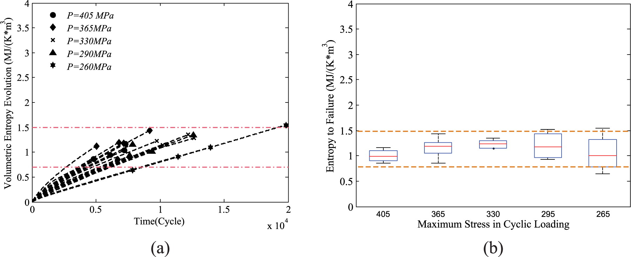
Volumetric entropy generation evolution. In the Figure 2(a), P represents the tensile stress.
Imanian, A., Modarres, M., “A Thermodynamic Entropy-Based Damage
Assessment with Applications to Prognosis and Health Management”,
Structural Health Monitoring, 2018, Vol. 17(2) 240–254
DOI: 10.1177/1475921716689561

Slide 36
Jundong Wang and Yao Yao” An Entropy Based Low-Cycle Fatigue Life Prediction Model for Solder Materials”
Entropy 2017, 19, 503; doi:10.3390/e19100503
Jundong Wang and Yao Yao” An Entropy Based Failure Prediction Model for the Creep and Fatigue of Metallic Materials,” Entropy, 2019, 21(11), 1104
“Eight groups of experiments were performed under different aging treatment and experiment conditions. The fatigue life predictions agree well with experimental data.”

Slide 37
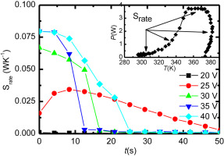
Angel Cuadras, Ramon Romero, Victoria J. OvejasEntropy characterization of overstressed capacitors for lifetime prediction, Journal of Power Sources, Volume 336, 30 December 2016, Pages 272–278
“We proposed a method to estimate ageing in electrolyte capacitors based on a measurement of entropy generation rate, S..”
Time evolution of, entropy generation rate S_ and capacitance for the capacitor 33 mF capacitor biased with a 4 V pulsed excitation.

Slide 38
Angel Cuadras, Jiaqiang Yao, and Marcos Quilez,” Determination of LEDs degradation with entropy generation rate” Journal of Applied Physics 122, 145702 (2017); doi: 10.1063/1.4996629
Conclusions
A correlation between LED’s optical fade and entropy generation rate was found.
Note: A Light-Emitting Diode is a two-lead semiconductor light source.
It is a p–n junction diode that emits light when activated.

Slide 39
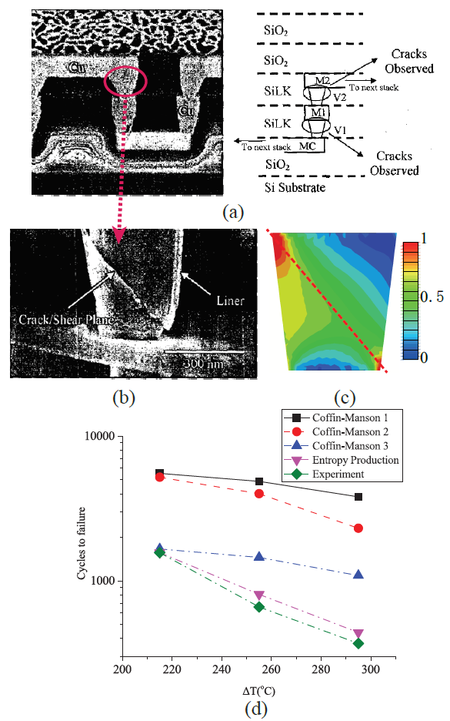
Tianchen Wang, Sandeep Kumar Samal, Sung Kyu Lim, and Yiyu Shi, “
“Entropy Production Based Full-Chip Fatigue Analysis: From Theory to Mobile Applications”, IEEE Transactions on Computer-Aided Design of Integrated Circuits and Systems, PP(99):1-1 4/2018. DOI 10.1109/TCAD.2018.2803623

Slide 40
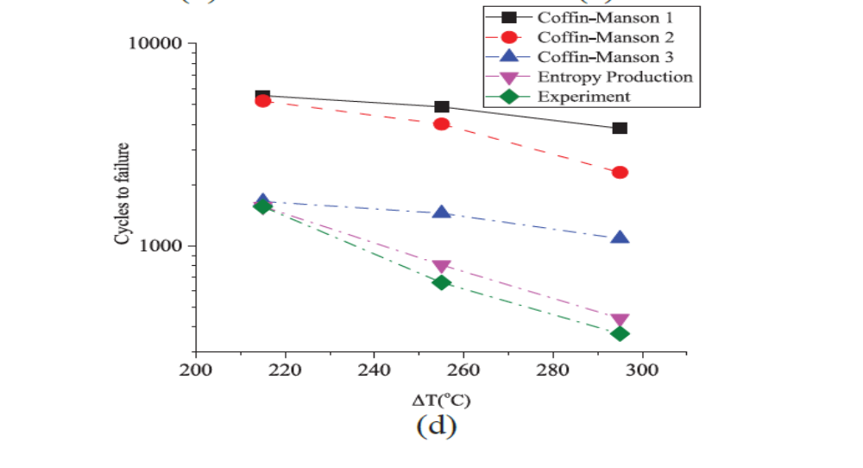
Comparison of Experiments, UMT, Coffin_Manson

Slide 41
Colin Yung and Ganesh Subbarayan, “Maximum Entropy Models for Fatigue Damage in Metals with Application to Low-Cycles Fatigue of Aluminum 2024-T351”, Entropy, 2019, 21(10), 967
The developed damage models are shown to more accurately and consistently describe fatigue life than several alternative damage models, including the Weibull distribution function and the Coffin-Manson relation.

Slide 42
Huisung Yun* and Mohammad Modarres
Measures of Entropy to Characterize Fatigue Damage in Metallic Materials, Entropy 2019, 21,(8), 804
Classical thermodynamic entropy provide a reasonably constant level of entropic endurance to fatigue failure. Thermodynamic entropy was shown to be an appropriate index of damage.

Slide 43
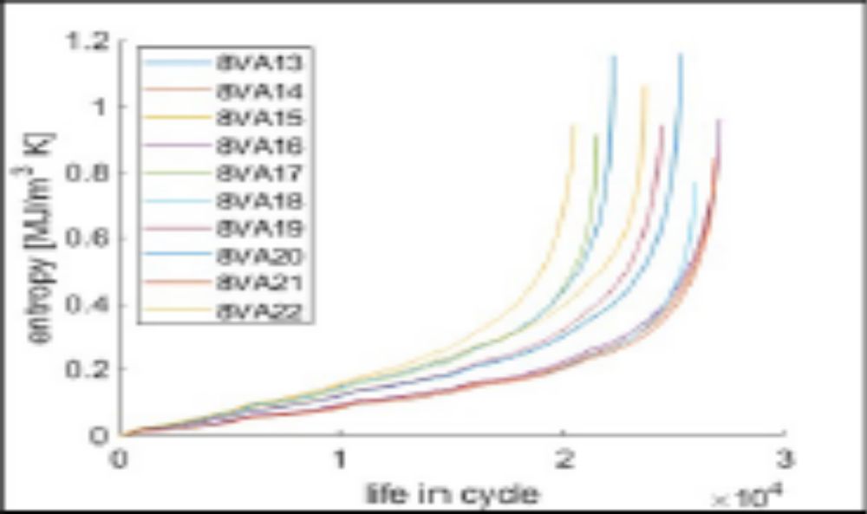
Huisung Yun and Mohammad Modarres, “Measures of Entropy to Characterize Fatigue Damage in Metallic Materials”, Entropy (2019), 21, ,(8), 804
Cumulative classical thermodynamic entropy for ten tests
Conclusions “…..Classical thermodynamic entropy shown to be an appropriate index of damage”

Slide 44
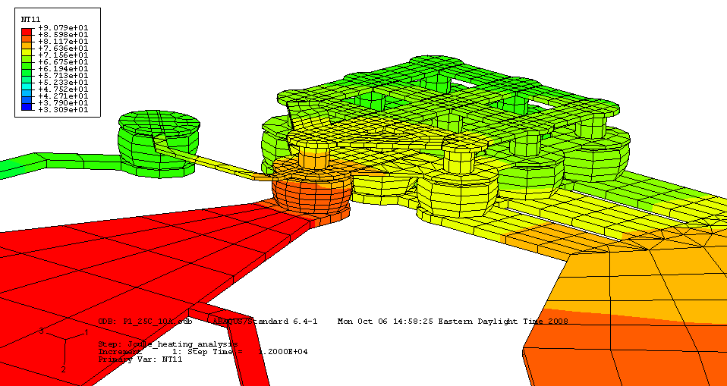
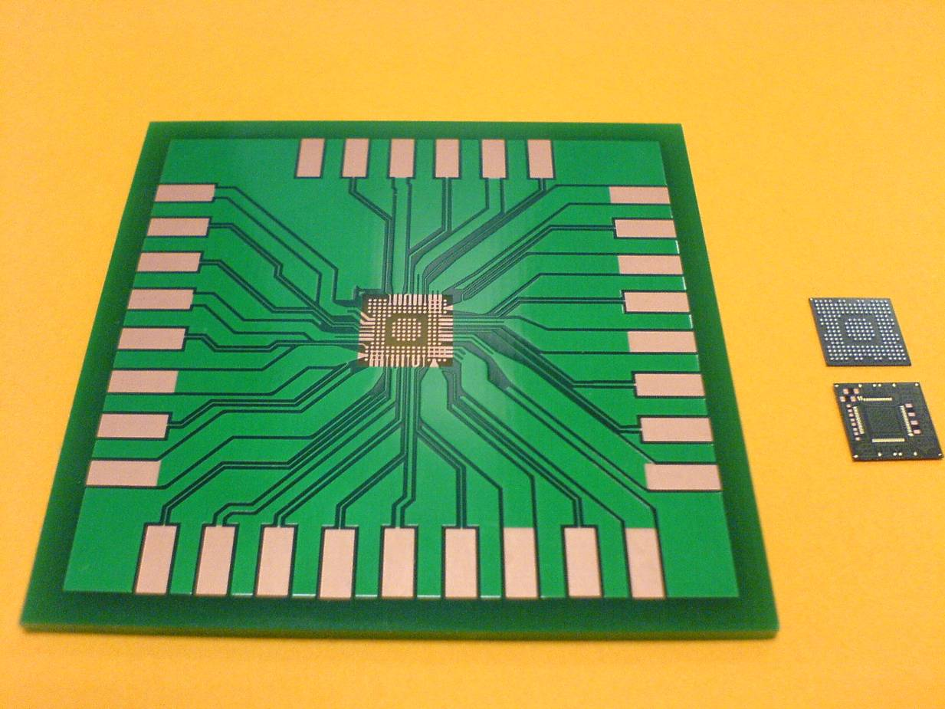
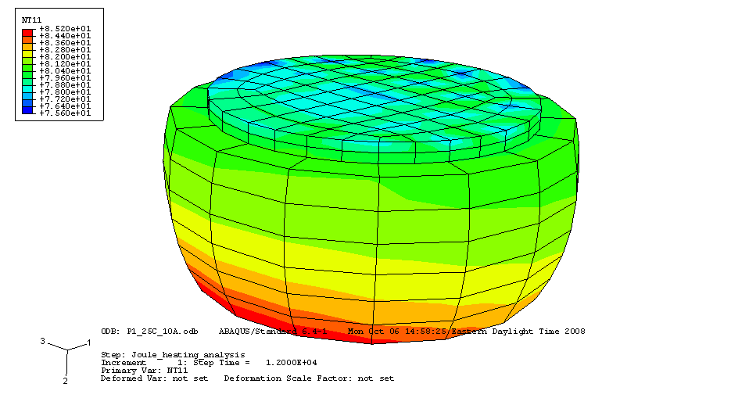
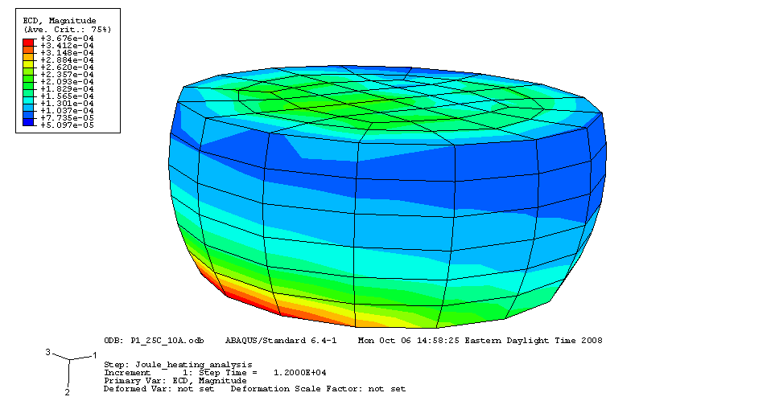
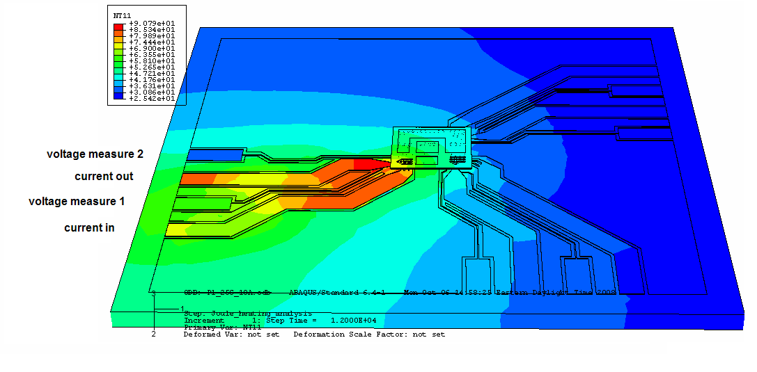
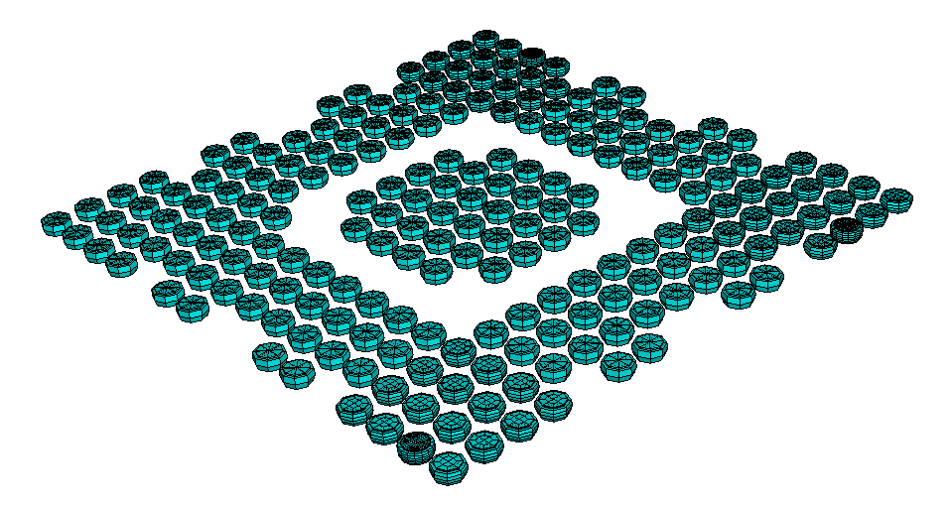
Thermal Cycling of a Computer Chip
test ball 3
test ball 2
test ball 1

Slide 45
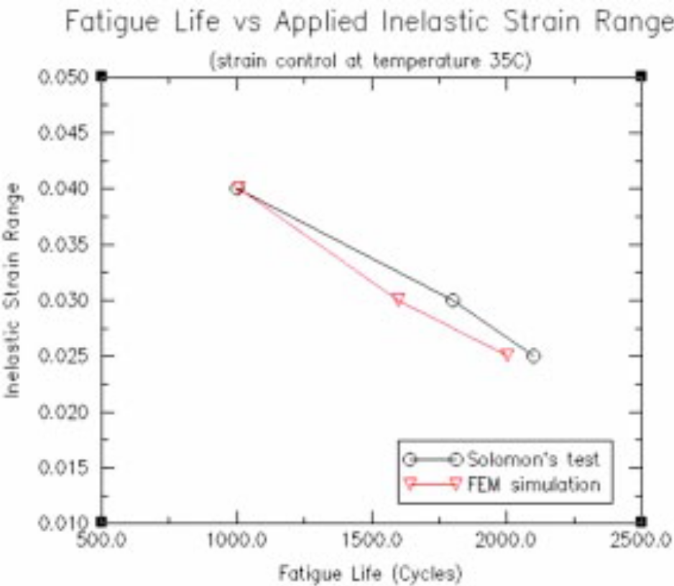
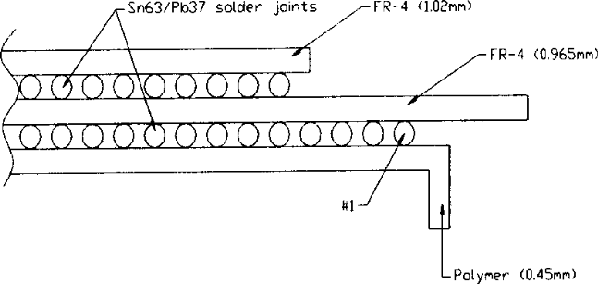
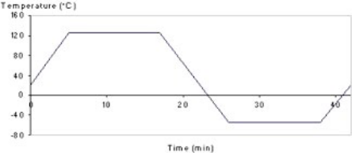
Fatigue due to Temperature Cycling
Basaran, C. , Tang, H. ”Implementation of a Thermodynamic Framework for Damage Mechanics of Solder Interconnects in Microelectronic Packaging,” International Journal of Damage Mechanics, Vol. 11, No. 1, pp. 87-108, January 2002.

Slide 46
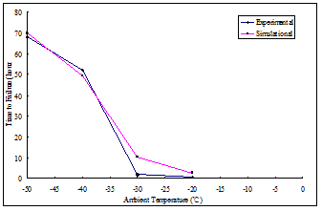
Time to Failure under Electromigration + Thermomigration for different Ambient Temperatures

Slide 47
Time to Failure : Simulation vs. Test Data
Current Density | Experiment Data TTF=a/j³e ^{(b/T)} ^{(hours)} | Simulation Results (Φ_{cr}=1) (hours)
1.0x 10⁴ Amp/cm² | 228.7 | 222.41
0.8 x 10⁴ Amp/cm² | 446.6 | 435.33
0.6 x 10⁴ Amp/cm² | 1058.7 | 1098.2
Basaran,C., Li, S., Hopkins, D.C. and Veychard, D. "Electromigration time to failure of SnAgCuNi solder joints“ Journal of Applied Physics. 106, 013707 (2009)

Slide 48
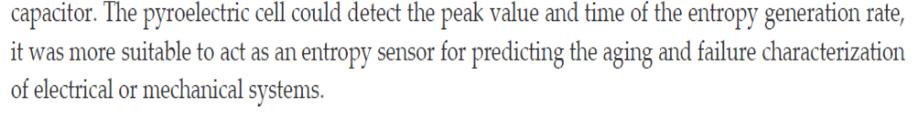
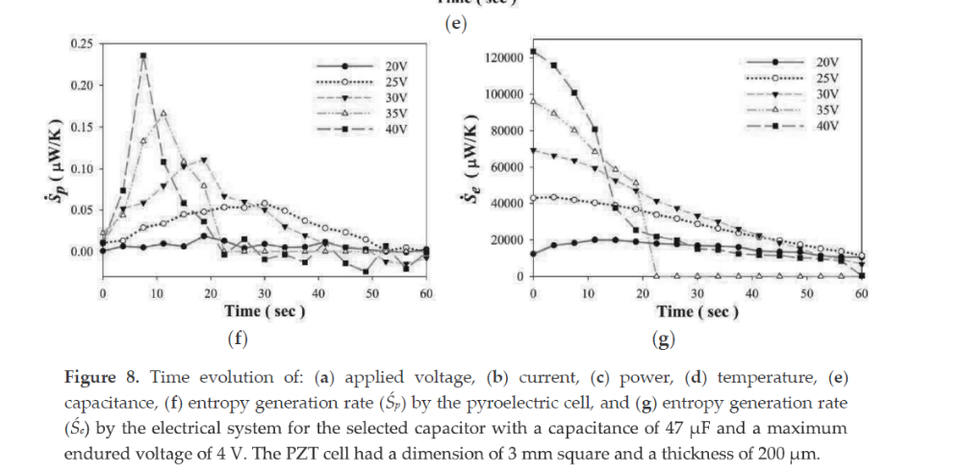
TChun-Ching Hsiao,and Bo-Hao Liang
The Generated Entropy Monitored by Pyroelectric
Sensors, Sensors, 2018, 18, 3320; doi:10.3390/s18103320

Slide 49
J. Osara and M. Bryant” Thermodynamics of Fatigue: Degradation-Entropy Generation Methodology for System and Process Characterization and Failure Analysis, Entropy, 2019, 21(7), 685;
“…..A near 100% agreement between the fatigue model and measurements is achieved on torsion fatigue of steel sample SS 304 “

Slide 50
JA Osara and MD Bryant, “Thermodynamics of Lead-Acid Battery Degradation: Application of the
Degradation-Entropy Generation Methodology “ Journal of the Electrochemical Society, (2019)
“. The model combines thermodynamic first principles with the Degradation-Entropy Generation theorem, to relate instantaneous and cyclic capacity fade (loss of useful charge-holding capacity) in the lead-acid battery to the entropy generated via the underlying dissipative physical processes responsible for battery degradation.”
“A near 100% agreement between the thermodynamic battery model and measurements is achieved. The model also gives rise to new material and design parameters to characterize all lead-acid batteries. “

Slide 51
A. Cuadras, P. Miró , VJ. Ovejas and F. Estrany ”Entropy generation model to estimate battery ageing, Entropy (2019), 20, (in print)
“We aim to determine battery ageing in terms of irreversible entropy production because entropy describes transformations and entropy production combines voltage, current and temperature effects in a single function.”
“We have devised a methodology to monitor battery ageing using internal entropy production.”

Slide 52
LA Sosnovskiy and S. Sherbakov, “On the Development of Mechanothermodynamics as a New Branch of Physics” Entropy, 2019, 21, 1188;
“This paper aims to substantiate and formulate the main principles of the physical discipline-mechanothermodynamics that unites Newtonian mechanics and thermodynamics. Its principles are based on using entropy as a bridge between mechanics and thermodynamics. Mechanothermodynamics combines two branches of physics, mechanics and thermodynamics, to take a fresh look at the evolution of complex systems.
It is shown that a generalized physical discipline—mechanothermodynamics—can becreated by making two main bridges. The first one is the tribo-fatigue entropy that allowed transfer from thermodynamics to mechanics. The second one is the fundamental tribo-fatigue understanding of irreversibility of damage of everything that allowed transfer from mechanics to thermodynamics.”

Slide 53
LA Sosnovskiy and S. Sherbakov, “On the Development of Mechanothermodynamics as a New Branch of Physics” Entropy, 2019, 21, 1188;
“The analysis of more than 600 experimental results allowed for determining a unified mechanothermodynamical function of limiting states (critical according to damageability) of polymers and metals. They are also known as fatigue fracture entropy states. “

Slide 54
Temperature Dependent Fatigue
Liakat, M. and Khonsari, M.M. “Entropic Characterization of Metal Fatigue with Stress Concentration”, Int. Journal of Fatigue, 70, (2015) 223-234
“………fatigue fracture entropy can predict fatigue life at different temperatures and different stress levels perfectly.”

Slide 55
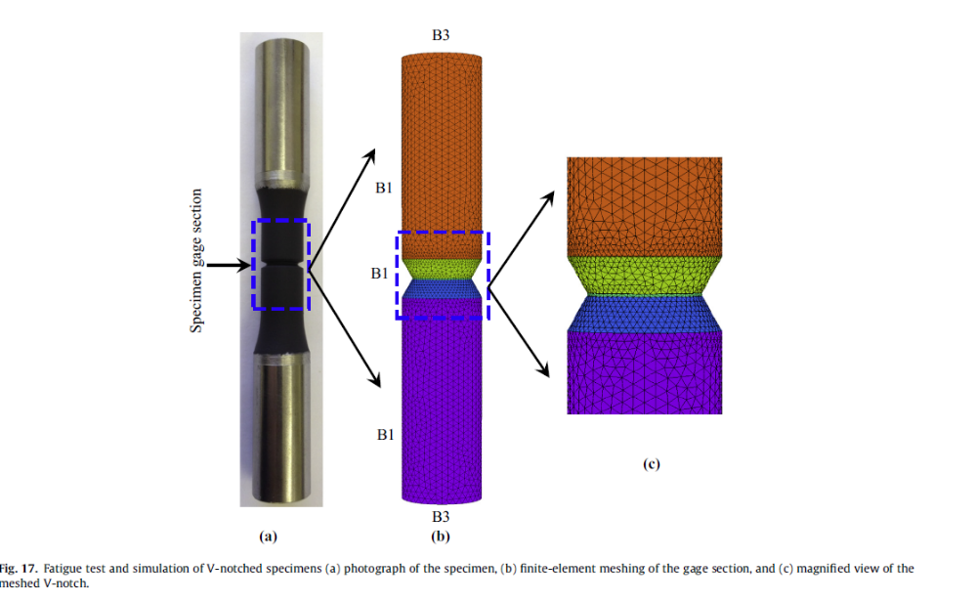

Slide 56
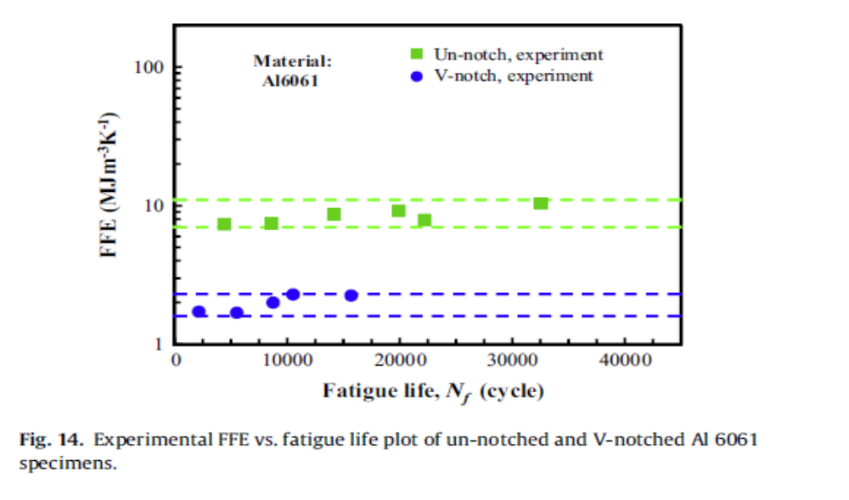
Liakat, M. and Khonsari, M.M. “Entropic Characterization of Metal Fatigue with Stress Concentration”, Int. Journal of Fatigue, 70, (2015) 223-234

Slide 57
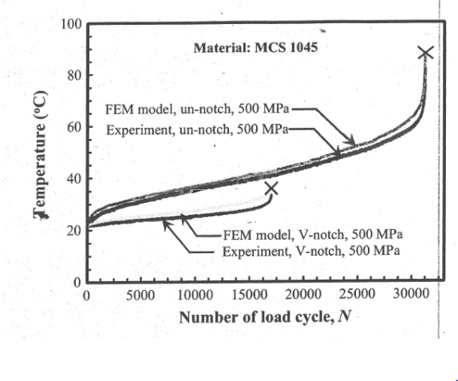
Temperature Dependent Fatigue Testing
Liakat, M. and Khonsari, M.M. “Entropic Characterization of Metal Fatigue with Stress Concentration”, Int. Journal of Fatigue, 70, (2015) 223-234

Slide 58
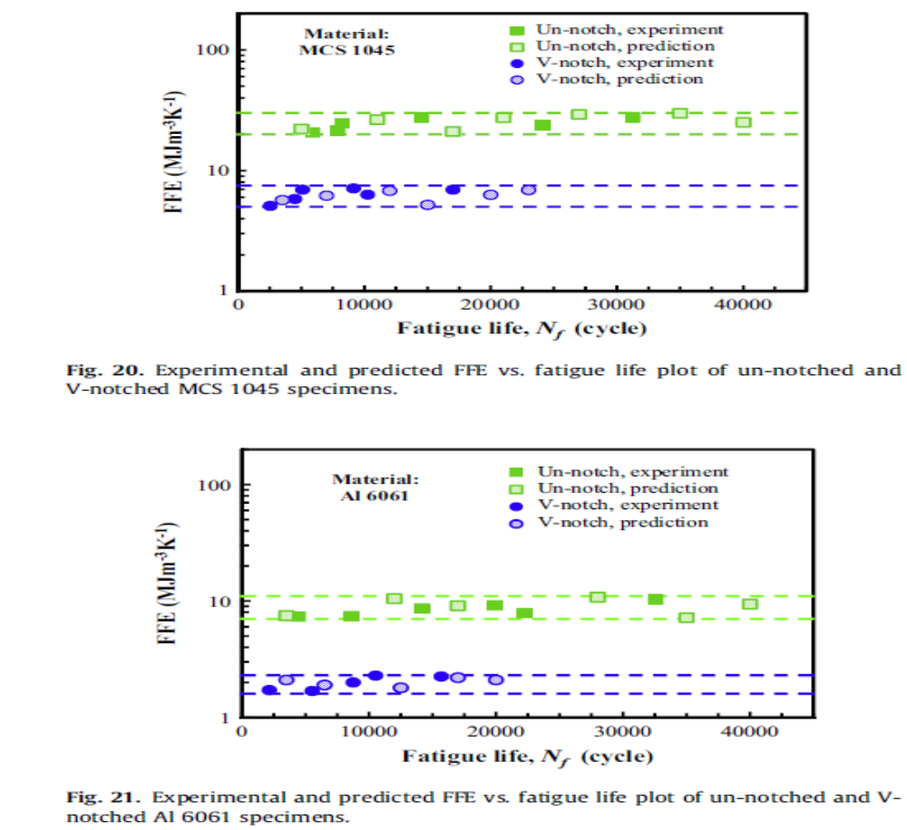

Slide 59
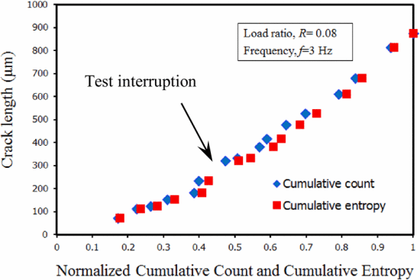
M. Amiri ; M. Modarres E.L. Droguett,” AE Entropy for Detection of Fatigue Crack Initiation and Growth,” 2015 IEEE Conference on Prognostics and Health Management (PHM), DOI: 10.1109/ICPHM.2015.7245038
The results showed that the evolutions of the AE entropy estimated in the time domain correlates well with the evolution of the AE hit count

Slide 60
Huisung Yun and Mohammad Modarres, “Measures of Entropy to Characterize Fatigue Damage in Metallic Materials”, Entropy (2019), 21(8), 804.
Cumulative classical thermodynamic entropy for ten tests
Conclusions “…..Classical thermodynamic entropy shown to be an appropriate index of damage”

Slide 61

NB Jamal, A. Kumara, CL Rao, and C. Basaran, «Fatigue Life Prediction Using Unified Mechanics Theory in Ti-6Al-4V Alloys” Entropy (2019) (in review)

Slide 62
CONCLUSIONS
Space-Time-TSI coordinate system is essential to define a point in any system.
Unified Mechanics Theory replaces Newtonian Mechanics Theory to govern actual response of any system during its lifetime.
Unified Mechanics Theory requires analytical derivation of fundamental equation of the material/structure including all mechanisms that generate entropy under the given load, (i.e. mechanical, thermal, chemical, electrical, radiation, corrosion etc.)

Slide 63
Thank you for listening
QUESTIONS

