Slide 1
PROPOSED PRINCIPLES OF ECONOMICS:
BIOSYMMETRY AND HIERARCHIC SYMMETRY
Presentation WP120-W138
By Garvin H Boyle
Orrery Software, PO Box 1149, Richmond,
Ontario, Canada, K0A 2Z0
Orrery@Rogers.Com
Proceedings of the IAISAE 2020
International Conference on Thermodynamics 2.0
June 22-24, 2020, Worcester, MA, USA
Notes:
Good afternoon, ladies and gentlemen. By name is Garvin Boyle. This afternoon I want to talk about two proposed principles for a science of economics – biosymmetry and hierarchic symmetry.
{Click}

Slide 2
BIOSYMMETRY AND HIERARCHIC SYMMETRY
Agenda
Introduction
  In search of the principles of an "economic science”.
  Part of a proposed methodology for establishing principles of an economic science.
  Xi Ji’s paper in the Ecological Economics Research Agenda book.
Principle of Economic Biosymmetry
  Each species has a subjective biological frame of reference;
  Laws of an economic science must be consistent from all such biological frames of reference.
Principle of Hierarchic Symmetry
  Physics, chemistry, biology, ecology, sociology and economic science form a nested hierarchy of increasingly specific sciences;
  Laws of an economic science must be consistent with all of the more general sciences.
Notes:
My presentation will proceed in three segments. In the first segment, I will explain the need for scientific principles of an “economic science”, and how such principles might be organized.
{Click}
In the second segment I will introduce the principle of economic biosymmetry.
{Click}
And in the final segment I will introduce the principle of hierarchic symmetry.
{Click}

Slide 3
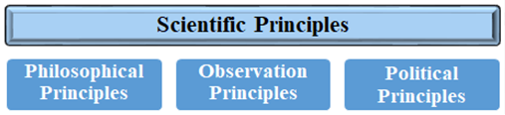
PART A – INTRODUCTION
This presentation is inspired by the proposed methodology for developing science-based principles of economics (Xi Ji, 2020)
Xi Ji. (2020). Ecological economics in China: from origins, to inertia, to rejuvenation.
In Costanza, R., J.D. Erickson, J. Farley, and I. Kubiszewski (editors). Sustainable Wellbeing Futures: A Research and Action Agenda for Ecological Economics. Edward Elgar Publishing, Cheltenham: 61-89.
Notes:
This presentation is inspired by a paper written by Professor Xi Ji of Peking University in China, in which she proposed a methodology for developing science-based principles of a science of economics. Her paper was just published this month in the Research and Action Agenda for Ecological Economics.
{Click}

Slide 4
PART A – INTRODUCTION
Economic systems are complex adaptive evolving systems;
Our experience of economic activities is subjective and teleological (purpose-driven);
  So all modern economic theory is, perforce, biased by our subjective and teleological worldview,
  But science must strive to be objective;
There is a desperate need for economic theory to be re-developed as an “economic science” based on scientific principles and practices.
Notes:
Economic systems are complex adaptive evolving systems. Our experience of economic activity is both subjective and teleological, or purpose-driven, in nature.
So all modern economic theory is, perforce, biased by our subjective and teleological worldview. But, science must strive to be objective.
There is a desperate need for economic theory to be re-developed as an “economic science” based on scientific principles and practices.
{Click}

Slide 5

PART A – INTRODUCTION
Philosophical Principles
Fundamental assumptions;
Kitty Ferguson’s list;
E.g. the laws of physics are invariant under translation in time.
Such principles are not falsifiable, but are debatable.
Ferguson. “The Fire in the Equations: Science, Religion, and the Search for God”. Templeton Press. (2004).
Notes:
Professor Xi Ji proposes that we recognize three kinds of principles in a science of economics. The first kind are the philosophical principles. These are the fundamental philosophical assumptions that underly all scientific activity. The best explanation of these principles that I have seen is in the book “The Fire in the Equations” by Kitty Ferguson. An example of a philosophical principle would be “the laws of physics are invariant under translation in time”. Such principles are not falsifiable. They must be assumed to be true. However, the truth of them is debateable.
{Click}

Slide 6
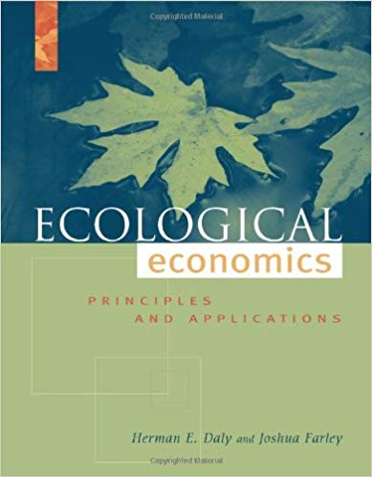
PART A – INTRODUCTION
Political Principles
Social, moral or political goals must be consistent with philosophical and observational principles of science.
Examples from Ecological Economics
Sustainable scale;
Just distribution;
Efficient allocation¹;
Resilience².
¹Daly and Farley. “Ecological Economics: principles and applications”. Second Edition. Island Press. (2004).
²Stanley. “Living to Spend Another Day: Exploring Resilience as a New Fourth Goal of Ecological Economics”, In review. (2020).
Such principles are not falsifiable, but are debatable.
Notes:
At the far right of the diagram we find the “political principles”. Many of you would not consider such principles as scientific at all. These are the social, moral or political constraints that we, as a society, decide to place on our economic activity. What gives them a scientific character is the fact that, contrary to many modern political goals, we demand that they must be consistent with the philosophical and observational principles of science.
{Click}
Examples can be found in this book, by Daly and Farley, in which they recommend three goals of economic theory: sustainable scale; just distribution ; and efficient allocation. In addition, Stanley has recently argued for the addition of Resilience to the list of political principles.
{Click}

Slide 7
PART A – INTRODUCTION
Observational Principles of an Economic Science
Must be consistent with:
  Laws of physics, chemistry, thermodynamics;
  Accepted bodies of knowledge of biology, ecology and sociology;
  A framework of universal dynamics.
Are extended into Economics via laws of symmetry, by conserved aspects, not via analogy.
  A is contained in B; A is part of B;
  NOT A is like B.
Observational principles are both falsifiable and debatable.
Notes:
That brings us to the observational principles. For those of you who are steeped in science, these are the empirically-based laws that you are familiar with – the laws of science discovered using some sort of scientific method. Any economic science must be consistent with the laws of the hard sciences: physics, chemistry and biology. They must also be consistent with the accepted bodies of knowledge of biology, ecology and sociology. And they must be consistent with a framework of universal dynamics, an idea that I will discuss further in a few minutes.
{Click}
But, how do we extend laws discovered in these disciplines of science into economics? We do it using symmetries. I am proposing two means to extend these laws into a science of economics: biosymmetry and hierarchic symmetry. This is an extension, not by analogy, but by equality. This is the difference between saying that A is like B, and A is an integral part of B. So, what happens in B probably also happens in A.
{Click}

Slide 8
PART A - INTRODUCTION
Role of symmetries in science?
In the practice of science, we seek out natural symmetries:
A symmetry exists when there are aspects of a natural dynamic system that remain invariant while most or all other aspects are varying.
Symmetries in nature are often associated with conservation laws:
Newtonian Mechanics:
F = ma (1687) F = ma (2020)
Invariance when translated in time ⬅ ➔ conservation of energy
[Noether’s Theorem (1918)]
Notes:
In the practice of science, we seek out symmetries in nature. A symmetry exists when there are aspects of a natural dynamic system that remain invariant while most or all other aspects are varying.
{Click}
Symmetries in nature are often associated with conservation laws. For example, Newton said force equals mass times acceleration in 1687. That law of motion is still true in 2020. It can be translated in time and still be true. Under Noether’s theorem, this assumption leads diretly to the law of the conservation of energy.
{Click}

Slide 9
PART A – INTRODUCTION
Role of symmetries in economics and engineering?
In the practice of engineering, and economics, agreed-upon standards of manufacture and/or construction create economic symmetries:
Those aspects that remain unchanged are called the gauge of the symmetry.
For example:
  the gauge of a railroad system is the distance between the rails.
  the gauge of an electrical copper wire is the diameter of the wire.
We use symmetries to make the economy run more efficiently.
Notes:
In contrast to that, in the practice of engineering and economics, agreed-upon standards of manufacture and/or construction create economic symmetries. Those aspects that remain unchanged are called the gauge of the symmetry.
{Click}
For example, the gauge of a railroad system is the distance between the rails. If that distance is allowed to vary, then trains fall off of the tracks. The gauge of a copper wire is the diameter of the wire. If that distance is allowed to vary, then houses catch on fire and burn.
{Click}
In economic practice, we use symmetries to make the economy function much more efficiently.
{Click}

Slide 10
PART A – INTRODUCTION
The branches of scientific study can be organized into a nested hierarchy of increasing specificity and decreasing generality.
The specific systems are nested within, are part of, and are constrained by the more general systems.
Economic Systems
Social Systems
More Specific
Ecological Systems
More General
Biological Systems
Chemical Systems
Physical Systems
Notes:
The many branches of scientific study can be organized into a nested hierarchy of increasing specificity and decreasing generality. The laws of physics are the most general and apply absolutely to all other systems within the the physical systems.
The specific systems are nested within, are part of, and are constrained by the more general systems.
{Click}
Furthermore, with a little thought, we realise that the higher up we go in this hierarchy, the more complex and intractable the dynamics become.

Slide 11
PART A – INTRODUCTION
Hierarchic Level
The branches of scientific study then form a nested hierarchy of increasing complexity.
Semantics, logic and mathematics form a meta-system from which all “laws” of science spring.
I arbitrarily choose to place this meta-system at the bottom.
Economic Systems
Social Systems
INCREASING COMPLEXITY
Ecological Systems
Biological Systems
Chemical Systems
Physical Systems
Semantic, Logical and Mathematical Constraints
Cohen and Stewart. “The Collapse of Chaos: Discovering Simplicity in a Complex World”. (1994).
Notes:
Furthermore, with a little thought, we realise that the higher up we go in this hierarchy, the more complex and intractable the dynamics become. So the branches of scientific study then form a nested hierarchy of increasing complexity.
{Click}
Semantics, logic and mathematics form a meta-system from which all of the “laws” of science spring.
I arbitrarily choose to place this meta-system at the bottom, in accordance with the arguments of Cohen and Stewart, as expressed in their book of 1994 “The Collapse of Chaos”.
{Click}

Slide 12
BIOSYMMETRY AND HIERARCHIC SYMMETRY
Agenda
Introduction
  In search of the principles of an "economic science”.
  Part of a proposed methodology for establishing principles of an economic science.
  Xi Ji’s paper in the Ecological Economics Research Agenda book.
Principle of Economic Biosymmetry
  Each species has a subjective biological frame of reference;
  Laws of an economic science must be consistent from all such biological frames of reference.
Principle of Hierarchic Symmetry
  Physics, chemistry, biology, ecology, sociology and economic science form a nested hierarchy of increasingly specific sciences;
  Laws of an economic science must be consistent with all of the more general sciences.
Notes:
Let’s now look at the principle of biosymmetry.
{Click}

Slide 13
PART B – BIOSYMMETRY
Why do we need a principle of biosymmetry:
Most sciences strive to be objective (i.e. unbiased) – and an economic science must do the same;
In contrast, mainstream economic theory is extremely anthropocentric, extremely subjective, and focused on money;
  So, unfortunately, non-monetary ecological “economic externalities” are dismissed from most economic analyses as irrelevant;
  Such external costs are all paid for by third parties – i.e. by elements of the biosphere external to the analysis.
This has become an existential issue;
      Modern economic theory has become a distal cause of most of our global ecological crises that now threaten the future existence of our species.
Notes:
Most sciences strive to be objective (that is, unbiased) and an economic science must do the same. In contrast to that, mainstream economic theory is extremely anthropocentric, extremely subjective, and very much focused on money.
{Click}
Unfortunately, this means that ecological “economic externalities” are usually dismissed from most economic analyses as irrelevant. Such external costs are all paid for by third parties. That is, paid for by elements of the biosphere that are external to the anlaysis.
{Click}
This has become an existential issue. Modern economic thoery has become a distal cause of most of our global ecological crises that now threaten the future existence of our species.
{Click}

Slide 14
PART B – BIOSYMMETRY
Why do we need a principle of biosymmetry:
We need a Copernican-like shift
Geocentric circles → Heliocentric ellipses
  (Copernicus’ paradigmatic shift)
  Copernicus (1543), Brahe, Kepler, Galileo, Newton (1687)
Anthropocentric Desires→ Biosymmetric Needs
  (Needed paradigmatic shift of modern day)
How do we do this?
GH Boyle. (2014) A Contextual Redefinition of the Anthroposphere. (Unpublished article).
Notes:
We need a paradigm shift similar to the Copernican revolution of the 16th and 17th centuries. Copernicus introduced a change in worldview that shifted us from a geocentric cosmos to a heliocentric cosmos, with all of the philosophical and religious implications that entailed.
{Click}
We need a shift in worldview from anthropocentric desires to biosymmetric needs.
But, how do we start that paradigm shift?
{Click}

Slide 15
PART B – BIOSYMMETRY
Retro-Definition of an “Economy”
An economy is a system in which people work for the livelihood of themselves and their family.
  It is not just a financial system.
  It is a livelihood system in which people meet their needs.
Livelihood:
Food
Clothes
Shelter
Family
Notes:
We start with a return to Classical economic theory. We define an economy as a livlihood system, a system in which people work for the livlihood of themselves and their families. An economy is not just a financial system. It is a system that delivers to us the necessities of life such as food, clothes, shelter and family.
{Click}

Slide 16
PART B – BIOSYMMETRY
Re-Defining an “Economy”
Borrow a word.
Earth Sciences: “Anthroposphere” – scope of influence of human activity.
Notes:
Then we borrow a word from Earth Sciences – Anthroposphere – the scope of influence of human activity.
{Click}

Slide 17
PART B – BIOSYMMETRY
Earth Sciences: Anthroposphere – scope of influence of human activity.
Re-Defining an “Economy”
Borrow.
Dissect the word, into three parts.
Anthroposphere:
Biotic – what we are;
  (a species in the ecosystem).
Technosphere – what we have built.
Noösphere – controls what we do;
  (instinctive and cognitive actions in society).
Notes:
We disect the word, a bit, to undertand all that it entails. There are three parts. The biotic part is the flesh and blood of our species. The technosphere is all that we have built. The noösphere is all that we know, and includes our instinctive behavioural controls.
{Click}

Slide 18
PART B – BIOSYMMETRY
Re-Defining an “Economy”
Borrow.
Dissect.
Coin a new “standard” word.
Earth Sciences: Anthroposphere – scope of influence of human activity.
Anthroposphere:
Biotic – what we are;
Technosphere – what we have built.
Noösphere – controls what we do;
“Phenosphere” of any species:
Biotic – what they are.
Technosphere – what they have built.
Noösphere – controls what they do.
Notes:
Now if the antthroposphere is associated with the human phenotype, then we might coin a more general word “phenosphere” that goes with other phenotypes. The phenosphere has three parts: biotic part, technosphere and noösphere. Every species has its own phenosphere.
{Click}

Slide 19
PART B – BIOSYMMETRY
Re-Defining an “Economy”
Borrow.
Dissect.
Coin a standard.
Apply the standard.
Earth Sciences: Anthroposphere – scope of influence of human activity.
Anthroposphere:
Biotic – what we are.
Technosphere – what we have built.
Noösphere – controls what we do.
Phenosphere of any species:
Biotic – what they are.
Technosphere – what they have built.
Noösphere – controls what they do.
  Principle of Biosymmetry:
  Each species has an economy – associated with its phenosphere.
  Laws of an economic science must be consistent from the perspective of all phenospheres.
Notes:
We are now ready to apply the principle of biosymmetry. Each species has an economy, associated with its phenosphere. Then the laws of an economic science must be consistent from the perspective of all phenotypes.
Now, I would imagine that, if there are any economics listenting to this presentation right now, you are saying to yourself “That’s pretty silly!” I disagree.
{Click}

Slide 20
PART B – BIOSYMMETRY
Re-Defining an “Economy”
Where does the principle of biosymmetry fit into the nested hierarchy of sciences?
Economic Systems
Each species has its own economy.
APPLICABLE RANGE
Social Systems
Each species has its own society.
Ecological Systems
An ecosystem contains a set of species, of societies, and of economies.
Notes:
Where does such a principle of biosymmetry first appear in the hierarchy of scientific disciplines. Here, in ecological systems, where the concept of species, and the conservation of some sense of collective purposeful activity first starts to emerge.
{Click}

Slide 21
PART B – BIOSYMMETRY
How can the principle of biosymmetry improve economic theory?
It gives us a different perspective on our economic role.
Anthropocentrism
Biosymmetry
This temporal cohort of the human species has proprietary interest in the entirety of the Earth.
This temporal cohort of the human species assumes trustee responsibilities for the entirety of the Earth on behalf of all species – and for both present and future generations.
Notes:
This principle gives us a different prespective on our role in this world.
Under anthropocentrism, this temporal cohort of the human species has a proprietary interest in the entirely of the Earth.
In contrast, under biosymmetry, as in some sense the senior species on the planet, we must assume trustee responsiblitiies for the entirely of the Earth on behalf of all species – and for both present and future generations.
{Click}

Slide 22
Changing the Mandate of Economics as a Science!
Scope of control/interest/influence?
Reality as we see it?
Reality as it is?
SCOPE OF INFLUENCE
Biodiversity Collapse
Climate Change
Oceanic Acidification
SCOPE OF CONTROL
Biodiversity Collapse
Climate Change
Oceanic Acidification
SCOPE OF INTEREST
Resources/Pollutants
Ecosystem Services
Eco Extractions/Insertions
SCOPE OF INTEREST
Resources/Pollutants
Ecosystem Services
Eco Extractions/Insertions
SCOPE OF CONTROL
Economic Activity
Economic Inputs/Outputs
Economic Policies
Economic Institutions
SCOPE OF INFLUENCE
Economic Activity
Economic Inputs/Outputs
Economic Policies
Economic Institutions
Notes:
Those of you who have some experience in project management will understand theexpressions on this slide: scope of control, scope of interest, and scope of influence. The purple box at the top – the scope of control is the mandate of modern economic theory. Economic activties, inputs, outputs, policies and institutions. The scope of interest is the set of things they can turn to a profit. The scope of influence is broader than that, and includes most of the things that pay the price on externalities.
{Click}
But, when we consider this through the lens of biosymmetry, the boxes change roles. The mandate of economic science is the green box. The existential threats to humanity and to the other species on this Earth. The purple box is merely the side-effects of policies implemented as we exercise our mandate.
{Click}

Slide 23
PART B – BIOSYMMETRY
Insight: All economies prosper at the expense of other economies:
  transfers of wealth often involve extracting, reaping, catching or otherwise harvesting wealth from another economy and appropriating it;
  externalities of any one economy are paid for by organisms in other economies;
  it’s a zero-sum game.
Notes:
What insight can we derive from this? Transfers of wealth often involve extracting, reaping, catching or otherwise harvesting wealth from another economy and appropriating it.
{Click}
Externalities of any one economy are paid for by the organisms in other economies. When someone wins, someone else loses. But, there is just one planet. Ultimately, we all pay the price. In a sustainable world, it’s a zero-sum game at best. Otherwise, if we are not careful, we can lose it all.
{Click}

Slide 24
PART B – BIOSYMMETRY
How can the principle of biosymmetry improve economic theory?
It gives us a different perspective on our own economic activity.
Anthropocentrism
Biosymmetry
Externalities
Ecosystem services
Economic rents earned from abiotic resources
Marginal financial focus
Wealth Transfers
Economic surpluses/deficits
Interspecies, international and intergenerational debts
Holistic biophysical focus
⬅➔
⬅➔
⬅➔
⬅➔
Notes:
What do we gain? it gives us a different perpective on our own economic activity. Externalities become wealth transfers. Ecosystem services become economic surpluses and deficits. Economic rents earned from abiotic resources become interspecies, international and intergenerational debts. A marginal financial focus become a holistic biophysical focus.
{Click}

Slide 25
BIOSYMMETRY AND HIERARCHIC SYMMETRY
Agenda
Introduction
  In search of the principles of an "economic science”.
  Part of a proposed methodology for establishing principles of an economic science.
  Xi Ji’s paper in the Ecological Economics Research Agenda book.
Principle of Economic Biosymmetry
  Each species has a subjective biological frame of reference;
  Laws of an economic science must be consistent from all such biological frames of reference.
Principle of Hierarchic Symmetry
  Physics, chemistry, biology, ecology, sociology and economic science form a nested hierarchy of increasingly specific sciences;
  Laws of an economic science must be consistent with all of the more general sciences.
Notes:
Let’s now look quickly at the principle of hierarchic symmetry.
{Click}

Slide 26
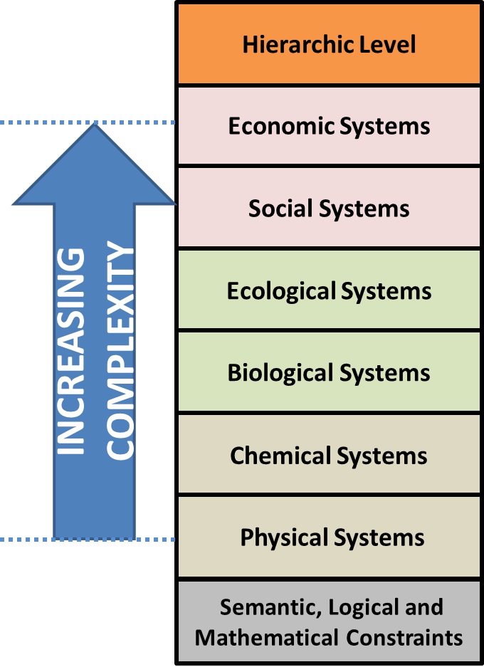
PART C – HIERARCHIC SYMMETRY
Many laws or principles established at lower levels constrain the dynamics of all higher levels, including economics.
In recent years, these multi-level dynamic laws have been called “universal dynamics”.
Notes:
Many laws or principles established at lower levels constrain the dynamics of all higher levels, encluding economics. In recent years, these multi-level dynamic laws have been called “universal dynamics”. I have been watching discussions of such things for a few years now, and trying to place them into a common frame of reference.
{Click}

Slide 27
A Framework Of Universal Dynamics
COMPLEXITY SELECTION EFFECTS
Encompasses:
Lotka’s PoPSF at all scales
  Darwin’s ToE
  Odum’s PoMPE
  Lotka’s PoMDE
Issues of efficiency and effectiveness
Models of growth
ENTROPY PRODUCTION EFFECTS
Encompasses:
Entropy of many types
  Thermodynamic
  Informational
  Land
  Genes
  Money
Models of decay
OTHER UNIVERSAL
DYNAMICS
Encompasses:
Percolation Theory.
Emergence of scale-free networks.
Inequality of access to political power.
Emergence of fractal patterns in nature.
Polarization of political postitions.
CONSERVATION EFFECTS – Invariance under recursion
Absolutely Conserved (energy, momentum)
Sufficiently-well Conserved (water, air, soil, land, genes, people, money, … )
EFFECTS OF RECURSION
Simple Recursive Stochastic Processes Can Generate Complex Structures
Notes:
This is a work in progress. Each time I have spoken about this, it has changed a little. This is my newest version. I will start at the bottom and work up.
{Click}

Slide 28
A Framework Of Universal Dynamics
COMPLEXITY SELECTION EFFECTS
Encompasses:
Lotka’s PoPSF at all scales
  Darwin’s ToE
  Odum’s PoMPE
  Lotka’s PoMDE
Issues of efficiency and effectiveness
Models of growth
ENTROPY PRODUCTION EFFECTS
Encompasses:
Entropy of many types
  Thermodynamic
  Informational
  Land
  Genes
  Money
Models of decay
OTHER UNIVERSAL
DYNAMICS
Encompasses:
Percolation Theory.
Emergence of scale-free networks.
Inequality of access to political power.
Emergence of fractal patterns in nature.
Polarization of political postitions.
EVOLUTIONARY PROCESSES SELECT SOME MICRO-COMPLEXITIES FOR PRESERVATION, CAUSING THEM TO ACCUMULATE INTO COMPLEX STRUCTURES AND PROCESSES.
ENTROPY PRODUCTION PROCESSES CONTINUALLY DEGRADE AND DISSASSEMBLE COMPLEX LOW-ENTROPY STRUCTURES AND PROCESSES.
MANY OTHER UNIVERSAL DYNAMICS ADD CONTEXT AND VARIETY TO THIS ONGOING ENDLESS RE-INVENTION OF COMPLEX ADAPTIVE EVOLVING SYSTEMS.
3
4
5
CONSERVATION EFFECTS – Invariance under recursion
Absolutely Conserved (energy, momentum)
Sufficiently-well Conserved (water, air, soil, land, genes, people, money, … )
CONSERVATION: SYMMETRIES PREVENT THE EMERGENCE OF MOST MICRO-COMPLEXITIES, BUT ALSO PREVENT THE IMMEDIATE SUBSIDENCE OF SOME MICRO-COMPLEXITIES THAT HAVE EMERGED, THEREBY ESTABLISHING A PLATFORM ON WHICH OTHER MICRO-COMPLEXITIES CAN ACCIDENTALLY EMERGE.
2
EFFECTS OF RECURSION
Simple Recursive Stochastic Processes Can Generate Complex Structures
RECURSION: LOW-ENTROPY MICRO-COMPLEXITIES EMERGE FROM TIME TO TIME AS LOW-PROBABILITY ACCIDENTS OF RANDOM FLUCTUATIONS.
1
Notes:
The effects of recursion are … [ read from the slide ].
{Click}
The effects of conservation are … [ read from the slide ].
{Click}
Then evolutionary processes … [ read from the slide ].
{Click}
At the same time entropy production processes … [ read from the slide ].
{Click}
While all of that is going on, there is a large variety of other universal dynamics that add context and variety to the ongoing endless re-invention of complex adaptive evolving systems.
{Click}

Slide 29
Hierarchy of Sciences
From “Natural Sciences” to “Social Sciences”
Hierarchic Level
Associated academic Discipline (and examples of sub-disciplines)
Economic Systems
Economics (ecological, biophysical, evolutionary, behavioural, institutional, complexity,)
Carrying Capacity
Social Systems
Sociology (professional, policy, critical and public)
Ecological Systems
Ecology (evolutionary biology, ecophysiology, behavioral, autecology, synecology, landscape or human ecology)
INCREASING COMPLEXITY
Thermodynamics
Entropy (destroys complexities)
Generation, preservation and accretion of complexities
Biological Systems
Biology (health sciences, genetics.
cellular biology, biochemistry, microbiology, zoology, botany)
Chemical Systems
Chemistry (classical, statistical, organic, materials science)
Physical Systems
Classical physics, thermodynamics, Newtonian mechanics, statistical mechanics, quantum mechanics, relativistic mechanics
Semantic, Logical and Mathematical Constraints
Probability distributions, symmetries and broken symmetries, universal dynamics
Notes:
How then do these universal dynamics fit into our hierarchy of scientific disciplines.
{Click}
We now know that entropy is fundamentally a probabilistic phenomenon of a mathematical that affects all kinds of systems.
{Click}
It was first discovered in physical systems as part of thermodynamics, and that physical concept clearly applies to all higher levels.
{Click}
On the other hand, a concept like carrying capacity does not have any meaning before we define ecosystems and the species within them. So that grows out of ecosystems, and applies to all levels above that.
{Click}
And there is a host of other universal dynamics that seem to have a mathematical character that apply at many levels.
{Click}

Slide 30
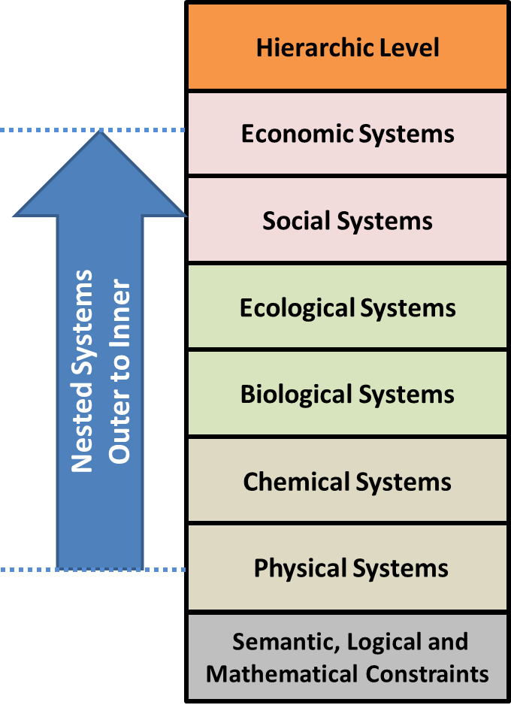
PART C – HIERARCHIC SYMMETRY
Implicit Research Question:
If the same dynamic is functional in some general systems at lower levels ( ),
And, if these are nested systems,
When can we assume that they also operate in the more specific nested systems contained in them at higher levels?
?
Notes:
Here is the implicit research question that this line of reasoning asks us. If the same dynamic is funtional in some general systems at lower levels,
And, if these are nested systems,
When can we assume that they also operate in the more spedific nested systems contained within them at higher levels?
{Click}

Slide 31
PROPOSED PRINCIPLES OF ECONOMICS:
BIOSYMMETRY AND HIERARCHIC SYMMETRY
THE END!
Any Questions?
Garvin H Boyle
Orrery@Rogers.Com
This presentation is based on my Diary Notes:
140904 PPR Principles of BioEco R3.1.PDF
191130 NTF Principles of EE and BPE Part 1 R4.PDF
191201 NTF Principles of EE and BPE Part 2 R4.PDF
191203 NTF Principles of EE and BPE Part 3 R2.PDF
Notes:
That brings me to the end of my presentations.
Are there any questions?

