Slide 1
System Dynamics Must Supplant Equilibrium Modelling in Economics
www.patreon.com/profstevekeen
www.profstevekeen.com
www.isrs.org.uk

Slide 2
Abstract
“It takes a model to beat a model” is not enough. Instead “It takes a paradigm to beat a paradigm”. To beat Neoclassical economics, we need
    Alternative to seductive “microfoundations” method to derive models (A)
    Toolbox for extending the models
    Set of puzzles by which new researchers can extend the paradigm
    Foundations that conform to the Laws of Thermodynamics (B)
Minsky: system dynamics (in general and) for economics (C)
Bashing the old :the appallingly bad Neoclassical climate change economics (D)
  That Nordhaus was given a “Nobel” Prize for this is reason to abolish the Prize
  If you haven’t read his papers in detail, they are far worse than you might expect
    Equating climate with weather; using temperature:GDP today as proxy for global warming; distorting scientific literature… (see embedded paper Keen 2020 for full details…)

Slide 3
(A) A macrofoundation for macroeconomics
Economists won’t adopt system dynamics because they want “good foundations”
  See anything other than “derive macro from micro” as “bad foundations”
    “any interesting model must be a dynamic stochastic general equilibrium model. From this perspective, there is no other game in town… A useful aphorism in macroeconomics is: "If you have an interesting and coherent story to tell, you can tell it in a DSGE model. If you cannot, your story is incoherent."” (Chari 2010, p. 2)
    “Starting from explicit microfoundations is clearly essential; where else to start from?” (Blanchard 2018, p. 47)
Counter: Macroeconomics can be derived directly from macroeconomics itself
  Start from macroeconomic definitions:
    Differentiate to convert definitions into true by definition dynamic statements
  Convert into model with simplest possible relations & behavioural assumptions
    Add more definitions, more complicated functions to base structure later
  Neoclassicals can’t dispute without disputing indisputable definitions…

Slide 4
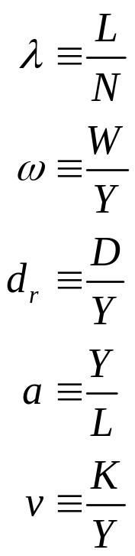
(A) A macrofoundation for macroeconomics
Differentiate these three
Employment to Population Ratio
Wages to Output Ratio
Private debt to Output Ratio
Output to Labour Ratio
Capital to Output Ratio
Three true-by-definition dynamic statements:
  “The employment rate will rise if economic growth exceeds the sum of change in the output to labour ratio and population growth”;
  “The wages share of output will rise if the total wages grow faster than GDP”; &
  “The private debt to GDP ratio will rise if private debt growth exceeds the rate of economic growth”…

Slide 5
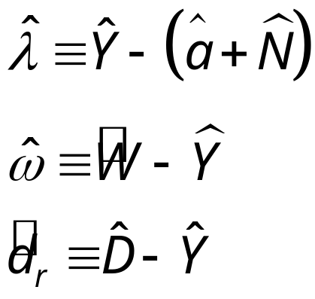
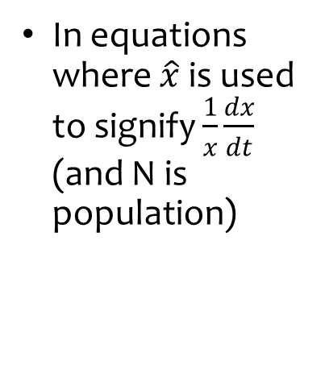
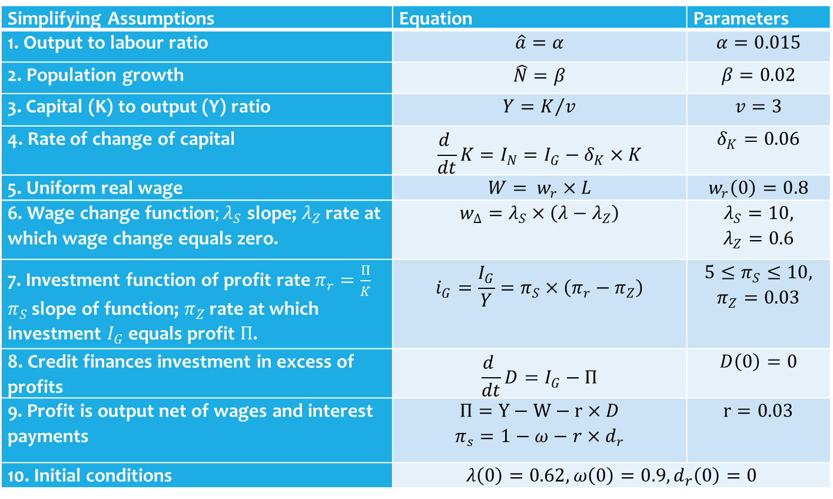
(A) A macrofoundation for macroeconomics
In equations where $\hat{x}$is used to signify $\frac{1}{x}\frac{dx}{dt}$ (and N is population)
Simplifying Assumptions | Equation | Parameters
1. Output to labour ratio | $$\hat{a}=α$$ | $$α=0.015$$
2. Population growth | $$\hat{N}=β$$ | $$β=0.02$$
3. Capital (K) to output (Y) ratio | $$Y=K/v$$ | $$v=3$$
4. Rate of change of capital | $$\frac{d }{dt}K=I_{N}=I_{G}−δ_{K}×K$$ | $$δ_{K}=0.06$$
5. Uniform real wage | $$W= w_{r}×L$$ | $$w_{r}\left(0\right)=0.8$$
6. Wage change function$;λ_{S}$ slope; $λ_{Z}$ rate at which wage change equals zero. | $$w_{Δ}=λ_{S}×\left(λ−λ_{Z}\right)$$ | $$λ_{S}=10,$$ $$λ_{Z}=0.6$$
7. Investment function of profit rate $π_{r}=\frac{Π}{K}$ $π_{S}$ slope of function; $π_{Z}$ rate at which investment $I_{G}$ equals profit $Π$. | $$i_{G}=\frac{I_{G}}{Y}=π_{S}×\left(π_{r}−π_{Z}\right)$$ | $$5≤π_{S}≤10,$$ $$π_{Z}=0.03$$
8. Credit finances investment in excess of profits | $$\frac{d }{dt}D=I_{G}−Π$$ | $$D\left(0\right)=0$$
9. Profit is output net of wages and interest payments | $$Π=Y−W−r×D$$ $$π_{s}=1−ω−r×d_{r}$$ | $$r=0.03$$
10. Initial conditions | $$λ\left(0\right)=0.62,ω\left(0\right)=0.9,d_{r}\left(0\right)=0$$
Convert to model:
Simplest system state relations
Simplest behavioural rules

Slide 6
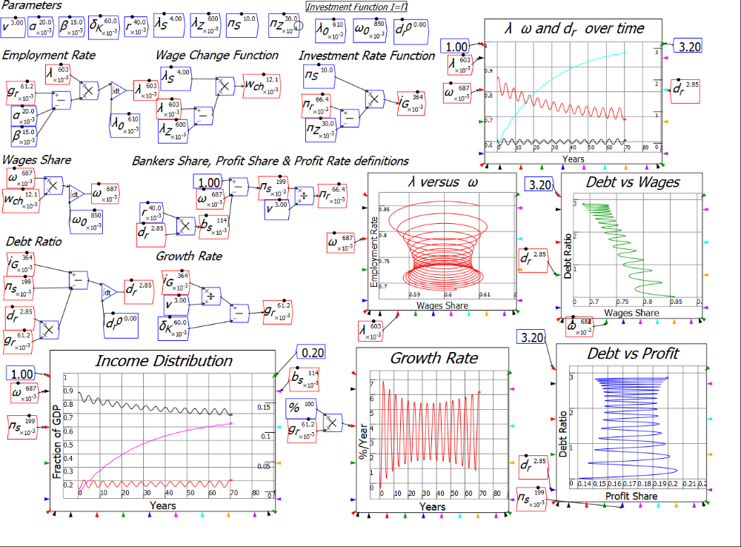

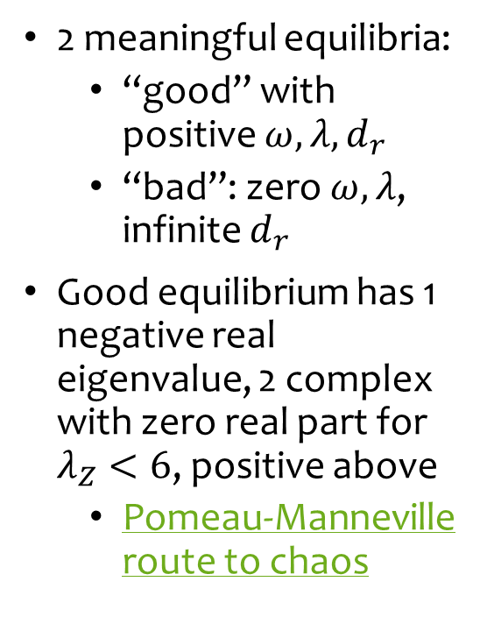
(A) A macrofoundation for macroeconomics
Model in Minsky:
2 meaningful equilibria:
  “good” with positive $ω,λ,d_{r}$
  “bad”: zero $ω,λ$, infinite $d_{r}$
Good equilibrium has 1 negative real eigenvalue, 2 complex with zero real part for $λ_{Z}<6$, positive above
  Pomeau-Manneville route to chaos

Slide 7
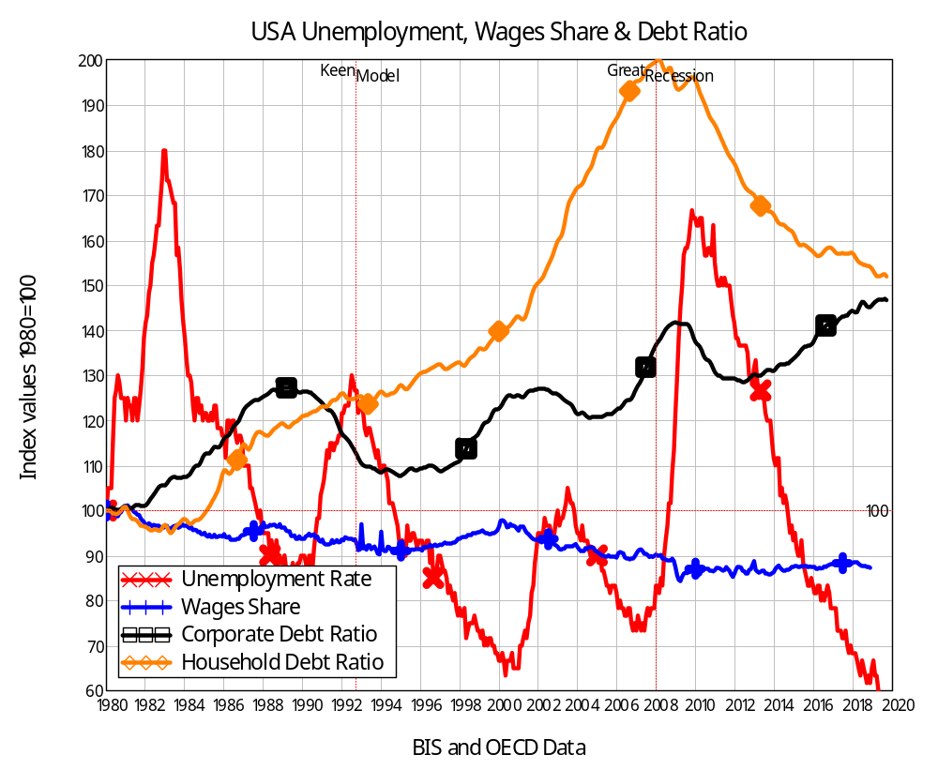
(A) A macrofoundation for macroeconomics
Simplest possible model derived directly from definitions more accurately captures real-world macroeconomics than highly complicated DSGE models
  “Great Moderation” followed by “Great Recession”
  Inequality: Rise in Bankers’ share comes at expense of falling workers’ share
Anomalies in the Neoclassical paradigm are core predictions of the new paradigm…

Slide 8
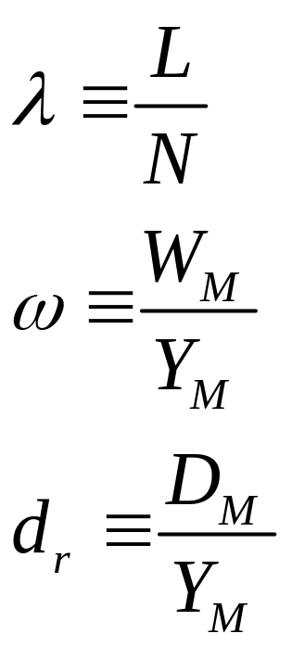
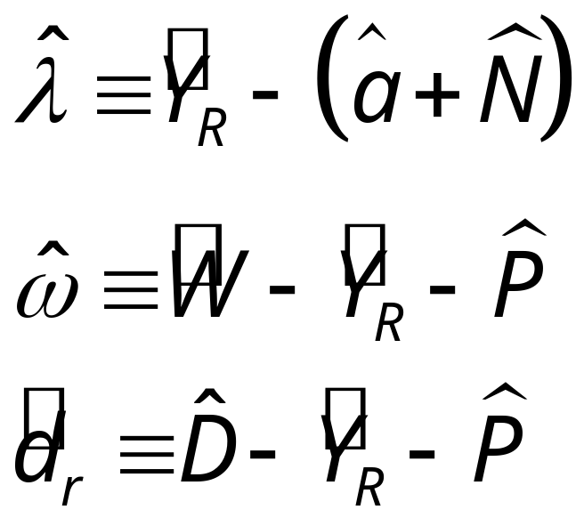
(A) A macrofoundation for macroeconomics
Can be extended by expanding definitions
  Nominal rather than real output model from these monetary definition:
“The employment rate will rise if real economic growth exceeds the sum of population growth and growth in labor productivity;
“The wages share of output will rise if money wage demands exceed the sum of inflation and growth in labor productivity”; and
“The private debt to GDP ratio will rise if the rate of growth of private debt exceeds the sum of inflation plus the rate of economic growth.”
Similar expansions to include government spending, multi-sectoral production
End result is system dynamics
  System structure (largely) determines system behaviour
  Individual/group behaviour occurs within system confines
  System is dynamic, far-from-equilibrium, complex, nonlinear

Slide 9
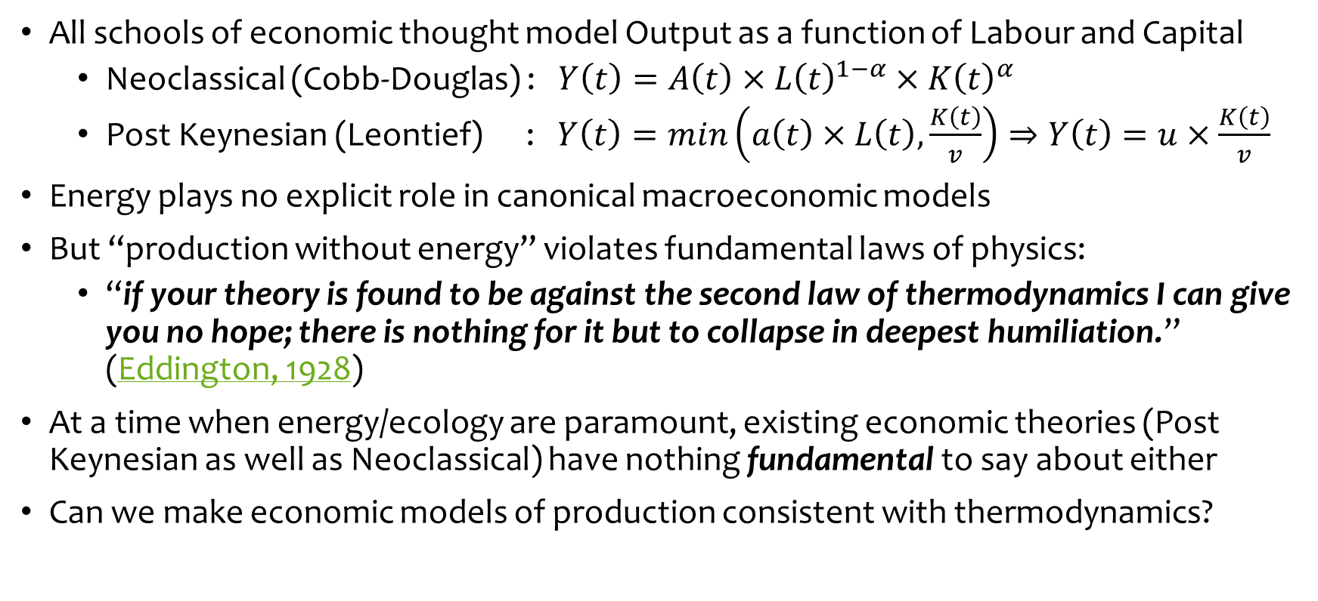
(B) Deriving macroeconomics from thermodynamics
All schools of economic thought model Output as a function of Labour and Capital
  Neoclassical (Cobb-Douglas) : $Y\left(t\right)=A\left(t\right)×{L\left(t\right)}^{1−α}×{K\left(t\right)}^{α}$
  Post Keynesian (Leontief) : $Y\left(t\right)=min\left(a\left(t\right)×L\left(t\right),\frac{K\left(t\right)}{v}\right)⇒Y\left(t\right)=u×\frac{K\left(t\right)}{v}$
Energy plays no explicit role in canonical macroeconomic models
But “production without energy” violates fundamental laws of physics:
  “if your theory is found to be against the second law of thermodynamics I can give you no hope; there is nothing for it but to collapse in deepest humiliation.” (Eddington, 1928)
At a time when energy/ecology are paramount, existing economic theories (Post Keynesian as well as Neoclassical) have nothing fundamental to say about either
Can we make economic models of production consistent with thermodynamics?

Slide 10
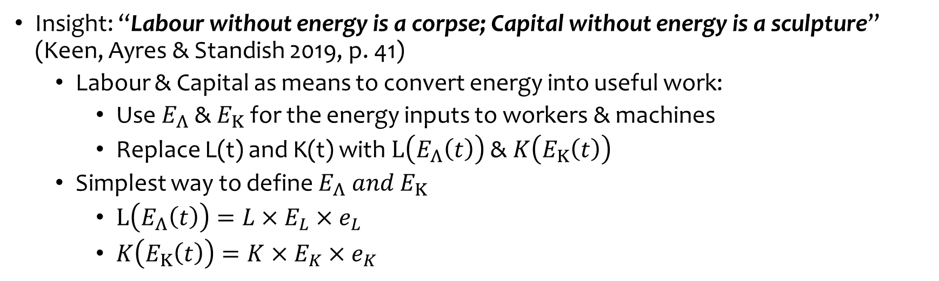
(B) Deriving macroeconomics from thermodynamics
Insight: “Labour without energy is a corpse; Capital without energy is a sculpture” (Keen, Ayres & Standish 2019, p. 41)
  Labour & Capital as means to convert energy into useful work:
    Use $E_{Λ}$ & $E_{Κ}$ for the energy inputs to workers & machines
    Replace L(t) and K(t) with $L\left(E_{Λ}\left(t\right)\right)$ & $K\left(E_{Κ}\left(t\right)\right)$
  Simplest way to define $E_{Λ} and E_{Κ}$
    $L\left(E_{Λ}\left(t\right)\right)=L×E_{L}×e_{L}$
    $K\left(E_{Κ}\left(t\right)\right)=K×E_{K}×e_{K}$
Number of workers
Energy consumption per worker
Efficiency of conversion into useful work
Number of machines
Energy consumption per machine
Efficiency of conversion into useful work
Results in energy-based production function that acknowledges essential role of energy in production, unavoidability of waste
  No energy in, no output out
  Conversion of energy to useful work must be less than 100% efficient (2nd Law)

Slide 11
(C) Minsky Open Source System Dynamics
Primary objective: enabling easy modelling of monetary flows via Godley Tables
Unique features:
  Godley Tables for integrated financial flow modelling
  Direct entry of mathematics onto canvas, overall mathematical format
  Overloaded operators (+,-,/) to reduce model clutter
  L^{A}T_{E}X formatting supporting Greek, subscripts, superscripts
  L^{A}T_{E}X output of equations for model documentation
Rare features
  Pass values by name as well as by wire
  Visual equations, Dynamic plots embedded into design canvas
  Sliders to control simulation during execution
Weak features: grouping (alternative: bookmarks)
Pending features: multi-dimensional data importing, parameter fitting, direct equation entry.

Slide 12
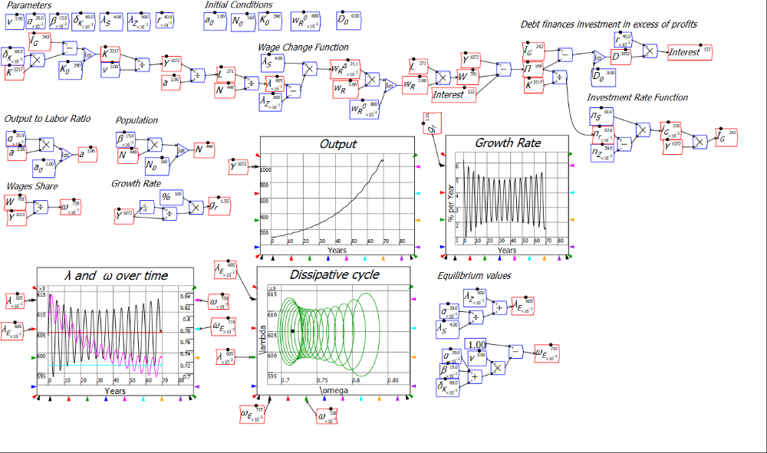

(C) Minsky Open Source System Dynamics
Real (non-price) model in more traditional causal diagram mode
Unique strength of Minsky: uses double-entry bookkeeping to create ODEs…

Slide 13
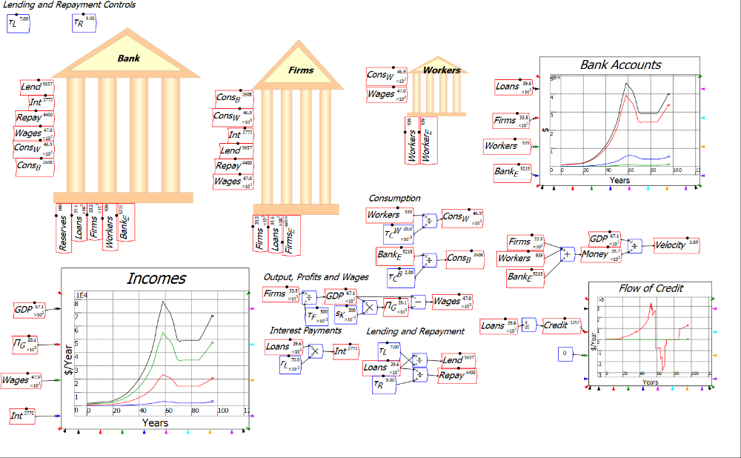
(C) Minsky Open Source System Dynamics
A quick demo of Godley Tables:

Slide 14
(C) Minsky Open Source System Dynamics
Rapid development of easily edited model of financial dynamics
Sliders
Greek characters, subscripts
Overloaded operators

Slide 15
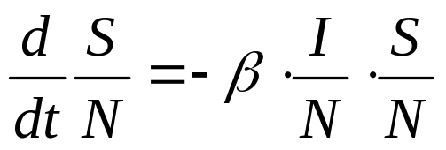
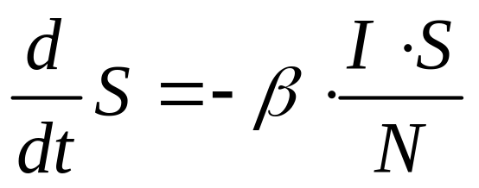
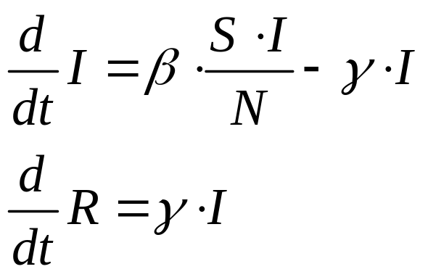

(C) Minsky Open Source System Dynamics
Can be adapted to other compartmentalized models: eg SIR model
  Susceptible→Infected→Recovered
Basic logic: Rate of growth of epidemic depends on interactions between proportion of population susceptible & proportion infected:
Assume population constant (simplifying assumption given rate of growth of epidemic >> rate of growth of population)
Infected proportion recovers at rate $γ$
Rates must be stock-flow consistent
Godley Table ideal for ensuring this…

Slide 16
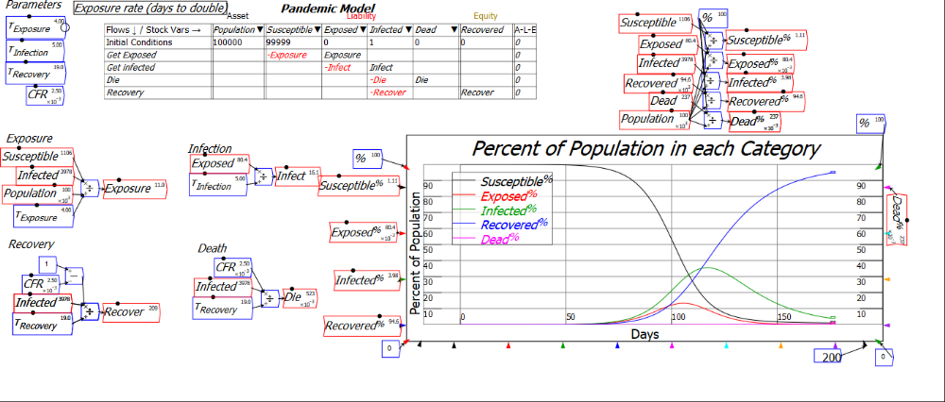
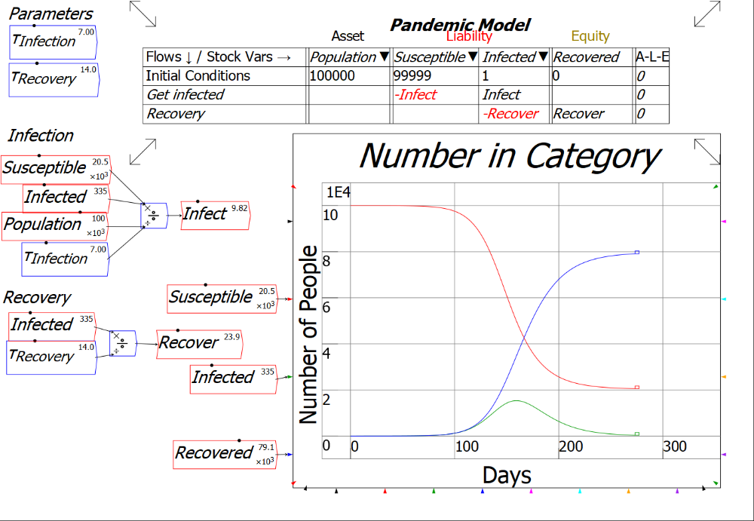
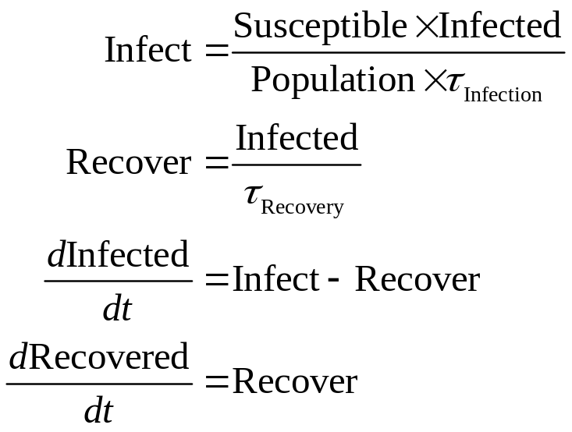


(C) Minsky Open Source System Dynamics
Define 4 columns Population, Susceptible, Infected, Recovered
Define two flows: Infect, Recover
Differential equations generated by Godley Table
Extend model by adding different compartments, defining new flows
Godley Table ensures consistency

Slide 17
(C) Minsky Open Source System Dynamics
Please download Minsky’s beta builds and check it out
Currently being developed via £200,000 grant from Friends Provident Foundation
  New beta released roughly every month
We’re interested in
  Your reactions to Minsky
  Bug reports/feature requests
    What additional features would Minsky need to have for you to use it in preference to Vensim, Matlab, etc?

Slide 18
(D) Appallingly bad Neoclassical climate change economics
2°C “will stress human societies and destroy many natural ecosystems such as rainforests and coral reefs”
3°C “the stability of human civilisation will be seriously imperilled…”
4°C “a full-scale global collapse of human societies is probable…”
5°C “will leave most of the globe biologically uninhabitable, with humans reduced to a precarious existence in small refuges…”
6°C: “a runaway warming process that could render the biosphere completely extinct and forever destroy the capacity of this planet to support life…”
“global annual economic losses for additional temperature increases of ~2°C are between 0.2 and 2.0% of income.”
“the best guess of the impact of a 3-degree warming by 2090 would reduce the growth of per capita incomes from, say, 1.5 percent per year to 1.485 percent per year.”
“The parameter used in the model was a … 0.227 percent loss in global income per degrees Celsius squared … This leads to a damage of … 7.9 percent of global income at a global temperature rise of 6°C.”

Slide 19
(D) Appallingly bad Neoclassical climate change economics
Left column: Mark Lynas (2020) Our Final Warning: Six Degrees of Climate Emergency, p. ix
Right column:
  IPCC 2014 Economic Impacts chapter (Chapter 10; lead co-author Richard Tol);
  Nordhaus 1991 paper “Expert Opinion on Climate Change”; and
  Nordhaus 2018 paper “Projections and Uncertainties about Climate Change in an Era of Minimal Climate Policies”, American Economic Review: Economic Policy
Basis of Lynas’s conclusions:
  Compilation of paleontological research on climate over the last 250 million years
Basis of conclusions of economists:
  “Textbook economics” ideological belief that markets can cope with anything
  Confusing temperature distribution today with raising overall global temperature
  Assuming activities undertaken indoors are immune from climate change
  Distort or ignore scientific literature
  Minimizing expected impact of climate change every step of the way…

Slide 20
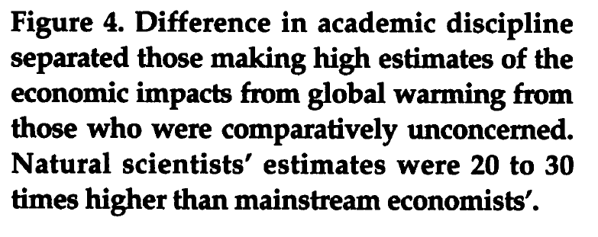
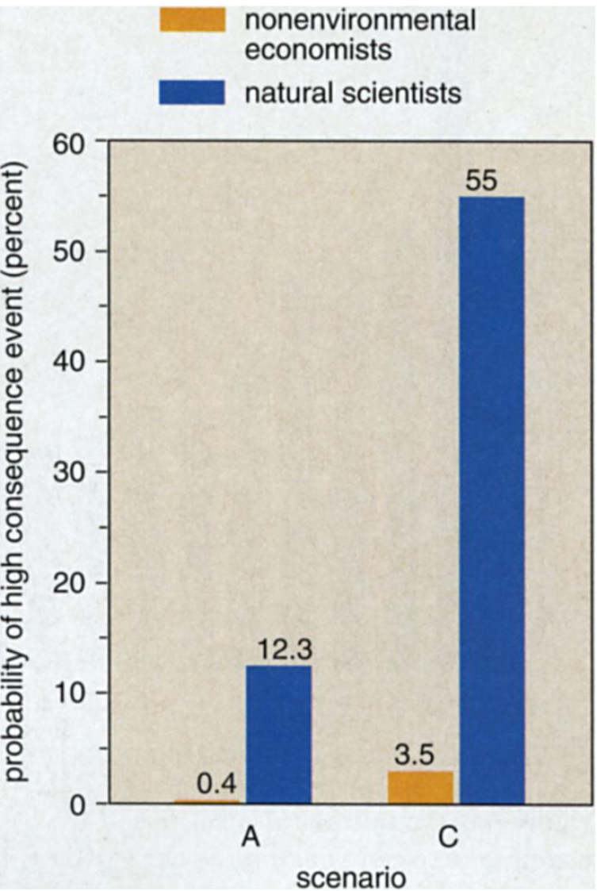
(1) Economists’ beliefs vs scientists’ knowledge
Nordhaus’s “Expert Opinion on Climate Change” surveyed 19 “experts”…
  “experts hold vastly different views about the potential economic impact of climatic change. At one extreme are the natural scientists, all three of whom have profound concerns about the economic pacts of greenhouse warming…
  At the other extreme are the other subdisciplines of economics (those whose principal concerns lie outside environmental economics) these eight respondents see much less calamitous outcome—about one-30th of the magnitude estimated by the natural scientists”

Slide 21
(2) Climate variation today confused with climate change from huge increase in retained solar energy
“First, it must be recognised that human societies thrive in a wide variety of climatic zones. For the bulk of economic activity, non-climate variables like labour skills, access to markets, or technology swamp climatic considerations in determining economic efficiency.” (Nordhaus 1991, p. 930)
“An alternative approach… is based on direct estimates of the welfare impacts, using observed variations (across space within a single country) in prices and expenditures to discern the effect of climate.
Mendelsohn assumes that the observed variation of economic activity with climate over space holds over time as well” (Tol 2009, p. 32)
This is mistaking climate:GDP variations today, with no change in total energy in the biosphere…
for the impact of climate change as the energy level of the biosphere increases dramatically because of the additional solar radiation retained via increased CO₂…

Slide 22
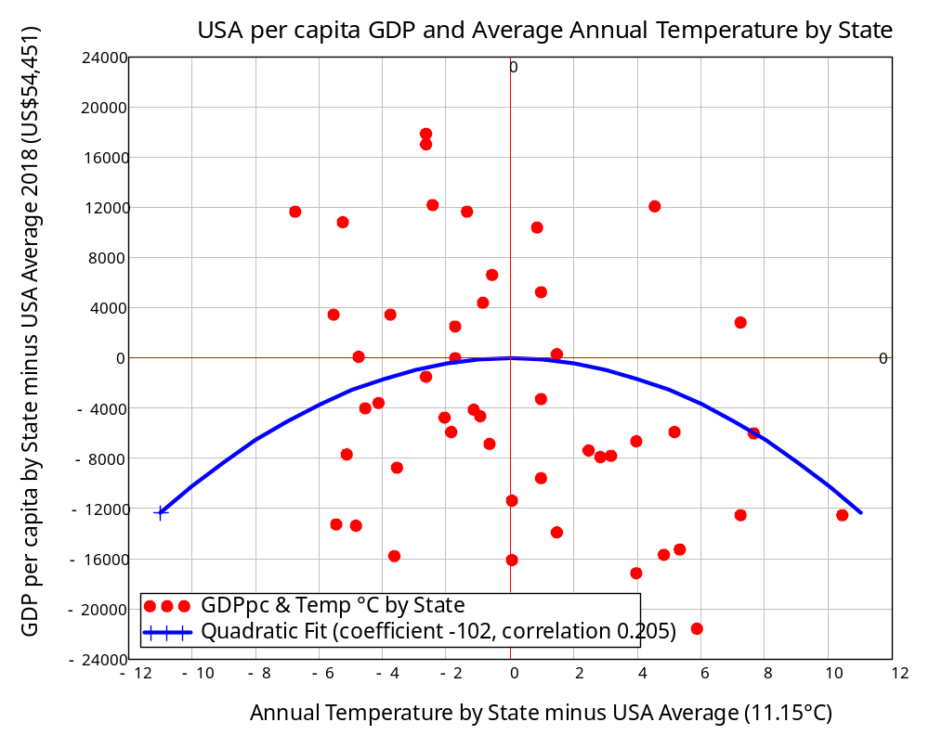
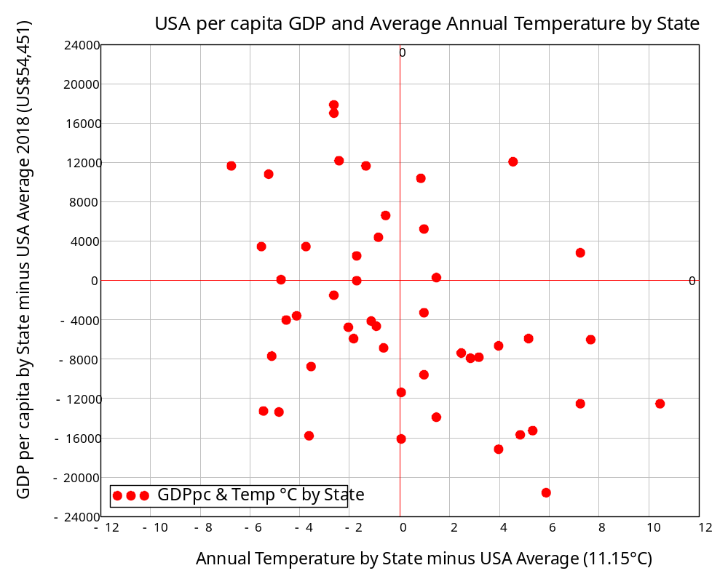
(2) Climate variation today confused with climate change from huge increase in retained solar energy
Data used on average temperature and GDP by region in the USA:
Average temperature data
Gross State Product per capita data
$$GDP\left(°C\right)=−102×{°C}^{2}$$
A weak, nonlinear relationship
Mild temperature State→slightly higher GDP than hot or cold temperature state
Temperature deviation from USA average
GDP variation from USA average
Fitted a quadratic to it
Then “assumed” climate change would have the same effect!

Slide 23
(2) Climate variation today confused with climate change from huge increase in retained solar energy
Tol 2009: “Mendelsohn assumes that the observed variation of economic activity with climate over space holds over time as well”
This generates criminally small estimates of the impact of climate change
°C increase over pre-industrial global average temperature | 2°C | 4°C | 6°C | 8°C | 10°C | 12°C
Nordhaus’s actual 2011 “Damage Function” forecasts (from Weitzman 2011, Table 3). | -1.00% | -4.00% | -8.0% | -13.0% | -19.0% | -26.0%
Parabola, fitted to today’s USA temperature:GDP distribution | -0.19% | -1.69% | -4.7% | -9.2% | -15.2% | -22.7%
Lynas’s paleontologically based predictions | Possible to almost certain collapse of civilization |  |  | Probable end of life on Earth

Slide 24

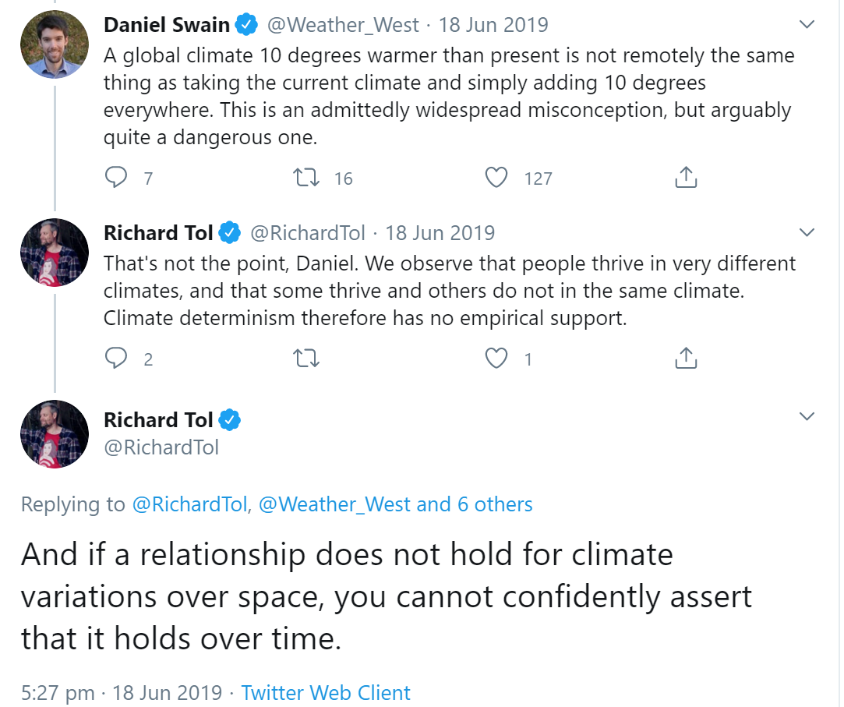
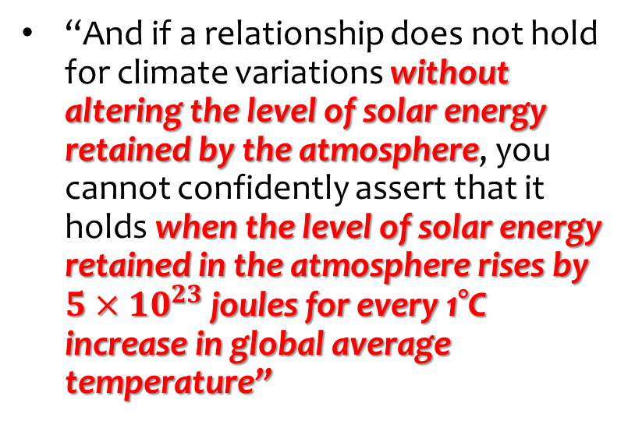
(2) Climate variation today confused with climate change from huge increase in retained solar energy
Defence of this by Tol is pseudo-statistical logic…
Putting Tol’s clever-sounding statement in context:
“And if a relationship does not hold for climate variations without altering the level of solar energy retained by the atmosphere, you cannot confidently assert that it holds when the level of solar energy retained in the atmosphere rises by $5×{10}^{23}$ joules for every 1°C increase in global average temperature”
10°C warming of the atmosphere alone is equivalent to the energy from 81 billion Hiroshima bombs… about 160 Hiroshima bombs per square kilometre

Slide 25
(2) Climate variation today confused with climate change from huge increase in retained solar energy
What these economists did:
  Compared “GDP” in two places with different temperatures while the level of energy in the biosphere remained constant
  E.g., Mendelsohn et al. 2000 “Comparing impacts across climate models”
    “COSMIC combines a simple climate/ocean model with the geographical distributions of the changes in surface temperature and precipitation…
    Assuming that the geographic climate distributions from each model can be scaled by the global-mean surface temperature change, COSMIC predicts country-specific climate projections for each GCM.” (p. 37)
    “By comparing one area with a warmer site, the Cross-sectional approach is able to discern what would happen to that place in the long run if it warmed.” (p. 38)
What Global Warming will do:
  Dramatically increase the level of energy in the biosphere

Slide 26
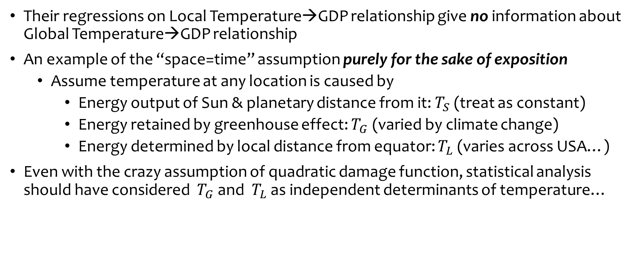
(2) Climate variation today confused with climate change from huge increase in retained solar energy
Their regressions on Local Temperature→GDP relationship give no information about Global Temperature→GDP relationship
An example of the “space=time” assumption purely for the sake of exposition
  Assume temperature at any location is caused by
    Energy output of Sun & planetary distance from it: $T_{S}$ (treat as constant)
    Energy retained by greenhouse effect: $T_{G}$ (varied by climate change)
    Energy determined by local distance from equator: $T_{L}$ (varies across USA…)
Even with the crazy assumption of quadratic damage function, statistical analysis should have considered $T_{G}$ and $T_{L}$ as independent determinants of temperature…

Slide 27

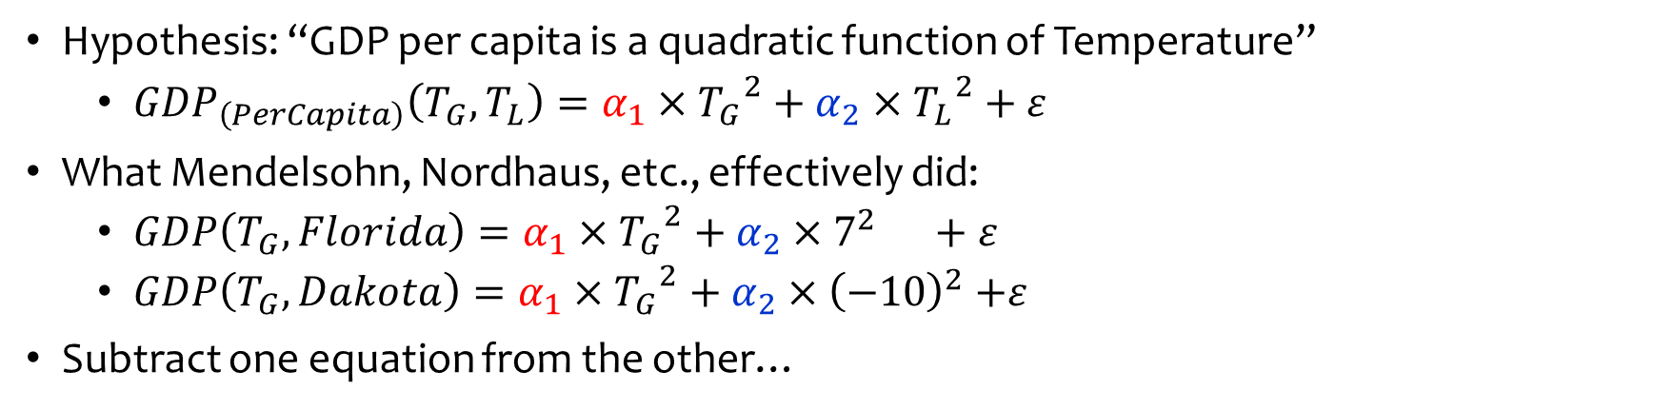

(2) Climate variation today confused with climate change from huge increase in retained solar energy
Hypothesis: “GDP per capita is a quadratic function of Temperature”
  ${GDP}_{\left(PerCapita\right)}\left(T_{G},T_{L}\right)=α_{1}×{T_{G}}^{2}+α_{2}$ $×{T_{L}}^{2}+ε$
What Mendelsohn, Nordhaus, etc., effectively did:
  $GDP\left(T_{G},Florida\right)=α_{1}×{T_{G}}^{2}+α_{2}×7^{2} +ε$
  $GDP\left(T_{G},Dakota\right)=α_{1}×{T_{G}}^{2}+α_{2}×{\left(−10\right)}^{2}$ $+ε$
Subtract one equation from the other…
$α_{1}×{T_{G}}^{2}$ cancels out
  $\text{Solve} \text{for} α_{2}=\frac{GDP\left(T_{G},Florida\right)−GDP\left(T_{G},Dakota\right)}{51}$
    $\text{“}\text{We} \text{have} \text{no} \text{information} \text{on} α_{1} \text{, }\text{so} \text{let}\text{’}\text{s} \text{assume} α_{1}=α_{2}\text{”}$
Confirmed by recent paper by Kahn, Mohaddes, et al. (2019) “Long-Term Macroeconomic Effects of Climate Change: A Cross-Country Analysis”

Slide 28
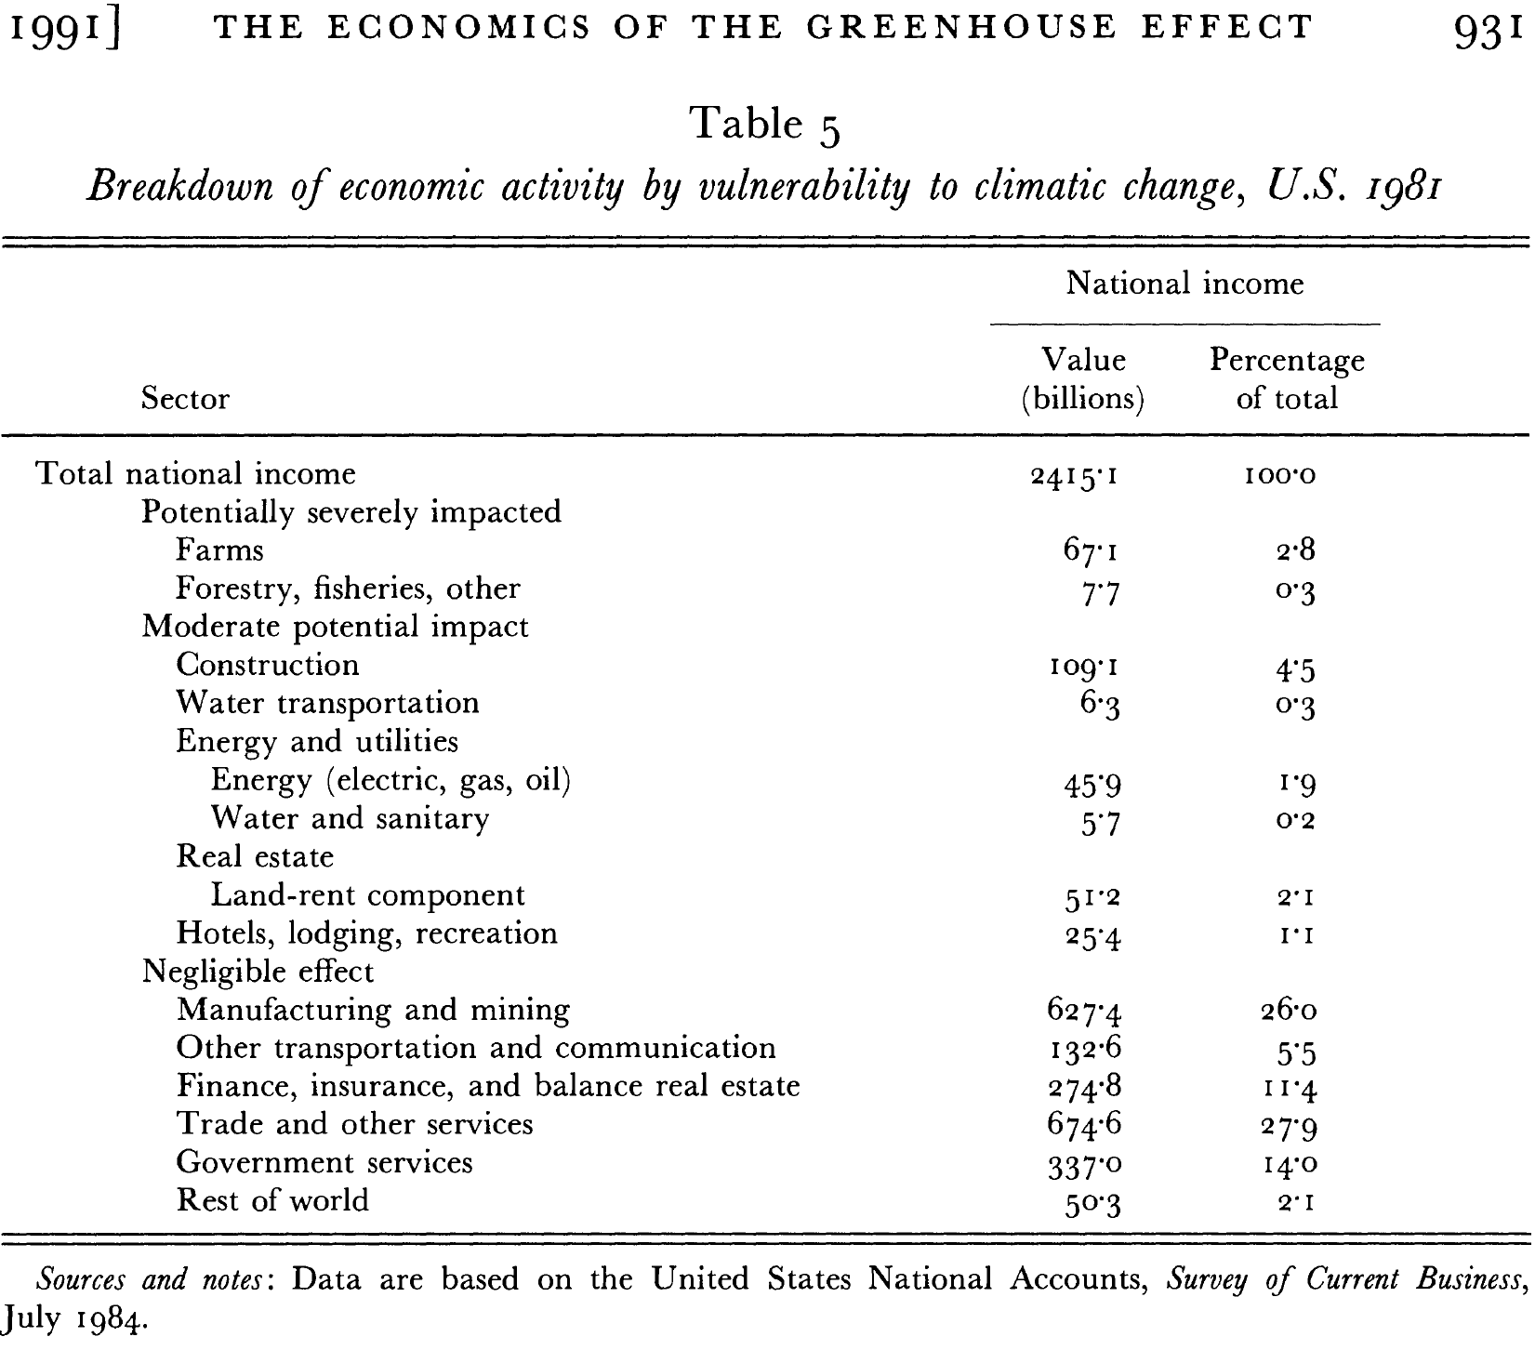
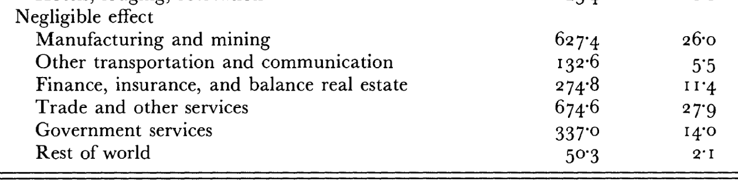
(3) Assume industry unaffected because it happens indoors!
“Table 5 shows a sectoral breakdown of United States national income, where the economy is subdivided by the sectoral sensitivity to greenhouse warming.
The most sensitive sectors are likely to be those, such as agriculture and forestry, in which output depends in a significant way upon climatic variables.
At the other extreme are activities, such as cardiovascular surgery or microprocessor fabrication in 'clean rooms', which are undertaken in carefully controlled environments that will not be directly affected by climate change.
Our estimate is that approximately … about 87% in sectors that are negligibly affected by climate change. (Nordhaus 1991, p. 930. Emphasis added)
87% of economy simply assumed to be unaffected!

Slide 29
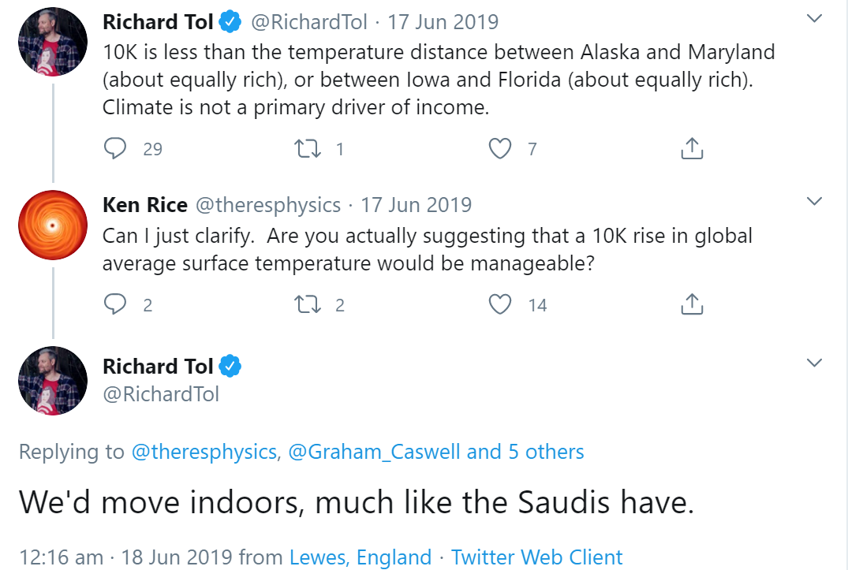
(3) Assume industry unaffected because it happens indoors!
All you need… is Air-conditioning

Slide 30
(4) Distort or ignore scientific literature
Nordhaus justifies using a simple parabola for the damages from climate change:
  “The current version assumes that damages are a quadratic function of temperature change and does not include sharp thresholds or tipping points,
  but this is consistent with the survey by Lenton et al. (2008).”
    (Nordhaus & Sztorc 2013, p. 11)
Lenton et al.’s actual conclusion:
  “Society may be lulled into a false sense of security by smooth projections of global change.
  Our synthesis of present knowledge suggests that a variety of tipping elements could reach their critical point within this century under anthropogenic climate change.” (Lenton 2008, p. 1792)

Slide 31
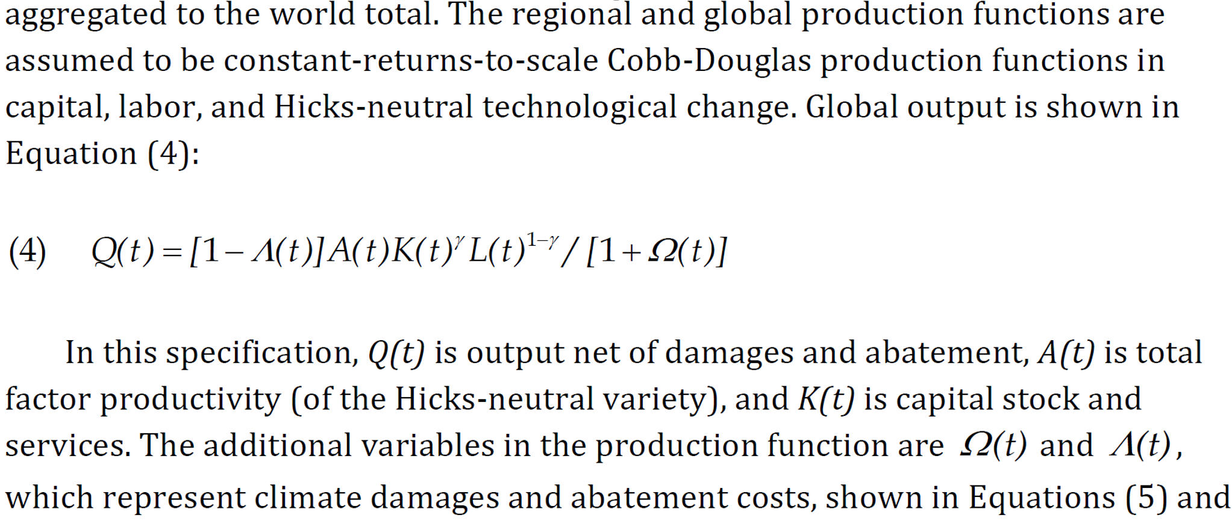
(5) Minimize expected impact every step of the way
Damages in Nordhaus’s DICE model affect flow of output (GDP) but not stock of industry itself (factories that produce output)
Damages reduce GDP…
But Assumes capital, technology & population are unaffected by climate change

Slide 32
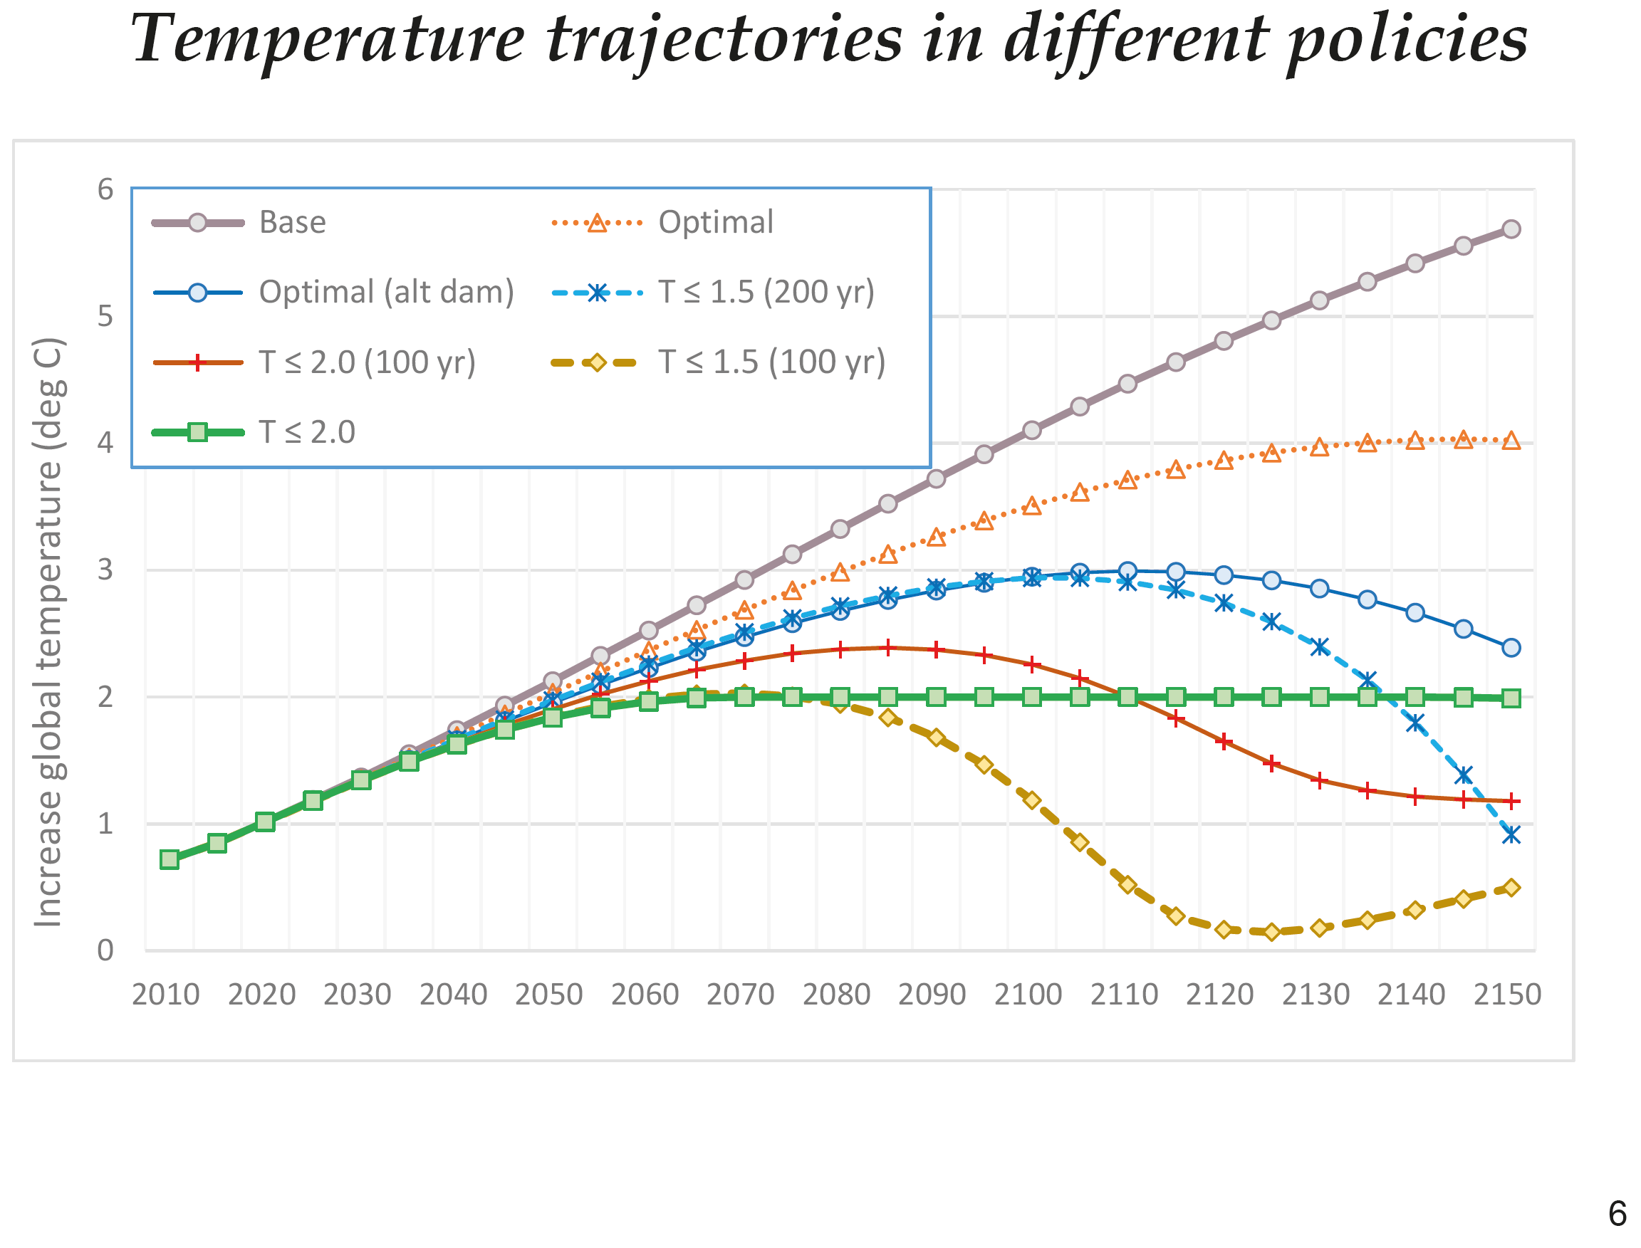
Why was work this bad given a “Nobel Prize”?
To “William D. Nordhaus ‘for integrating climate change into long-run macroeconomic analysis’”
His “Nobel Prize” lecture: Optimal time path of global temperature stabilizes at 4°C above pre-industrial levels in 2140…
Because it defends an inherent belief in the superiority of unfettered free market
Climate change requires controls on markets, therefore it can’t be a problem…

Slide 33
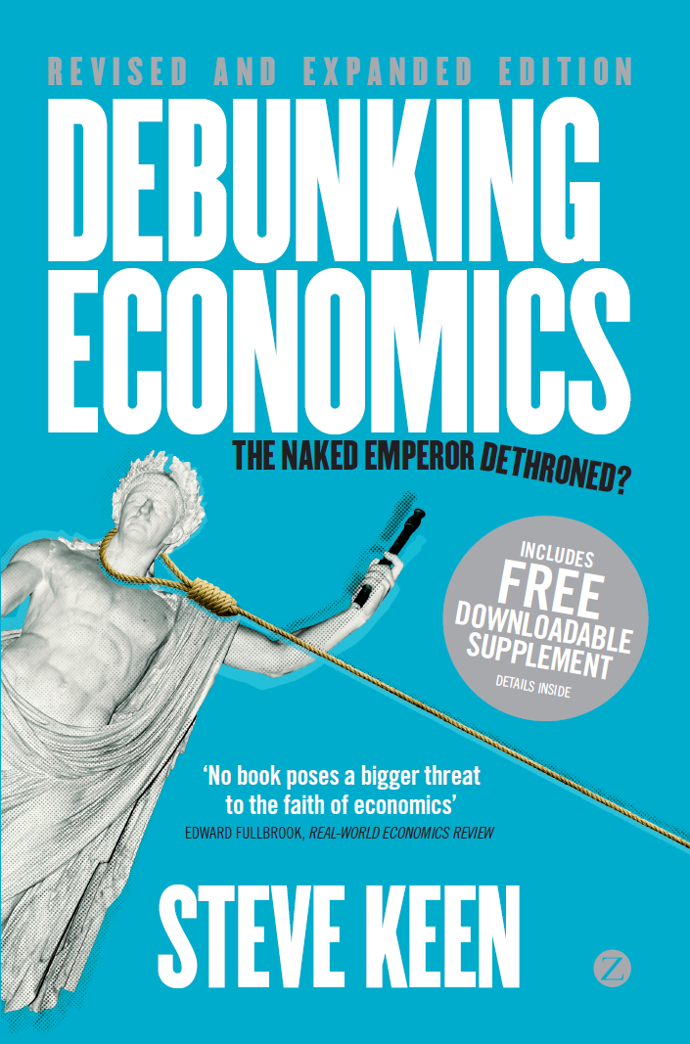
Why was work this bad given a “Nobel Prize”?
Neoclassical economics is an internally flawed model of capitalism
Believed by its adherents because it “explains everything”
  It is “scientism”: not mathematics but “mythematics”
  “Simplifying assumptions”?
    “Mendelsohn assumes that the observed variation of economic activity with climate over space holds over time as well”
    Assume that “manufacturing and services, largely take place in controlled environments and are not really exposed to climate change”?
  IT’S NOT A “SIMPLIFYING ASSUMPTION” WHEN YOUR CONCLUSIONS DEPEND ON IT BEING TRUE

Slide 34
How does work this bad get past referees?
(1) Neoclassicals call domain assumptions “simplifying assumptions” (Musgrave)
  “In order to derive conditions for equilibrium in the capital market … we assume homogeneity of investor expectations: investors are assumed to agree on the prospects of various investments … Needless to say, these are highly restrictive and undoubtedly unrealistic assumptions…” (Sharpe 1964; c f. Sharpe 1970)
  Acceptance of absurd assumptions is habitual in economics (Friedman 1964)
(2) Fundamental flaw in the refereeing process: Once you are published in an area, you get approached to referee papers in it
  Nordhaus establishes “economics of climate change”; referees incoming papers
    Only papers whose conclusions he agrees with get published
    Groupthink builds up as more “approved” economists join refereeing process
      “it is still a reasonably small and close-knit community who may be subject to groupthink, peer pressure, and self-censoring” (Tol 2009, p. 43).

Slide 35
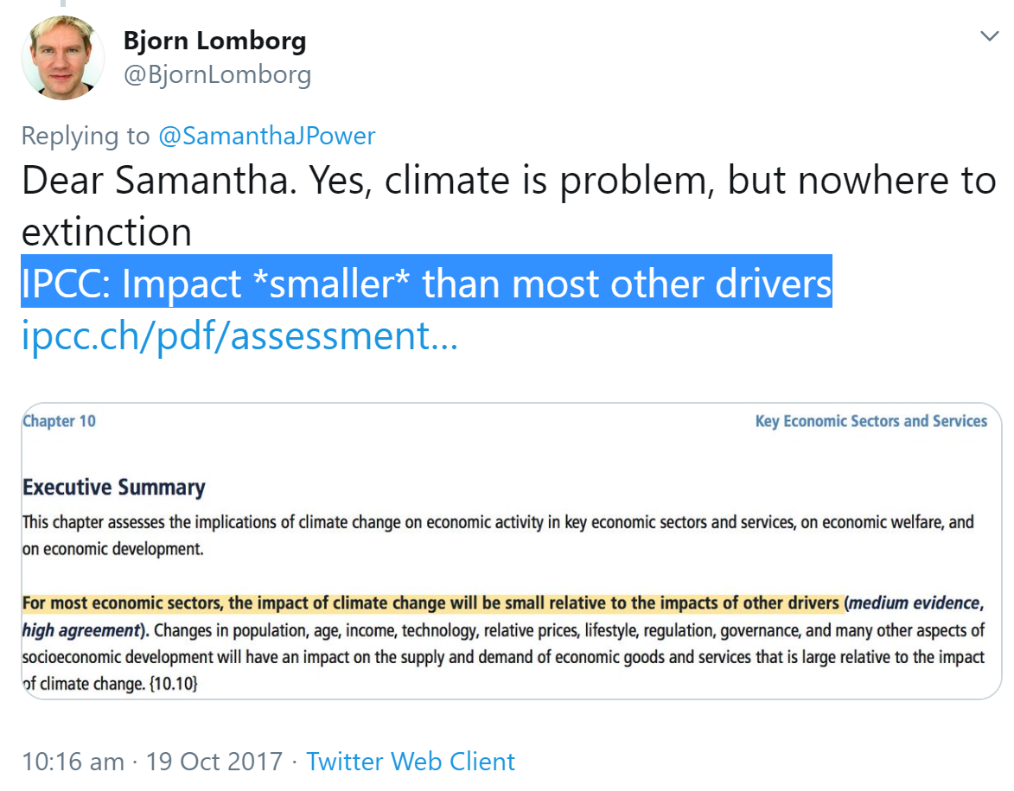
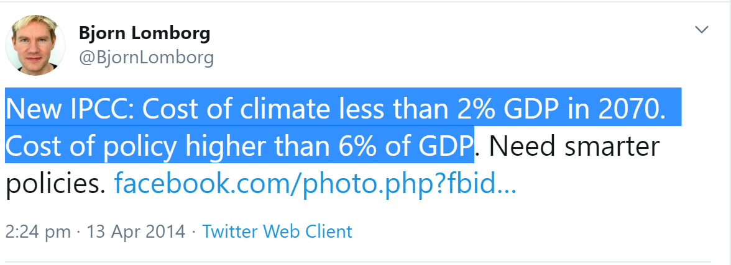
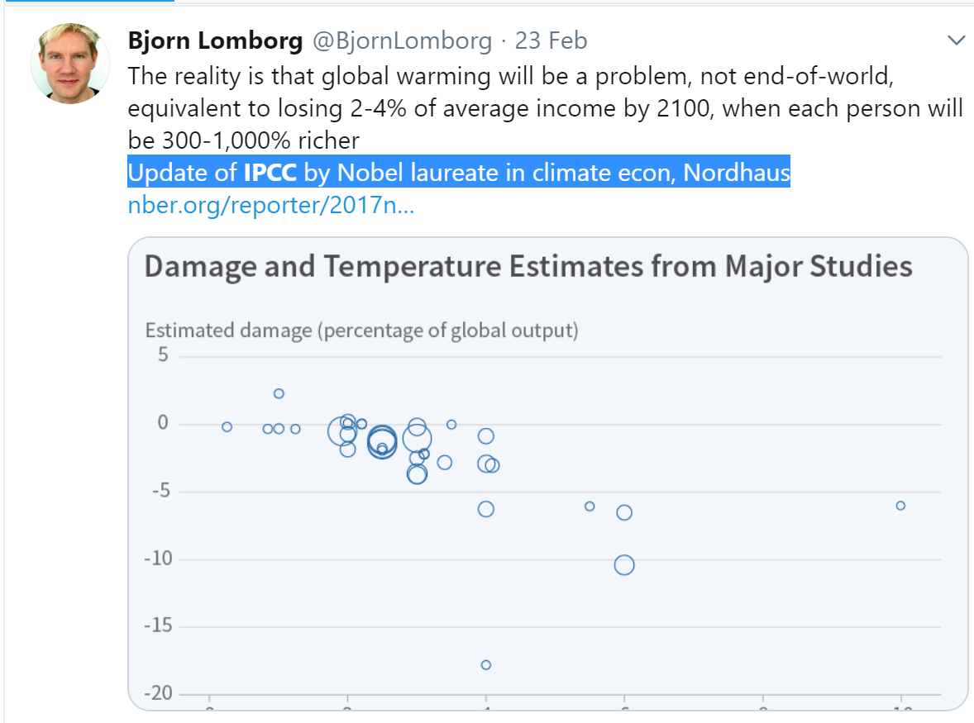
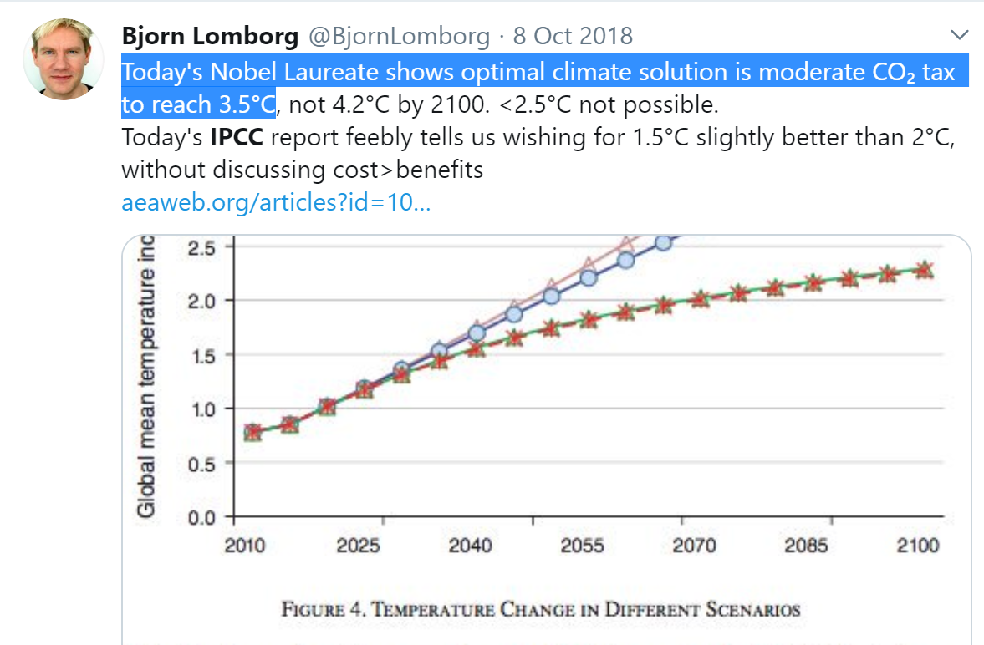
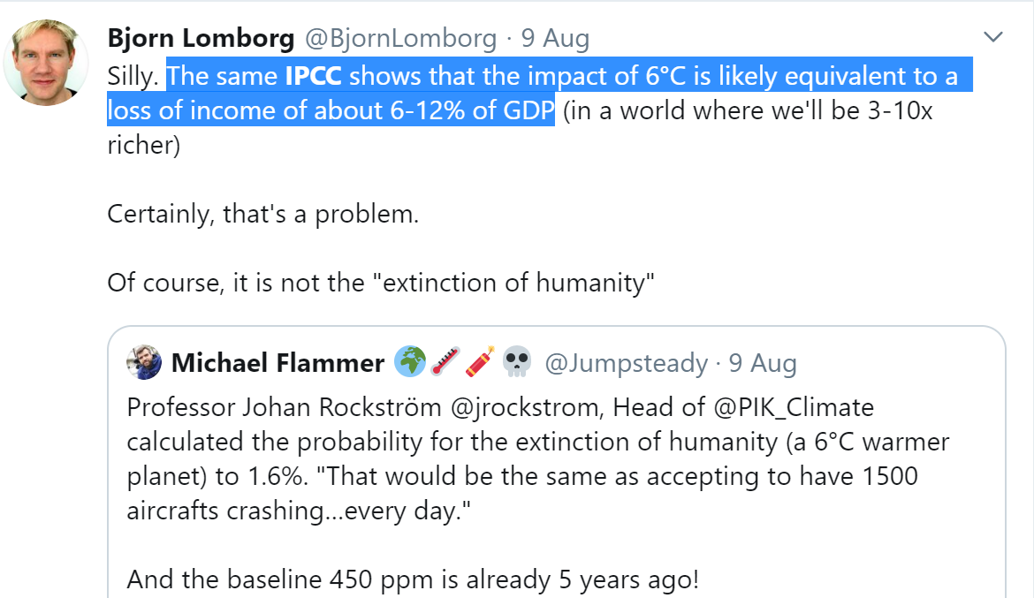
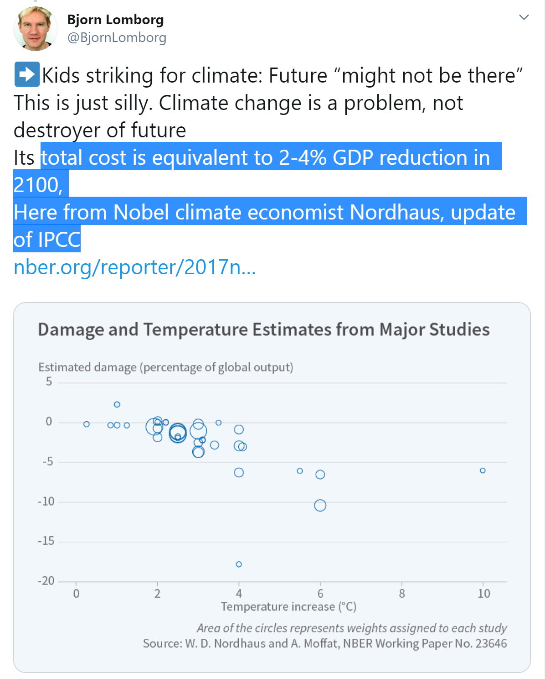

Nordhaus & his cronies support inaction on climate change
Nordhaus & economists in the IPCC are providing ammunition for climate change deniers/trivializers to attack science-based Working Groups and undermine Global Warming policy…
“High Agreement”

Slide 36
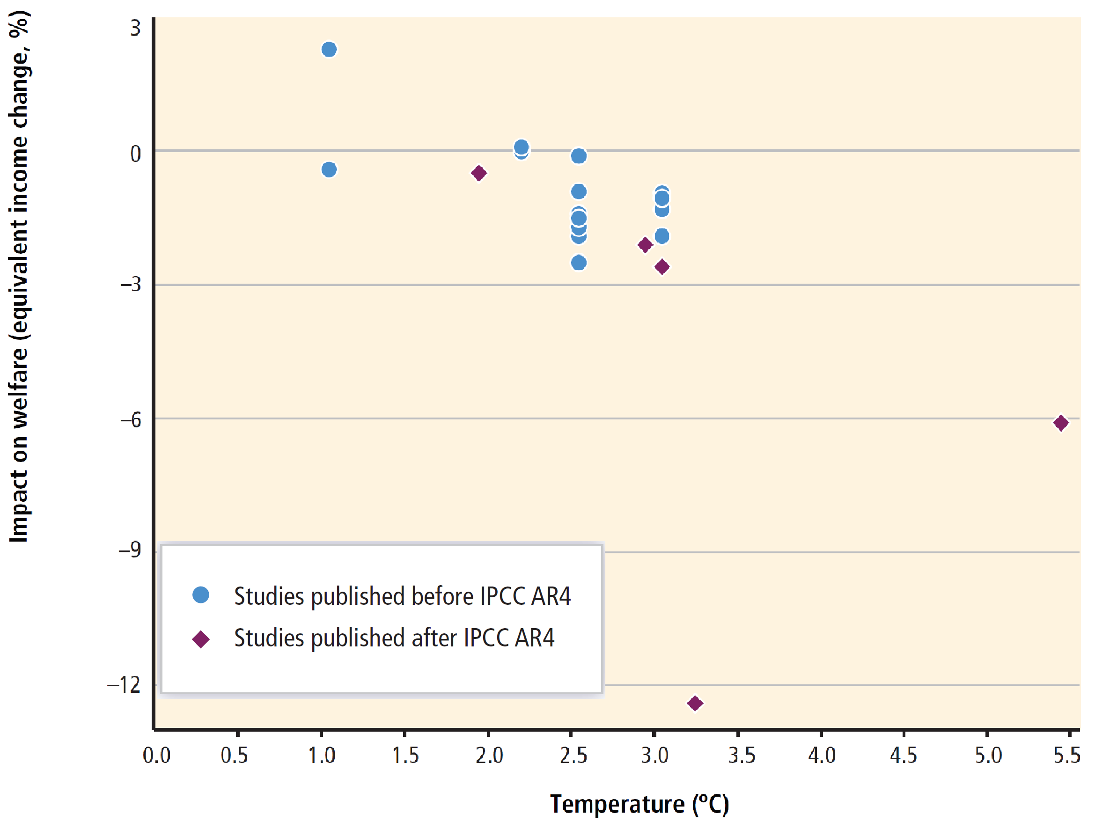
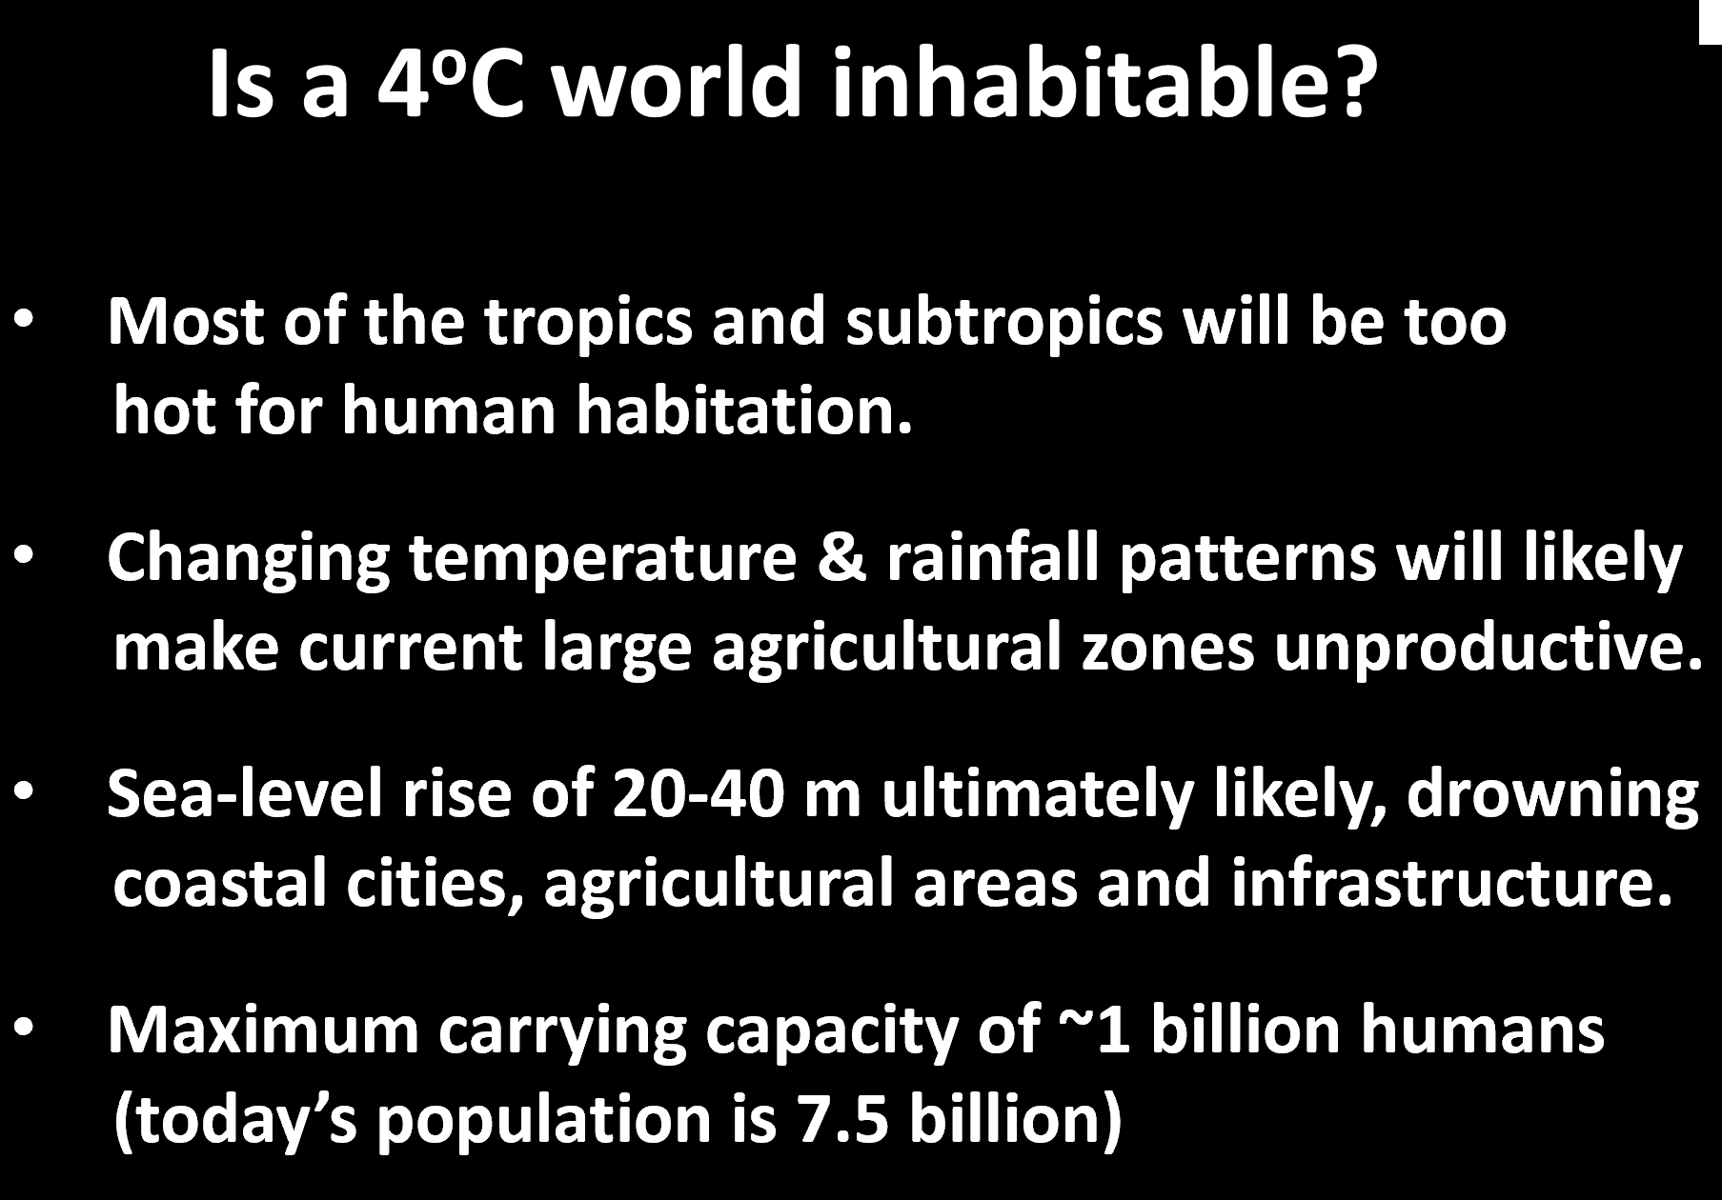
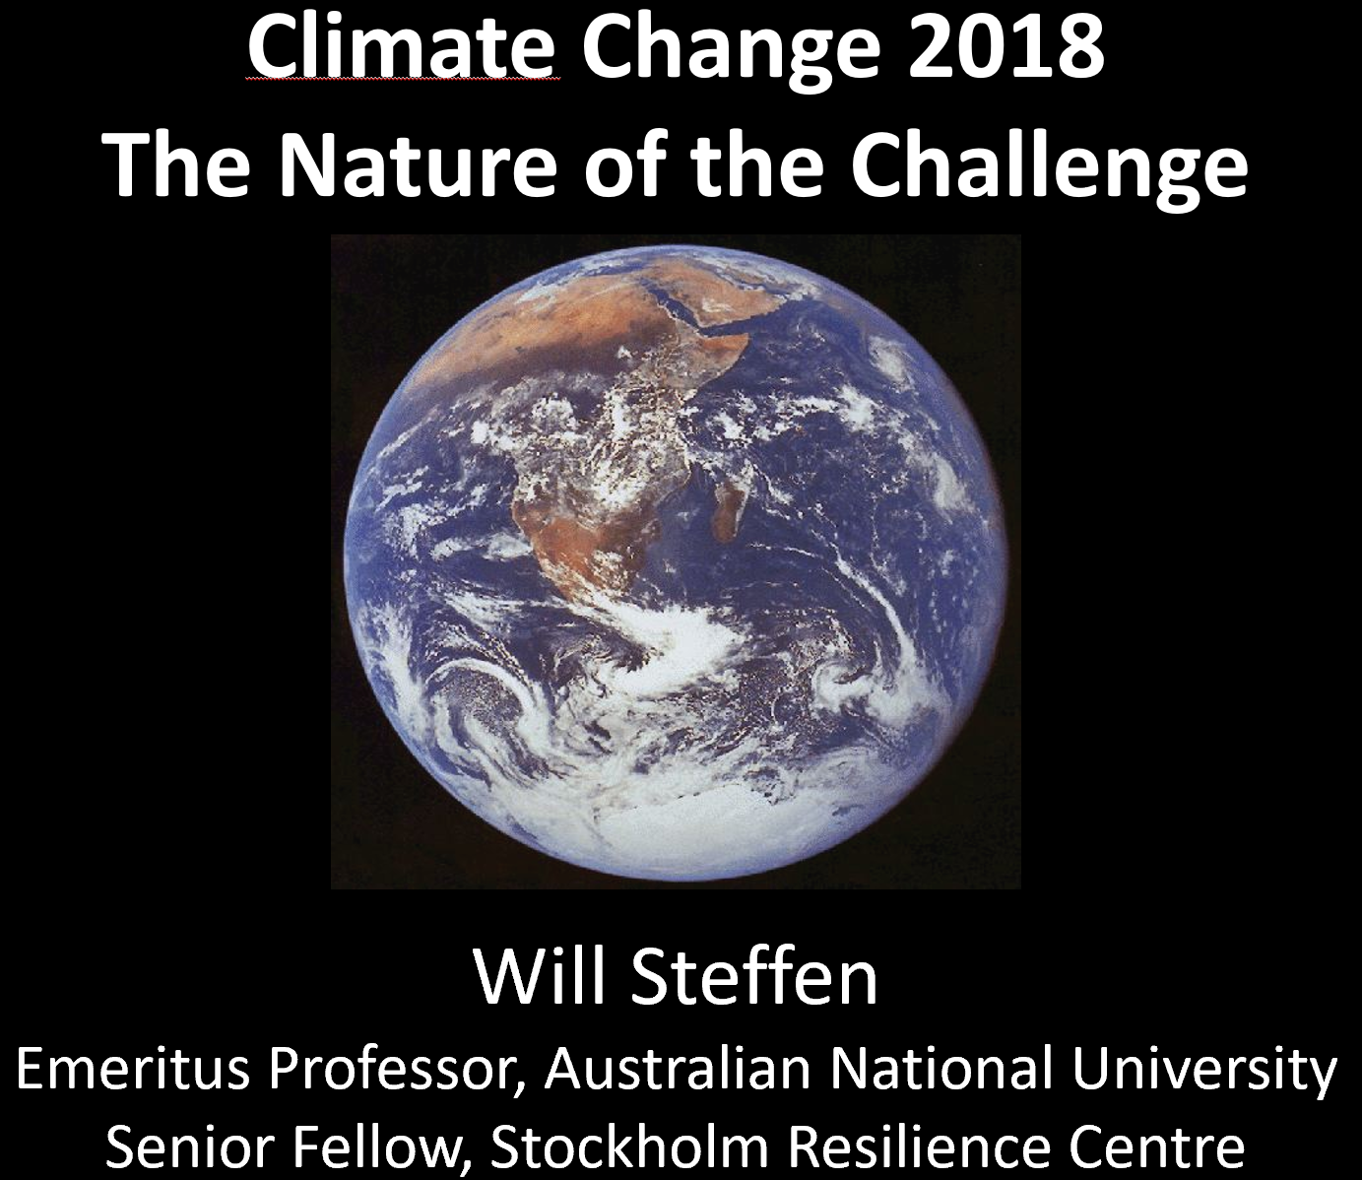
“Climate change economics” is an existential threat to humanity
“Garbage in, garbage out”. Even without considering the models themselves, IAMs using “data” like this—from IPCC 2014—are inherently useless:
Predictions like these from actual climate scientists are more likely

Slide 37
Conclusion
Neoclassical economics developed to defend capitalism against socialism
Its inability to escape equilibrium modelling may end up dooming capitalism itself, by trivializing the dangers of climate change:
  Nordhaus 1991: “We estimate that the net economic damage from a 3° warming is likely to be around ¼% of national income … This figure is clearly incomplete…
  We might raise the number to around 1% of total global income to allow for these unmeasured and unquantifiable factors, although such an adjustment is purely ad hoc. It is not possible to give precise error bounds around this figure, but
  my hunch is that the overall impact upon human activity is unlikely to be larger than 2% of total output.” (p. 932-933)
Economics will not reform itself
  Physicists, complex systems specialists, mathematicians, engineers, biologists, should feel no compunction about invading economics & doing the job properly

Slide 38
Annotated References with URLs where available
Arent, D. J., R. S. J. Tol, et al. (2014). Key economic sectors and services. Climate Change 2014: Impacts, Adaptation, and Vulnerability. Part A: Global and Sectoral Aspects. Contribution of Working Group II to the Fifth Assessment Report of the Intergovernmental Panel on Climate Change. C. B. Field, V. R. Barros, D. J. Dokkenet al. Cambridge, United Kingdom, Cambridge University Press: pp. 659-708.
  “For most economic sectors, the impact of climate change will be small relative to the impacts of other drivers (medium evidence, high agreement). Changes in population, age, income, technology, relative prices, lifestyle, regulation, governance, and many other aspects of socioeconomic development will have an impact on the supply and demand of economic goods and services that is large relative to the impact of climate change.” (p. 662)
  “Frequently Asked Questions: FAQ 10.3 | Are other economic sectors vulnerable to climate change too? Economic activities such as agriculture, forestry, fisheries, and mining are exposed to the weather and thus vulnerable to climate change. Other economic activities, such as manufacturing and services, largely take place in controlled environments and are not really exposed to climate change.” (p. 668)
Blanchard, O. (2018). "On the future of macroeconomic models." Oxford Review of Economic Policy 34(1-2): 43-54.
  “All these objections are serious. Do they add up to a case for discarding DSGEs and exploring other approaches? I do not think so. I believe the DSGEs make the right basic strategic choices and the current flaws can be addressed.
  Let me explain these two claims. The pursuit of a widely accepted analytical macroeconomic core, in which to locate discussions and extensions, may be a pipe dream, but it is a dream surely worth pursuing. If so, the three main modelling choices of DSGEs are the right ones. Starting from explicit microfoundations is clearly essential; where else to start from? Ad hoc equations will not do for that purpose. Thinking in terms of a set of distortions to a competitive economy implies a long slog from the competitive model to a reasonably plausible description of the economy. But, again, it is hard to see where else to start from. Turning to estimation, calibrating/estimating the model as a system rather than equation-by-equation also seems essential. Experience from past equation-by-equation models has shown that their dynamic properties can be very much at odds with the actual dynamics of the system.” (p. 47)

Slide 39
Annotated References with URLs where available
Chari, V. V. (2010). Building a science of economics for the real world. Subcommittee on investigations and oversight , Committee on science and technology. U. Congress. Washington, U.S. Government printing office
  All the interesting policy questions involve understanding how people make decisions over time and how they handle uncertainty. All must deal with the effects on the whole economy. So, any interesting model must be a dynamic stochastic general equilibrium model. From this perspective, there is no other game in town. Modern macroeconomic models, often called DSGE models in macro share common additional features. All of them make sure that they are consistent with the National Income and Product Accounts. That is, things must add up. All of them lay out clearly how people make decisions. All of them are explicit about the constraints imposed by nature, the structure of markets and available information on choices to households, firms and the government. From this perspective DSGE land is a very big tent. The only alternatives are models in which the modeler does not clearly spell out how people make decisions. Why should we prefer obfuscation to clarity? My description of the style of modern macroeconomics makes it clear that modern macroeconomists use a common language to formulate their ideas and the style allows for substantial disagreement on the substance of the ideas. A useful aphorism in macroeconomics is: "If you have an interesting and coherent story to tell, you can tell it in a DSGE model. If you cannot, your story is incoherent." (p. 2)

Slide 40
Annotated References with URLs where available
DeCanio, S. J. (2003). Economic models of climate change : a critique. New York, Palgrave Macmillan.
  “Given the magnitude of the stakes, it is perhaps surprising that much of the debate about the climate has been cast in terms of economics. Economics does a relatively better job of calculating what might happen in the wake of marginal changes in policy or circumstances than it does in handling comparisons between radically different situations… This requirement for "marginal“ welfare analysis does not hold when considering climate change.” (p. 3)
  The result is that the application of general equilibrium analysis to climate policy has produced a kind of specious precision, a situation in which the assumptions of the analysts masquerade as results that are solidly grounded in theory and the data. This leads to a tremendous amount confusion and mischief, not least of which is the notion that though the physical science of the climate is plagued by uncertainty it is possible to know with a high degree of certainty just what economic consequences of alternative policy actions will be. This more than any other, has created the policy paralysis and public illusion that so far have impeded constructive action to meet the climate challenge.” (p. 7)
Eddington, A. S. (1928). The Nature Of The Physical World. Cambridge, Cambridge University Press.
  “The practical measure of the random element which can increase in the universe but can never decrease is called entropy. … Entropy continually increases. We can, by isolating parts of the world and postulating rather idealized conditions in our problems, arrest the increase, but we cannot turn it into a decrease. That would involve something much worse than a violation of an ordinary law of Nature, namely, an improbable coincidence. The law that entropy always increases—the second law of thermodynamics—holds, I think, the supreme position among the laws of Nature. If someone points out to you that your pet theory of the universe is in disagreement with Maxwell’s equations—then so much the worse for Maxwell’s equations. If it is found to be contradicted by observations—well, these experimentalists do bungle things sometimes. But if your theory is found to be against the second law of thermodynamics I can give you no hope; there is nothing for it but to collapse in deepest humiliation.” (p. 37)

Slide 41
Annotated References with URLs where available
Friedman, M. (1953). The Methodology of Positive Economics. Essays in positive economics. Chicago, University of Chicago Press
  “Truly important and significant hypotheses will be found to have “assumptions” that are wildly inaccurate descriptive representations of reality, and, in general, the more significant the theory, the more unrealistic the assumptions (in this sense).”¹²
  Footnote 12: “The converse of the proposition does not of course hold: assumptions that are unrealistic (in this sense) do not guarantee a significant theory.”
Kahn, M. E., K. Mohaddes, et al. (2019) Long-Term Macroeconomic Effects of Climate Change: A Cross-Country Analysis. DOI:
  “the literature relies primarily on the cross-sectional approach, and as such does not take into account the time dimension of the data (i.e., assumes that the observed relationship across countries holds over time as well)… We show that an increase in average global temperature of 0.04°C per year— corresponding to the Representative Concentration Pathway (RCP) 8.5 scenario, which assumes higher greenhouse gas emissions in the absence of mitigation policies— reduces world’s real GDP per capita by 7.22 percent by 2100” (pp 1-4)
Keen, S., R. U. Ayres, et al. (2019). "A Note on the Role of Energy in Production." Ecological Economics 157: 40-46.
  “This altered form is motivated by epistemological concerns, as well as the empirical issues already outlined. The functional form shown in Equation (1.2) implies that energy can be added to a production process independently of labour and capital, and that labour and capital can operate without energy inputs themselves. Neither proposition is true. Adding energy independently of labour and capital to a production process would cause not output but destruction: both labour and capital are needed, and are used, to harness energy in its various forms to perform useful work. Similarly, both labour and capital need energy in order to be able to function: to coin a phrase, labour without energy is a corpse, while capital without energy is a sculpture.
  The functional form in Equation (1.7) acknowledges both epistemological issues: energy is not added to a production process independently of labour and capital, but is instead channelled by them to perform useful work; and if the energy input to either labour or capital is zero, then the useful work performed by it is also zero.
  Once both labour and capital are seen as means to turn energy into useful work, then the inputs of the functions L(E) and K(E) are energy, while the outputs are the potential for useful work (exergy).”

Slide 42
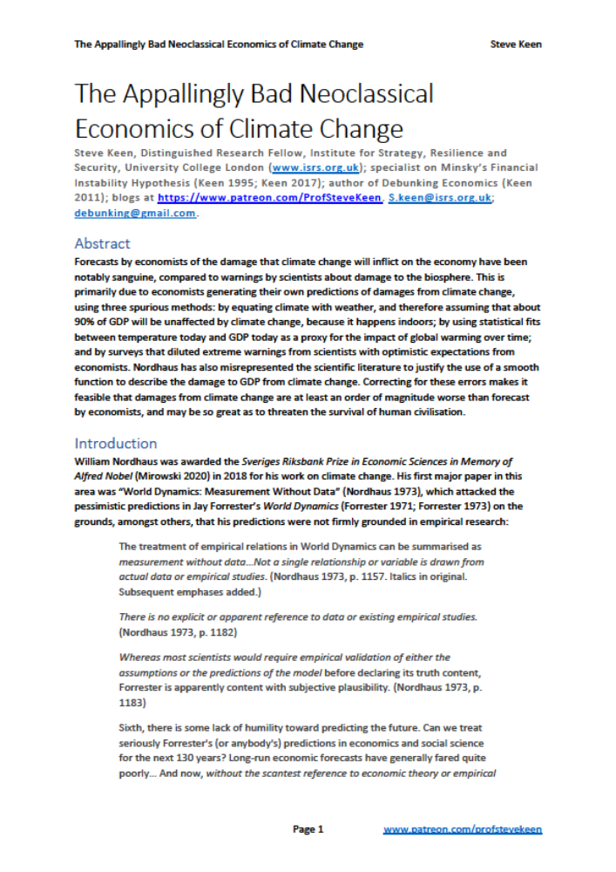
Annotated References with URLs where available
Keen, S. (2020). "The Appallingly Bad Neoclassical Economics of Climate Change." Globalizations Forthcoming.
  Forecasts by economists of the damage that climate change will inflict on the economy have been notably sanguine, compared to warnings by scientists about damage to the biosphere. This is primarily due to economists generating their own predictions of damages from climate change, using three spurious methods: by equating climate with weather, and therefore assuming that about 90% of GDP will be unaffected by climate change, because it happens indoors; by using statistical fits between temperature today and GDP today as a proxy for the impact of global warming over time; and by surveys that diluted extreme warnings from scientists with optimistic expectations from economists. Nordhaus has also misrepresented the scientific literature to justify the use of a smooth function to describe the damage to GDP from climate change. Correcting for these errors makes it feasible that damages from climate change are at least an order of magnitude worse than forecast by economists, and may be so great as to threaten the survival of human civilisation.
Lenton, T. M., H. Held, et al. (2008). "Tipping elements in the Earth's climate system." Proceedings of the National Academy of Sciences 105(6): 1786-1793
  “Society may be lulled into a false sense of security by smooth projections of global change. Our synthesis of present knowledge suggests that a variety of tipping elements could reach their critical point within this century under anthropogenic climate change”. (p. 1792)
Lynas, M. (2020). Our Final Warning: Six Degrees of Climate Emergency. London, HarperCollins Publishers.
  “When I started writing this book I thought that we could probably survive climate change. Now I am not so sure… At three degrees I now believe that the stability of human civilisation will be seriously imperilled, while at four degrees a full-scale global collapse of human societies is probable, accompanied by a mass extinction of the biosphere that will be the worst on Earth for tens or even hundreds of millions of years.” (p. ix).

Slide 43
Annotated References with URLs where available
Mendelsohn, R., W. D. Nordhaus, et al. (1994). "The Impact of Global Warming on Agriculture: A Ricardian Analysis." The American Economic Review 84(4): 753-771.
  “The basic hypothesis is that climate shifts the production function for crops. Farmers at particular sites take environmental variables like climate as given and adjust their inputs and outputs accordingly. Moreover, we assume perfect competition in both product and input markets. Most important, we assume that the economy has completely adapted to the given climate so that land prices have attained the long-run equilibrium that is associated with each county’s climate.” (p. 756)
Mendelsohn, R., M. Schlesinger, et al. (2000). "Comparing impacts across climate models." Integrated Assessment 1(1): 37-48
  “By comparing one area with a warmer site, the Cross-sectional approach is able to discern what would happen to that place in the long run if it warmed.” (p. 38)
Musgrave, A. (1990). “'Unreal Assumptions' in Economic Theory: The F-Twist Untwisted”. Milton Friedman: Critical assessments. Volume 3. J. C. Wood and R. N. Woods. London and New York, Routledge: 333-342
  “Suppose a scientist is investigating some phenomenon and has the hypothesis that some factor F which might be expected to affect that phenomenon actually has no effect upon it… I will call assumptions like these negligibility assumptions…
  FRIEDMAN is wrong to conclude from this that 'the more significant the theory, the more unrealistic the assumptions”
  a scientist may conclude that his theory will only work where factor F is absent, and restrict its applicability to cases of this kind. He may retain the 'assumption' that F is absent, but now use it to specify the domain of applicability of his theory. Let us call assumptions of this second kind domain assumptions…
  If a domain assumption is always false, then the theory containing it can be applied to no actual situation and is in fact untestable.”
Nordhaus, W. D. (1991). "To Slow or Not to Slow: The Economics of The Greenhouse Effect." The Economic Journal 101(407): 920-937.
  “human societies thrive in a wide variety of climatic zones. For the bulk of economic activity, non-climate variables like labour skills, access to markets, or technology swamp climatic considerations in determining economic efficiency.” (p. 930)

Slide 44
Annotated References with URLs where available
Nordhaus, W. (1994). "Expert Opinion on Climate Change." American Scientist 82(1): 45–51.
  “the growing list was trimmed by giving preference to those … who had written on the issue of the economics of climatic change. In the end, 22 persons (including the author) were invited, but three did not… The respondents consisted of 10 economists, four other social scientists and five natural scientists and engineers… I am known to the respondents as one who has developed estimates of the impact of climatic change that are modest compared with some of the scientific concerns and popular rhetoric, and this knowledge might have influenced the respondents.” (p. 46)
Nordhaus, W. D. (2007). "A Review of the "Stern Review on the Economics of Climate Change"." Journal of Economic Literature 45(3): 686-702.
  It would be useful to determine how robust our prescriptions are to alternative formulations of the preference structures. These would include preferences where utility adapts to the level of consumption, or where consumption is compared to the last generation, or where large parts of the population lose interest in economic goods and turn to ascetic pursuits, or where rich nations use higher productivity to develop fiendish new weapons, or where people come to love the altered landscape of the warmer world.” (p. 693)
Nordhaus, W. and P. Sztorc (2013). DICE 2013R: Introduction and User’s Manual
  “The current version assumes that damages are a quadratic function of temperature change and does not include sharp thresholds or tipping points, but this is consistent with the survey by Lenton et al. (2008).” (p. 11)
    “Society may be lulled into a false sense of security by smooth projections of global change. Our synthesis of present knowledge suggests that a variety of tipping elements could reach their critical point within this century under anthropogenic climate change”. (Lenton 2008, p. 1792)
Nordhaus, W. (2018). "Projections and Uncertainties about Climate Change in an Era of Minimal Climate Policies." American Economic Journal: Economic Policy 10(3): 333–360
  “The parameter used in the model was a … 0.227 percent loss in global income per degrees Celsius squared … This leads to a damage of … 7.9 percent of global income at a global temperature rise of 6°C.” (p. 345)

Slide 45
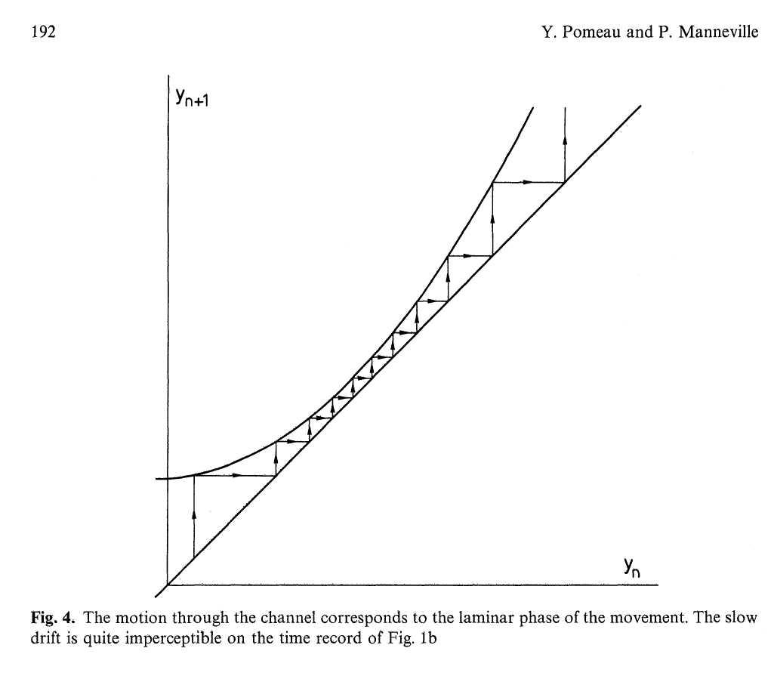
Annotated References with URLs where available
Pindyck, R. S. (2017). "The Use and Misuse of Models for Climate Policy." Review of Environmental Economics and Policy 11(1): 100-114
  “integrated assessment models (IAMs) have flaws that make them close to useless as tools for policy analysis. IAM-based analyses of climate policy create a perception of knowledge and precision that is illusory and can fool policymakers into thinking that the forecasts the models generate have some kind of scientific legitimacy…” (p. 100)
Pomeau, Y. and P. Manneville (1980). "Intermittent transition to turbulence in dissipative dynamical systems." Communications in Mathematical Physics 74: 189-197.
Sharpe, W. F. (1964). "Capital Asset Prices: A Theory of Market Equilibrium under Conditions of Risk." The Journal of Finance 19(3): 425-442
  “In order to derive conditions for equilibrium in the capital market we invoke two assumptions. First, we assume a common pure rate of interest, with all investors able to borrow or lend funds on equal terms. Second, we assume homogeneity of investor expectations: investors are assumed to agree on the prospects of various investments – the expected values, standard deviations and correlation coefficients described in Part II. Needless to say, these are highly restrictive and undoubtedly unrealistic assumptions. However, since the proper test of a theory is not the realism of its assumptions but the acceptability of its implications, and since these assumptions imply equilibrium conditions which form a major part of classical financial doctrine, it is far from clear that this formulation should be rejected – especially in view of the dearth of alternative models leading to similar results.” (p. 434)
  The consequence of accommodating such aspects of reality are likely to be disastrous in terms of the usefulness of the resulting theory . . . The capital market line no longer exists. Instead, there is a capital market curve – linear over some ranges, perhaps, but becoming flatter as [risk] increases over other ranges. Moreover, there is no single optimal combination of risky securities; the preferred combination depends upon the investors’ preferences . . . The demise of the capital market line is followed immediately by that of the security market line. The theory is in a shambles. (Sharpe, W. F. (1970). Portfolio theory and capital markets. New York, McGraw Hill)

Slide 46
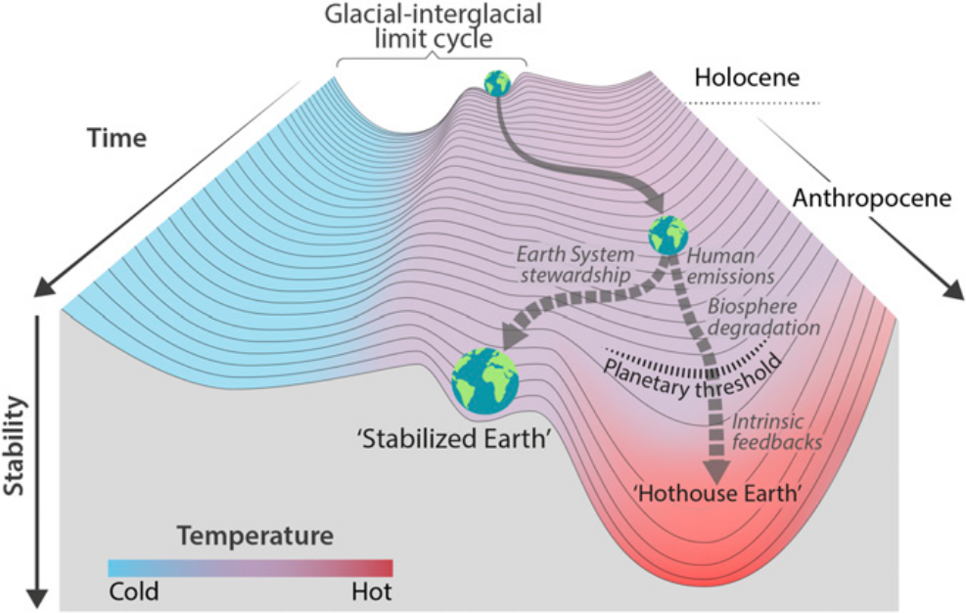
Annotated References with URLs where available
Smith, J. and D. Tirpak (1989). The Potential Effects of Global Climate Change on the United States. E. P. Agency. Washington, Environmental Protection Agency
  “Annual electricity generation in 2055 was estimated under the transient scenarios to be 4 to 6% greater than without climate change. The annual costs of meeting the increase due to global warming, assuming no change in technology or efficiency, was estimated to be $33-$73 billion (in 1986 dollars). (p. xi)
    (Nordhaus 1991 citing Smith & Tirpak: “Electricity demand … -$1.65 billion”)
Steffen, W., J. Rockström, et al. (2018). "Trajectories of the Earth System in the Anthropocene." Proceedings of the National Academy of Sciences 115(33): 8252-8259
  “While this may seem to be an extreme scenario, it illustrates that a warming into the range of even the lower-temperature cluster (i.e., the Paris targets) could lead to tipping in the mid- and higher-temperature clusters via cascade effects. Based on this analysis of tipping cascades and taking a risk-averse approach, we suggest that a potential planetary threshold could occur at a temperature rise as low as ~2.0 °C above preindustrial (Fig. 1).” (p. 8255)

Slide 47
Annotated References with URLs where available
Tol, R. S. J. (2009). "The Economic Effects of Climate Change." The Journal of Economic Perspectives 23(2): 29–51
  “Mendelsohn assumes that the observed variation of economic activity with climate over space holds over time as well” (p. 32)
Weitzman, M. L. (2011). "Fat-Tailed Uncertainty in the Economics of Catastrophic Climate Change." Review of Environmental Economics and Policy 5(2): 275-292
  “the most striking feature of the economics of climate change is that its extreme downside is nonnegligible…” (p. 275)
  “I do not find the numbers in Table 3 convincing for higher temperatures. At an extraordinarily high global average temperature change of 10°C, the welfare-equivalent damage in Table 3 is a loss of ‘‘only’’ 19 percent of world output at the time of impact If the annual growth rate is, say, 2 percent and the time of impact is, say, two centuries from now, then the welfare difference between no temperature change in two hundred years and a temperature change of 10°C in two hundred years is the difference between output that is fifty-five times larger than current levels and output that is forty-four times larger than current levels. This is equivalent to a reduction in projected annual growth rates from 2 percent to 1.9 percent. Such a mild kind of damages function is practically preordained to make extreme climate change look empirically negligible, almost no matter what else is assumed. Conversely, it turns out that fat-tailed temperature PDFs are not by themselves sufficient to make extreme climate change have empirical ‘‘bite’’ without a damages function that is far more immiserizing at high-temperature changes.”
  While it is true that people live very well in places where the mean temperature is 10°C higher than in Yakutsk, Siberia, I do not think that this type of analogy justifies using a comparative geography approach for estimating welfare equivalent damages from an average global temperature change of 10°C. Global mean temperatures involve a double averaging: across space and over time…
  There is just too much structural uncertainty and too much heterogeneity to put trustworthy bounds on the unprecedented, almost unimaginable, changes to planetary welfare that would result from average global temperatures increasing by 10°C. (pp. 280-281)

