Slide 1
T2022 / T3
The Entropy Counteracting Report Revealed in the Artwork
Agnieszka Giszterowicz
Modrzewski Cracow University, Cracow, Poland
Thermodynamics 2.0
Boone, USA 2022

Slide 2
T2022 / T3
PREFIX
[Accounting]
Thermodynamics 2.0
The Entropy Counteracting Report
(ECR)
[Art]
SUFFIX
→ Introduce, explain and justify ECR concept

Slide 3
T2022 / T3
I. Fisher, Y. Ijiri, R. Mattesich, P. Atkins
+
Thermodynamics 2.0
Concrete
Tangible
Visible
A₀ = C₀
Abstract
Elusive
Invisible
EPHEMERAL (?)

Slide 4
T2022 / T3
can not be created,
can not arise by itself
(first law of thermodynamics)
ENERGY
Thermodynamics 2.0
Capital
depends on (so called) „thermodynamic neccessity”,
it can dissapear (→ ephemeral) and depreciate under the influence of the second law of thermodynamics

Slide 5
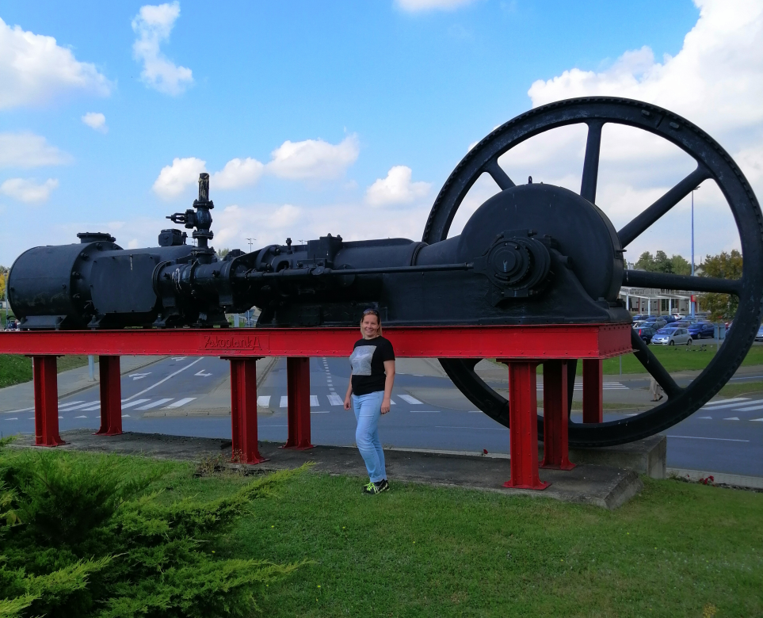
T2022 / T3
Thermodynamics 2.0
[Art]
Working constructively
to counteract the entropy
Steam engine monument at the Zakopianka Shopping Center in Cracow - a memento of the currently non-existent Cracow Soda Works Solvay, private photo

Slide 6
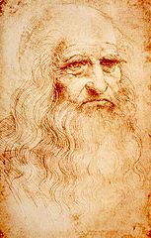
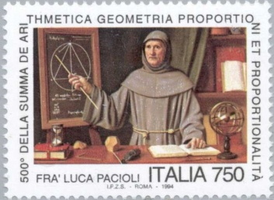
T2022 / T3
 | Assets | Liabilities
Visible Dt |  | Invisible Ct
„Physical nature exhibits all these dualities: day and night, narrow and wide, fast and slow,” Luca would say, “and so does human nature.”
“We carry good and evil, love and hatred, in our spirits and” Leonardo
would reply.
Thermodynamics 2.0
Duality
„A good painter has two chief objects to paint — man and the intention of his soul.”
To adjust the rythm of economic life
to the rythm of universe so the man
in business can respect natural principles as dualism (and after…
1st & 2nd law of thermodynamics)

Slide 7
T2022 / T3
The basis of ECR
„The law that entropy always increases holds, I think, the supreme position among the laws of Nature. If someone points out to you that your pet theory of the universe is in disagreement with Maxwell's equations—then so much the worse for Maxwell's equations. If it is found to be contradicted by observation—well, these experimentalists do bungle things sometimes. But if your theory is found to be against the second law of thermodynamics I can give you no hope; there is nothing for it but to collapse in deepest humiliation.”
Eddington A.S. (1928). The Nature of the Physical World. Cambridge: Cambridge University Press, p. 74.
Thermodynamics 2.0

Slide 8
3xECR
T2022 / T3
3 x ECR
The Description of Unhappiness by W.G. Sebald (England/Germany)
Loss Account . Poetry –
Critics – Reading by Paweł Próchniak (Poland)
Les Miserables
by Victor Hugo
(France)
Thermodynamics 2.0

Slide 9
T2022 / T3
ECR in „Les Miserables”
Assets (concrete and tangible) | Liabilities (expectations) | Liabilities (Light, Spark, Fire, Brightness →abstract and elusive)
Misery Bitterness Injustice Sadness Hopeless Anger Ignorance Enslavement Suffering Exile Prosecution Persecution Slander Mocking Calumny Condemnation Excommunication Conviction | Abundance Sweetness Justice Joy Hope Composure Wisdom Freedom Well-being Clasp Release Help Praise Respect Bow Recognition Adoption Settlement | Insight, intoxication, dream (p. 321, vol. I) "Light of nature" (p. 72, vol. I) "He saw some light in the mysterious depths" (p. 95, vol. I) "Ecstatic dreaming" (p. 95, vol. I) "Radiant brightness" (p. 95, vol. I) "A strange light illuminated him, a delightful light (p. 95, vol. I) "Light of the Day of Paradise" (p. 96, vol. I) "The Bloom of All the Realities of Paradise" (p. 161, vol. I) "The great and strange movement of the heart" (p. 332, vol. I) "The unfathomable and divine mystery of the balance of human destinies" (p. 334, vol. I) "Delightful Light" (p. 334, vol. I) Suddenly, in the deep silence, there was a new sound, a sound heavenly, divine, as delightful as the other was terrible. It was a hymn coming out of the darkness, a dazzling flight of prayer and harmony (...) it was an unearthly choir (p. 352, vol. I)
Thermodynamics 2.0

Slide 10
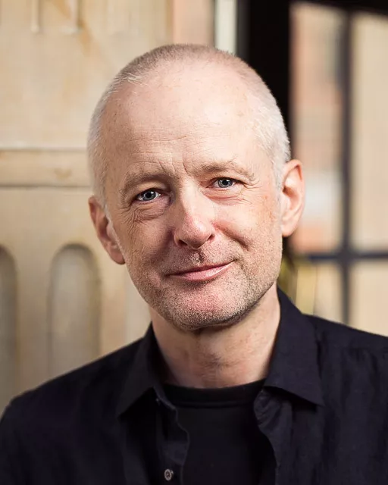
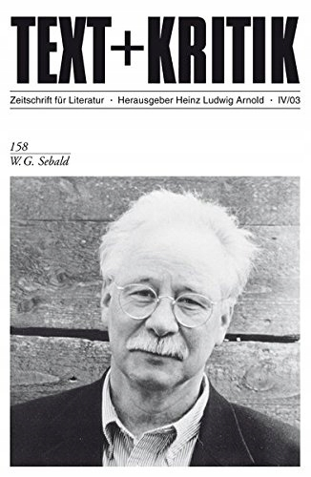
T2022 / T3
Authors of ECR
Fresh
phenomenons
–
readers who write and writers who carefully and throughly read
Thermodynamics 2.0
Paweł Próchniak - Polish professor, critic, expert in literature studies and literature history, works at the University in Cracow. He is a member and chief of the most important literary institutions and humanistic councils in Poland.
1) http://silesius.wroclaw.pl/jury/
2) https://www.bookdepository.com/W-G-Sebald-Heinz-Ludwig-Arnold9
W.G. Sebald - German writer and academic who worked and lived in England. At the time of his death, he was called one of the greatest living authors. His famous works are: „Austrlitz“or „Rings of Saturn“.

Slide 11
T2022 / T3
„The description of unhapiness includes
the possibilty of overcome it” W.G. Sebald
Assets (concrete and tangible) | Liabilities (abstract and elusive)
Homesickness Misfortune Horror Disgrace Pogrom Darkness Malheur Kaddish Loss Suicide/Death Passing time Lonelines | Love Love Chosen Messianism Dream Messenger of Heaven Dream Promised Land Brightening the darkness Emancipation of feelings Memory Sensitivity
Thermodynamics 2.0
W.G. Sebald’s ECR

Slide 12
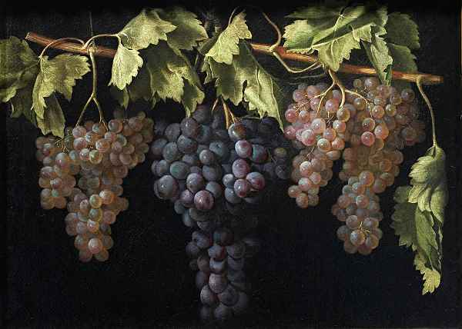
T2022 / T3
„Like Day and Night” – Sebald’s essay about
Tripp’s illusory painting
Thermodynamics 2.0
Still Life with four Bunches of Grapes, Juan Fernández “el Labrador”, ca. 1636, Museo Del Prado, https://www.thecollector.com/zeuxis/
Jan Peter Tripp, DastNest, 2021, Acrylic on MDF, Artnet.com.

Slide 13
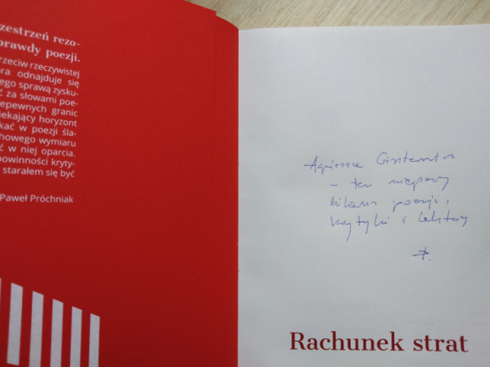
T2022 / T3
Próchniak’s ECR & trompe-l’oeil
The description / list of loss already includes
the possibility of eliminating them (Sebald’s paraphrase)
Thermodynamics 2.0
Jan Peter Tripp, Salut für Čechov, 2020, Acrylic on MDF, Artnet.com
For Agnieszka Giszterowicz – this (ad hoc/local?) balance of poetry, criticism and reading P.

Slide 14
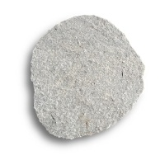
T2022 / T3
Corellation model
Crystal crane
"The principles of operation of even such a complex correlator as the brain, especially the human brain, must be the same as they would be in the correlator in the form of a shapeless lump of substance, to which potentials would be brought at any points considered as inputs to find out what potentials arise at other points considered as outputs."
Marian Mazur
feelings
Brain
&
Mind
skills
Thermodynamics 2.0
memory
Sumerian
‘me’
||
emotions
knowledge
||
Valise

Slide 15
T2022 / T3
Thank you for your attention
"He sleeps. Although his fate was very strange, he lived.
He died when he had no longer his angel.
The thing came to pass simply, of itself,
as the night comes when day is gone.”
----------
V. Hugo, Les Miserables, the lines scribbled anonymously
on top of Jean Valjean’s gravestone.
Thermodynamics 2.0
Agnieszka Giszterowicz
agiszterowicz@gmail.com

