Slide 1
The Humanistic Bases
of
Systems Science
Alexander Laszlo, Ph.D.
alexander.laszlo@bcsss.org

Slide 2
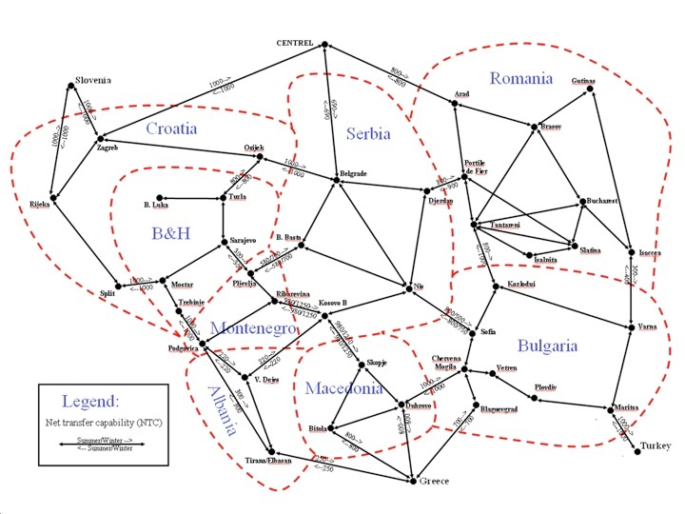
Systems Thinking

Slide 3
Early International Influences
Thales of Miletus (624 – 546 BCE)
Nicholas of Cusa (1401 – 1464 ACE)
Alfred North Whitehead (1861 – 1947 ACE)
Aleksandr Bogdánov (1873 – 1928 ACE)
Ludwig von Bertalanffy (1901 – 1972 ACE)

Slide 4
The
Systems Movement
1954 the modern-day Movement begins
objective: to develop a humanly relevant science, capable of addressing the pressing needs of a burgeoning humanity seemingly plagued by increasing levels of complexity and interdependence.
Founders of the Movement —
Ludwig von Bertalanffy
Anatol Rapoport
Ralph Gerard
Kenneth Boulding
These four establish the Society for the Advancement of General Systems Theory in 1954, which was renamed to the Society for General Systems Research in 1956, with the collaboration of —
James Grier Miller
Margaret Mead

Slide 5
The Aims of GST according to von Bertalanffy
There is a general tendency toward integration in the various sciences, natural and social.
Such integration seems to be centered in a general theory of systems.
Such theory may be an important means for aiming at exact theory in the nonphysical fields of science.
Developing unifying principles running "vertically" through the universe of the individual sciences, this theory brings us nearer the goal of the unity of science.
This can lead to a much-needed integration in scientific education.
– von Bertalanffy, L. (1968). General system theory: Essays on its foundation and development, rev. ed. New York: George Braziller, p. 38.

Slide 6
General System Theory Allgemeine Systemtheorie
What it is:
“A theory, not of systems of a more or less special kind, but of universal principles applying to systems in general”
Von Bertalanffy, 1968
The point is that there is a kind of theory known as system theory, and there is a general form of this theory: general system theory

Slide 7
General System Theory
What it is not:
A theory that relates to several entities called systems
A theory of an entity called a general system
Theorie der algemeinene Systeme
General Systems Theory

Slide 8
Boulding to Bertalanffy on GST
I seem to have come to much the same conclusion as you have reached, though approaching it from the direction of economics and the social sciences rather than from biology – that there is a body of what I have been calling “general empirical theory,” or “general system theory” in your excellent terminology, which is of wide applicability in many different disciplines. I am sure there are many people all over the world who have come to essentially the same position that we have, but we are so widely scattered and do not know each other, so difficult is it to cross the boundaries of the disciplines.
– Letter from Kenneth Boulding to Ludwig von Bertalanffy in 1953.

Slide 9
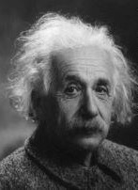
The need for Systems Thinking
Increasing interdependencies among social, technological and environmental systems
Increasing power of technology to shape our world
for better
the
unleashed power of the atom has changed everything …
save our modes of thinking,
and thus we drift toward unparalleled catastrophes
or for worse

Slide 10
Defining “system”
Ecosystem
Digestive system
Production system
Computer system
Solar system

Slide 11
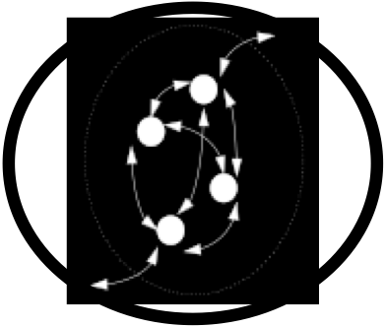
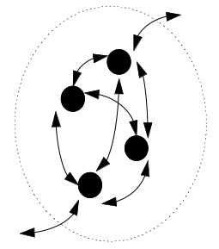
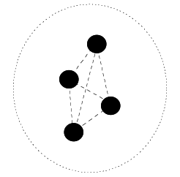
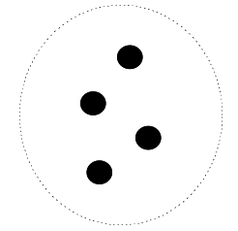
Key Distinction: Set vs. System
System
Structured Set
Set
“A system is less a thing than a pattern”
– Joanna Macy

Slide 12
System - defined
“A set of two or more interrelated elements with the following properties:
1. Each element has an effect on the functioning of the whole.
2. Each element is affected by at least one other element
in the system.
3. All possible subgroups of elements also have
the first two properties.”
(Ackoff, Russell L. Creating the corporate future: Plan or be planned for. New York: Wiley, 1981. Pp. 15-16.)
In short, a whole made up of interdependent components in interaction is identified as a system.

Slide 13
What is Systems Thinking?
Analysis
Synthesis
Structure (identification of components)
Function (identification of role)
Analysis
Synthesis
Knowledge (answers to “how to” & “what” questions)
Understanding (answers to “why” questions)
∴
in order to both know and understand
our environment, we must use
analysis and synthesis
analysis + synthesis = Systems Thinking

Slide 14
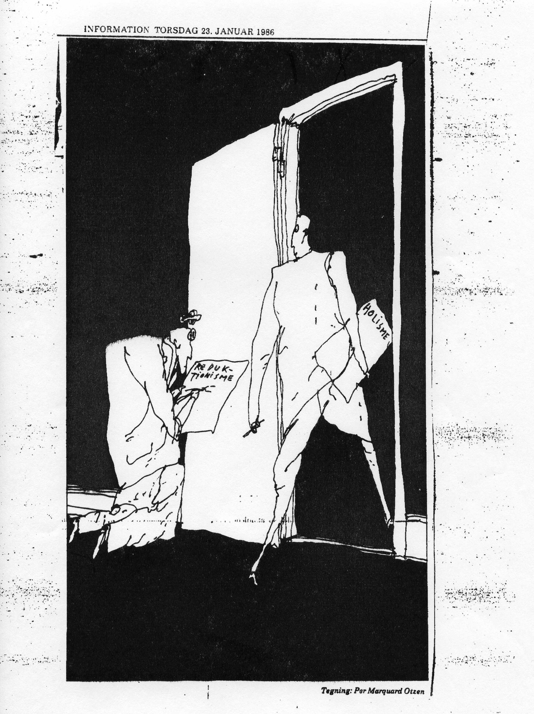

Slide 15
Pyramid of Meaning
Holistic
Systemi
c
Perspect
i
ve
Enlightenment
Reaches new
planes of
- is transcendent
consciousness
Wisdom
Requires
empathy
- is valuative
and is
normative
Understanding
Answers to ...
- why?
- is explanatory
... type questions
Limits of
Limits of
Teaching
Teaching
Knowledge
- is instructive
Answers to ...
- how?
- how to?
... type questions
Information
- is descriptive
Answers to ...
- who?
- what?
- when?
- where?
Data
- how many?
... type questions
Elements of
information
without context
Reductionistic
"factoids"

Slide 16
Systems Thinking Types
Systems thinking An internalized manifestation (in the thinking of individuals or social systems) of systems concepts, systems principles, and systems models.
Systematic thinking Any methodical step-by-step approach that is carried out according to a pre-determined algorithm or a fixed plan.
Systemic thinking A tendency or natural predisposition to think in terms of systemic relationships without necessarily drawing upon systems concepts, systems principles, or systems models. Some examples of areas that incorporate and foster such thinking include permaculture, feminist studies, ecology, and the I Ching.

Slide 17
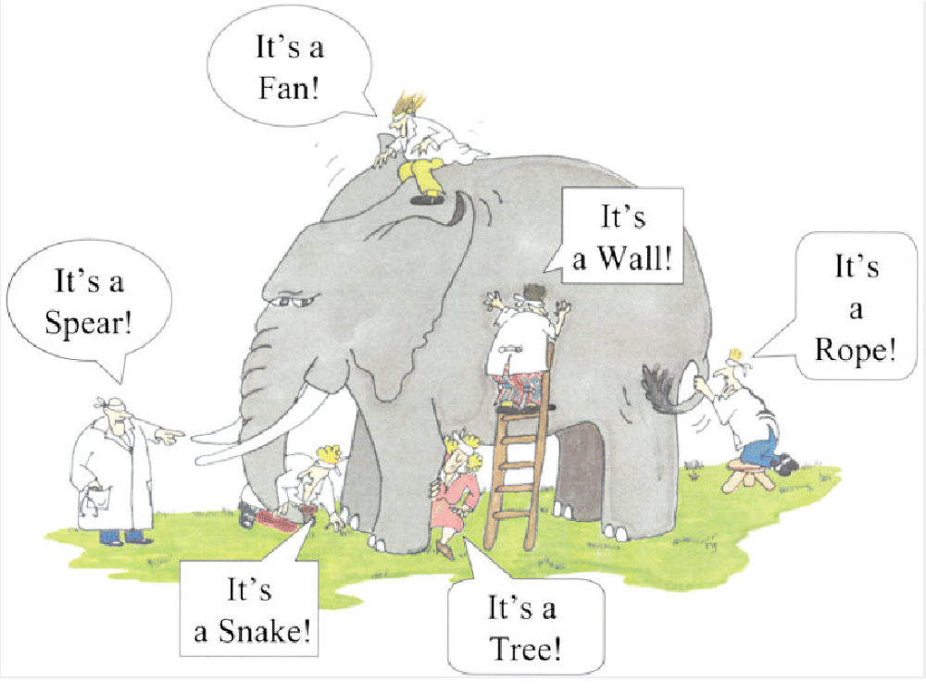

Slide 18
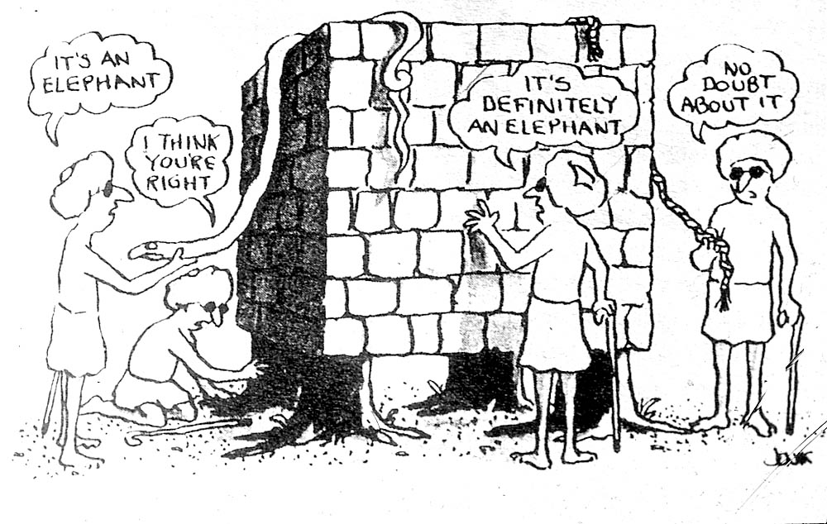

Slide 19
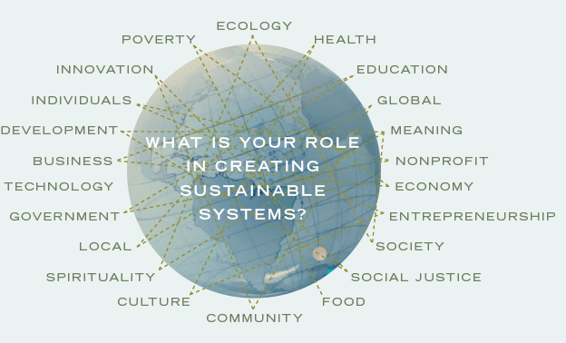
Systemic Interdependencies

Slide 20
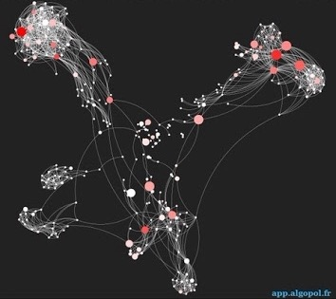
Connective Intelligence

Slide 21
Collective Intelligence

Slide 22
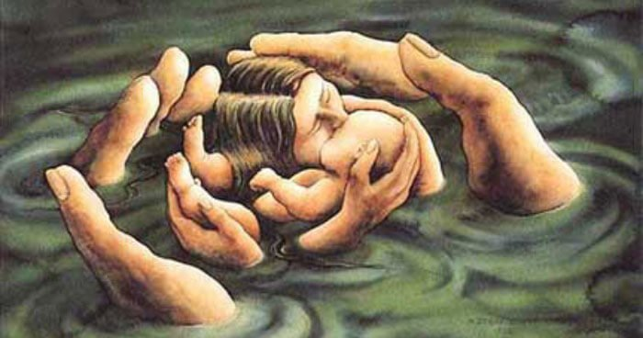
Empathetic Intelligence

Slide 23
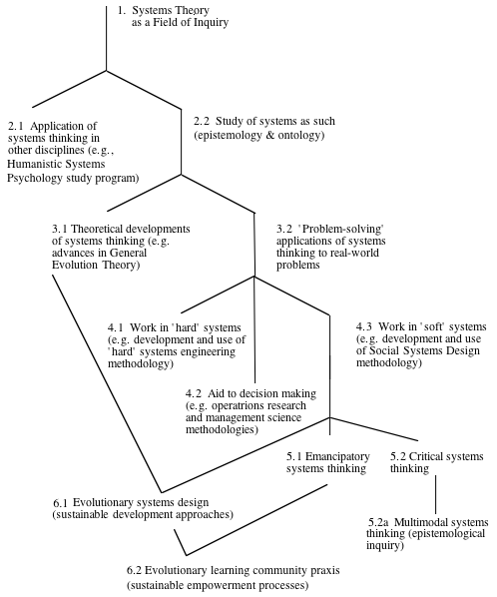
The shape of the systems movement
indicating the progressive development of particular theoretical branches

Slide 24
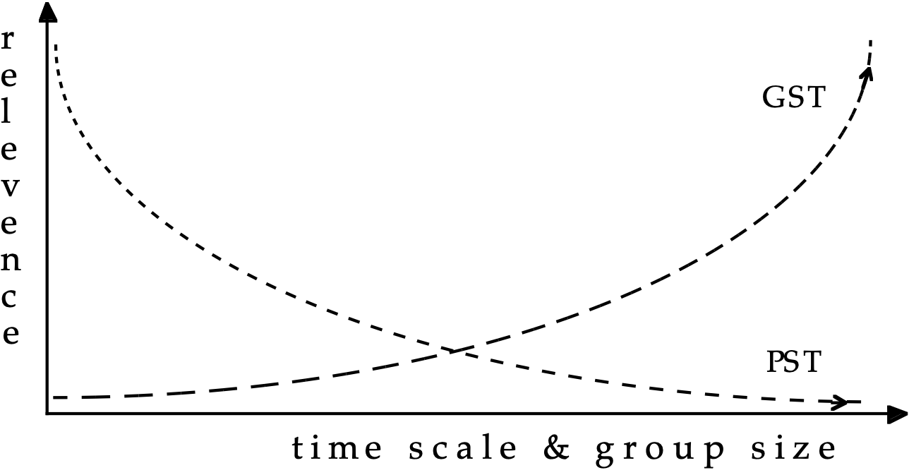
Relative interpretive power of two frameworks for sociocultural change

Slide 25
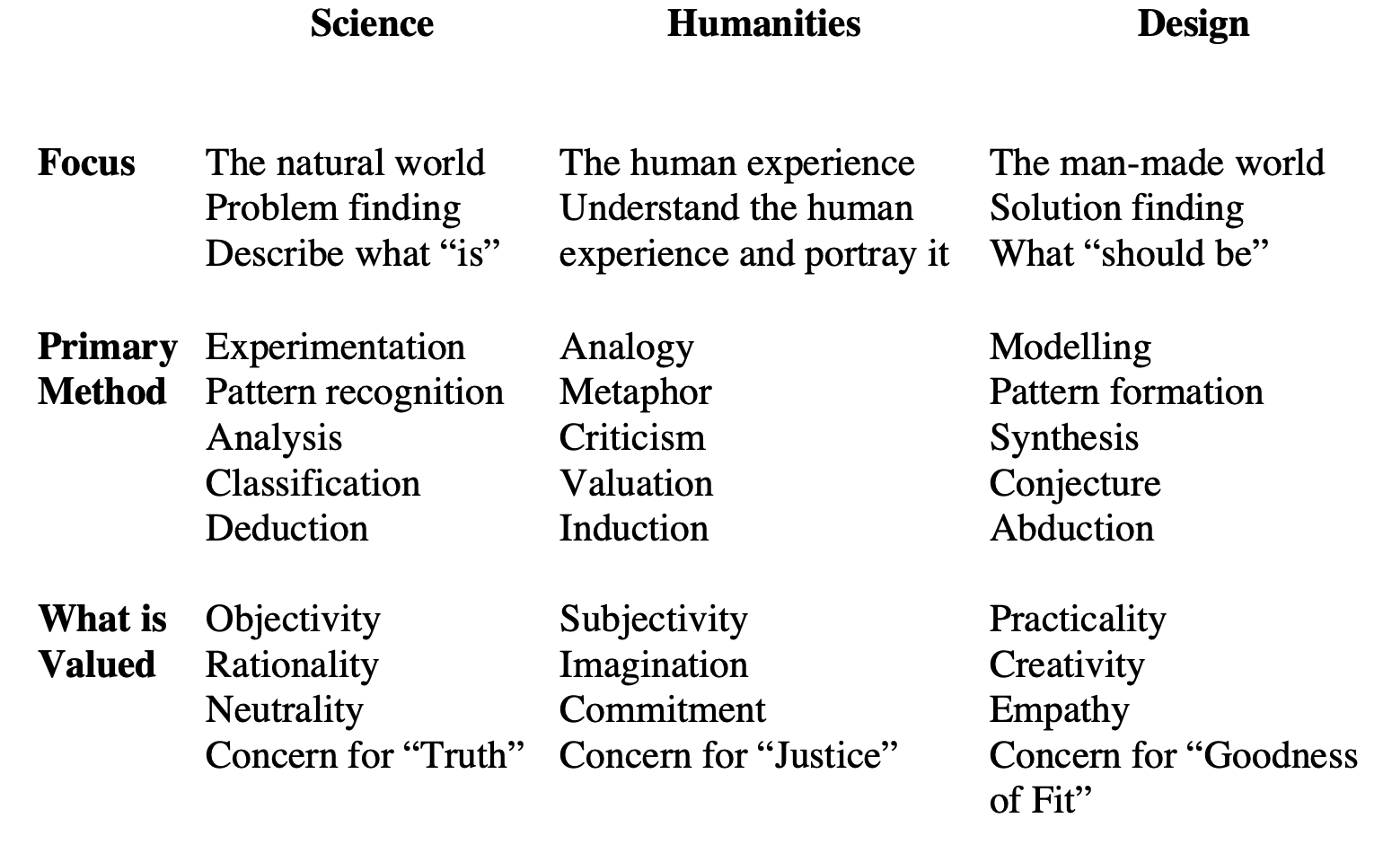
The Three Cultures
after Bela H. Banathy

Slide 26
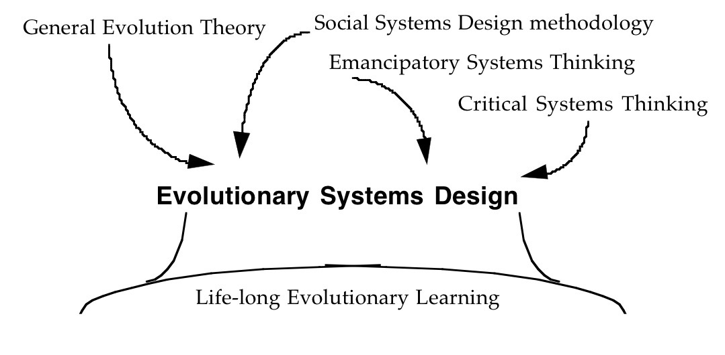
Epistemological Foundations of ESD

Slide 27
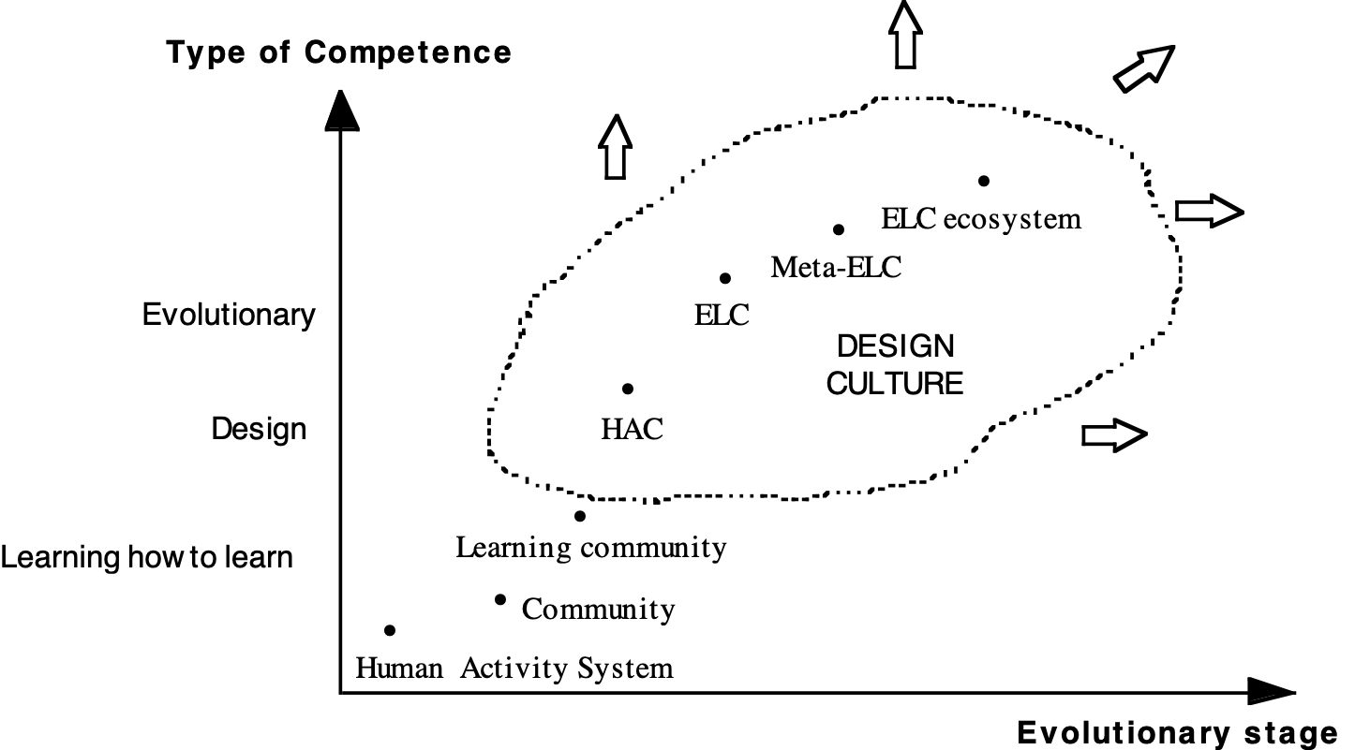
Toward a Culture of
Evolutionary Systems Design

Slide 28
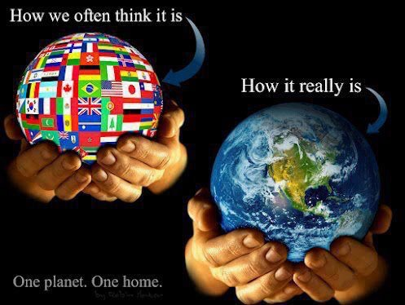
The Next Stage of
the Systems Movement
From Systems Thinking & Systems Practice
To Systems Consciousness & Systems Being
Relational Intelligence

Slide 29
Toward a Relational Intelligence
Emotional Intelligence — Daniel Goleman
Social Intelligence
Ecological Intelligence
Spiritual Intelligence — Dana Zohar
Multiple Intelligences — Howard Gardner
Naturalistic Intelligence (nature smarts)
Musical Intelligence (musical smarts)
Logical-Mathematical Intelligence (number/reasoning smarts)
Existential Intelligence (being/knowing smarts)
Interpersonal Intelligence (people smarts)
Bodily-Kinesthetic Intelligence (body smarts)
Linguistic Intelligence (word smarts)
Intra-personal Intelligence (self smarts)
Spatial Intelligence (picture smarts)

Slide 30
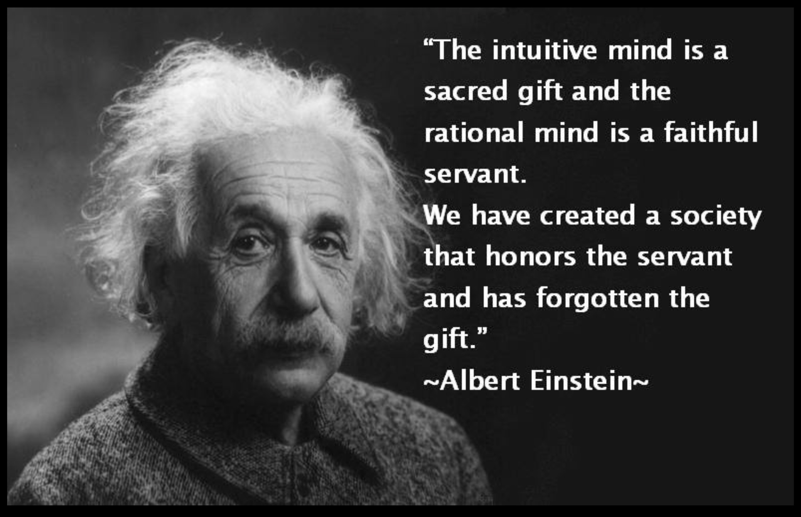
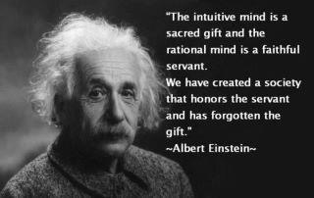
From Systems Thinking
to Systems Seeing
to Systems Feeling
to Systems Sensing
to Curating Emergence

Slide 31
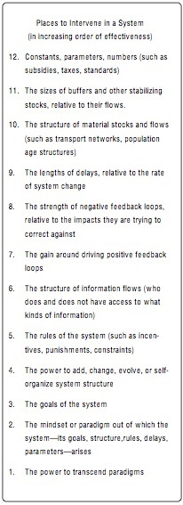
Systemic Leverage Points for Emerging a Global Eco-Civilization
Donella Meadows: “Paradigms are the sources of systems.”
(D. Meadows. “Leverage Points: Places to Intervene in a System.” Hartland, VT: The Sustainability Institute, 1999, p. 18)

Slide 32
Downward Causation?
The process by which a system generates emergent properties is known as synergy.
Typically, this is seen to be a matter of upward causation.
interaction of the parts gives rise to properties and characteristics not contained in the parts.
The systems perspective adds consideration of how the embedding context shapes the whole.
the “greenhouse effect” creates environments that propitiate certain types of emergence.

Slide 33
Upward & Downward Causation
Is any creative process of emergence shaped only by the interaction of its parts?
Is there really such a thing as “empty space” or a true “vacuum”?
Curating Emergence for Thrivability

Slide 34
Systemic Nurturance Spaces for Conviviality & Thrivability
Ivan Illich suggests conviviality is a mode of autonomous and creative interaction among people and between people and their environment.
it shifts from planning to designing and ultimately to curating the dynamics of emergence
planning imposes and involves projecting onto
designing imagines and involves creating with
curating elicits and involves listening into

Slide 35
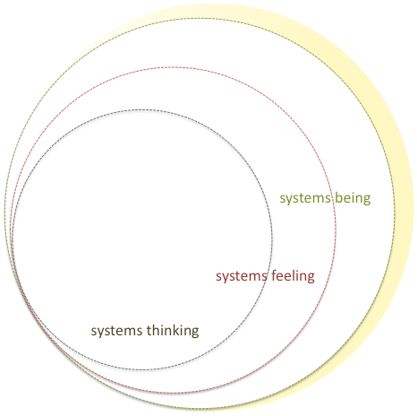
Connected Intelligence

Slide 36
Learn to Be the
systems
you
want
to see
in the World

