Slide 1


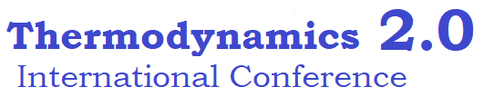
Universidad Autónoma del Estado de México
Facultad de Ingeniería
Optimal truncation criterion for compound parabolic collectors: A thermodynamic justification
Eduardo González-Mora
Sustainable Energy Systems Enginering
Engineering Department
Universidad Autónoma del Estado de México

Slide 2
Contents
1
Introduction
2
The description of the CPC
3
Results and discussion
4
Conclusion
Eduardo González-Mora | Facultad de Ingeniería UAEM | ICT2.0

Slide 3
Introduction
Introduction
Origin
Mid 60’s
Baranov & Melinkov – USSR
Ploke – Germany
Hinterberg & Winston - US
Objective
Optimal radiation transfer in the optical system
Born of nonimaging optics
Advantage to reach the thermodynamic limit
Problems?
The ratio of height vs the receiver’s area is too large
Eduardo González-Mora | Facultad de Ingeniería UAEM | ICT2.0

Slide 4
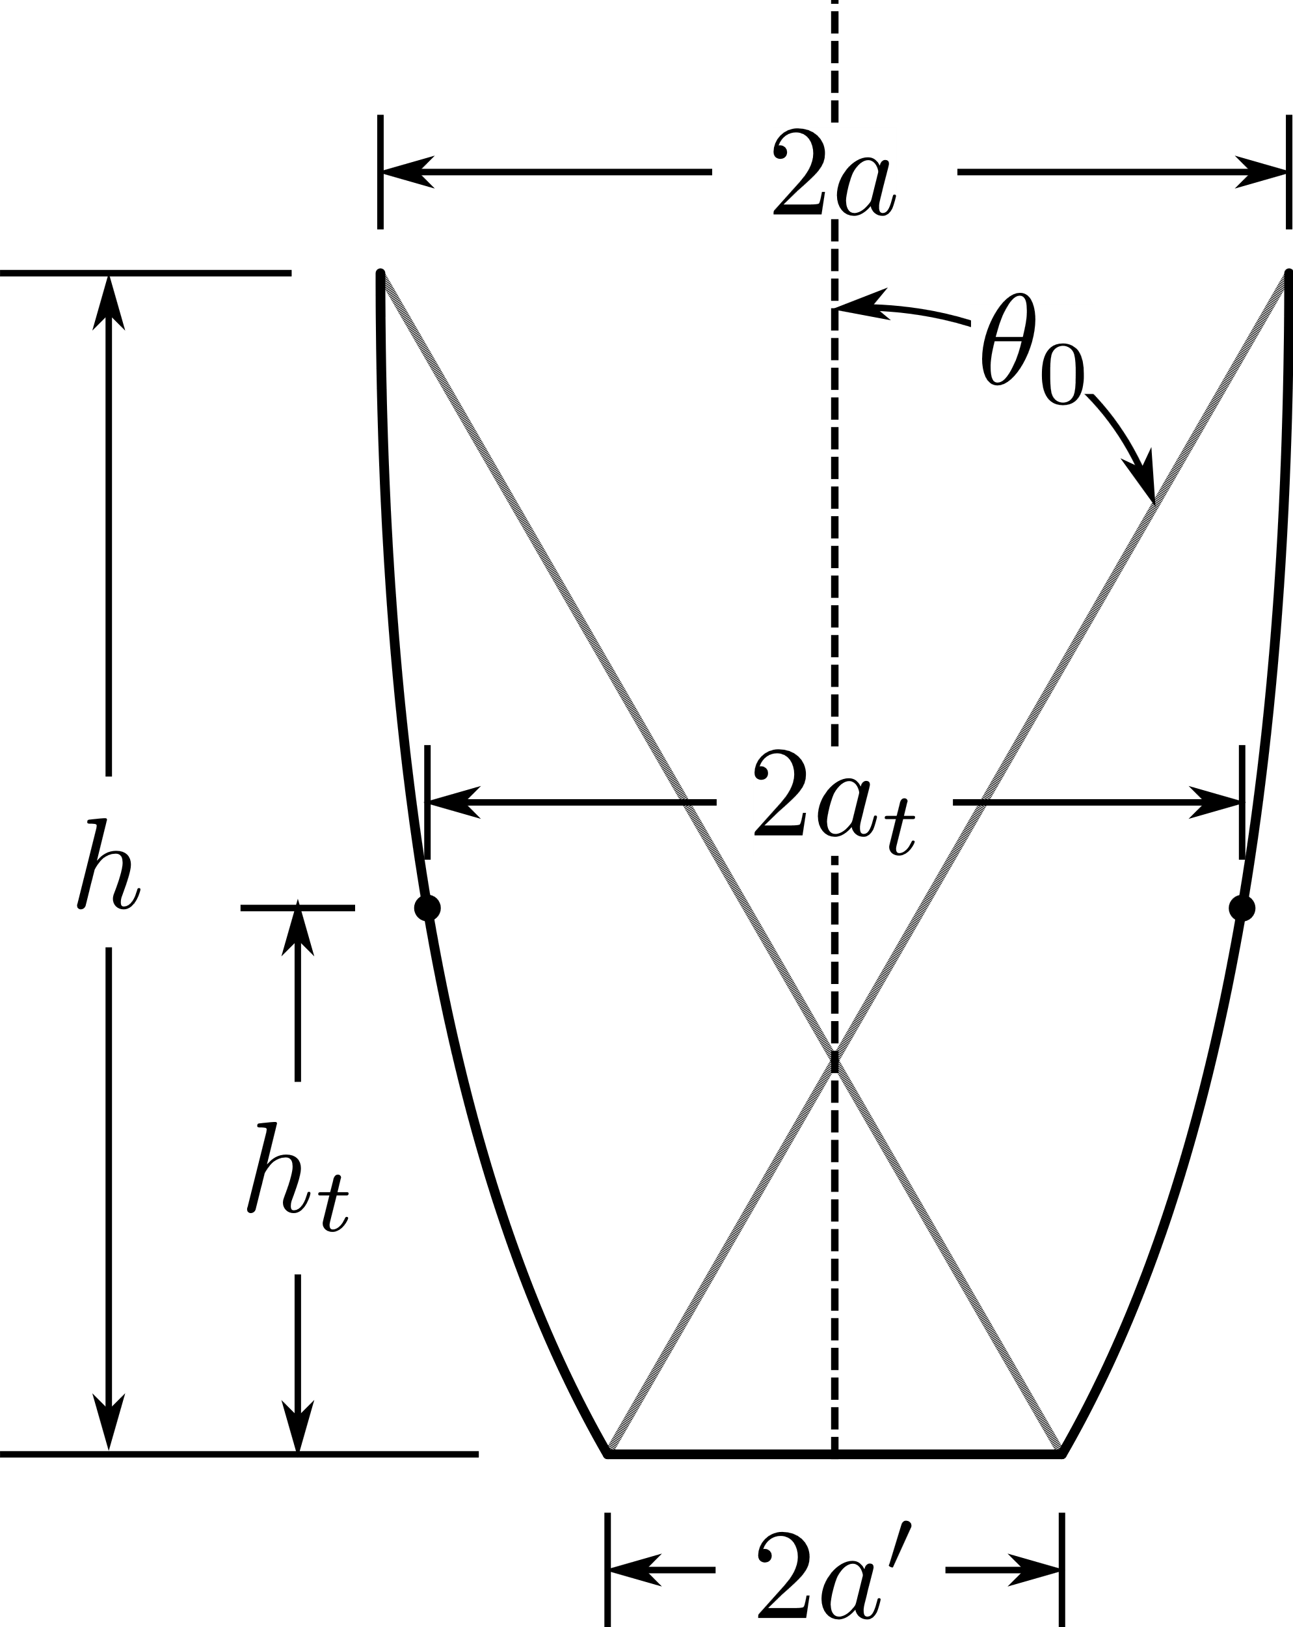
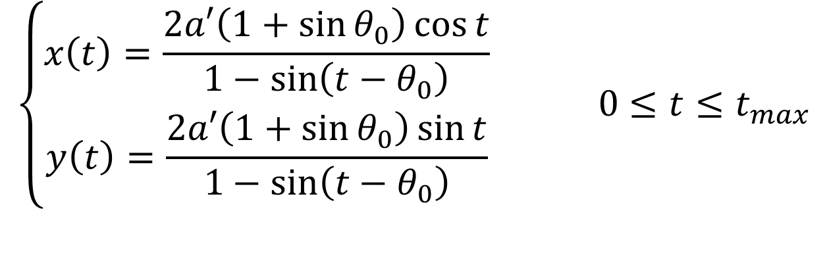
The description of the CPC
The description of the CPC
$$\left\{\begin{aligned}x\left(t\right)=\frac{2a′\left(1+\sin{θ_{0}}\right)\cos{t}}{1−\sin\left(t−θ_{0}\right)} \\ y\left(t\right)=\frac{2a′\left(1+\sin{θ_{0}}\right)\sin{t}}{1−\sin\left(t−θ_{0}\right)}\end{aligned}\right. 0≤t≤t_{max}$$
Full
$$t_{max}=\frac{π}{2}−θ_{0}$$
𝑡_𝑚𝑎𝑥=𝜋/2−𝜃_0
$$C_{g}=\frac{1}{\sin{θ_{0}}}$$
𝐶_𝑔=1/sin⁡〖𝜃_0 〗
Truncated
$$t_{max}<\frac{π}{2}−θ_{0}$$
𝑡_𝑚𝑎𝑥<𝜋/2−𝜃_0
$$C_{g}=\frac{a_{t}}{a′}$$
𝐶_𝑔=𝑎_𝑡/𝑎′
Eduardo González-Mora | Facultad de Ingeniería UAEM | ICT2.0

Slide 5
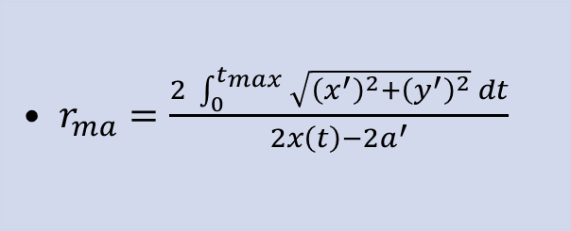
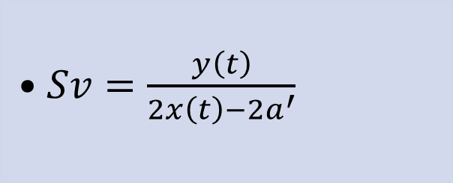
The description of the CPC
Geometric parameters
$$\left\{\begin{aligned}x\left(t\right)=\frac{2a′\left(1+\sin{θ_{0}}\right)\cos{t}}{1−\sin\left(t−θ_{0}\right)} \\ y\left(t\right)=\frac{2a′\left(1+\sin{θ_{0}}\right)\sin{t}}{1−\sin\left(t−θ_{0}\right)}\end{aligned}\right. 0≤t≤t_{max}$$
Svelteness
Reflector area- aperture ratio
  $Sv=\frac{y\left(t\right)}{2x\left(t\right)−2a^{′}}$
  $r_{ma}=\frac{2 \int_{0}^{t_{max}}{\sqrt{{\left(x^{′}\right)}^{2}+{\left(y^{′}\right)}^{2}} dt}}{2x\left(t\right)−2a^{′}}$
Eduardo González-Mora | Facultad de Ingeniería UAEM | ICT2.0

Slide 6

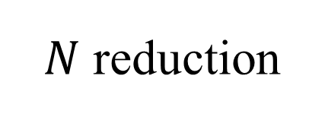
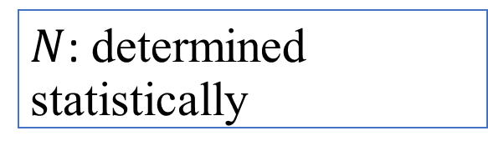

The description of the CPC
Optical-energy related parameters
Energy at the absorber
Optical efficiency
Average number of reflections
$${\dot{Q}}_{u}\sim G_{b}C_{g}η_{o}$$
$$η_{o}\sim ρ^{N}$$
$N$: determined statistically
$N$ reduction
Useful power
Eduardo González-Mora | Facultad de Ingeniería UAEM | ICT2.0

Slide 7
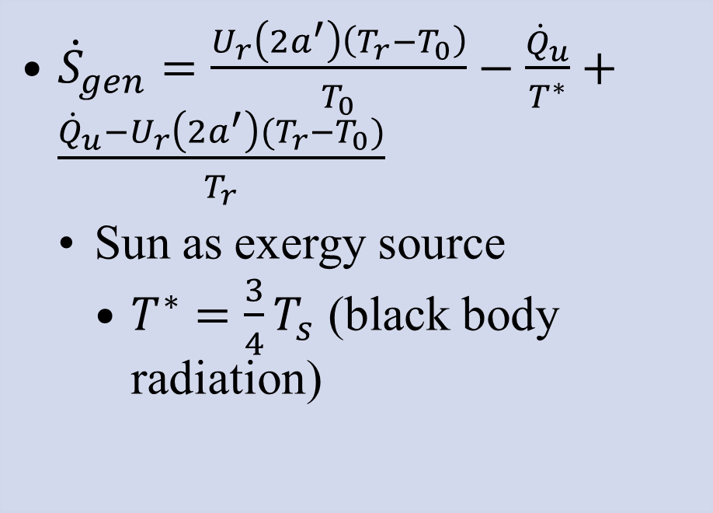
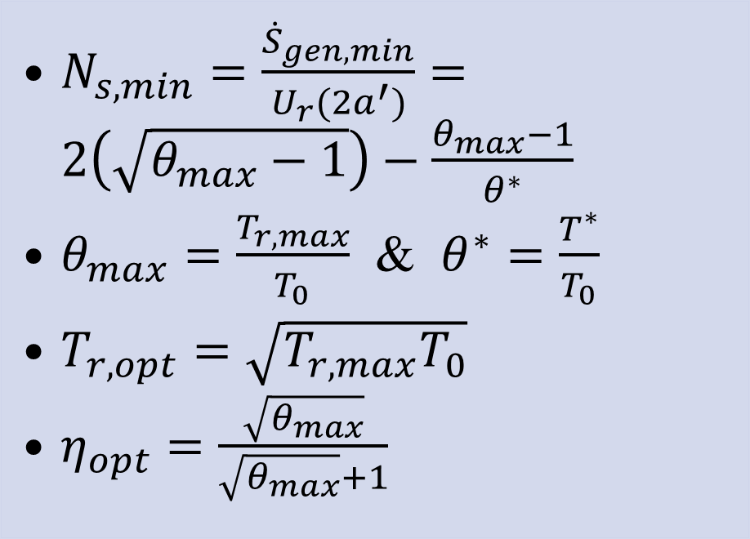
The description of the CPC
Entropy related parameters
Entropy generation
Entropy generation number
  ${\dot{S}}_{gen}=\frac{U_{r}\left(2a^{′}\right)\left(T_{r}−T_{0}\right)}{T_{0}}−\frac{{\dot{Q}}_{u}}{T^{∗}}+\frac{{\dot{Q}}_{u}−U_{r}\left(2a^{′}\right)(T_{r}−T_{0})}{T_{r}}$
    Sun as exergy source
      $T^{∗}=\frac{3}{4}T_{s}$ (black body radiation)
  $N_{s,min}=\frac{{\dot{S}}_{gen,min}}{U_{r}(2a^{′})}=2\left(\sqrt{θ_{max}−1}\right)−\frac{θ_{max}−1}{θ^{∗}}$
  $θ_{max}=\frac{T_{r,max}}{T_{0}}$ & $θ^{∗}=\frac{T^{∗}}{T_{0}}$
  $T_{r,opt}=\sqrt{T_{r,max}T_{0}}$
  $η_{opt}=\frac{\sqrt{θ_{max}}}{\sqrt{θ_{max}}+1}$
Eduardo González-Mora | Facultad de Ingeniería UAEM | ICT2.0

Slide 8
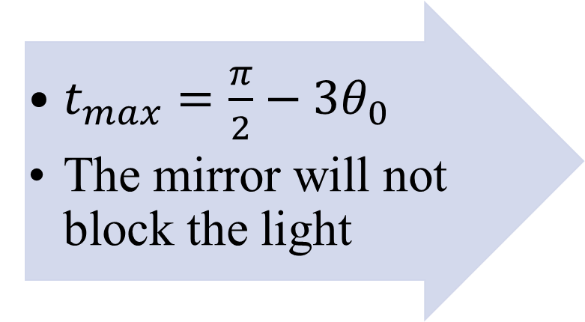
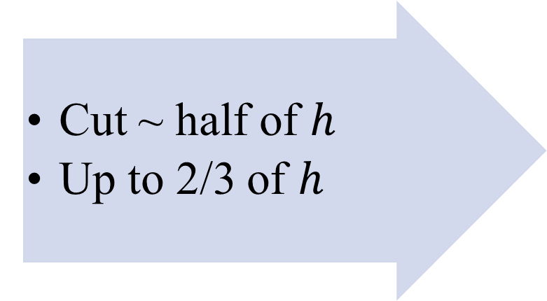
The description of the CPC
Truncation of the CPC
Winston, Rabl & O’gallagher
  Cut ~ half of $h$
  Up to 2/3 of $h$
Rincón
(Renamed as Maximum acceptance angle - MAA-)
  $t_{max}=\frac{π}{2}−3θ_{0}$
  The mirror will not block the light
Eduardo González-Mora | Facultad de Ingeniería UAEM | ICT2.0

Slide 9




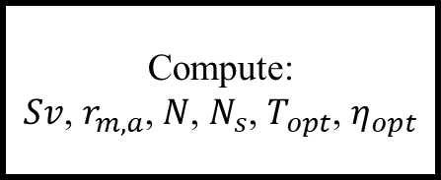
Results and discussion
Results and discussion
Start
Define $C_{g}$
Full
Winston
MAA
$$t_{max}=\frac{π}{2}−θ_{0}$$
$$h_{t}=\frac{1}{2}h$$
$$t_{max}=\frac{π}{2}−{3θ}_{0}$$
Compute:
$Sv$, $r_{m,a}$, $N$, $N_{s}$, $T_{opt}$, $η_{opt}$
End
Eduardo González-Mora | Facultad de Ingeniería UAEM | ICT2.0

Slide 10
Results and discussion
Geometric results
Eduardo González-Mora | Facultad de Ingeniería UAEM | ICT2.0

Slide 11
Results and discussion
Optical results
Eduardo González-Mora | Facultad de Ingeniería UAEM | ICT2.0

Slide 12
Results and discussion
Entropy results
Eduardo González-Mora | Facultad de Ingeniería UAEM | ICT2.0

Slide 13
Conclusions
Conclusions
CPC can achieve the thermodynamic limit, it’s height is considerable
Two main criterions had been proposed, the MAA criterion is the adecuate according to thermodynamics
A proper design with MAA will optimize techno-economical considerations
Eduardo González-Mora | Facultad de Ingeniería UAEM | ICT2.0

Slide 14
References
V. K. Baranov and G. K. Melnikov, “Study of the illumination characteristics of hollow focons,” Sov. J. Opt. Technol, vol. 33, no. 5, pp. 408–411, 1966.
M. Ploke, “LICHTFUHRUNGSEINRICHTUNGEN MIT STARKER KONZENTRATIONSWIRKUNG,” Optik (Stuttg)., vol. 25, no. 1, p. 31, 1967.
H. Hinterberger and R. Winston, “Efficient Light Coupler for Threshold Čerenkov Counters,” Rev. Sci. Instrum., vol. 37, no. 8, pp. 1094–1095, Aug. 1966, doi: 10.1063/1.1720428.
R. Winston, L. Jiang, and V. Oliker, Nonimaging Optics: Solar and Illumination System Methods, Design, and Performance. Crc Press, 2020.
Y. D. Goswami, Principles of Solar Engineering, 3rd ed. Boca Raton: CRC Press, 2015.
R. Winston, “Principles of solar concentrators of a novel design,” Sol. Energy, vol. 16, no. 2, pp. 89–95, Oct. 1974, doi: 10.1016/0038-092X(74)90004-8.
J. Chaves, Introduction to NONIMAGING OPTICS, 2nd ed. New York: CRC Press, 2017.
A. Rabl, “Optical and thermal properties of compound parabolic concentrators,” Sol. Energy, vol. 18, no. 6, pp. 497–511, Jan. 1976, doi: 10.1016/0038-092X(76)90069-4.
A. Rabl, N. B. Goodman, and R. Winston, “Practical design considerations for CPC solar collectors,” Sol. Energy, vol. 22, no. 4, pp. 373–381, 1979, doi: 10.1016/0038-092X(79)90192-0.
J. O’Gallagher, Nonimaging Optics in Solar Energy, 1st ed. Morgan & Claypool Publishers, 2008.
E. A. Rincón Mejía, M. D. Durán García, and Á. Lentz Herrera, “New Solar Air Heater Based on Non-Imaging Optics for High-Temperature Applications,” in ASME 2009 3rd International Conference on Energy Sustainability, Volume 2, 2009, no. April, pp. 839–844, doi: 10.1115/ES2009-90306.
E. González-Mora, E. A. Rincón-Mejía, and D. Morillón Gálvez, “Diseño constructal de CPCs y la evolución de los diseños Tolokatsin,” in XVII Congreso Ibérico y XIII Congreso Iberoamericano de Energía Solar, 2020, pp. 131–136, doi: https://doi.org/10.34637/cies2020.1.2013.
J. A. Duffie and W. A. Beckman, Solar Engineering of Thermal Processes, 4th ed. John Wiley & Sons, Inc., 2013.
A. Bejan, Entropy generation through heat and fluid flow, vol. 1. Wiley, 1982.
R. Petela, “Exergy of Heat Radiation,” J. Heat Transfer, vol. 86, no. 2, pp. 187–192, May 1964, doi: 10.1115/1.3687092.
Eduardo González-Mora | Facultad de Ingeniería UAEM | ICT2.0

Slide 15
Acknowledgements
The author would like to acknowledge the participants at CIES2020 and ISES SWC 2021, for the fruitful discussions and encouragement to describe in deep the thermodynamics behind the Tolokatsin design’s success. In addition, it is appropriate to acknowledge all those who have suggested re-naming Rincón's criteria; their decision to remain anonymous to avoid any conflict of interest has been upheld.
Eduardo González-Mora | Facultad de Ingeniería UAEM | ICT2.0

Slide 16



Universidad Autónoma del Estado de México
Facultad de Ingeniería
Thanks for your attention
egonzalezmo@uaemex.mx
@MoraEdd_
Eduardo González-Mora
Eduardo González-Mora | Facultad de Ingeniería UAEM | ICT2.0

